Slide 1



Bonus 0004
The Ultimate Kitchen &
Storage Solutions
Love in Every Bite: Nourishing Wellness

Slide 2
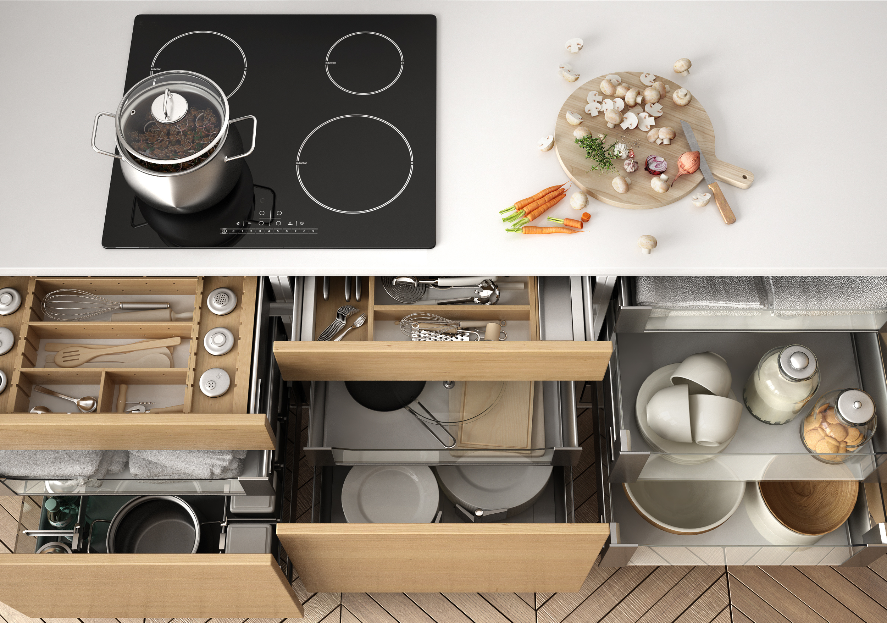
0004 Bonus Culinary Art
THE ULTIMATE KITCHEN & STORAGE SOLUTIONS
Embarking on the culinary journey requires not just passion but also the right tools that act like the compass and map on this adventure. Think of kitchen tools as the wardrobe for your culinary expressions—essential, versatile, and reflective of your cooking style. Here’s a refined guide to essential kitchen tools and equipment, aimed at enhancing efficiency and joy in your culinary endeavors.

Slide 3

0004 Bonus Culinary Art
ESSENTIAL CATEGORIES OF KITCHEN TOOLS
1. Preparation: Washing & soaking begin with cleanliness and preparation. Tools like colanders, salad spinners, and large bowls are indispensable for washing fruits, vegetables, and grains. These tools ensure that your ingredients are clean and ready for the culinary magic to happen.

Slide 4

0004 Bonus Culinary Art
ESSENTIAL CATEGORIES OF KITCHEN TOOLS
2. Precision: Cutting The heart of the kitchen lies in its knives. A durable chef's knife, a paring knife, and a serrated bread knife cover almost all your cutting needs. A good cutting board—consider having separate ones for produce and raw meats to prevent cross-contamination—is equally important.

Slide 5
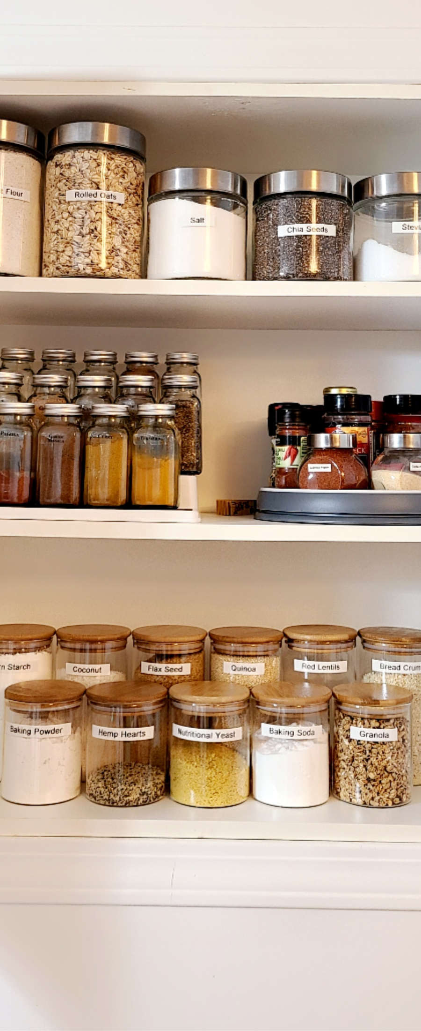
0004 Bonus Culinary Art
ESSENTIAL CATEGORIES OF KITCHEN TOOLS
3. Organization: Mise en Place & Storage. The French term 'mise en place' translates to 'everything in its place.' Small to medium bowls for prepping spices and chopped ingredients, alongside clear glass or BPA-free plastic containers for storage, are essentials. This step is crucial for a seamless cooking process.

Slide 6

0004 Bonus Culinary Art
ESSENTIAL CATEGORIES OF KITCHEN TOOLS
4. Creativity: Mixing Avoid culinary chaos with adequately sized mixing bowls and reliable equipment like a sturdy whisk, spatulas, and a high-quality blender or food processor. These tools are the key to smooth batters, perfectly emulsified dressings, and finely chopped ingredients.

Slide 7
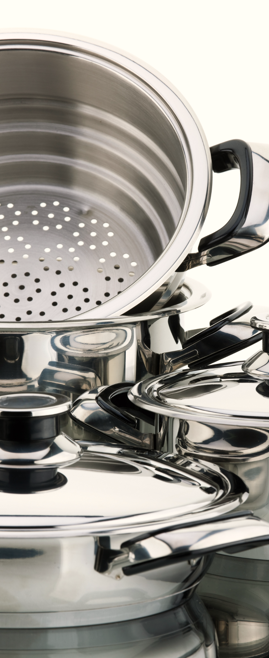
0004 Bonus Culinary Art
ESSENTIAL CATEGORIES OF KITCHEN TOOLS
5. Technique: Cooking Your cooking vessels should cater to various cooking methods—whether it's sautéing in a stainless-steel skillet, simmering in a durable pot, or baking in a cast-iron pan. Opt for cookware with oven-safe handles to transition from stove to oven seamlessly.

Slide 8

0004 Bonus Culinary Art
ESSENTIAL CATEGORIES OF KITCHEN TOOLS
6. Presentation: Serving & Plating The visual appeal of your dishes can enhance the dining experience. Invest in a range of serving dishes and simple, elegant white plateware. These choices allow the colors and textures of your plant-based creations to stand out, making every meal a feast for the eyes.

Slide 9
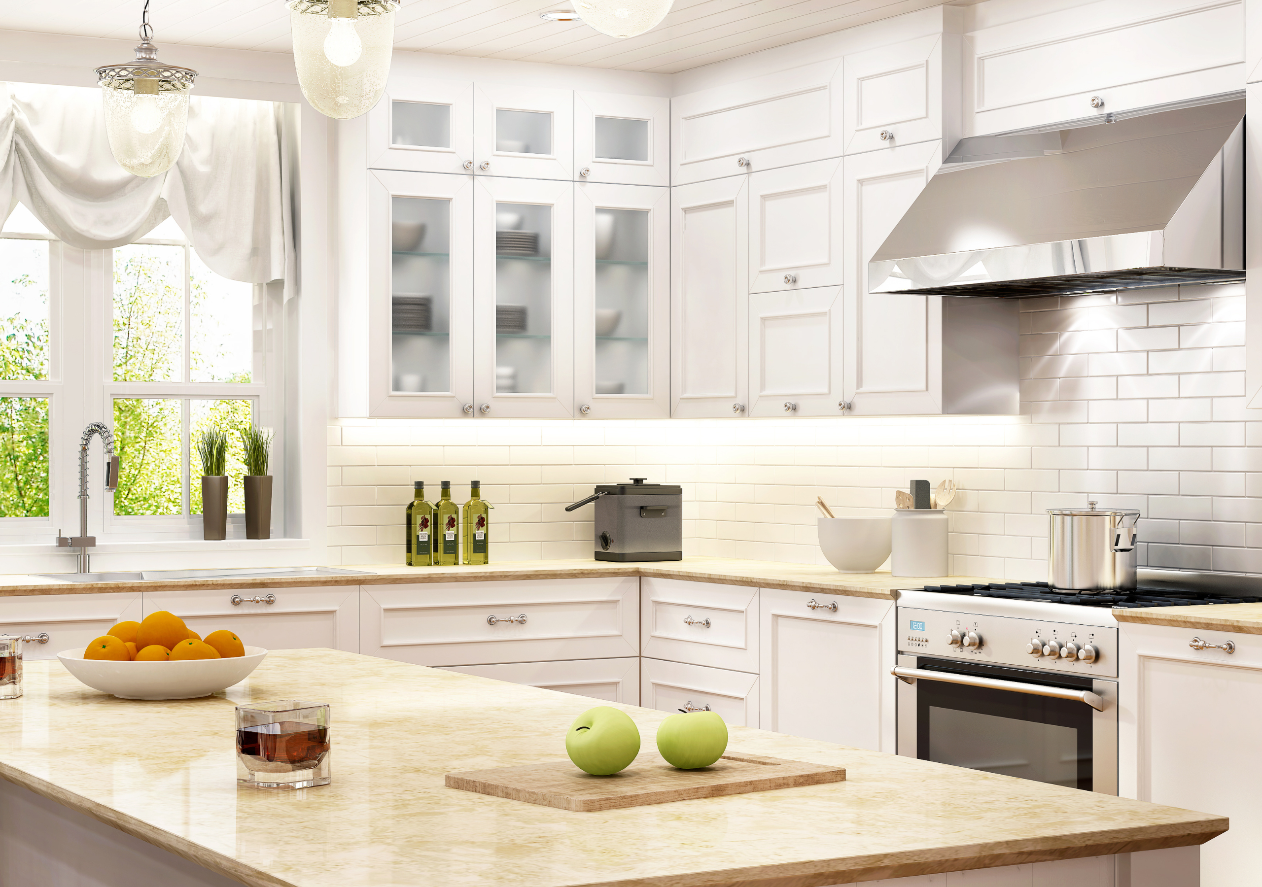
0004 Bonus Culinary Art
Shopping Smart: Functionality Over Gimmicks
In the quest for the perfect kitchen setup, remember the principle of multipurpose use. Resist the allure of one-trick gadgets in favor of tools that offer versatility and longevity. Quality over quantity reigns supreme in a well-equipped kitchen

Slide 10
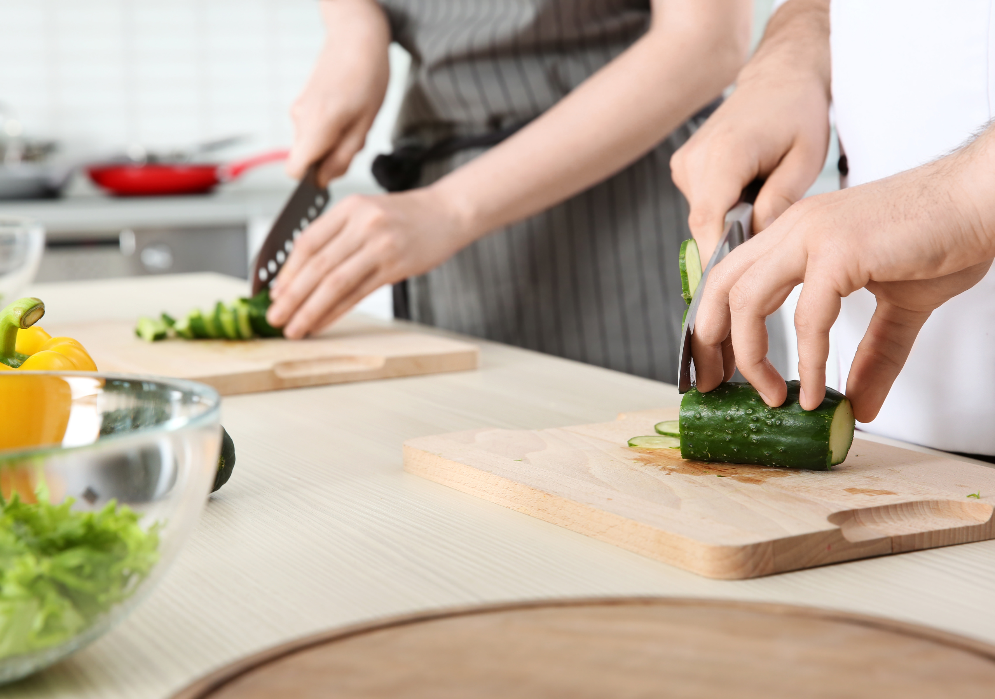
0004 Bonus Culinary Art
Beyond Tools: Cultivating Skills
While the right tools are important, they are but one ingredient in the recipe for culinary success. Dedication to honing your skills, experimenting with flavors, and understanding the science behind cooking will elevate your dishes from good to extraordinary.

Slide 11

0004 Bonus Culinary Art
Your Kitchen, Your Rules
Finally, remember that the best kitchen is one that resonates with your cooking philosophy and lifestyle. Whether it’s embracing the minimalist approach with just the basics or outfitting your space with professional-grade equipment, what matters most is that it inspires you to cook, explore, and enjoy the art of food.

Slide 12
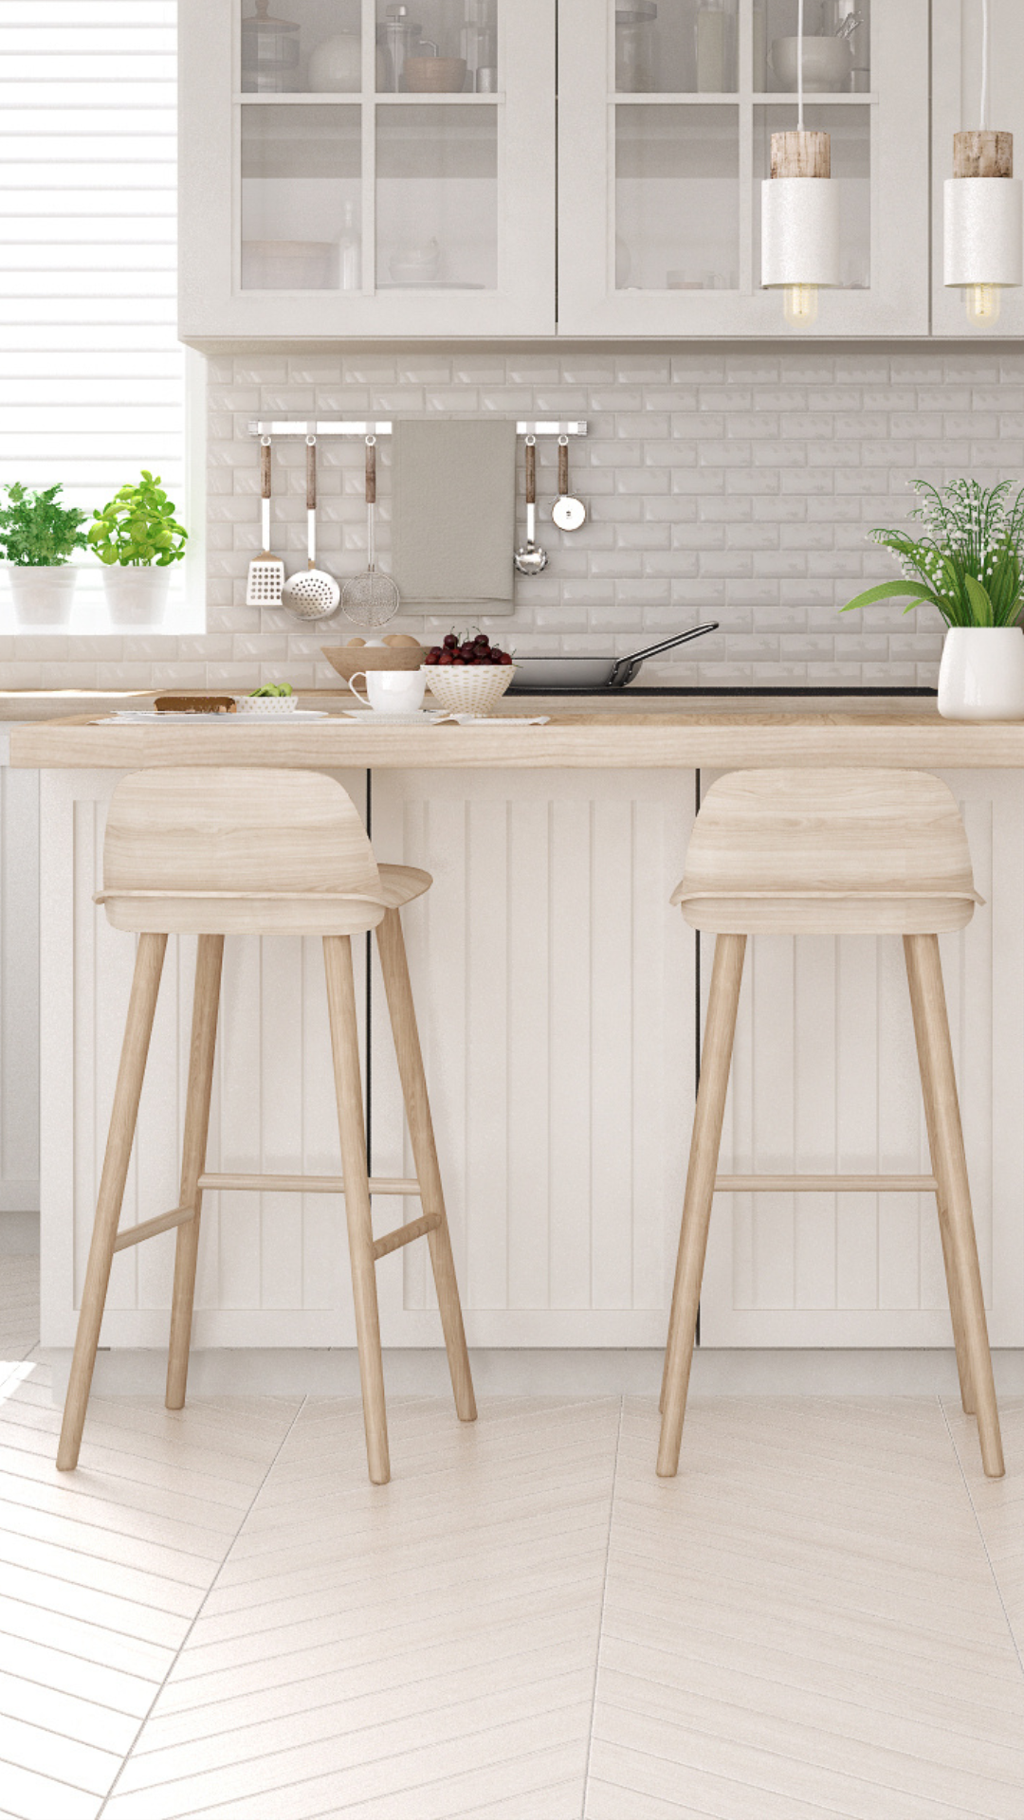
Bonus 0004
The Ultimate Kitchen &
Storage Solutions
Love in Every Bite: Nourishing Wellness

