Slide 1



Bonus 0007
Grocery Shopping
Love in Every Bite: Nourishing Wellness

Slide 2
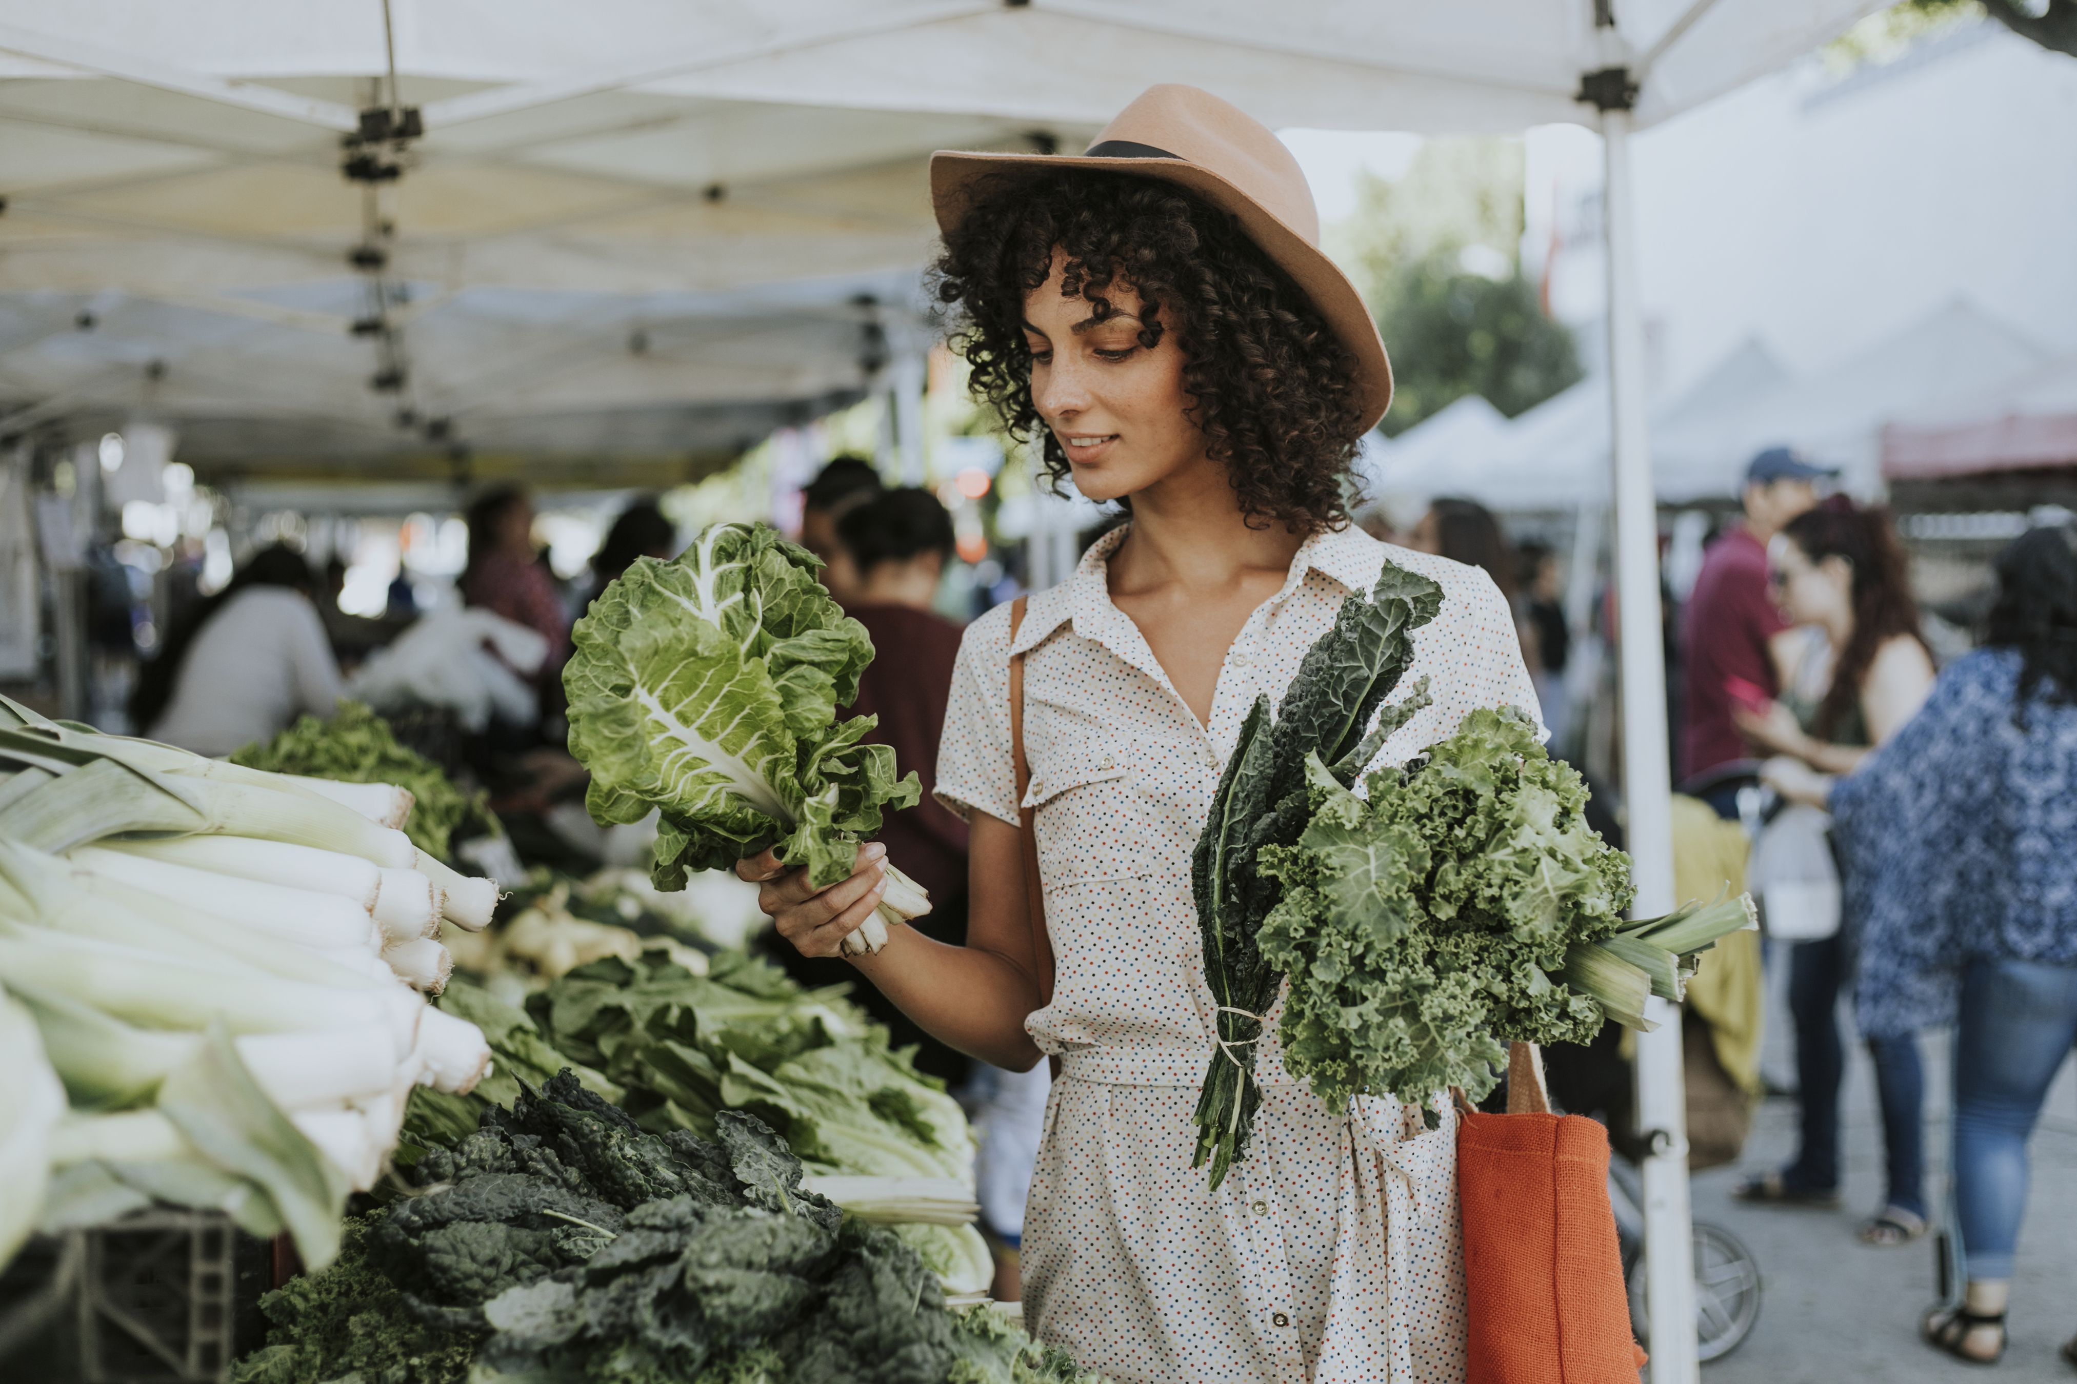
0007 Bonus Culinary Arts
HOW TO CHOOSE WHERE TO SHOP
Choosing where to shop for groceries is a personal decision that can have far-reaching implications for your health, community, and the environment. By considering the factors above, you can make informed decisions that align with your values and lifestyle.

Slide 3
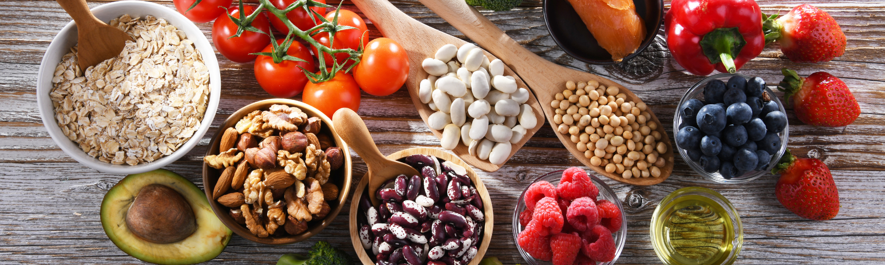
0007 Bonus Culinary Arts
HOW TO CHOOSE WHERE TO SHOP
Product Quality and Variety: Look for stores that offer a wide selection of fresh produce, whole foods, and high-quality animal products. Stores that stock local, seasonal, and organic items are often a good bet for nutritional quality.
Sustainability Practices: Consider shopping at stores that demonstrate a commitment to sustainability. This could include stocking local produce to reduce transport emissions, offering bulk purchase options to minimize packaging waste, and supporting sustainable farming practices.
Community Impact: Choosing to shop at local farmers' markets, co-ops, or small grocers can have a positive impact on your local economy. These venues often offer unique, locally-produced items that are not available in larger chain stores.

Slide 4

0007 Bonus Culinary Arts
HOW TO CHOOSE WHERE TO SHOP
Convenience and Accessibility: While quality and sustainability are important, convenience also matters. Choose a store that is accessible and fits your lifestyle and budget. Remember, the best store is one that you will consistently use.
Price and Budget: Compare prices among different stores and consider where you can get the best value for high-quality products. Remember, investing in nutritious food is also an investment in your health.

Slide 5
0007 Bonus Culinary Arts
OPTIONS
Shopping for groceries can be a diverse experience, each offering unique benefits and catering to different preferences. Here's a look at various types of shopping experiences, from the local farmers' market to specialized health food stores, and what each has to offer.
Farmers' Market
Characteristics: These markets are typically open-air setups where local farmers sell their produce directly to consumers. Products are seasonal, fresh, and often organically grown.
Benefits: Shopping at a farmers' market supports local agriculture and the local economy. It offers access to the freshest seasonal produce, often at competitive prices. It's also an opportunity to meet and talk directly with the producers about their farming practices.

Slide 6

0007 Bonus Culinary Arts
OPTIONS
Local Grocery Stores
Characteristics: Local grocery stores are usually smaller than chain supermarkets and may offer a selection of products that reflect the community's preferences and cultural influences.
Benefits: These stores often foster a sense of community and can be more accessible for quick shopping trips. They may also stock local brands that aren't available in larger chains.

Slide 7

0007 Bonus Culinary Arts
OPTIONS
Health Food Stores
Characteristics: Health food stores specialize in organic, natural, and often locally sourced foods. They cater to specific dietary needs such as vegan, vegetarian, gluten-free, and paleo diets.
Benefits: These stores are ideal for those with special dietary needs or preferences, offering a wide range of products that might not be found in conventional supermarkets. Staff are usually knowledgeable about health and nutrition.

Slide 8
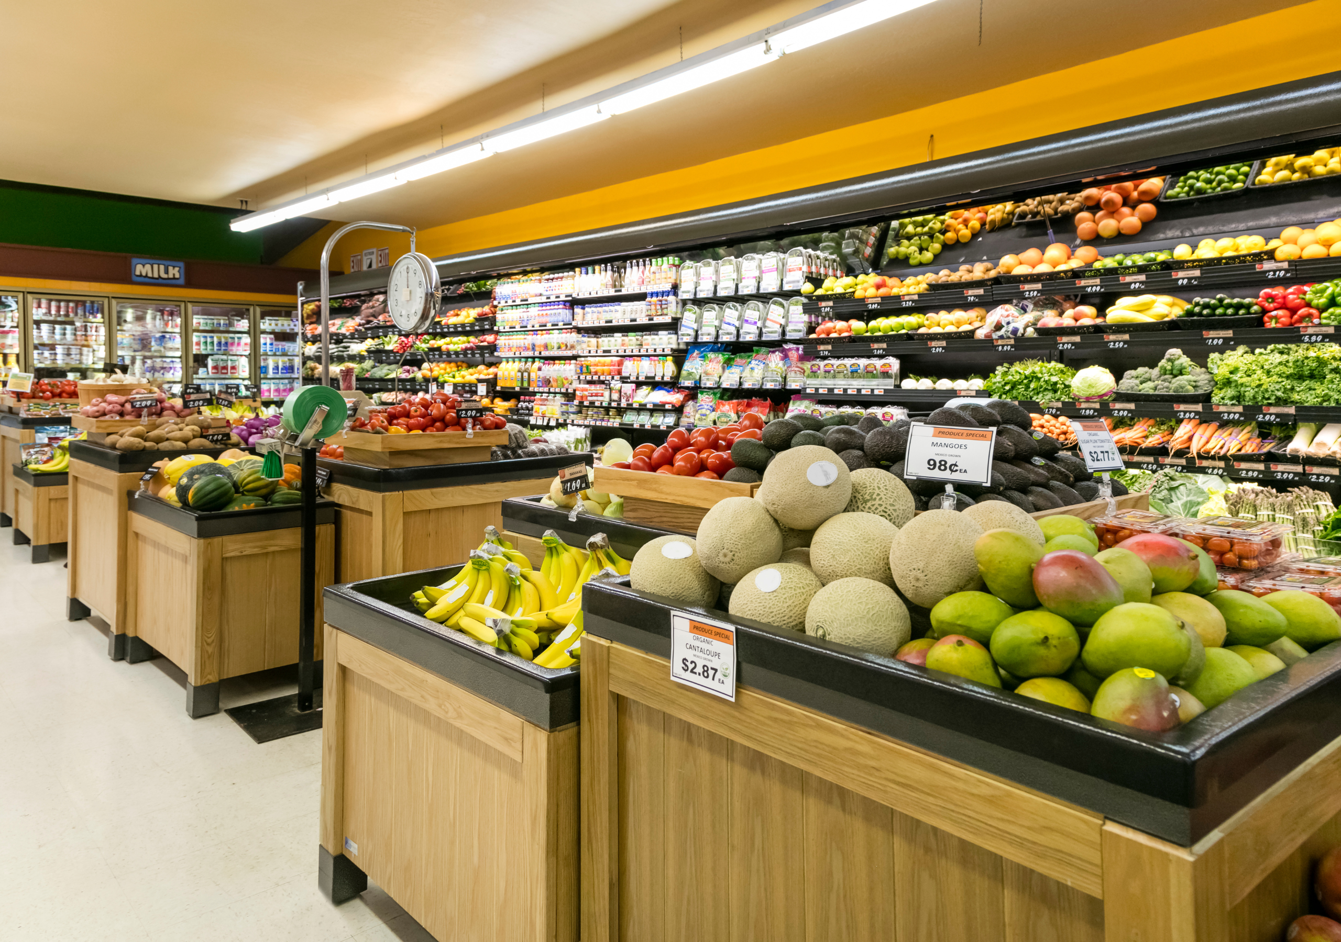
0007 Bonus Culinary Arts
OPTIONS
Supermarkets and Big Box Stores
Characteristics: These are large stores offering a wide variety of food and household products, including national and store brands.
Benefits: Supermarkets offer convenience, with one-stop shopping for a wide range of products at competitive prices. Many also offer loyalty programs and home delivery services.

Slide 9

0007 Bonus Culinary Arts
OPTIONS
Specialty Stores
Characteristics: Specialty stores focus on a particular type of product, such as butcher shops, fish markets, bakeries, and ethnic food stores.
Benefits: They offer a wide selection of high-quality, specialized products. Staff are typically experts in their field and can offer detailed information and recommendations

Slide 10

0007 Bonus Culinary Arts
OPTIONS
Online Grocery Shopping
Characteristics: Online platforms allow customers to order groceries for home delivery or curbside pickup.
Benefits: This option offers convenience and time savings, with the ability to shop from home. It's particularly beneficial for those with busy schedules, mobility issues, or those who live far from physical stores.

Slide 11
0007 Bonus Culinary Arts
OPTIONS
Co-ops
Characteristics: Cooperative grocery stores are owned and operated by members who pay a fee to join. They focus on sustainable practices and often stock organic and locally produced goods.
Benefits: Co-ops often offer high-quality, ethically sourced products and foster a strong sense of community. Members may receive discounts and have a say in the store's operations.
Each shopping experience offers unique advantages, whether it's the freshness of farmers' market produce, the convenience of supermarkets, the specialized offerings of health food stores, or the community focus of local shops and co-ops. The choice depends on personal preferences, dietary needs, and values such as supporting local economies and sustainable agriculture.

Slide 12

0007 Bonus Culinary Arts
HOW TO SHOP
Craft a Precise Shopping List: Navigating the grocery store with a clear list is crucial, as stores are cleverly arranged to tempt you into impulse purchases. Familiarize yourself with the store's layout, categorizing your list accordingly. Generally, fresh foods—including a variety of meats, dairy, and vegetables—are located along the store's perimeter. In contrast, the inner aisles are home to processed items.
Tip: Avoid shopping on an empty stomach to prevent "hanger"-induced impulse buys.

Slide 13
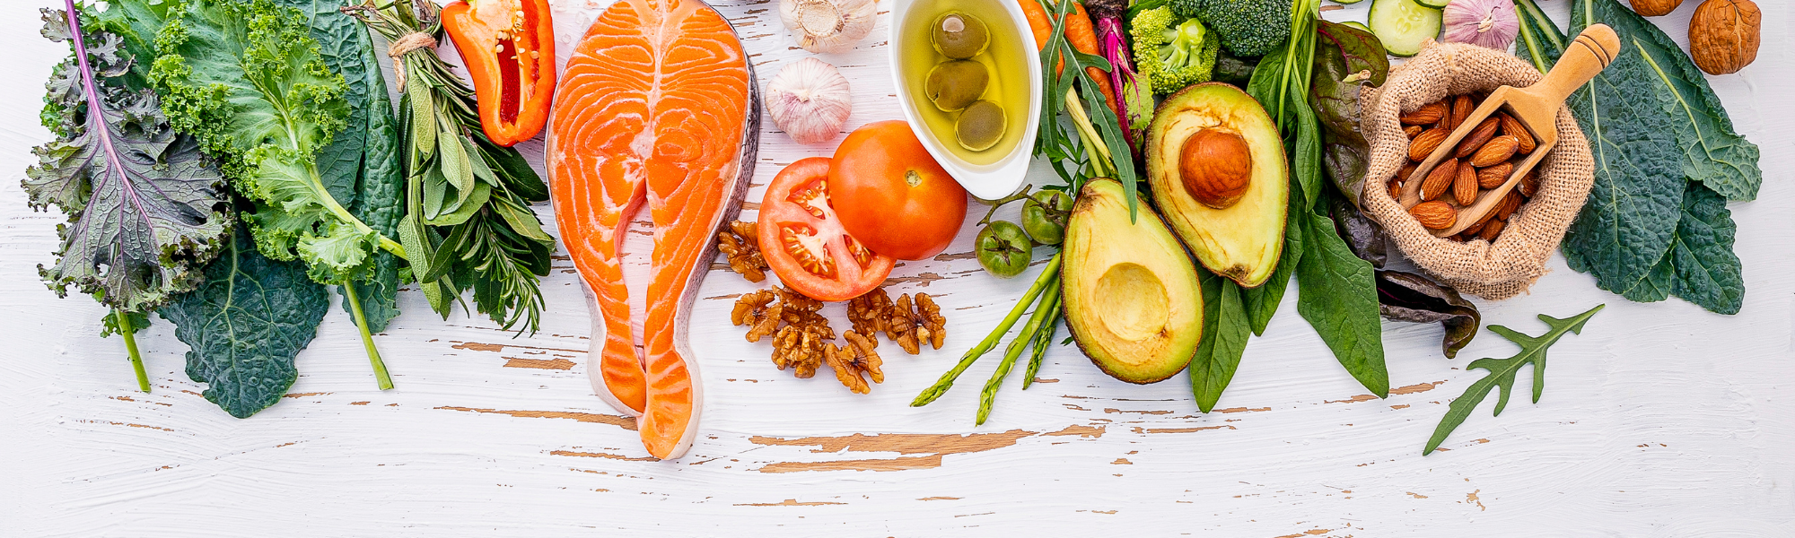
0007 Bonus Culinary Arts
HOW TO SHOP
Opt in For Regular Shopping Trips: While it may seem counterintuitive, shopping 2 to 3 times weekly can promote a healthier lifestyle than a single, large weekly haul. This strategy is particularly beneficial for adherents of a diet rich in plant-based whole foods and high-quality animal products, ensuring that you always have access to the freshest ingredients. Regular visits can also help minimize food waste, saving you money in the long run.
Be Discerning with Your Produce and Proteins.
Produce: Choose fruits and vegetables that are free from bruises or damage. If opting for pre-cut options, ensure they are chilled or on ice. Prioritize ripe produce for immediate use and consider whole spices and fresh herbs for the best flavor in your dishes.

Slide 14

0007 Bonus Culinary Arts
HOW TO SHOP
Animal Products: When selecting meats, eggs, or dairy, look for freshness and quality. Opt for products from animals that were raised in clean, humane conditions and, when possible, choose organic to reduce exposure to antibiotics and hormones. Freshness is key, so check sell-by dates and select items stored at proper temperatures.
By adhering to these guidelines, you'll not only enhance the nutritional value of your meals but also take meaningful steps towards sustainable eating habits.

Slide 15

Bonus 0007
Grocery Shopping
Love in Every Bite: Nourishing Wellness

