Slide 1



Bonus 0009
Food Misconceptions
Love in Every Bite: Nourishing Wellness

Slide 2
Food
Misconceptions
Love in Every Bite: Nourishing Wellness

Slide 3
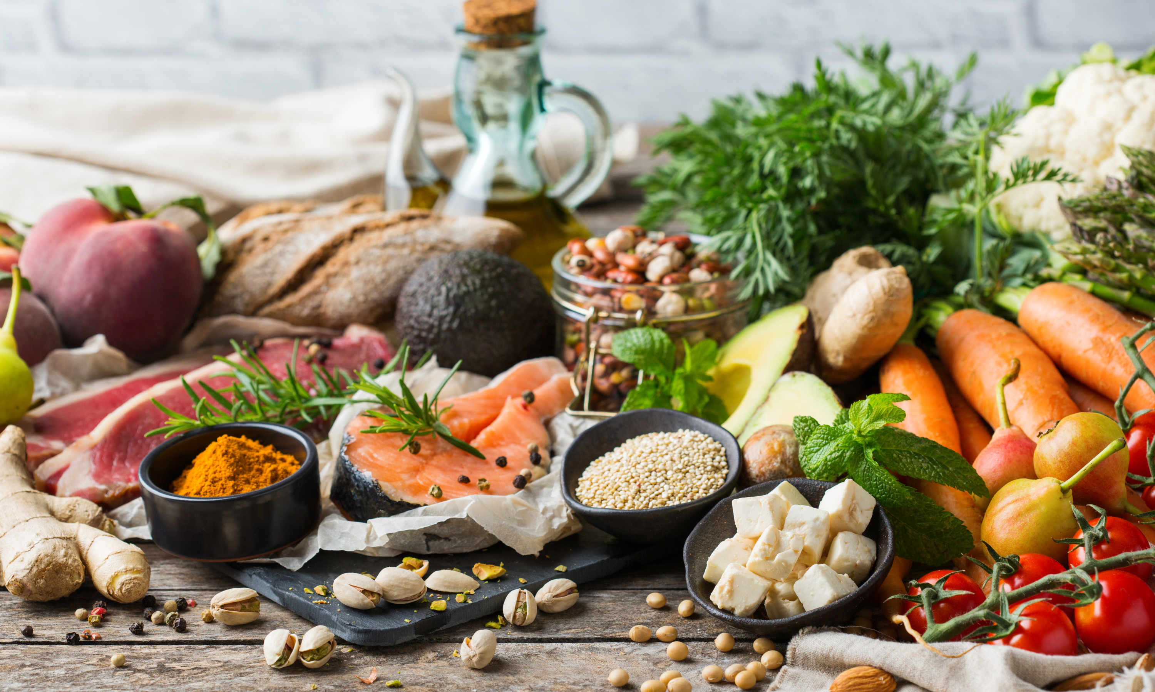
0009 Bonus Culinary Arts
FOOD MISCONCEPTIONS
Healthy eating is a topic ripe with misconceptions and myths. These misunderstandings can often deter individuals from pursuing a healthier diet or cause confusion about what healthy eating truly entails.
On the following pages you’ll learn some of the most common misconceptions about healthy eating and the truths behind them:

Slide 4
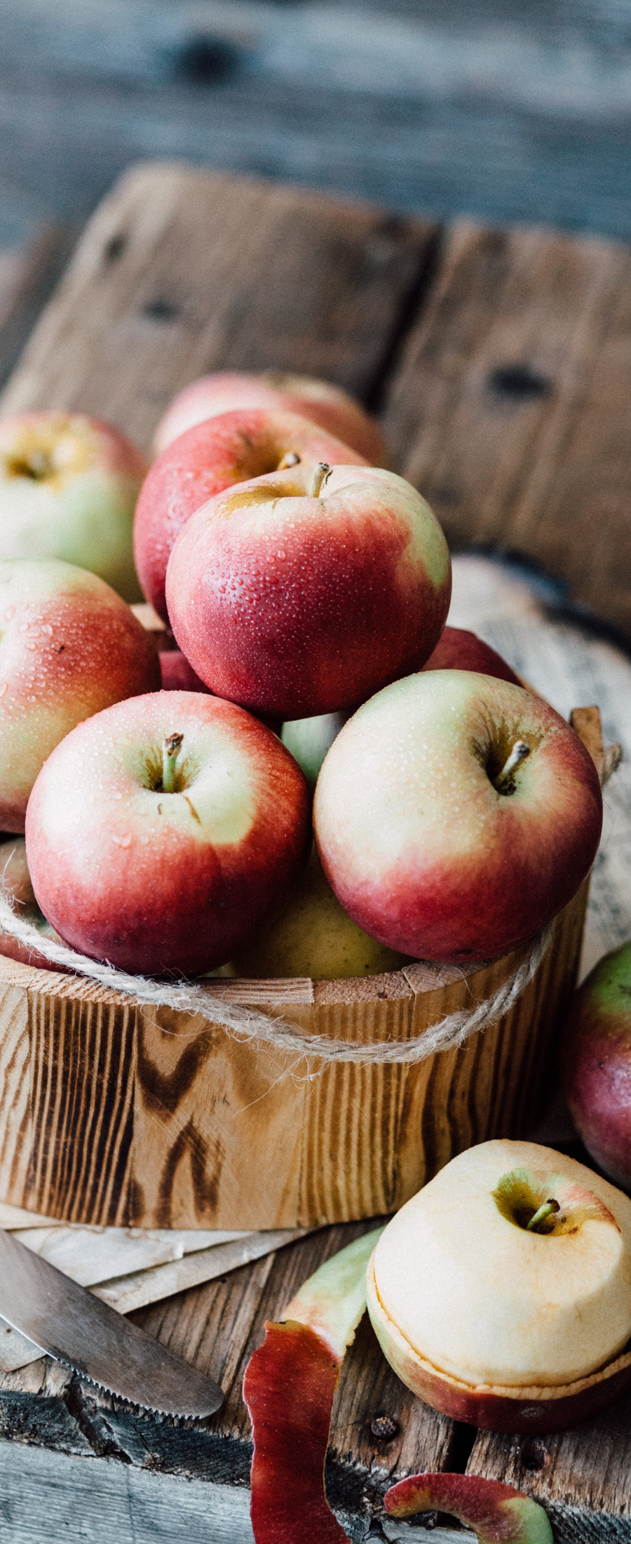
0009 Bonus Culinary Arts
FOOD MISCONCEPTIONS
1. Misconception: Eating Healthy Is All or Nothing.
Truth: Healthy eating is about balance and making more nutritious choices more often, not about strict dietary limitations or depriving yourself of the foods you love.

Slide 5
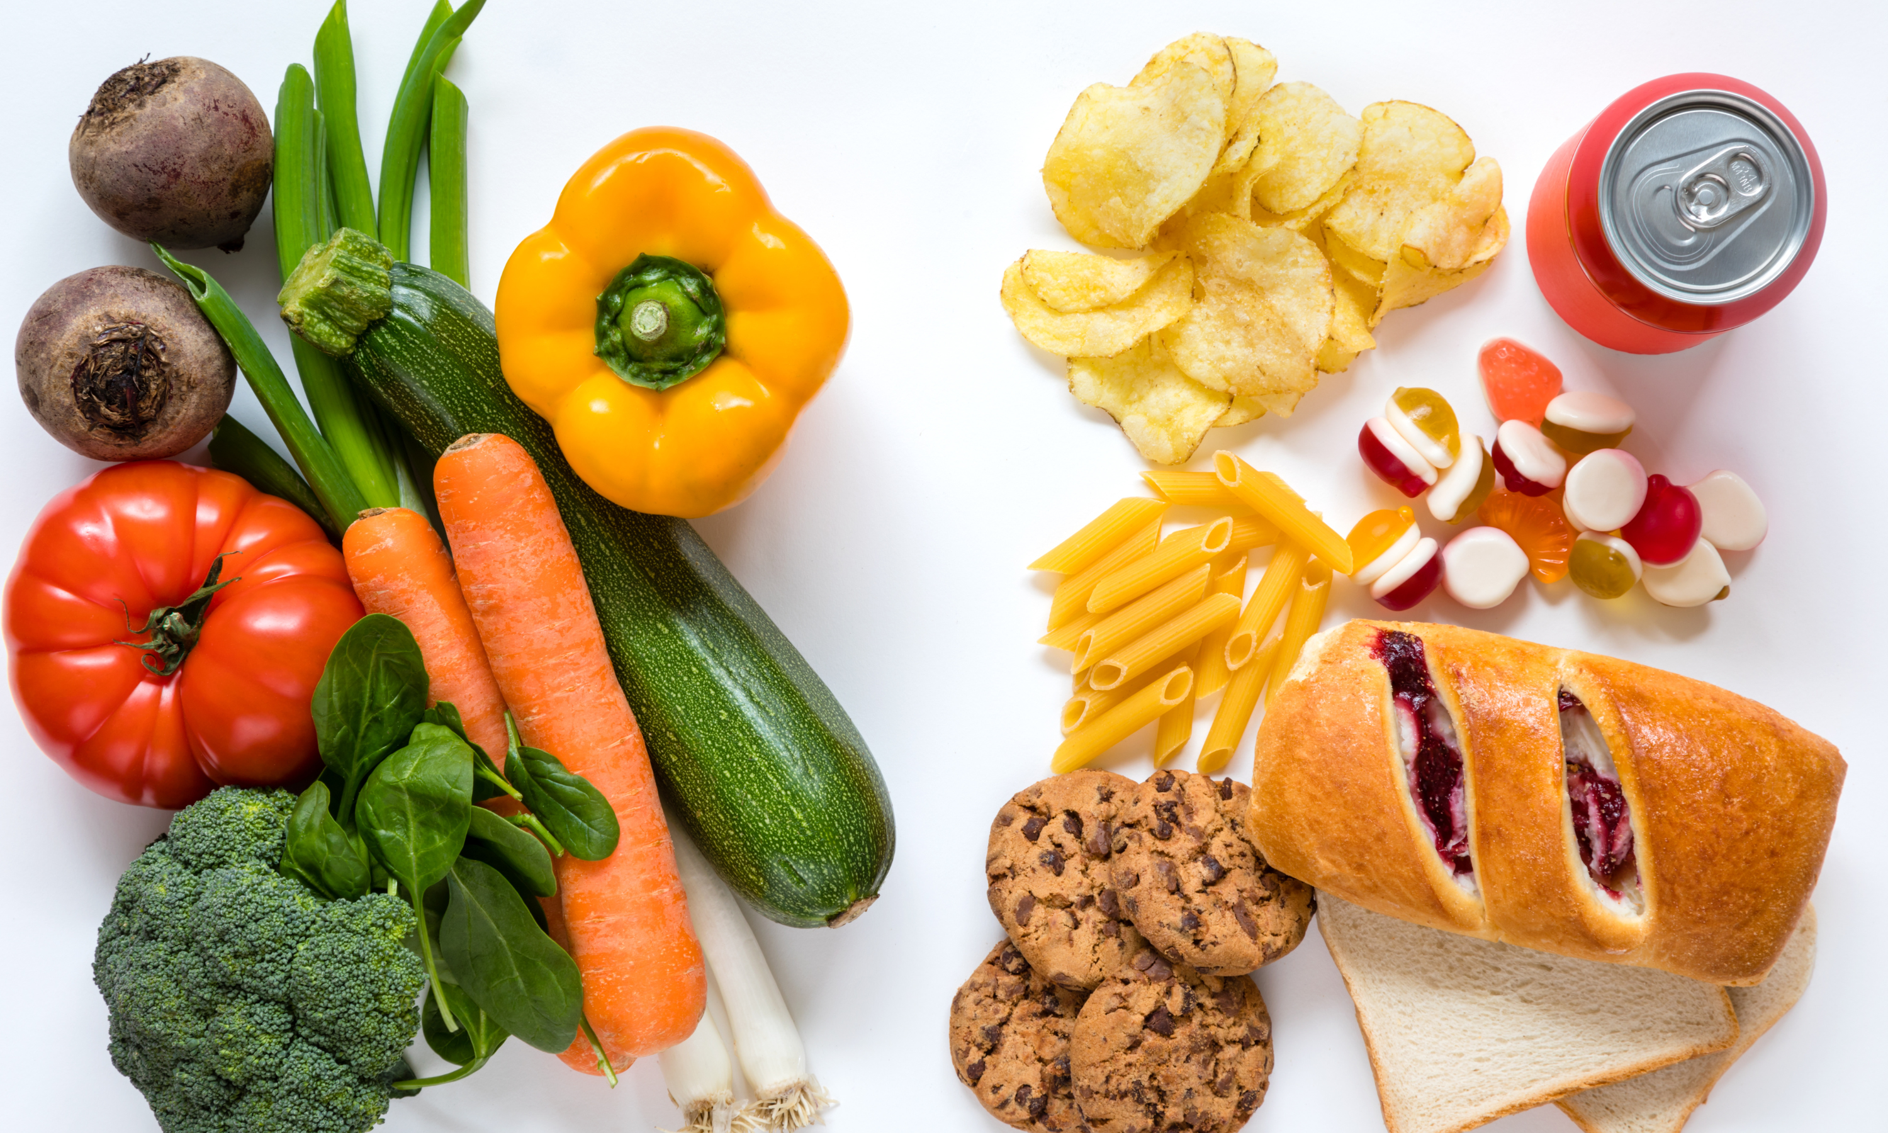
0009 Bonus Culinary Arts
FOOD MISCONCEPTIONS
COMPLEX CARBS
SIMPLE CARBS
2. Misconception: Carbs Are the Enemy.
Truth: Carbohydrates are an essential part of a healthy diet; it's the type of carbs that matters. Complex carbs such as whole grains, fruits, and vegetables are good carbs that provide energy and nutrients.

Slide 6

0009 Bonus Culinary Arts
FOOD MISCONCEPTIONS
3. Misconception: Healthy Food Is Expensive.
Truth: With smart shopping choices, such as buying seasonal produce, whole grains, and legumes, eating healthily can be economical.

Slide 7

0009 Bonus Culinary Arts
FOOD MISCONCEPTIONS
4. Misconception: Diet Foods Are Always a Healthier Option.
Truth: Foods labeled as "diet" or "low-fat" can often be high in sugars and artificial ingredients. It’s important to read labels and focus on whole, unprocessed foods.

Slide 8

0009 Bonus Culinary Arts
FOOD MISCONCEPTIONS
5. Misconception: Supplements Can Replace Whole Foods.
Truth: While supplements can help fill nutritional gaps, they can't replicate all of the nutritional benefits of whole foods, which contain a variety of vitamins, minerals, and other health-promoting compounds.

Slide 9

0009 Bonus Culinary Arts
FOOD MISCONCEPTIONS
6. Misconception: If It's Organic, It's Healthier.
Truth: Organic foods have benefits, such as lower pesticide levels, but not all organic foods are inherently healthier in terms of calorie or sugar content than their non-organic counterparts.

Slide 10
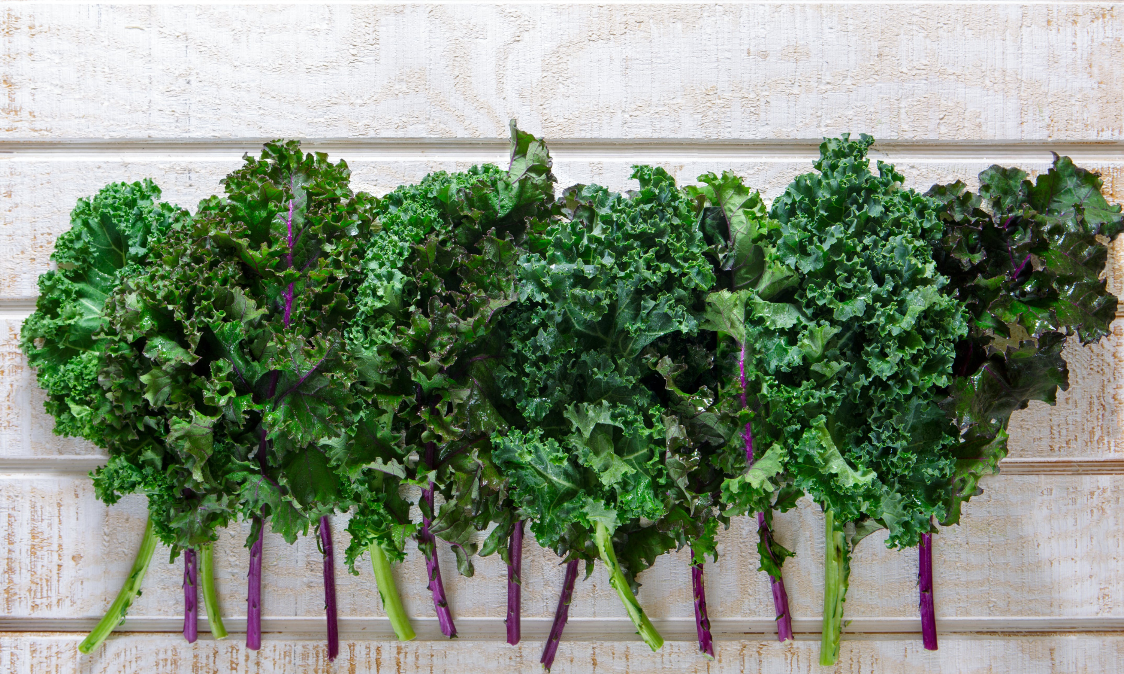
0009 Bonus Culinary Arts
FOOD MISCONCEPTIONS
7. Misconception: Drinking Milk Is Essential for Healthy Bones.
Truth: While milk is a good source of calcium, vitamin D, and other nutrients important for bone health, it's not the only way to support bone density and strength. A variety of foods, including leafy greens, almonds, and fortified plant-based milks, can also provide these essential nutrients. Balanced nutrition and regular exercise are key components of maintaining healthy bones, not just milk consumption.

Slide 11
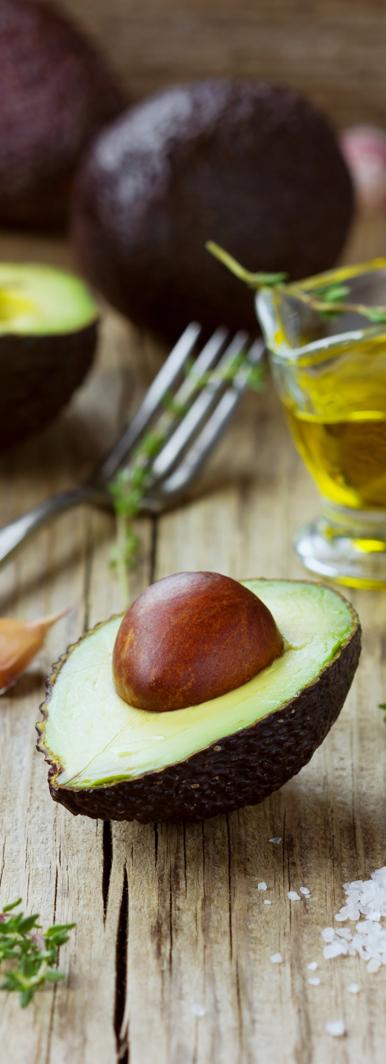
0009 Bonus Culinary Arts
FOOD MISCONCEPTIONS
8. Misconception: Eating Fat Makes You Fat.
Truth: Healthy fats, such as those from avocados, nuts, and olive oil, are essential for nutrient absorption and brain health. The key is consuming fats in moderation and focusing on the source of fat.

Slide 12

0009 Bonus Culinary Arts
FOOD MISCONCEPTIONS
9. Misconception: Skipping Meals Helps You Lose Weight.
Truth: Regular meals support metabolic health. Skipping meals can lead to overeating later and may disrupt blood sugar levels and metabolism.

Slide 13

0009 Bonus Culinary Arts
FOOD MISCONCEPTIONS
10. Misconception: Fresh Produce Is Always Better Than Frozen.
Truth: Frozen fruits and vegetables can be just as nutritious as fresh ones. They're picked and frozen at peak ripeness, locking in nutrients that might otherwise degrade during transport and storage of fresh produce.
Understanding these truths can empower individuals to make informed decisions about their diet, leading to healthier lifestyles without the burden of common dietary myths.

Slide 14

Bonus 0009
Food Misconceptions
Love in Every Bite: Nourishing Wellness

