Slide 1

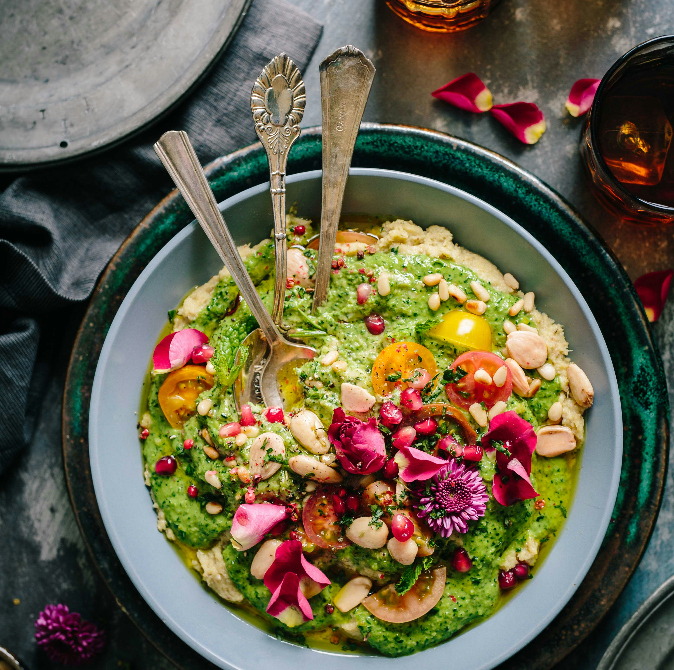

Cooking is Love You Can Taste.

Slide 2


Health
Happiness
Community
Private Practice
Canaan Vibes LLC
Dr. Brown fervently advocates that we hold power to extend our lives, elevate our health, and amplify our happiness by embracing simple lifestyle modifications and nurturing our bodies with real, wholesome food.
Dr. Brown stands at the forefront of health coaching and functional medicine, championing an integrated approach that concentrates on stress management, nurturing healthy sleep patterns, and leveraging the therapeutic power of food. This holistic method fosters longevity, energy, mental acuity, happiness, and a plethora of other health benefits.
As an active practicing physician, Dr. Brown’s influence extends beyond the clinic. She is an internationally acclaimed figurehead, speaker, educator, and advocate in the realm of Functional Medicine, commanding respect and recognition for her insightful contributions.
LIFE AND HEALTH DESIGN

Slide 3
01
02
03
04
INTRODUCTION
FOUNDATIONS
CULINARY SKILLS
MEALS
05
06
07
08
0001 CULINARY ARTS
SPECIAL DIETS
SUPERFOODS & HOLISTIC NUTRITION
ADVANCED NUTRITION
SOPHISTICATED TECHNIQUES I
09
10
11
12
SOPHISTICATED TECHNIQUES Ii
SUSTAINABLE COOKING
INNOVATIVE RECIPE DEVELOPMENT
PRESENTATION AND REVIEW

Slide 4

“Make the most of yourself by fanning the tiny inner sparks of possibility into flames of achievement.” ~ Golda Meir
Congratulations on embarking on CULINARY ARTS! This is a momentous first stride towards transforming your life. This uniquely tailored course has been crafted with you in mind, ensuring every aspect resonates with your personal journey. It's exhilarating to have you on board for this empowering program. By the conclusion of this course, we are confident that you'll share our enthusiasm, and will be equipped to take on the world like never before.
WELCOME TO
CULINARY ARTS

Slide 5
DISCLAIMER
This program does not provide medical advice.
Information in this program is provided for informational purposes only and is not intended as a substitute for the advice provided by your physician or other healthcare professional or any information contained on or in any product label or packaging. You should not use the information in this program for diagnosing or treating a health problem or disease or prescribing any medication or other treatment. It is your responsibility to speak with your physician or other healthcare professional before taking any medication, nutritional, herbal or homeopathic supplement, or adopting any treatment for a health problem. If you have or suspect that you have a medical problem, promptly contact your health care provider. Never disregard professional medical advice or delay in seeking professional advice because of something you have read in this program. Information provided in this program and the use of any products or services purchased from our web site or affiliated sites by you DOES NOT create a doctor-patient relationship between you and any of the medical professionals affiliated with this program. Information and statements regarding dietary supplements have not been evaluated by the Food and Drug Administration and are not intended to diagnose, treat, cure, or prevent any disease.
Everyone is different; not all products or services are suited for everyone. The creators of any products or services will not have any liability to users for injury or loss in connection therewith. Canaan Vibes LLC makes no representation or warranty and disclaim all liability concerning any treatment or any action that is taken following the information provided within or through the program.
Weight loss or health modifications can create injury. Canaan Vibes LLC urges you to first obtain a physical examination and approval from your physician. You agree that by using any of Canaan Vibes LLC products or services, you do this entirely at your own risk. Any recommendation for changes in diet including the use of food supplementation or weight reduction products are your responsibility and entirely at your own risk. You agree that you are voluntarily purchasing products or services. You assume all risks of injury, illness or death.
YOU ACKNOWLEDGE THAT YOU HAVE CAREFULLY READ THIS “WAIVER AND RELEASE”.

Slide 6

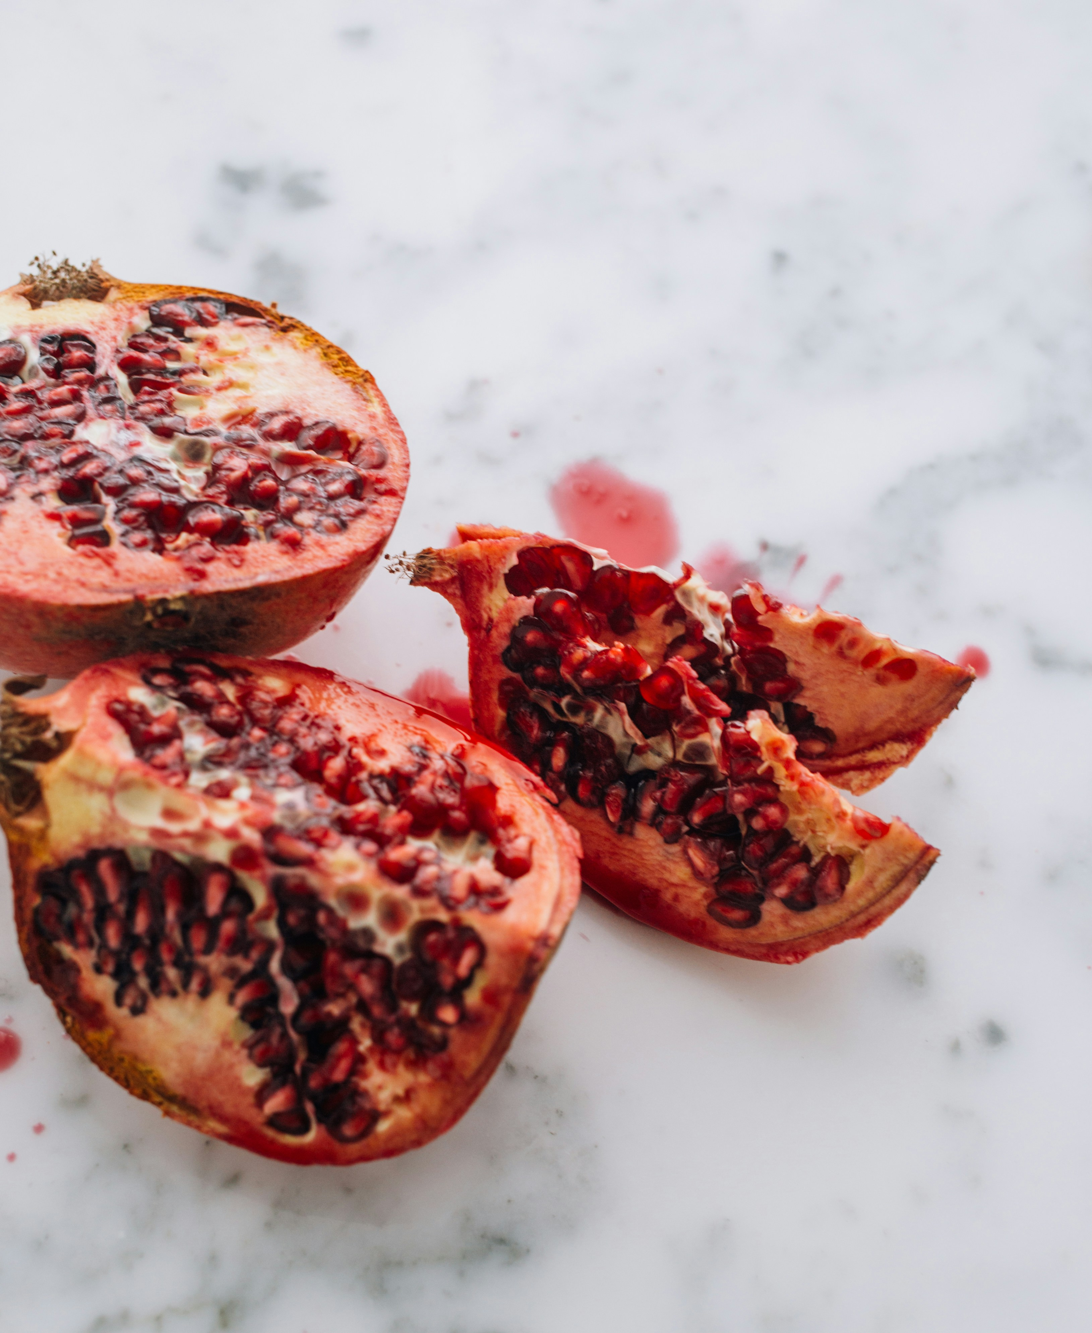

WELCOME
Welcome to a journey where food becomes your ally in health and wellness. I’m excited to guide you through "Mastering Recipe Development for Wellness." Get ready to transform the way you see, taste, and use food for your health.

Slide 7

0001 CULINARY ARTS
COURSE OVERVIEW
A BRIEF MODULE OVERVIEW
This journey unveils the incredible power of culinary skills in enhancing your wellness. You'll learn not just to cook but to create meals that nourish your body and delight your senses. We're here to show you how nutritious eating fits seamlessly into your lifestyle, making healthful choices both accessible and enjoyable.

Slide 8

0001 CULINARY ARTS
Importance of Culinary Skills in Your Wellness Journey
THE SCIENCE
Understanding the science behind food and mastering the art of cooking are essential skills on your path to wellness. It's one thing to know which foods are beneficial for your health; it's another to prepare them in ways that maintain their nutritional value and your interest. We aim to empower you with culinary skills that transform your diet, making healthy eating a sustainable and pleasurable part of your daily life.

Slide 9
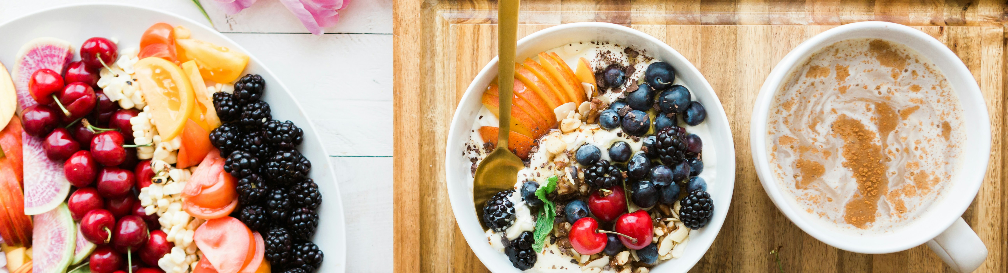
EXPANDING
Together, we will explore the essentials of nutrition, the joy of cooking, and how to adapt meals to your unique needs. By the end of this module, you'll not only be inspired but also equipped to make informed food choices and prepare meals that support your wellness goals.
0001 CULINARY ARTS
EMBARK WITH ME ON THIS CULINARY ADVENTURE TO WELLNESS!

Slide 10
UNDERSTAND NUTRITIONAL PRINCIPLES FOR WELLNESS
Your Wellness Journey Begins Here: Embark on a transformative journey to wellness with us! Our health coaches and practitioners are equipped with cutting-edge culinary arts knowledge, ready to guide you through the essentials of nutrition. Understanding these principles is the first step towards achieving your health and wellness goals.
0001 CULINARY ARTS

Slide 11

WHAT YOU’LL
DISCOVER
0001 CULINARY ARTS
The role of macronutrients (carbohydrates, proteins, fats) and micronutrients (vitamins, minerals) in your diet.
How to identify and choose nutrient-dense foods for optimal health.
The importance of balanced meals for sustaining energy, managing weight, and supporting overall well-being.
EMPOWERING YOUR HEALTH CHOICES: ARMED WITH THIS KNOWLEDGE, YOU'LL BE ABLE TO MAKE INFORMED DECISIONS ABOUT WHAT YOU EAT, UNDERSTANDING NOT JUST THE "WHAT" BUT THE "WHY" BEHIND HEALTHY EATING. LET'S NOURISH YOUR BODY AND MIND TOGETHER!

Slide 12
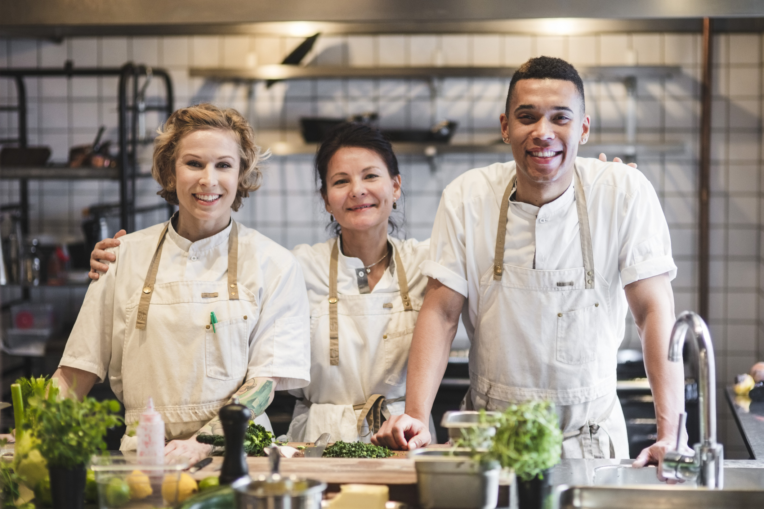
ENHANCE CULINARY CREATIVITY AND ADAPTABILITY
0001 CULINARY ARTS
Who says healthy eating can't be delicious and exciting? Dive into the art of culinary creativity with recipes that are not only nutritious but also appealing to the palate. Our trained health professionals are here to inspire your culinary journey, showing you how to blend flavors, textures, and colors to create dishes that delight your senses.

Slide 13

Mastering the art of flavor profiles to elevate your meals.
Using texture and color to make your dishes visually appealing.
Innovative combinations of ingredients that cater to health without compromising taste.
WHAT YOU’LL LEARN
“A JOURNEY OF A THOUSAND MILES BEGINS WITH A SINGLE STEP.” - CHINESE PROVERB

Slide 14
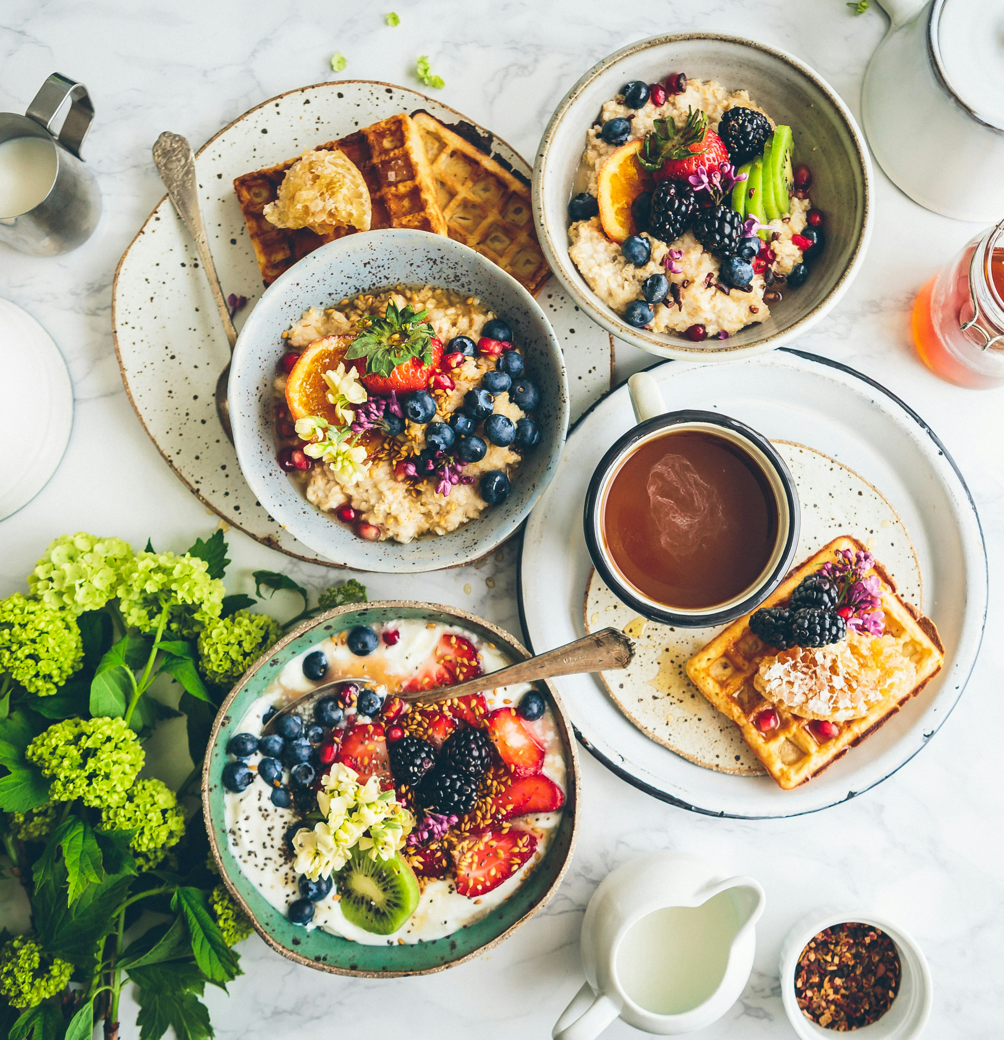
TRANSFORMING EVERYDAY MEALS
With these skills, you'll transform everyday meals into a celebration of wellness and taste. Get ready to impress your family and friends with dishes that look as good as they taste and feel as good as they look!
0001 CULINARY ARTS

Slide 15

CATERING TO EVERY BODY
WHAT'S ON THE MENU:
Strategies for adapting recipes to meet diverse dietary requirements.
Tips for substituting ingredients without losing nutritional value.
A variety of nutrient-dense recipes tailored to different health goals and dietary needs.
Every individual's journey to health is unique, and so are their dietary needs. Whether it's gluten-free, vegan, low-carb, or any other specific dietary preference, our health coaches and practitioners have the expertise to develop recipes that cater to you.

Slide 16

ENJOYING
PERSONALIZED NUTRITION
Enjoy the freedom of personalized nutrition where every meal is crafted with your health and preferences in mind. Together, we'll explore a world of flavors that not only satisfy your taste buds but also contribute to your wellness journey.
0001 CULINARY ARTS

Slide 17

NAVIGATING SPECIAL DIETS WITH EXPERTISE
Your Diet, Customized for You: Understanding that everyone's dietary needs and preferences are as unique as their fingerprints, our health coaches are adept at navigating and catering to a wide array of special diets. From gluten-free to vegan, low-carb, and beyond, we've got you covered.
What You'll Gain:
Insights into common dietary preferences and how to manage them.
Guidance on tailoring meals that meet your specific nutritional needs without compromising taste.
Confidence in choosing foods that align with your health goals and dietary restrictions.
0001 CULINARY ARTS

Slide 18

PERSONALIZED WELLNESS
0001 CULINARY ARTS
Experience the relief and joy that comes with knowing your diet is not only supporting your health but is also tailor-made for you. Say goodbye to one-size-fits-all solutions and hello to personalized nutrition care.

Slide 19
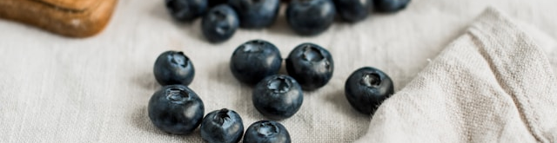
SUPERFOODS AND HOLISTIC NUTRITION
0001 CULINARY ARTS
Elevate Your Diet with Nature's Best: Unlock the power of superfoods and holistic nutrition principles with our health coaching services. Learn how to incorporate foods that are rich in nutrients and offer health benefits beyond basic nutrition into your daily meals.

Slide 20

WHAT YOU’LL DISCOVER
The top superfoods to include in your diet for optimal health.
How holistic nutrition principles can enhance your overall wellness.
Techniques for mindful eating and using nutrition to reduce stress.
0001 CULINARY ARTS

Slide 21

HOLISTIC NUTRITION
Embrace a holistic approach to your diet that not only focuses on physical health but also supports your mental and emotional wellbeing. With our guidance, integrating superfoods and mindful eating practices into your life will be both enjoyable and transformative.
0001 CULINARY ARTS

Slide 22

CULINARY ARTS
0001 CULINARY ARTS

