Slide 1
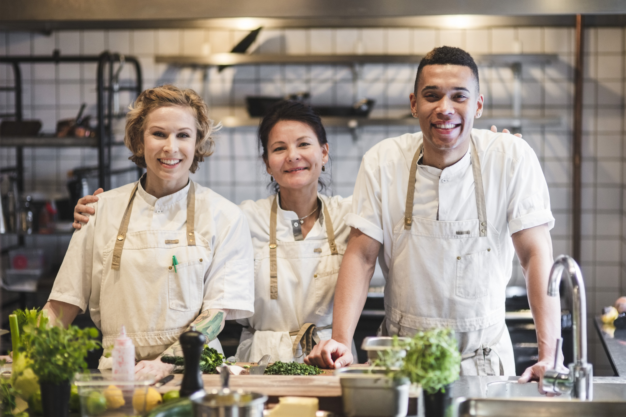


Workbook 0001
Love in Every Bite: Nourishing Wellness

Slide 2
0001 Culinary Arts
How do you utilize a holistic approach to nutrition? Do you recognize any unhelpful patterns in your day-to-day culinary wellness?
Superfoods are a quick and easy way to wellness. Which superfoods will you make sure to include in your diet this week?

Slide 3
0001 Culinary Arts
The kitchen is a sacred space. From dreams, to safety skills, the kitchen is filled with wonder. How do you embrace change in the kitchen?
Reflect on your current culinary goals. What do you hope to learn and accomplish with the help of these modules?

Slide 4
0001 Culinary Arts
Where do you find inspiration for making your meals? Do you have a song you play while cooking? Why this song?
Think about your current cooking process. Using Culinary Arts, what techniques do you hope to use or dive into more?

Slide 5
0001 Culinary Arts
Share your approach to meal prep. What habits can you change while preparing meals?
Consider your knowledge of sustainability. How do you hope to improve your organization and usage of power, in order to create a cleaner environment?

Slide 6
0001 Culinary Arts
At Home Reflection
Reflect on your current meal plan in the upcoming slides. Jot down what you’d like to change or correct here.
How will you deal with moldy food in your pantry? Is this a stable meal plan or is it thrown together on a whim? How do these foods make you feel after eating them? Does this diet help or hinder your culinary wellness goals? Can you find cheaper alternatives to what you ingest now?

Slide 7
0001 Culinary Arts
Monday Meal Plan
Recipe/Meal
Shopping List
Breakfast
Lunch
Dinner
Snack

Slide 8
0001 Culinary Arts
Tuesday Meal Plan
Recipe/Meal
Shopping List
Breakfast
Lunch
Dinner
Snack

Slide 9
0001 Culinary Arts
Wednesday Meal Plan
Recipe/Meal
Shopping List
Breakfast
Lunch
Dinner
Snack

Slide 10
0001 Culinary Arts
Thursday Meal Plan
Recipe/Meal
Shopping List
Breakfast
Lunch
Dinner
Snack

Slide 11
0001 Culinary Arts
Friday Meal Plan
Recipe/Meal
Shopping List
Breakfast
Lunch
Dinner
Snack

Slide 12
0001 Culinary Arts
Journal

Slide 13
0001 Culinary Arts
Journal

Slide 14
0001 Culinary Arts
Journal

Slide 15
0001 Culinary Arts
Journal

Slide 16
0001 Culinary Arts
Journal

Slide 17

Workbook 0001
Love in Every Bite: Nourishing Wellness

