Slide 1

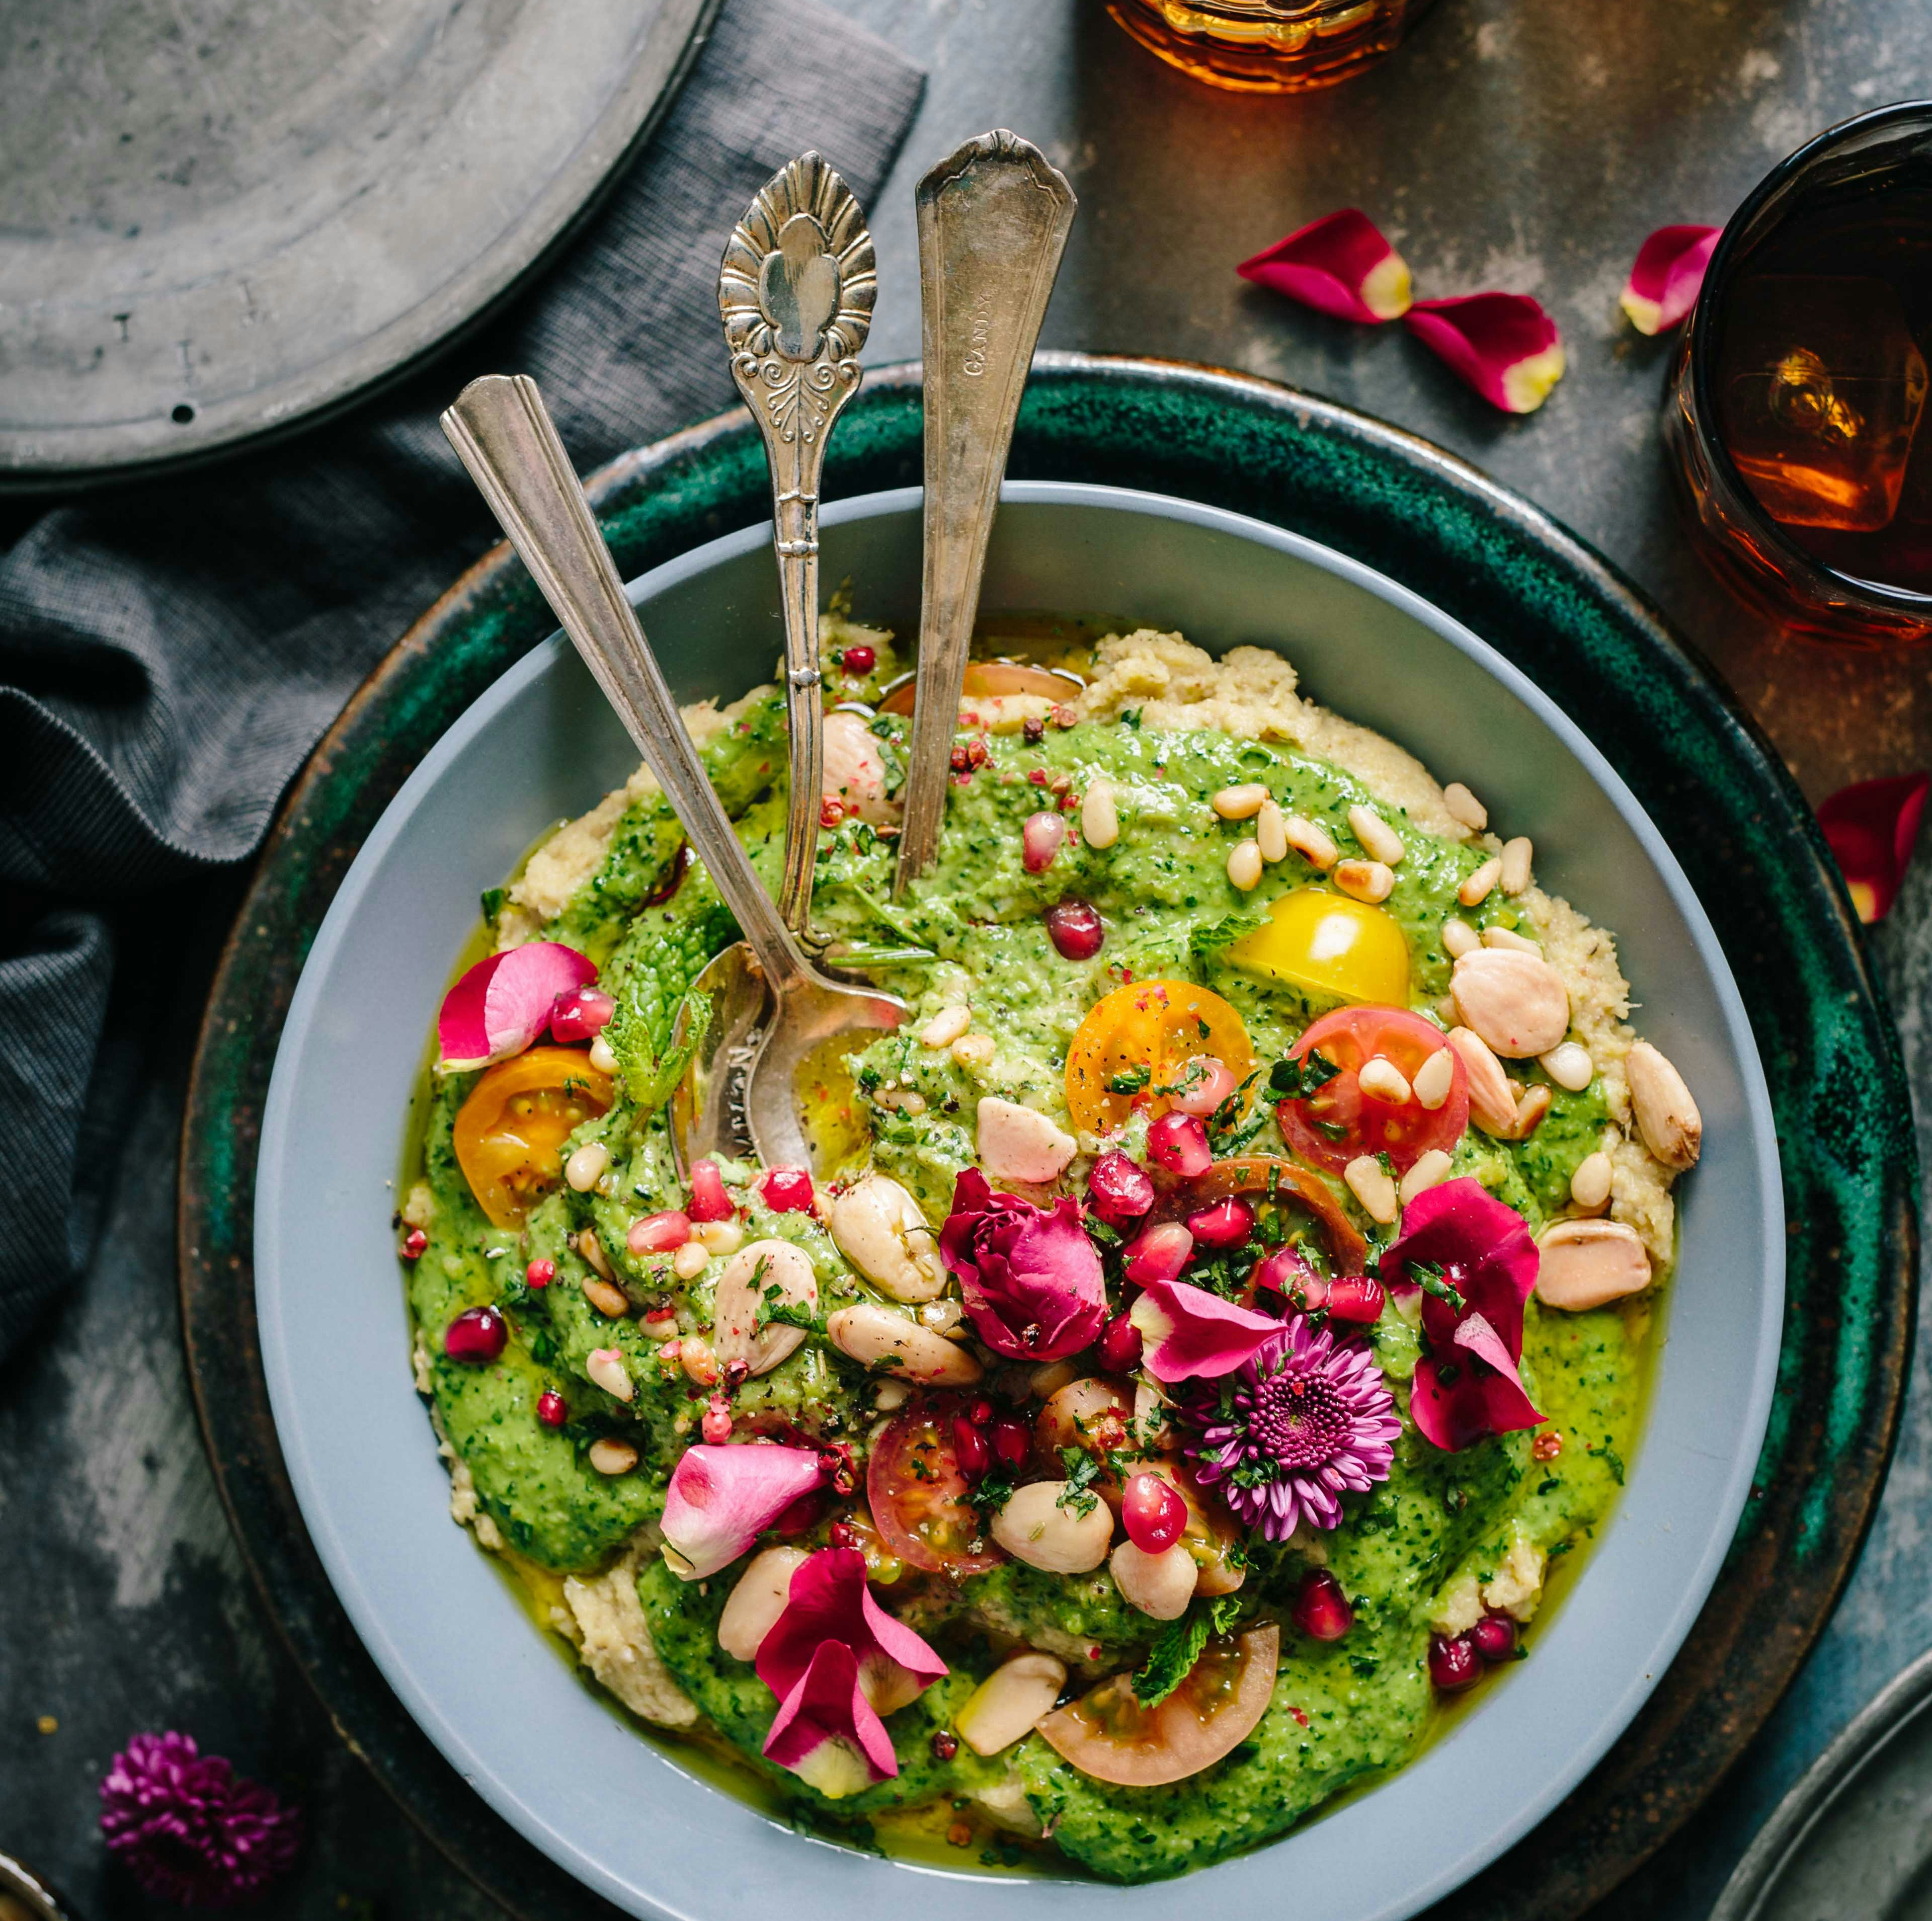

Cooking is Love You Can Taste.

Slide 2


Health
Happiness
Community
Private Practice
Canaan Vibes LLC
Dr. Brown fervently advocates that we hold power to extend our lives, elevate our health, and amplify our happiness by embracing simple lifestyle modifications and nurturing our bodies with real, wholesome food.
Dr. Brown stands at the forefront of health coaching and functional medicine, championing an integrated approach that concentrates on stress management, nurturing healthy sleep patterns, and leveraging the therapeutic power of food. This holistic method fosters longevity, energy, mental acuity, happiness, and a plethora of other health benefits.
As an active practicing physician, Dr. Brown’s influence extends beyond the clinic. She is an internationally acclaimed figurehead, speaker, educator, and advocate in the realm of Functional Medicine, commanding respect and recognition for her insightful contributions.

Slide 3
01
02
03
04
STARTING
MODULE OVERVIEW
BASIC NUTRITION PRINCIPLES
EAT WHOLE, UNPROCESSED FOODS
05
06
07
08
0002 CULINARY ARTS
PRIORITIZE GUT HEALTH
FOCUS ON NUTRIENT DENSITY
BALANCE MACRONUTRIENTS
MANAGE INFLAMMATION THROUGH DIET
09
10
11
SUPPORT DETOXIFICATION PROCESSES
ADAPT TO INDIVIDUAL NEEDS
FINISHING UP

Slide 4
DISCLAIMER
This program does not provide medical advice.
Information in this program is provided for informational purposes only and is not intended as a substitute for the advice provided by your physician or other healthcare professional or any information contained on or in any product label or packaging. You should not use the information in this program for diagnosing or treating a health problem or disease or prescribing any medication or other treatment. It is your responsibility to speak with your physician or other healthcare professional before taking any medication, nutritional, herbal or homeopathic supplement, or adopting any treatment for a health problem. If you have or suspect that you have a medical problem, promptly contact your health care provider. Never disregard professional medical advice or delay in seeking professional advice because of something you have read in this program. Information provided in this program and the use of any products or services purchased from our web site or affiliated sites by you DOES NOT create a doctor-patient relationship between you and any of the medical professionals affiliated with this program. Information and statements regarding dietary supplements have not been evaluated by the Food and Drug Administration and are not intended to diagnose, treat, cure, or prevent any disease.
Everyone is different; not all products or services are suited for everyone. The creators of any products or services will not have any liability to users for injury or loss in connection therewith. Canaan Vibes LLC makes no representation or warranty and disclaim all liability concerning any treatment or any action that is taken following the information provided within or through the program.
Weight loss or health modifications can create injury. Canaan Vibes LLC urges you to first obtain a physical examination and approval from your physician. You agree that by using any of Canaan Vibes LLC products or services, you do this entirely at your own risk. Any recommendation for changes in diet including the use of food supplementation or weight reduction products are your responsibility and entirely at your own risk. You agree that you are voluntarily purchasing products or services. You assume all risks of injury, illness or death.
YOU ACKNOWLEDGE THAT YOU HAVE CAREFULLY READ THIS “WAIVER AND RELEASE”.

Slide 5
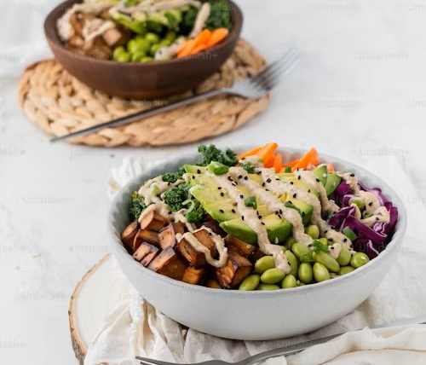
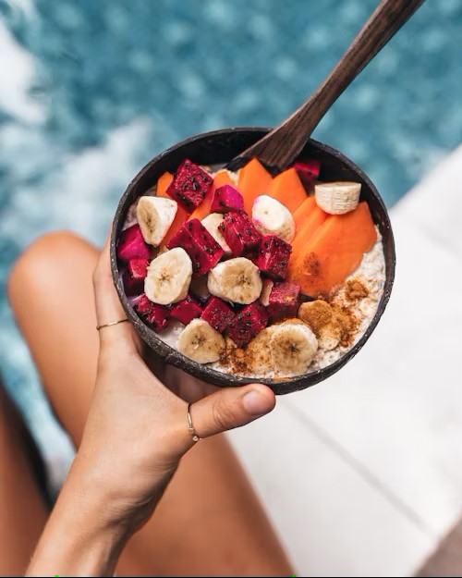
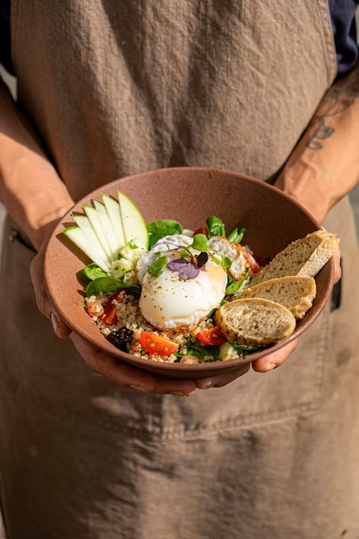
STARTING
Culinary wellness is a holistic approach that integrates the art of cooking with the science of nutrition to promote health and well-being. It transcends the basic act of eating for sustenance, emphasizing the selection, preparation, and consumption of food that nourishes the body, mind, and soul. Culinary wellness recognizes that food is not just fuel; it's a key component of our emotional happiness, physical health, and social connections.

Slide 6
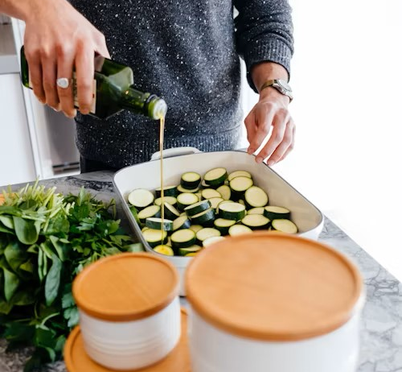
MODULE OVERVIEW
0002 CULINARY ARTS
This concept encourages individuals to engage actively with their food—from farm to kitchen to table—fostering a deeper understanding of ingredients, cooking methods, and their impact on health. By combining nutritional knowledge with culinary skills, culinary wellness empowers people to make informed dietary choices that support their health goals, whether that's preventing disease, managing weight, improving mental health, or simply maintaining overall well-being.
In embracing culinary wellness, we also embrace the joy of cooking and eating, the pleasure of sharing meals with others, and the benefits of a mindful, balanced approach to nutrition. It's about creating a positive, sustainable relationship with food that celebrates diversity, creativity, and the healing power of meals prepared with intention and care.

Slide 7

0002 CULINARY ARTS
Basic nutrition principles for everyday health, especially when viewed through the lens of functional nutrition …
BASIC NUTRITION PRINCIPLES
… emphasize a personalized and holistic approach to eating. Functional nutrition is grounded in understanding that food is more than just energy; it's information for every cell in our body. It focuses on optimizing health by addressing the root causes of imbalances and diseases through diet. Here are key principles of basic nutrition, framed within the functional nutrition context:

Slide 8
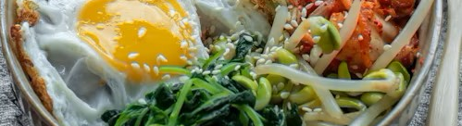
EAT WHOLE, UNPROCESSED FOODS
Functional Insight: Whole foods provide a complex blend of nutrients, phytochemicals, and fiber that work synergistically to promote health. They are more than the sum of their parts, supporting the body's natural healing processes and reducing inflammation.
0002 CULINARY ARTS
APPLICATION: INCORPORATE A VARIETY OF FRESH VEGETABLES, FRUITS, WHOLE GRAINS, LEGUMES, NUTS, AND SEEDS INTO YOUR DIET. THESE FOODS ARE RICH IN ESSENTIAL NUTRIENTS AND ANTIOXIDANTS THAT SUPPORT GUT HEALTH, DETOXIFICATION, AND CELLULAR REPAIR.

Slide 9

PRIORITIZE GUT HEALTH
Functional Insight: The gut is central to overall health, affecting everything from immunity to mental health. A healthy gut microbiome supports digestion, absorption of nutrients, and elimination of toxins.
0002 CULINARY ARTS
APPLICATION: INCLUDE PROBIOTIC-RICH FOODS LIKE YOGURT, KEFIR, AND FERMENTED VEGETABLES, AS WELL AS PREBIOTIC FIBERS FOUND IN FOODS LIKE GARLIC, ONIONS, AND BANANAS, TO NOURISH YOUR GUT MICROBIOTA.

Slide 10
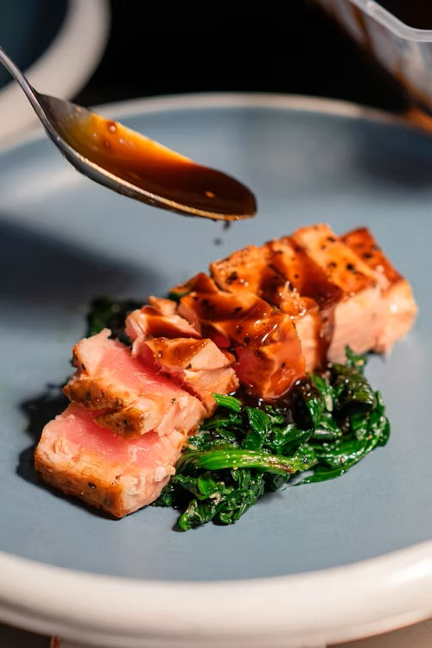
FOCUS ON NUTRIENT DENSITY
Functional Insight: Nutrient-dense foods provide high levels of vitamins, minerals, and other health-promoting components relative to their calorie content. These foods support optimal functioning of the body's systems and help prevent nutritional deficiencies.
Application: Choose foods that pack a nutritional punch, such as leafy greens, berries, sweet potatoes, and wild-caught fish. These foods enhance energy levels and support metabolic and cellular health.
0002 CULINARY ARTS

Slide 11
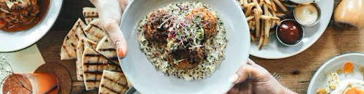
BALANCE MACRONUTRIENTS
0002 CULINARY ARTS
Functional Insight: The right balance of carbohydrates, proteins, and fats is essential for maintaining energy, muscle health, and hormonal balance. Functional nutrition considers individual needs based on lifestyle, health status, and goals.
Application: Tailor your intake of macronutrients to support your activity level, health objectives, and metabolic needs. This might mean adjusting proportions based on your response to different types of foods and observing how your body reacts to various macronutrient ratios.

Slide 12
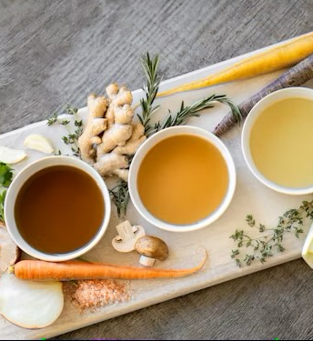
MANAGE INFLAMMATION THROUGH DIET
0002 CULINARY ARTS
Functional Insight: Chronic inflammation is a root cause of many health issues. Certain foods can either trigger or reduce inflammation.
Application: Incorporate anti-inflammatory foods like omega-3 rich fish, turmeric, ginger, and lots of colorful fruits and vegetables. Limit processed foods, sugars, and trans fats, which can promote inflammation.

Slide 13
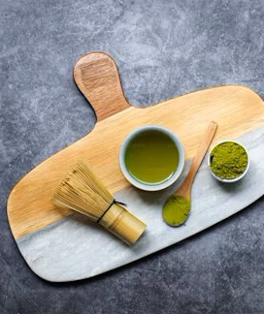
SUPPORT DETOXIFICATION PROCESSES
Functional Insight: The body's natural detoxification system is crucial for removing toxins and preventing disease. Nutrients from food support the liver and other detox organs.
Application: Consume foods high in antioxidants and compounds that support liver health, such as cruciferous vegetables, beets, and green tea. Ensure adequate hydration and fiber intake to support elimination pathways.

Slide 14

ADAPT TO INDIVIDUAL NEEDS
Functional Insight: Each person's body is unique, with different nutritional requirements. Functional nutrition emphasizes the importance of customizing dietary approaches to individual needs, considering factors like genetics, environment, and lifestyle.
Application: Pay attention to how different foods affect your body and mood. Consider working with a healthcare provider or a nutritionist who can help tailor a nutrition plan that addresses your specific health conditions and goals.
0002 CULINARY ARTS

Slide 15

Incorporating these basic nutrition principles into your daily life can lead to significant health benefits. By adopting a functional nutrition approach, you're not just eating to fill a void; you're consciously choosing foods that heal, nourish, and optimize your health from the inside out.
FINISHING UP

Slide 16

CULINARY ARTS
0001 CULINARY ARTS

