Slide 1

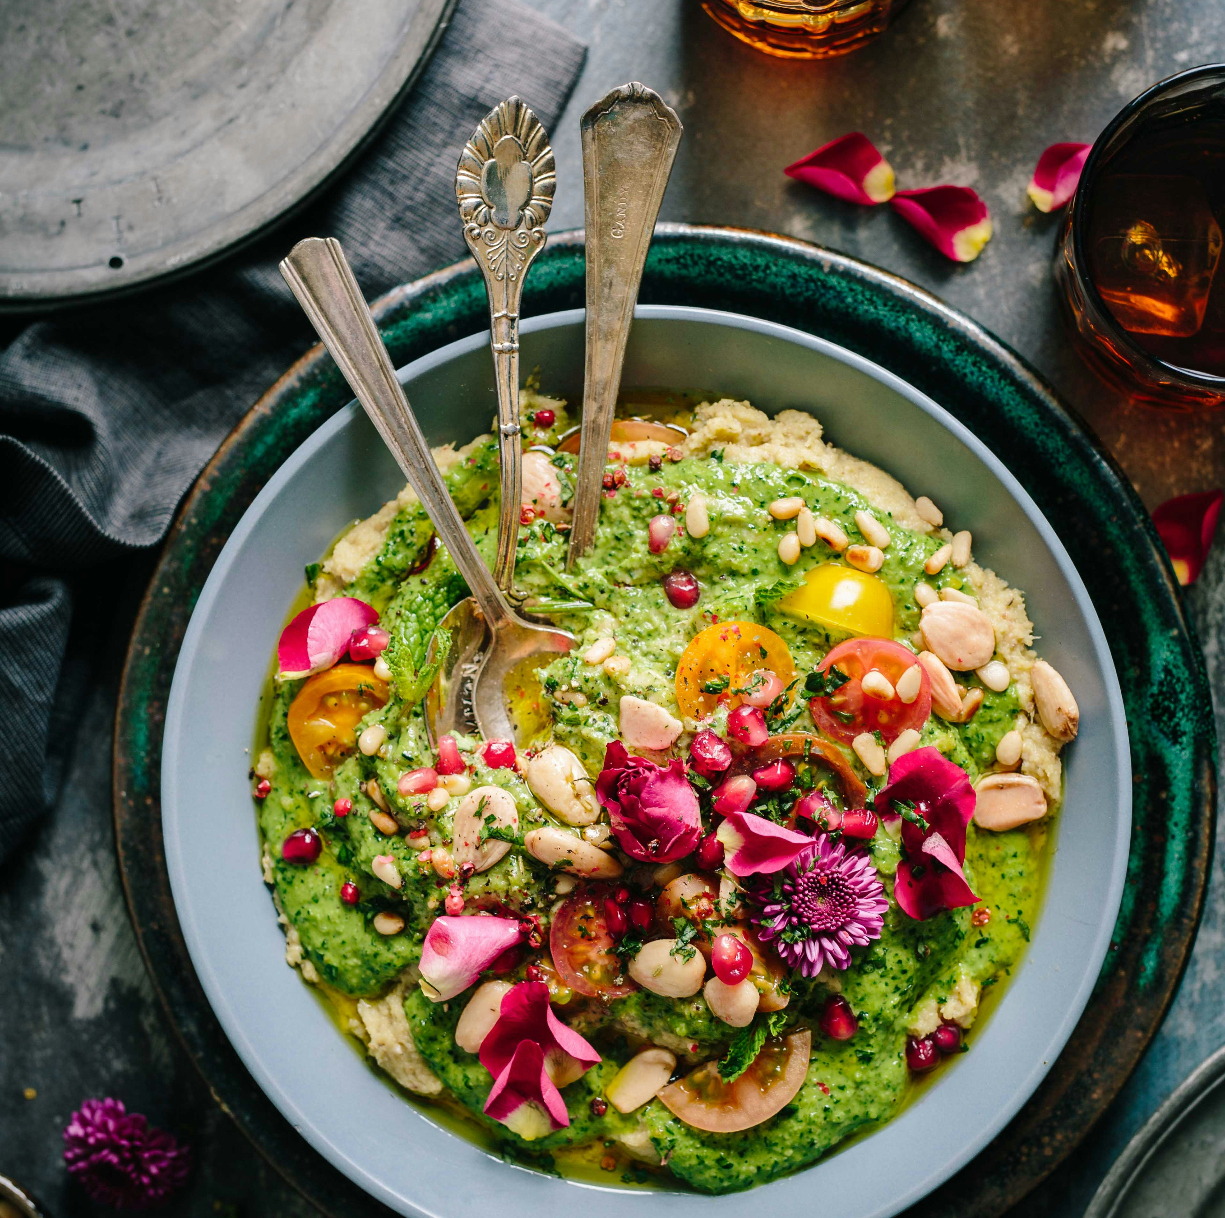

Cooking is Love You Can Taste

Slide 2


Health
Happiness
Community
Private Practice
Canaan Vibes LLC
Dr. Brown fervently advocates that we hold power to extend our lives, elevate our health, and amplify our happiness by embracing simple lifestyle modifications and nurturing our bodies with real, wholesome food.
Dr. Brown stands at the forefront of health coaching and functional medicine, championing an integrated approach that concentrates on stress management, nurturing healthy sleep patterns, and leveraging the therapeutic power of food. This holistic method fosters longevity, energy, mental acuity, happiness, and a plethora of other health benefits.
As an active practicing physician, Dr. Brown’s influence extends beyond the clinic. She is an internationally acclaimed figurehead, speaker, educator, and advocate in the realm of Functional Medicine, commanding respect and recognition for her insightful contributions.
LIFE AND HEALTH DESIGN

Slide 3
01
02
03
04
UNDERSTANDING BALANCE
MEAL PLANNING TIPS
PREPARATION STRATEGIES
FOR INCREASED ENERGY
05
06
07
08
0004 CULINARY ARTS
FOR WEIGHT MANAGEMENT
FOR SPECIFIC HEART HEALTH GOALS
RECIPE ADJUSTMENTS
FINISHING UP

Slide 4
DISCLAIMER
This program does not provide medical advice.
Information in this program is provided for informational purposes only and is not intended as a substitute for the advice provided by your physician or other healthcare professional or any information contained on or in any product label or packaging. You should not use the information in this program for diagnosing or treating a health problem or disease or prescribing any medication or other treatment. It is your responsibility to speak with your physician or other healthcare professional before taking any medication, nutritional, herbal or homeopathic supplement, or adopting any treatment for a health problem. If you have or suspect that you have a medical problem, promptly contact your health care provider. Never disregard professional medical advice or delay in seeking professional advice because of something you have read in this program. Information provided in this program and the use of any products or services purchased from our web site or affiliated sites by you DOES NOT create a doctor-patient relationship between you and any of the medical professionals affiliated with this program. Information and statements regarding dietary supplements have not been evaluated by the Food and Drug Administration and are not intended to diagnose, treat, cure, or prevent any disease.
Everyone is different; not all products or services are suited for everyone. The creators of any products or services will not have any liability to users for injury or loss in connection therewith. Canaan Vibes LLC makes no representation or warranty and disclaim all liability concerning any treatment or any action that is taken following the information provided within or through the program.
Weight loss or health modifications can create injury. Canaan Vibes LLC urges you to first obtain a physical examination and approval from your physician. You agree that by using any of Canaan Vibes LLC products or services, you do this entirely at your own risk. Any recommendation for changes in diet including the use of food supplementation or weight reduction products are your responsibility and entirely at your own risk. You agree that you are voluntarily purchasing products or services. You assume all risks of injury, illness or death.
YOU ACKNOWLEDGE THAT YOU HAVE CAREFULLY READ THIS “WAIVER AND RELEASE”.

Slide 5

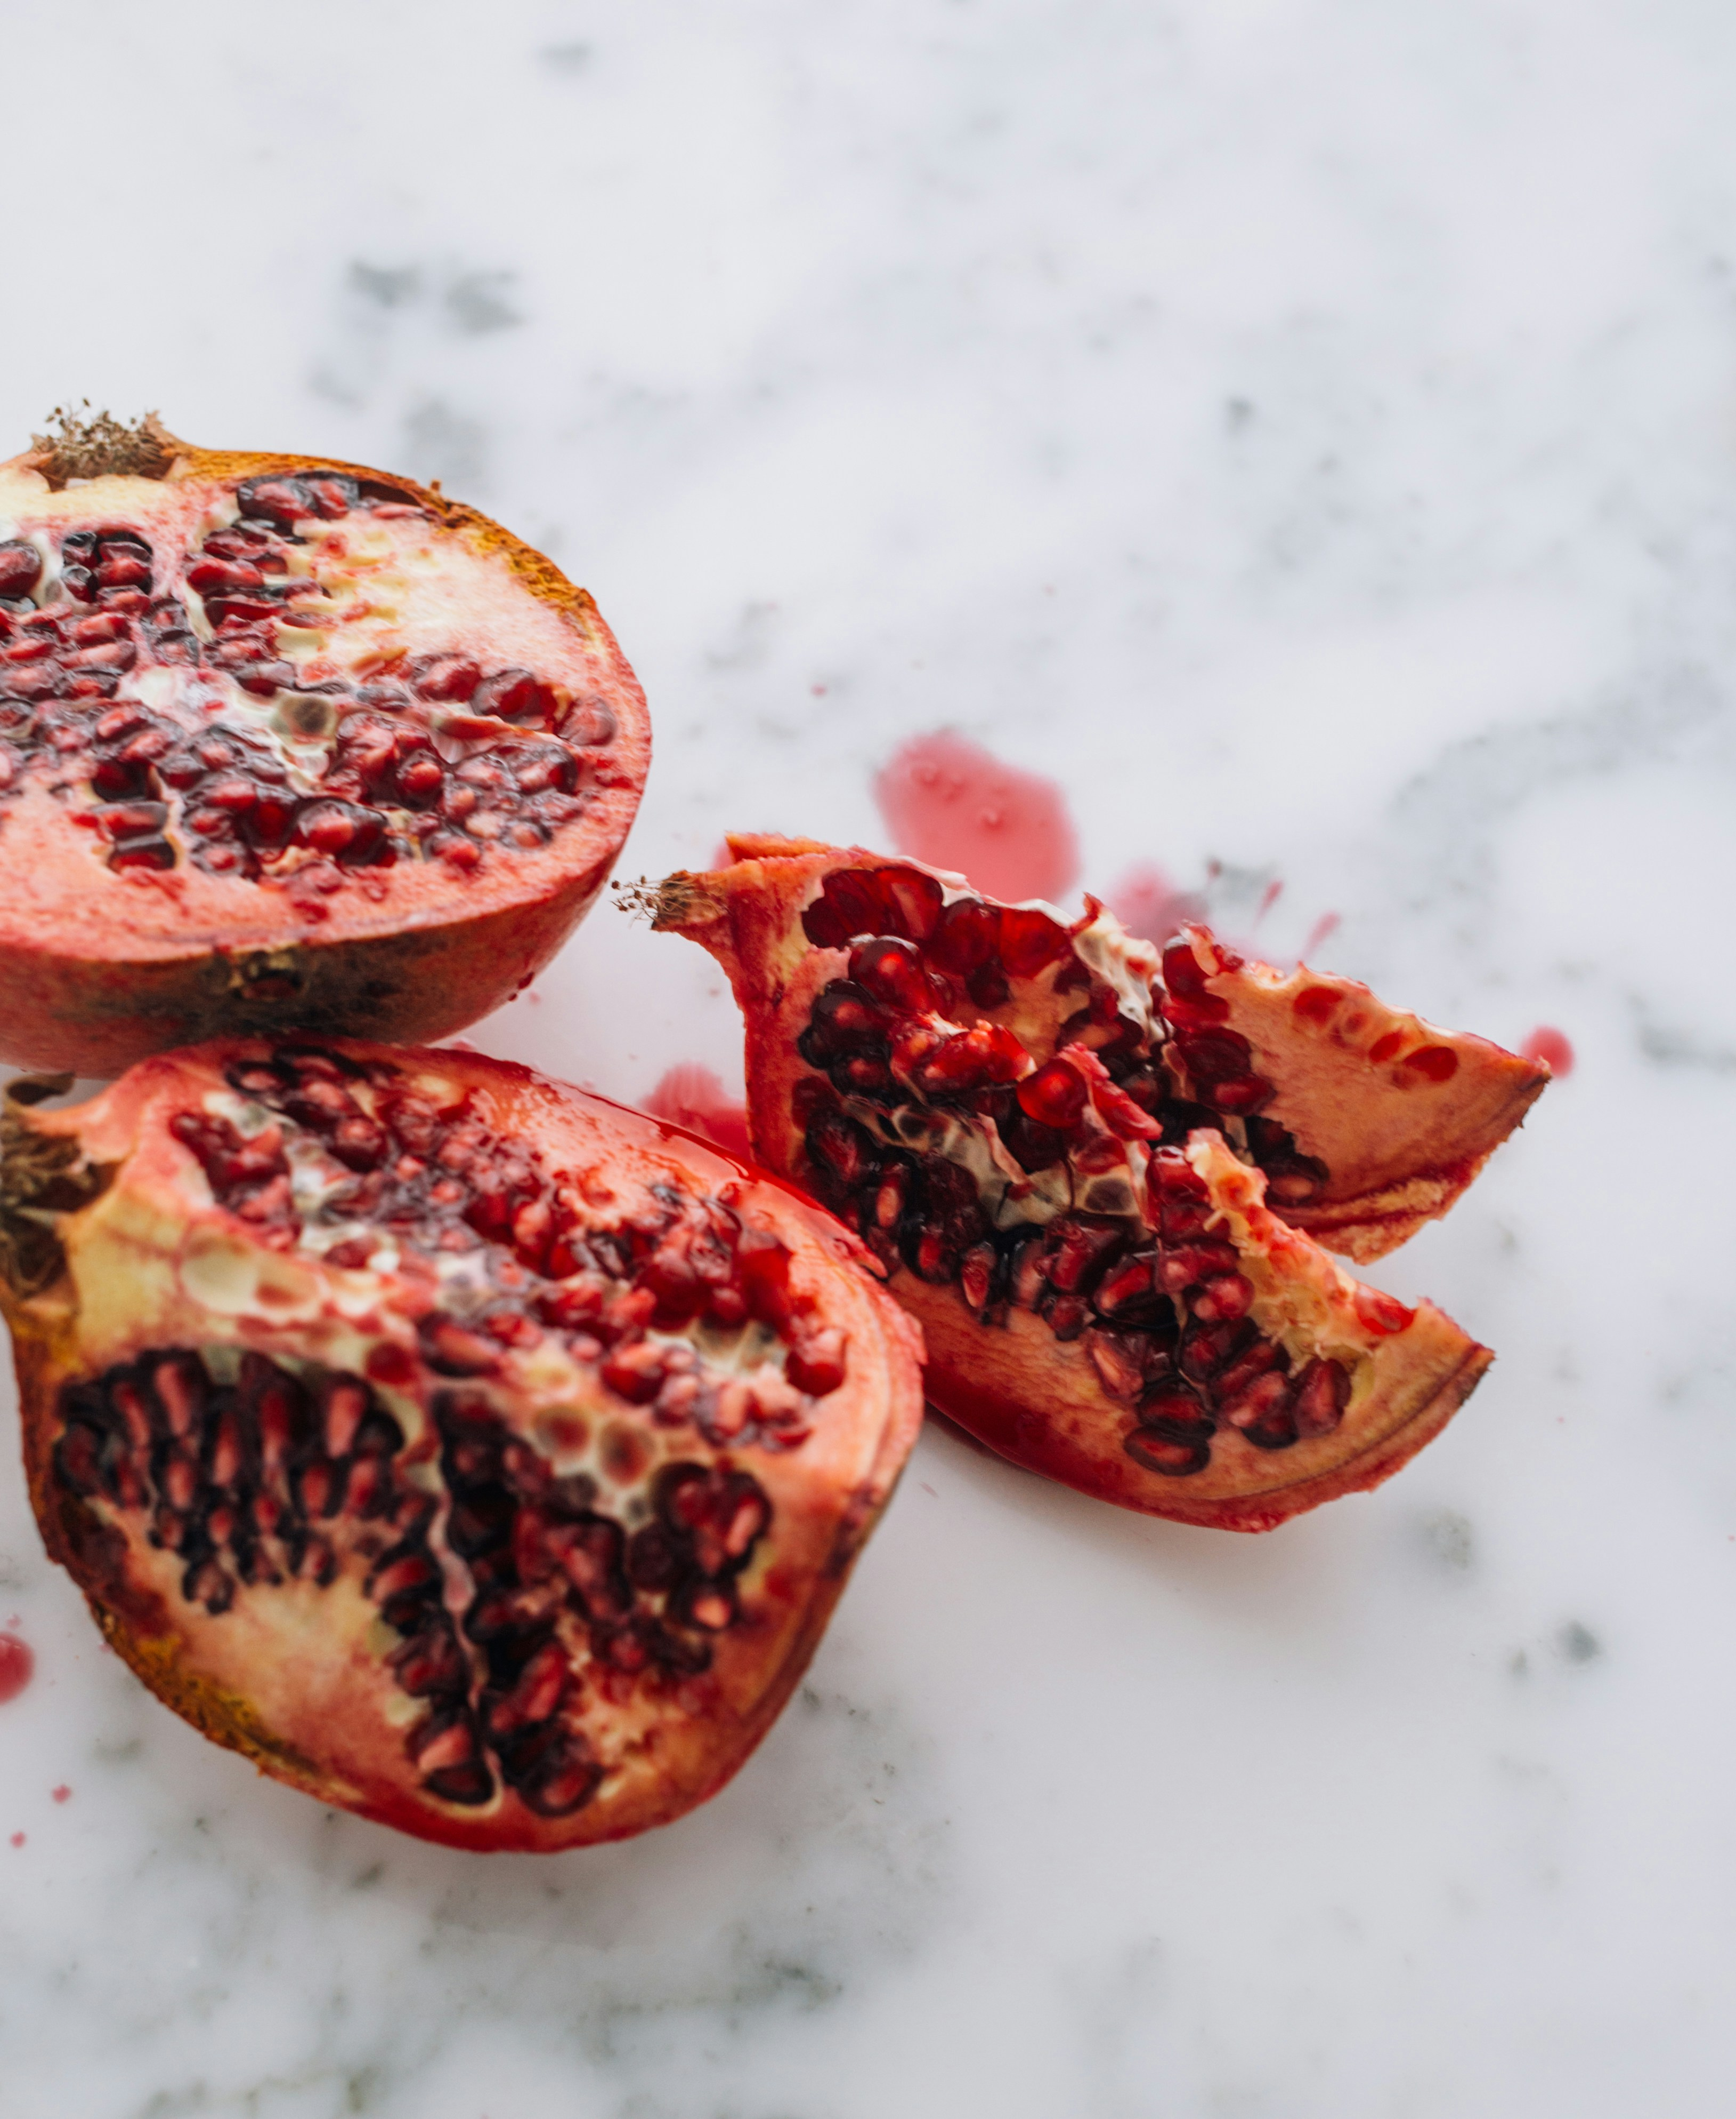

UNDERSTANDING BALANCE
A balanced meal includes all three macronutrients: carbohydrates for energy, proteins for muscle repair and growth, and fats for satiety and hormone production. Additionally, a variety of micronutrients from fruits, vegetables, nuts, seeds, and whole grains support overall health.

Slide 6
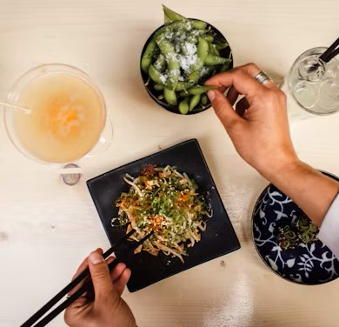
PLANNING AND PREPARING BALANCED MEALS
0004 CULINARY ARTS

Slide 7

0004 CULINARY ARTS
Diversity is Key: Incorporate a wide range of fruits, vegetables, whole grains, lean proteins, and healthy fats into your meals. This variety ensures you get a broad spectrum of vitamins, minerals, and other nutrients.
Portion Control: Use visual cues for portion sizes—half your plate should be vegetables and fruits, one-quarter should be protein, and one-quarter should be whole grains or starchy vegetables.
Plan Ahead: Take time each week to plan meals. This can help you make intentional choices about your diet, reduce stress around mealtime, and avoid the temptation of less healthy options.
MEAL PLANNING TIPS

Slide 8
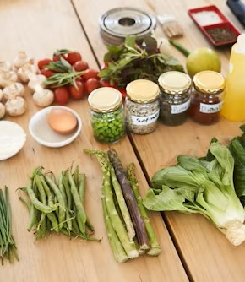
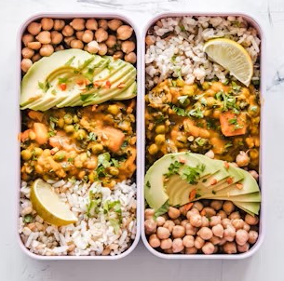
PREPARATION STRATEGIES
Cook in Bulk: Prepare staple ingredients in bulk, such as brown rice, quinoa, or roasted vegetables, to save time during the week.
Healthy Cooking Methods: Opt for cooking methods that preserve nutrients and flavor, such as steaming, baking, grilling, and stir-frying.
Snack Wisely: Prepare healthy snacks in advance, like cut-up vegetables, fruit, nuts, or yogurt, to prevent reaching for processed options.
0004 CULINARY ARTS
GET AHEAD OF YOUR BUSY SCHEDULE AND COOK!

Slide 9
ADJUSTING RECIPES FOR ENERGY, WEIGHT MANAGEMENT, AND SPECIFIC HEALTH GOALS
0004 CULINARY ARTS

Slide 10

FOR INCREASED
ENERGY
0004 CULINARY ARTS
Focus on complex carbohydrates like whole grains and legumes, which provide a steady release of energy.
Include a moderate amount of protein and healthy fats to stabilize blood sugar levels.

Slide 11

FOR WEIGHT MANAGEMENT
0004 CULINARY ARTS
Increase fiber-rich foods (vegetables, fruits, whole grains) to help feel fuller longer.
Opt for lean protein sources and monitor portion sizes, especially of high-calorie foods.
Adjust cooking methods to reduce added fats and sugars without sacrificing flavor (e.g., baking instead of frying, using herbs and spices instead of heavy sauces).

Slide 12

Heart Health: Incorporate foods high in omega-3 fatty acids (such as salmon and flaxseeds), fiber, and antioxidants. Limit saturated and trans fats.
Diabetes Management: Focus on low-glycemic index foods to help manage blood sugar levels. Balance carbohydrate intake with protein and healthy fats.
Digestive Health: Emphasize foods high in fiber and probiotics. Consider individual tolerances, especially for those with conditions like IBS.
FOR SPECIFIC HEART HEALTH GOALS

Slide 13
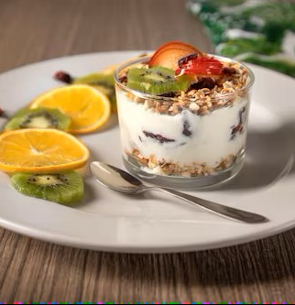
RECIPE ADJUSTMENTS
Substitute Healthier Ingredients: Replace white pasta with whole grain or legume-based options, use Greek yogurt instead of sour cream, or swap out white sugar for natural sweeteners like honey or maple syrup in moderation.
Experiment with Flavors: Use herbs, spices, and citrus to add flavor without extra calories or sodium.
Portion Adjustments: Be mindful of serving sizes, especially when cooking for specific health outcomes like weight loss or managing blood sugar levels.
0004 CULINARY ARTS

Slide 14

FINISHING UP
Creating nutrient-dense meals is a dynamic process that encourages creativity and experimentation in the kitchen. By focusing on balanced nutrition and adjusting recipes to meet individual needs, you can support your energy levels, manage your weight effectively, and achieve your health goals in a delicious, satisfying way.

Slide 15

CULINARY ARTS
0004 CULINARY ARTS

