Slide 1
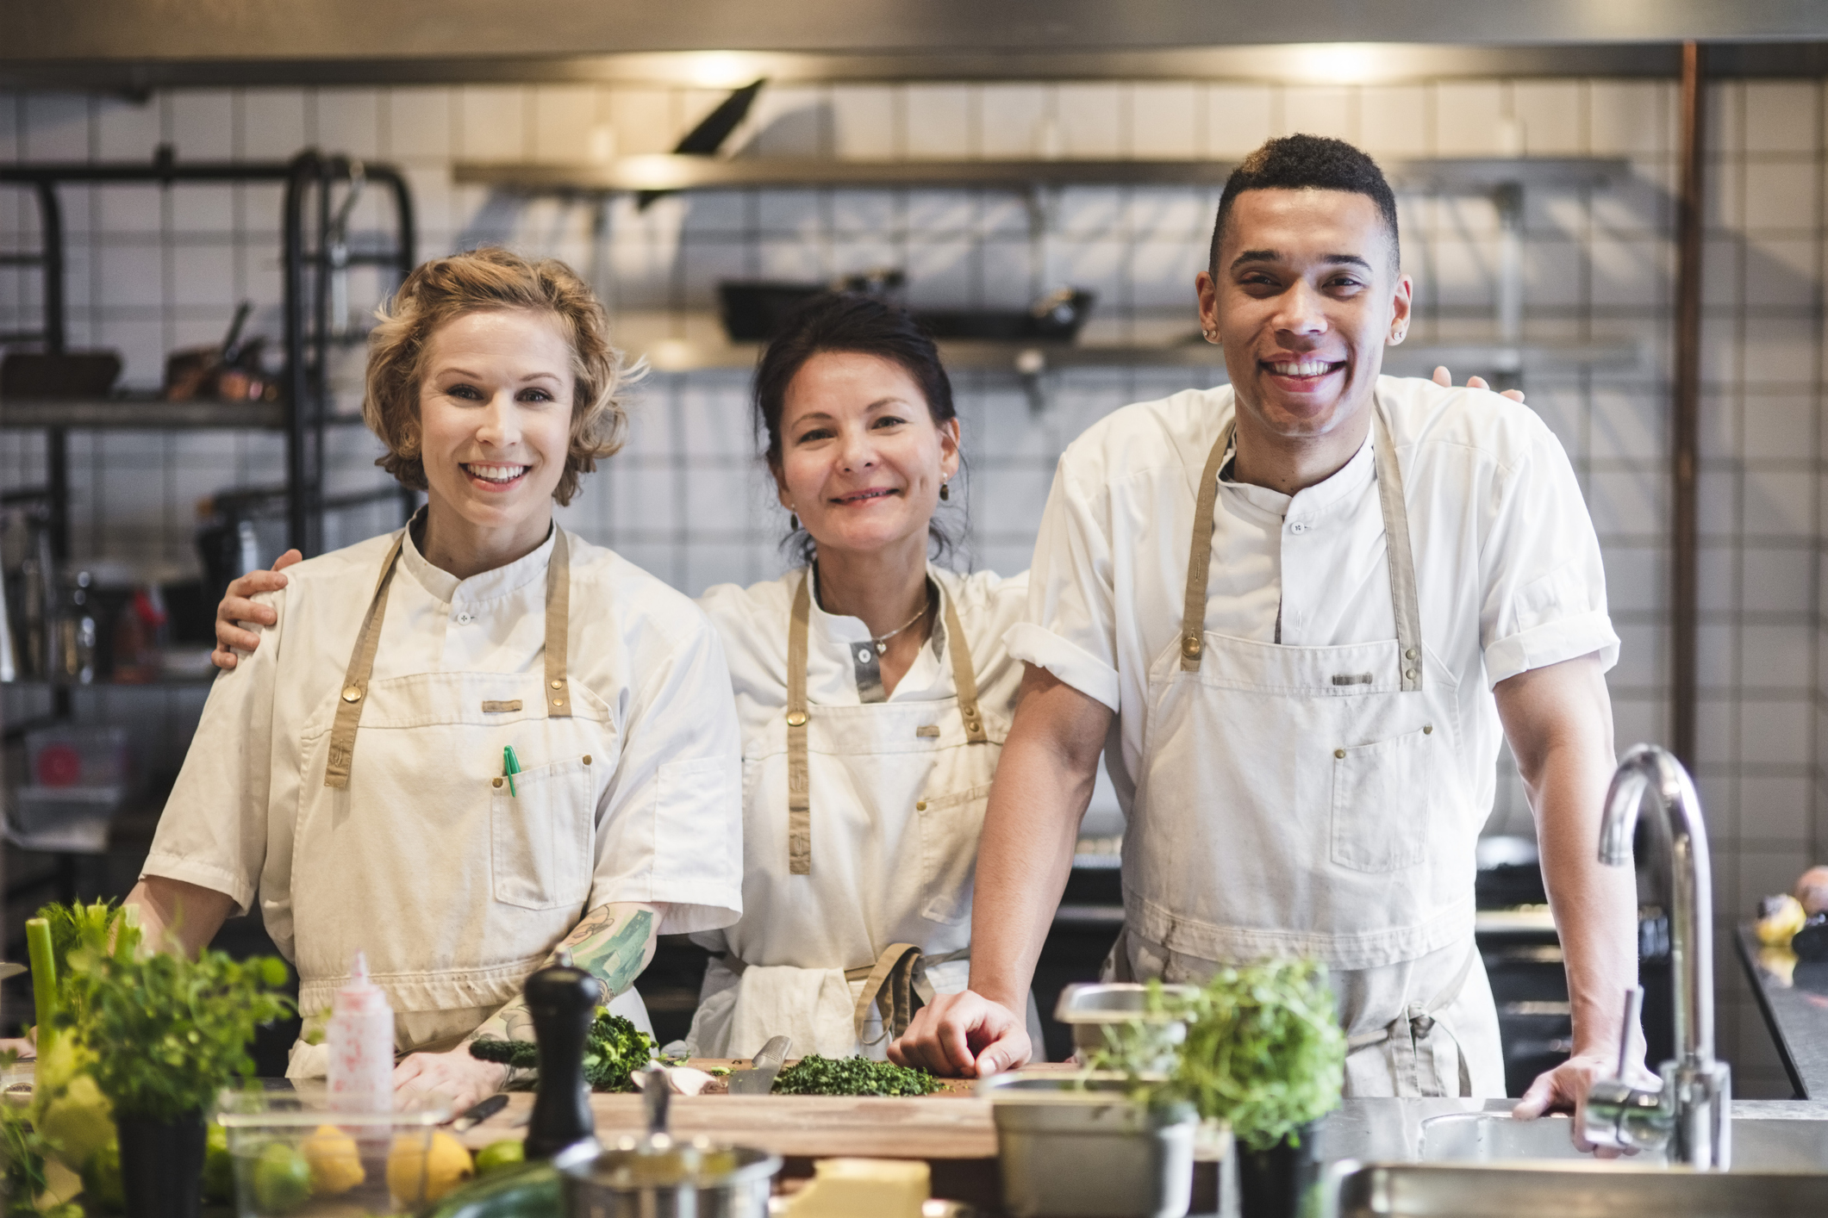


Workbook 0008
Love in Every Bite: Nourishing Wellness

Slide 2
0008 Culinary Arts
How do you prioritize maintaining sharp, high-quality knives as essential tools for preparing nutrient-rich meals that support your health goals?
How do you envision applying principles and techniques of presentation to ensure that your dishes not only taste exquisite but also look impeccable, leaving a lasting impression on your guests? Write down eye-catching designs you plan to use for your next dish.

Slide 3
0008 Culinary Arts
How do you see yourself using tools like squeeze bottles, offset spatulas, and brushes to artistically create textures and designs on your plate, infusing each dish with creativity and personality?
Precision seems to be a crucial element of sous-vide cooking, influencing everything from cooking times to flavor development. Can you elaborate on the role of precision in sous-vide cooking and how it allows chefs and home cooks alike to achieve culinary excellence?

Slide 4
0008 Culinary Arts
How do you envision incorporating fermentation into your cooking repertoire, and what are your goals for exploring this ancient culinary technique further?
Troubleshooting fermentation issues, such as identifying signs of proper fermentation versus contamination, is essential for achieving successful outcomes. Could you provide some guidance on recognizing common fermentation problems and how to address them effectively?

Slide 5
0008 Culinary Arts
Explain how techniques like spherification, foams, and gelification are used to create innovative dishes, challenging traditional cooking norms.
Incorporating modern cooking techniques often requires specialized equipment and a willingness to embrace technology in the kitchen. What are some examples of equipment, such as immersion circulators and siphons, that enable chefs to experiment with innovative culinary expressions?

Slide 6
0008 Culinary Arts
The contrast between smooth and crunchy textures can really elevate a dish.
Have you ever experimented with incorporating both elements into one of your own recipes? If so, how did it change the dynamics of the dish? Can you recall a time when you experimented with marination or brining to infuse deep flavors into a dish? How did it impact the final taste? Have you ever attempted to build layers of flavor in one of your culinary creations?

Slide 7
0008 Culinary Arts
Plan your next meaty meal
Butchery skills seem like they could really enhance a chef's ability to control the quality and presentation of their dishes. Have you ever tried your hand at butchering meats or poultry? If not, is it something you'd be interested in learning more about? Breaking down a whole chicken seems like it could be quite the task. Can you imagine yourself mastering this skill? How do you think it could benefit your cooking?

Slide 8
0008 Culinary Arts
Developing a signature dessert sounds like a fun challenge.
If you were to create your own signature dessert, what flavor combinations would you fuse together? How would you ensure it stands out both visually and in taste? Texture seems to be a key element in dessert creation. Have you ever played around with different textures in your desserts, combining creamy and crunchy elements? If so, what was the outcome?

Slide 9
0008 Culinary Arts
Journal

Slide 10
0008 Culinary Arts
Journal

Slide 11
0008 Culinary Arts
Journal

Slide 12
0008 Culinary Arts
Journal

Slide 13
0008 Culinary Arts
Journal

Slide 14
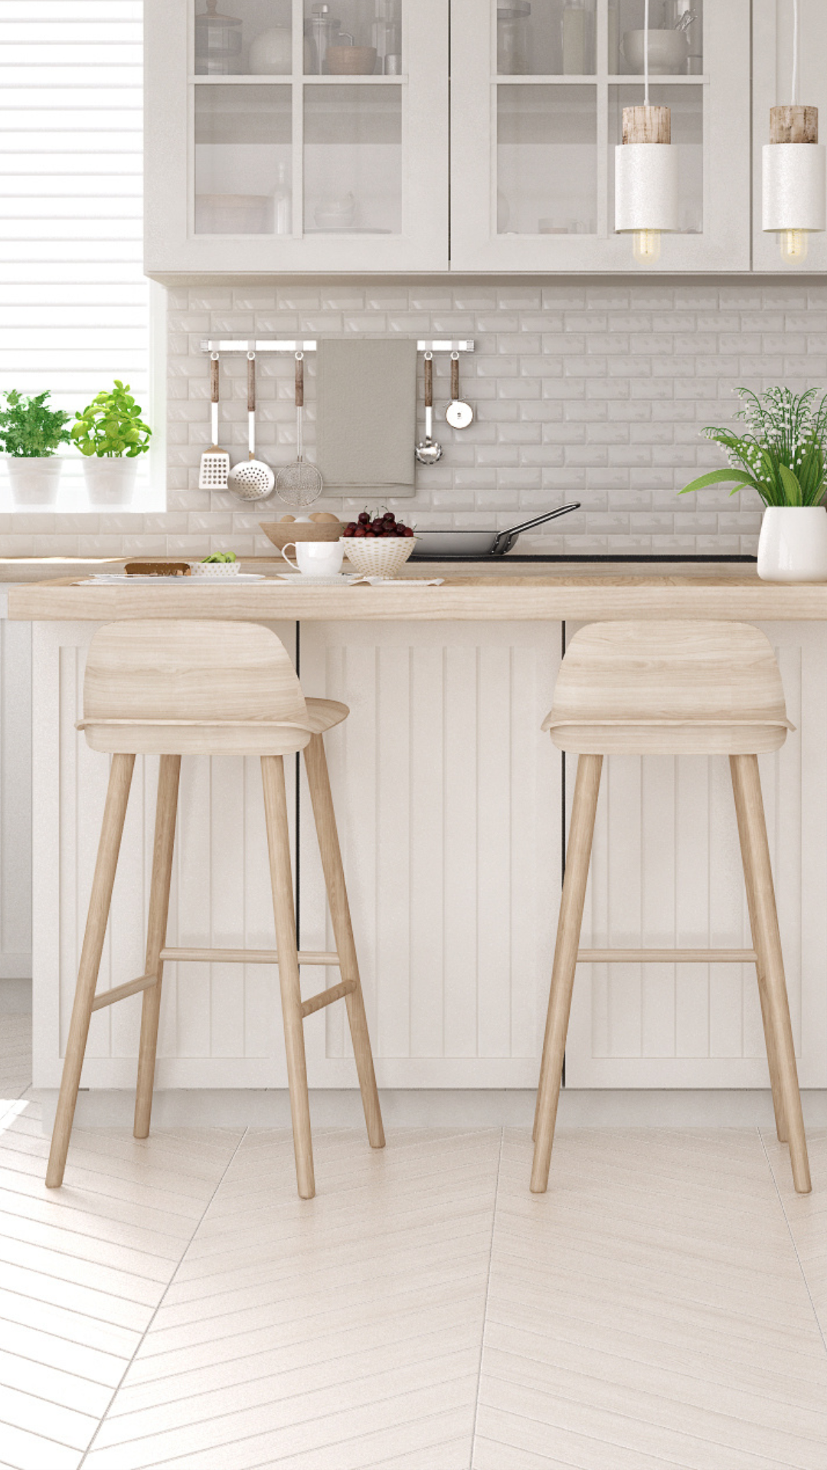
Workbook 0008
Love in Every Bite: Nourishing Wellness

