Slide 1
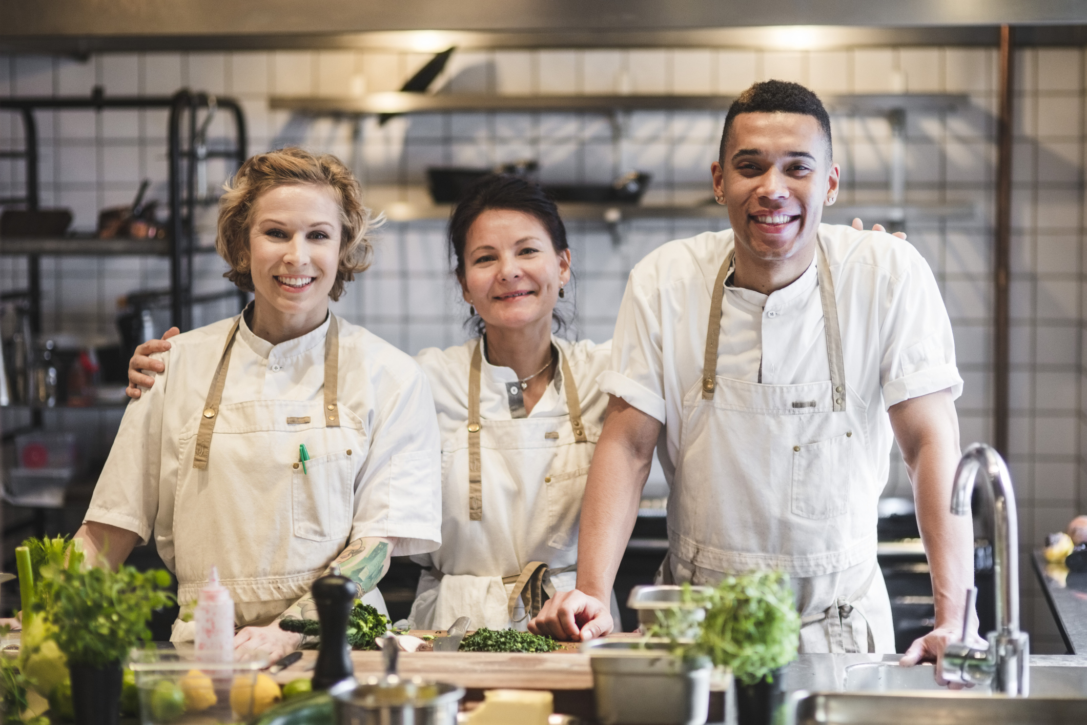


Workbook 0009
Love in Every Bite: Nourishing Wellness

Slide 2
0009 Culinary Arts
Gather ingredients needed to make steamed beef (or veggie) dumplings. Come back after making them and describe your experience doing so. Was it more difficult than you had expected or easier?
What is your favorite fermented dish? Although fermentation is a longer process than just heating up leftovers, it is always worth the wait! Pick three fermented dishes you plan to cook and plan out a schedule for making them. How will you display your excitement for this dish in the presentation?

Slide 3
0009 Culinary Arts
Grilling results in a lowered fat content. Why would this be beneficial to you? Revisit a time that you ate meat that was just too fatty. Would you be willing to try this dish again if it were grilled?
Cultural respect is vital when exploring Middle Eastern grilling techniques. How do you intend to honor the origins and traditions behind these dishes while infusing them with your own unique creativity and flair?

Slide 4
0009 Culinary Arts
What slow-cooked dish from a specific culinary tradition would you like to try recreating, and how do you envision adding your own twist to it?
Incorporating raw foods into your diet can offer a variety of health benefits. What raw food dish or snack would you like to introduce into your routine, and what steps will you take to ensure it's both nutritious and delicious?

Slide 5
0009 Culinary Arts
In exploring poaching, how do you envision incorporating poached proteins or fruits into modern cuisine with a balance of simplicity and sophistication?
Which delicate proteins or fruits do you anticipate poaching, and what strategies will you employ to enhance their natural flavors without additional fats? Poaching is done worldwide; do you find any inspiration in the amount of people who enjoy this dish?

Slide 6
0009 Culinary Arts
The Symphony of Whole Grains and Legumes
As you think about incorporating whole grains and legumes into your meals, what excites you the most about experimenting with these ingredients? Are there any specific dishes or cuisines you're eager to explore, or do you have any concerns or challenges you anticipate encountering along the way? Use your creativity to plan out new and fun dishes.

Slide 7
0009 Culinary Arts
Delving into the advanced techniques outlined for maximizing the health benefits of spices, such as toasting, blending, and infusing, take a moment to envision your culinary experiments.
Which specific method ignites your curiosity the most, and why? As you envision incorporating these techniques into your culinary endeavors, can you visualize particular dishes or cuisines where these spice-enhanced methods could truly shine, elevating both flavor profiles and nutritional content?

Slide 8
0009 Culinary Arts
Reflecting on the diverse array of superfoods celebrated across cultures, consider your own journey of discovering and incorporating these nutrient-packed ingredients into your diet.
What initially sparked your interest in exploring superfoods, and how has this journey evolved over time? Furthermore, as you dive deeper into the world of culinary nutrition, which superfood has grabbed your attention the most, and why? Can you envision a certain dish or recipe where this superfood takes center stage?

Slide 9
0009 Culinary Arts
Journal

Slide 10
0009 Culinary Arts
Journal

Slide 11
0009 Culinary Arts
Journal

Slide 12
0009 Culinary Arts
Journal

Slide 13
0009 Culinary Arts
Journal

Slide 14

Workbook 0009
Love in Every Bite: Nourishing Wellness

