Slide 1
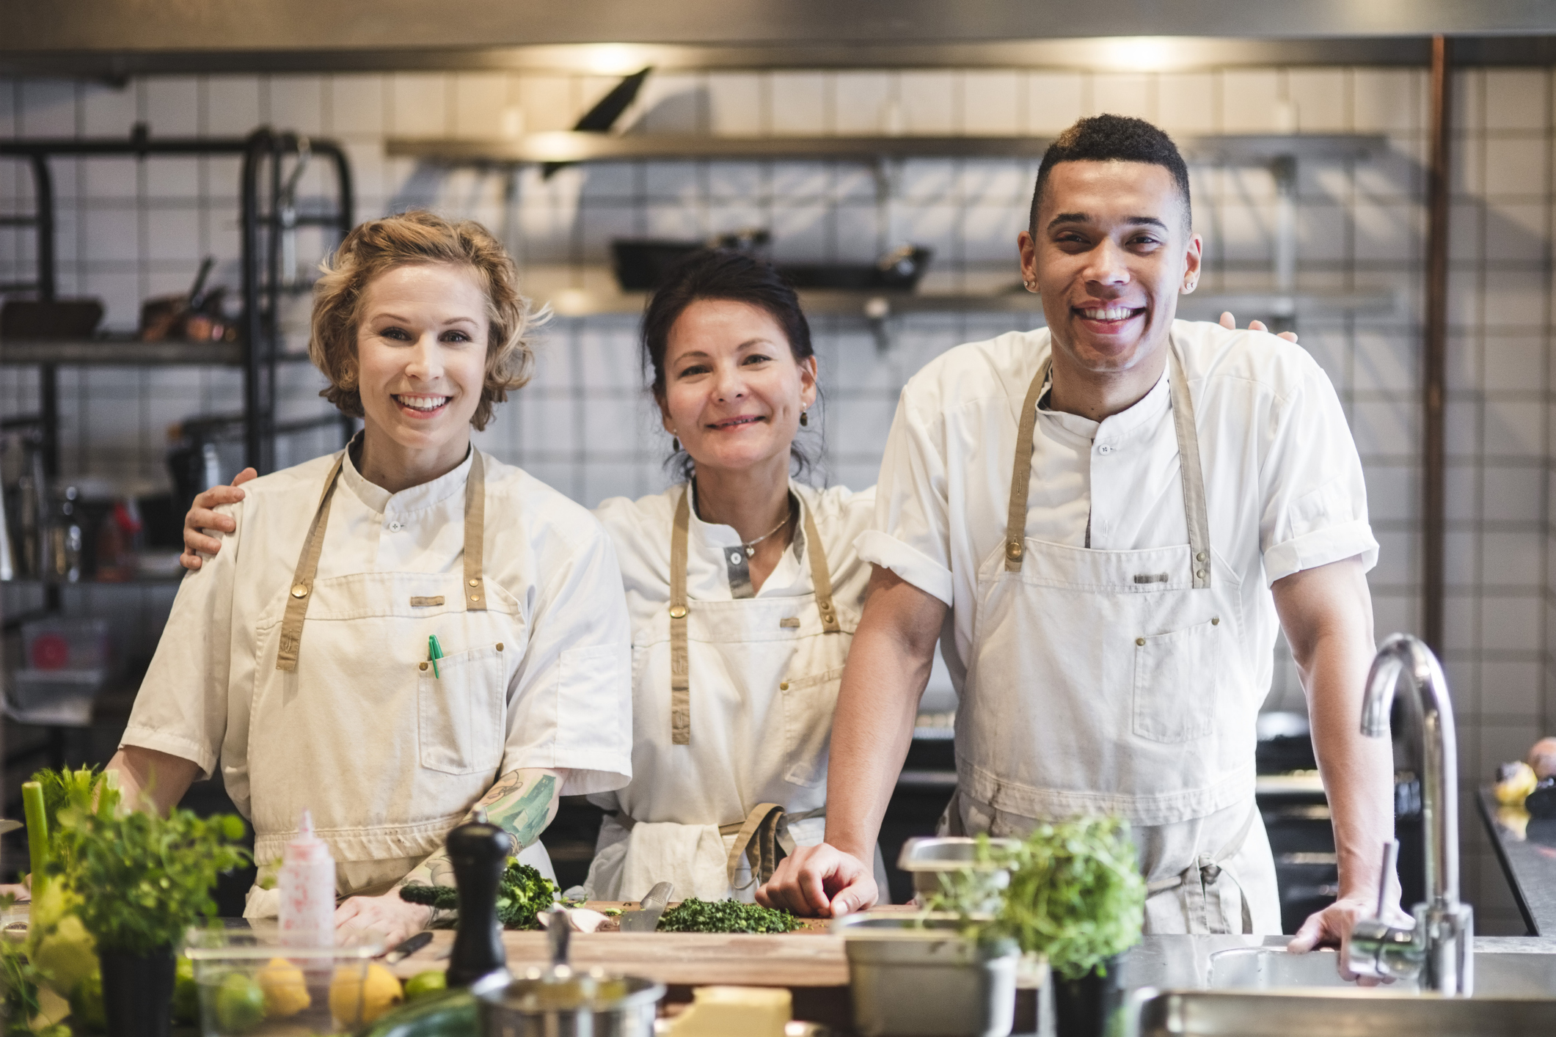


Presentation and Review 0012
Love in Every Bite: Nourishing Wellness

Slide 2
0012 Culinary Arts
Can you describe the atmosphere you aim to create during your presentation event, and how do you plan to enhance the ambiance to complement your culinary offerings?
What role do you see feedback playing in your ongoing culinary development, and how do you intend to leverage it to refine your skills and menu offerings in the future?

Slide 3
0012 Culinary Arts
What challenges or opportunities do you anticipate encountering during your culinary presentation, and how do you plan to adapt and overcome them to ensure a successful event?
Reflecting on the meticulous planning required to sequence your dishes and manage the flow of the presentation, could you share insights into how you intend to balance timing while maintaining an engaging experience for your guests, drawing from your own sense of pacing and storytelling?

Slide 4
0012 Culinary Arts
As you prepare to reflect on your presentation experience, could you share some personal thoughts on how you anticipate processing feedback and notes?
Considering the value of peer reviews in fostering mutual growth and learning, could you share any personal anecdotes or insights on how you intend to approach offering constructive feedback to your peers while also embracing their perspectives and insights?

Slide 5
0012 Culinary Arts
Write some personal insights into your approach to seeking feedback and continuous improvement in your culinary journey, perhaps sharing any specific goals or aspirations you have for future growth and development in your craft?
As you embark on the journey of preparing your culinary presentation, could you delve deeper into how you plan to infuse your chosen theme into every aspect of the event, ensuring that it authentically reflects your culinary identity and personal ethos?

Slide 6
0012 Culinary Arts
Self-assessment Reflection
Reflecting on the presentation process, you might explore what aspects of your dishes resonated well with your audience and what areas could be improved upon. Additionally, delving into your own feelings and observations during the preparation and presentation stages can offer valuable insights into your culinary journey.

Slide 7
0012 Culinary Arts
Using Feedback
As you gather feedback from peers, instructors, and guests, you might identify common themes or patterns that shed light on areas for improvement. However, it's equally important to align this feedback with your own culinary vision and intentions, ensuring that any adjustments made resonate with your creative expression. By synthesizing external critiques with your internal perspective, you can navigate the iterative process of culinary refinement with clarity and purpose.

Slide 8
0012 Culinary Arts
Considering the progress made and lessons learned during this module, you might envision specific milestones or achievements you aim to reach in the coming months or years. Whether it involves mastering a particular cuisine, exploring innovative cooking techniques, or contributing to culinary sustainability efforts, articulating your long-term vision can provide direction and motivation for continued growth. As you embark on this journey of culinary exploration and innovation, how do you envision your role within the broader culinary landscape, and what steps will you take to realize your aspirations?

Slide 9
0012 Culinary Arts
Journal

Slide 10
0012 Culinary Arts
Journal

Slide 11
0012 Culinary Arts
Journal

Slide 12
0012 Culinary Arts
Journal

Slide 13
0012 Culinary Arts
Journal

Slide 14

Workbook 0012
Love in Every Bite: Nourishing Wellness

