Slide 1
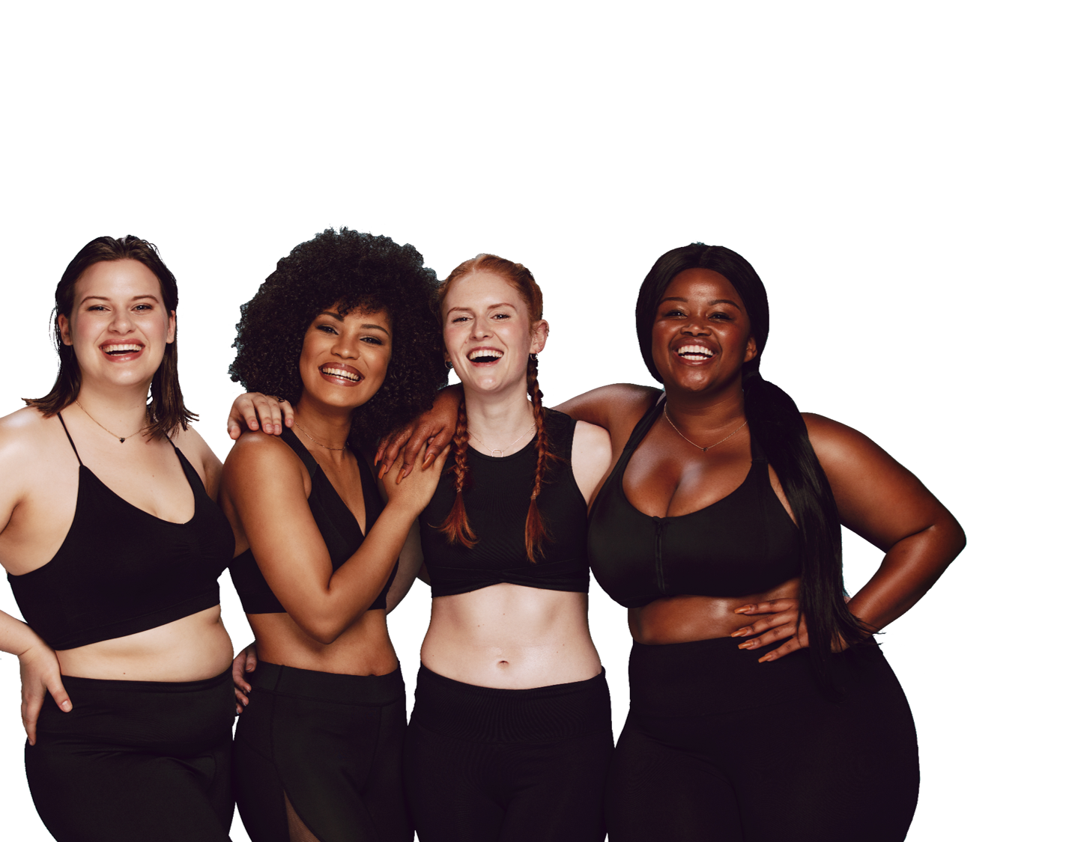
RECIPE BOOK
Canaan Vibes LLC
Address
City, State Zip
Phone #
Website
email

Slide 2
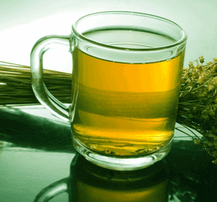
alkaline broth
fruits | veggies | grains | protein | dairy
grilled tofu

Slide 3
alkaline broth
Ingredients
1 head celery chopped in large pieces 1 bunch parsley 6 carrots chopped in quarters 1 onion quartered 1 clove garlic cut in half 2 cups spinach 6 potatoes quartered
Directions
Place all in a non-aluminum cooking pot, cover with water and cook for 1 hour. Strain and drink warm.
Leftover can be refrigerated and enjoyed cold or warm.
Notes
This is an easy and delicious soup. It cleanses and alkalizes. You can eat it in a bowl like a soup or drink it from a cup like tea.
fruits | veggies | grains | protein | dairy
grilled tofu

Slide 4
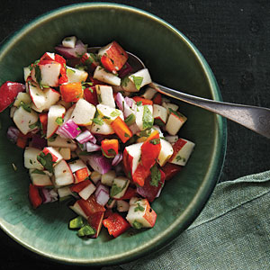
autumn apple salsa
fruits | veggies | grains | protein | dairy

Slide 5
autumn apple salsa
Ingredients
2 large apples 1/2 cup chopped cilantro 1/4 cup finely diced red onion 1 to 4 hot peppers, finely diced | 1 tbsp extra virgin olive oil 1 tbsp apple cider vinegar OR 2 tbsp of fresh lime juice Sea salt to taste
Directions
Place all ingredients into a bowl and mix together. Cover and place in the refrigerator for up to an hour before serving to let the flavors meld. Enjoy!
Notes
This is one of my favorite autumn recipes to make, when apple season is in full swing! The best apples to use for this salsa are crisp, firm apples such as Honeycrisp. Soft, sweet apples are better for sauce and baking. Use whatever hot peppers you have on hand - serrano, jalapeno, and cherry bomb are a few of my favorites! This salsa is a great addition to grilled fish, fish tacos, or even over a bowl of cooked quinoa!
fruits | veggies | grains | protein | dairy
grilled tofu

Slide 6
baked sweet potato & kale quinoa
fruits | veggies | grains | protein | dairy

Slide 7
baked sweet potato & kale quinoa
Ingredients
2 med sweet potatoes 1 cup uncooked quinoa 2 cups filtered water 1 bay leaf | 1 tbsp olive oil 3 cup chopped kale, ribs removed 2 garlic cloves, minced 1 tsp paprika Salt and pepper to taste
Directions
Preheat oven to 400 degrees. Pierce each potato several times with a fork and place on a baking sheet. Bake for about 45 minutes until tender. While sweet potato is in the oven, boil 2 cups of water and a bay leaf. Add dry quinoa and stir. Cover and simmer on low for about 15 minutes until water is absorbed. In a separate large pan, heat the chopped kale, oil, and garlic on low heat for about 10 minutes until tender. Add spices to taste. Once potatoes are cooked, set aside to cool, then chop into small cubes.
Toss the sweet potatoes and quinoa into the kale mixture and serve warm.
fruits | veggies | grains | protein | dairy
grilled tofu

Slide 8
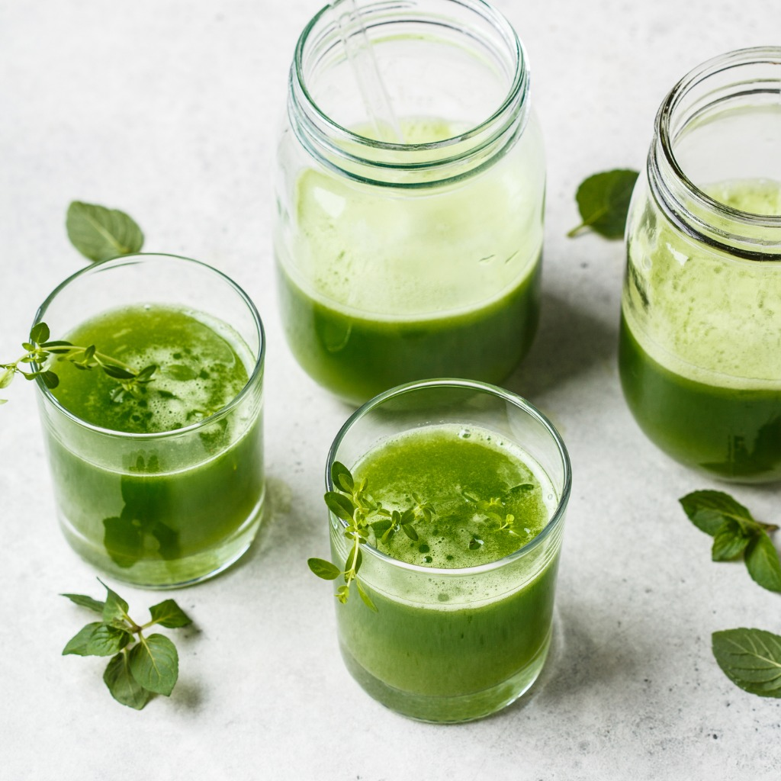
basic green juice
fruits | veggies | grains | protein | dairy

Slide 9
basic green juice
Ingredients
2 cups spinach 4 stalks celery 1 cucumber 1 bunch watercress 1 orange (peeled)
Directions
Juice and drink
fruits | veggies | grains | protein | dairy
grilled tofu

Slide 10
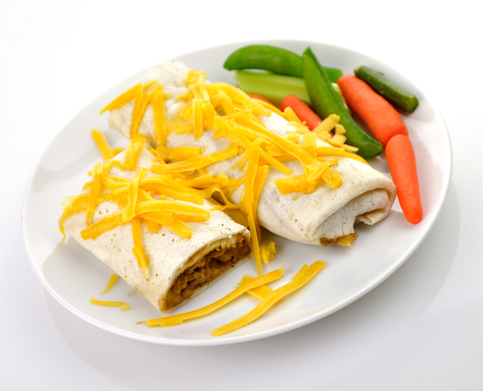
bean burritos
fruits | veggies | grains | protein | dairy

Slide 11
bean burritos
Ingredients
1 can refried beans 1 can refried black beans 1 1/2 cups corn 1 cup peas 1 onion | 2 garlic cloves 1 cup salsa 1 bag shredded cheddar or 1 ½ cups Mexican-blend of cheese add salt & pepper to taste tortillas
Directions
Sauté garlic & onions in a little olive oil. Add corn & peas heat until warm. In a bowl mix beans, salsa, & cheese. Add vegetable mix to bowl and mix well. Add salt and pepper to taste. Scoop mixture into tortillas and roll into a burrito. Place seam of burrito face down in 8 1/2 x 11 baking pan.
Bake at 350 for 20-30 min. If you like, serve with salsa, sour cream or guacamole.
Notes
These are great to freeze and pull out as needed. From freezer can be microwaved for a quick meal.
fruits | veggies | grains | protein | dairy
grilled tofu

Slide 12
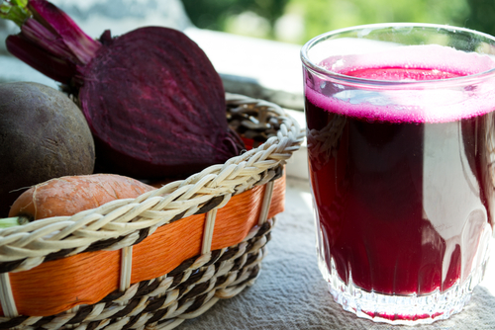
beeter than coffee
fruits | veggies | grains | protein | dairy

Slide 13
beeter than coffee
Ingredients
1 medium-large beet 4-6 medium carrots 1 medium-large red pepper 1 medium-large cucumber 1/2 pint of strawberries
Directions
Put each fruit or vegetable in the juicer - one at a time. Stir or shake to mix the juices together. Pour over ice, if desired. Enjoy! Alternative to juicing: Blend together. Strain if chunky consistency bothers you. Alternative to blending: Slice everything julienne style and create a salad with a little lime or lemon juice and some coconut oil.
fruits | veggies | grains | protein | dairy
grilled tofu

Slide 14
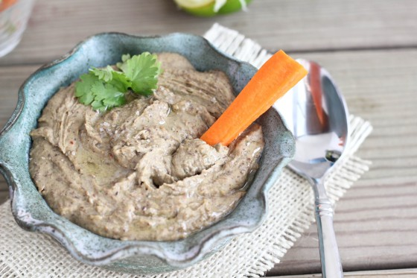
black bean hummus
Health Coach Group
fruits | veggies | grains | protein | dairy
grilled tofu

Slide 15
black bean hummus
Ingredients
1 can of organic black beans 1 tsp of olive oil 1-2 cloves of garlic touch of fresh lemon juice | water to your liking of texture sea salt to taste pepper to taste
Directions
Drain and rinse organic black beans. Put rinsed beans into a food processor add olive oil, garlic, lemon juice, a little water and blend. Add more water to desired consistency. Add sea salt and pepper toward end of mixing.
If this recipe is too bland for you or you want to spice it up you can add, onion, basil, spices, red pepper, or sundried tomato. This goes great with rice crackers or spread on rice cakes.
.
fruits | veggies | grains | protein | dairy
grilled tofu

Slide 16
blend of threes salad dressing
fruits | veggies | grains | protein | dairy

Slide 17
blend of threes salad dressing
Ingredients
1/3 c oil 1/3 c vinegar 1/3 c honey 1/3 t salt | 1/3 t dry mustard 1/3 t paprika 1 clove garlic mashed to paste
Directions
Put all ingredients in a jar. Shake until mixed. Enjoy!
Store leftovers in refrigerator. It tastes even better the next day. This is great on salad, poured over steamed vegetables and I've used it as a marinade.
Notes
You can really vary the taste of this dressing by the type of oil, vinegar and sweetener you chose. Experiment and come up, with your favorites.
This is the dressing that whenever anyone tastes it, no matter what it's on, they want the recipe.
fruits | veggies | grains | protein | dairy
grilled tofu

Slide 18
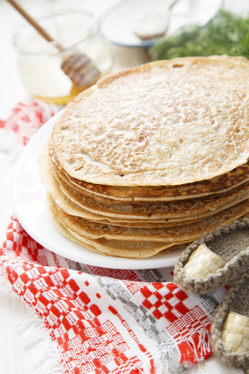
buckwheat pancakes
fruits | veggies | grains | protein | dairy

Slide 19
buckwheat pancakes
Ingredients
3/4 cup organic buckwheat flour 1 1/2 tbsp organic maple sugar 1/2 tsp sea salt 1/2 tsp baking soda 2 tbsp organic butter | 1 egg 1 cup organic goat kefir 1 tsp organic vanilla extract organic coconut oil organic maple syrup
Directions
In one bowl, mix all the dry ingredients. In a separate bowl, mix all the wet ingredients (excluding coconut oil and maple syrup). Stir wet ingredients into dry until completely blended. Heat coconut oil in large skillet over low to medium heat. Use 1/4 cup measuring cup to pour batter onto skillet. When pancakes bubble and the bubbles burst, turn them. Then remove after 1 minute.
Notes
Time saving tip ~ Use all the batter. Cook up all the pancakes and save the leftovers. Not only can they be put in the toaster for quick breakfast later in the week, they make an excellent bread like side to any meal or salad later in the day.
fruits | veggies | grains | protein | dairy
grilled tofu

Slide 20
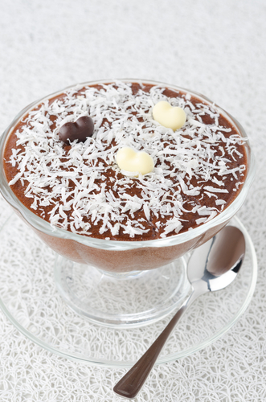
carob coconut delight
fruits | veggies | grains | protein | dairy

Slide 21
carob coconut delight
Ingredients
1 cup of carob powder 3/4 cup of coconut oil 1/2 cup of shredded coconut 1/4 cup of fresh or dried berries like cranberry, goji berry or golden berry | a sprinkle of cinnamon and vanilla powder soy lecithin is optional (will make it taste more like chocolate)
Directions
Melt coconut oil and mix in carob powder and keep stirring until incorporated. Throw in the other ingredients and mix in. Pour mixture in glass container and cool in the refrigerator.
fruits | veggies | grains | protein | dairy
grilled tofu

Slide 22
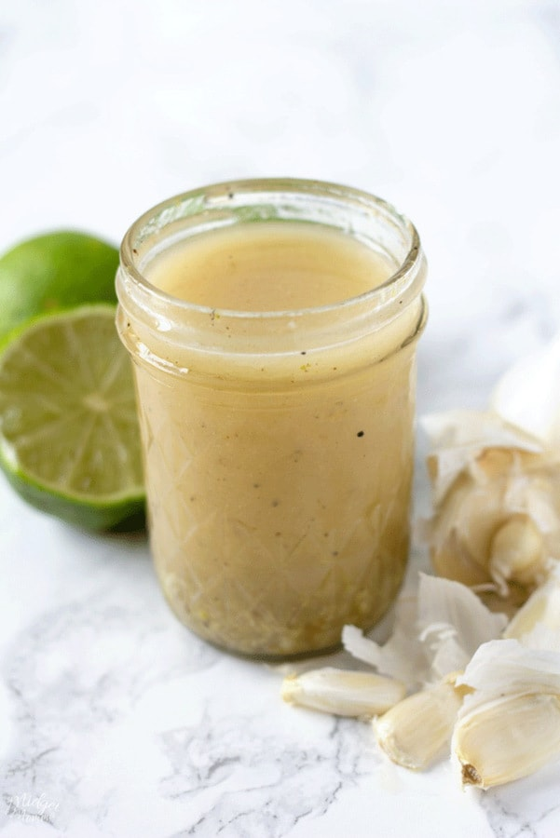
cathy’s favorite garlic dressing
Health Coach Group
fruits | veggies | grains | protein | dairy
grilled tofu

Slide 23
cathy’s favorite garlic dressing
Ingredients
2 tsp dijon mustard 4 tbsp raw wine vinegar (or balsamic vinegar) | 1 cup extra virgin cold pressed olive oil 3 cloves garlic, peeled and mashed
Directions
Combine all ingredients and shake (refrigerate)
Notes
You may add herbs like parsley, tarragon, thyme, basil or oregano and pepper if you like.
fruits | veggies | grains | protein | dairy
grilled tofu

Slide 24
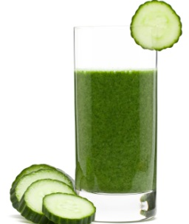
cathy’s favorite green juice
fruits | veggies | grains | protein | dairy

Slide 25
cathy’s favorite green juice
Ingredients
1 bunch kale 2 cucumbers 1 head celery 1 cup snap peas 4 fuji apples 1-inch ginger 1 orange peeled
Directions
Juice and drink!
fruits | veggies | grains | protein | dairy
grilled tofu

Slide 26
cedar plank grilled salmon filets
fruits | veggies | grains | protein | dairy

Slide 27
cedar plank grilled salmon filets
Ingredients
wild caught salmon filets cedar plank(s) 2 tbsp tamari 1 tbsp dijon mustard | 1/2 - 1 tsp fresh ginger juice (squeeze grated ginger root) 2 - 3 scallions
Directions
Follow soaking directions for cedar plank. Mix tamari, dijon, ginger juice and scallions in a bowl. Top salmon filets with mixture. Follow grilling directions for cedar plank. Place salmon filets on planks. Cook time depends on size of filets. Salmon is a fish that is delicious when removed from heat while still pink in the center. It will rest while you are plating the balance of your meal.
fruits | veggies | grains | protein | dairy
grilled tofu

Slide 28
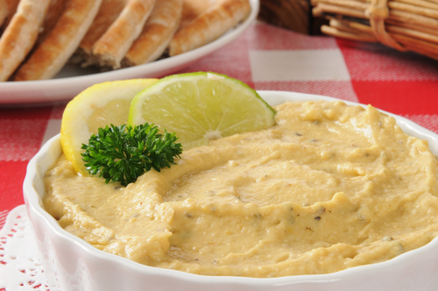
chipotle hummus
fruits | veggies | grains | protein | dairy

Slide 29
chipotle hummus
Ingredients
2 large cloves garlic 1 tsp Tony’s creole seasoning ¼ tsp cumin ¼ tsp coriander 2 cups HOT chickpeas (reserve ½ cup cooking liquid) 1-2 canned chipotle peppers in adobo sauce | 4 tbsp tahini or peanut butter 2-4 salt and pepper to taste 2-4 tbsp chickpea cooking liquid as needed juice of 2 limes (around 3 tbsp) ¼ cup chopped cilantro (optional) salt and pepper to taste
Directions
Pulse garlic and creole seasoning in food processor until garlic paste is formed.
Add the rest of the ingredients and puree until totally smooth.
Taste and adjust seasoning. Add more lime juice if needed.
fruits | veggies | grains | protein | dairy
grilled tofu

Slide 30
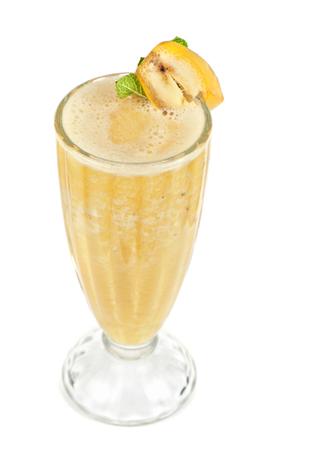
coconut banana smoothie
fruits | veggies | grains | protein | dairy

Slide 31
coconut banana smoothie
Ingredients
1 coconut (meat and water) 1 1/2 cup frozen papaya 1 banana 4 (deveined) collard leaves 1 cup hemp milk 1 tbsp stevia 1/2 cup crushed ice
Directions
Blend and serve.
Notes
Great for your digestive system!
fruits | veggies | grains | protein | dairy
grilled tofu

Slide 32
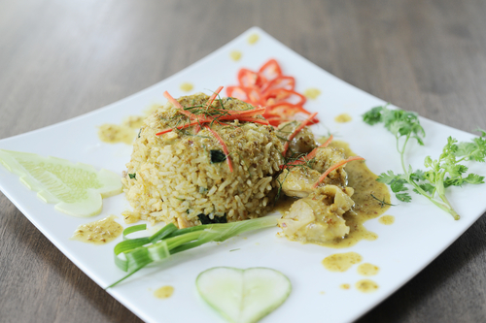
coconut chicken
fruits | veggies | grains | protein | dairy

Slide 33
coconut chicken
Ingredients
1 lb chicken breasts, cut into 1-inch pieces 1 small onion, diced 1 tsp chili powder 1 tsp ground ginger 1 tsp coriander 1 tbsp olive oil 2 tbsp flour | 1 can light coconut milk 1 tbsp creamy peanut butter 1 cup water 6 carrots, peeled and cut into ½-inch pieces 4 cloves garlic, minced Rice of your choice (I used sushi rice because I enjoy the sticky texture)
Directions
In a medium saucepan, cook rice following the package directions. While the rice is cooking, in a large frying pan, heat olive oil over medium heat. Once the oil is warm, add chicken, onion, chili powder, ginger, and coriander. Cook 5-7 minutes or until the chicken is no longer pink. Then, add flour. Stir well and cook for another 1-2 minutes. Slowly add coconut milk, peanut butter, and water. Stir over medium heat until it begins to boil, then add carrots and garlic. Cover and cook 15 minutes, or until carrots are at your desired consistency. Place rice on a plate and then place chicken mixture over rice.
Serve with Naan and Sriracha.
fruits | veggies | grains | protein | dairy
grilled tofu

Slide 34
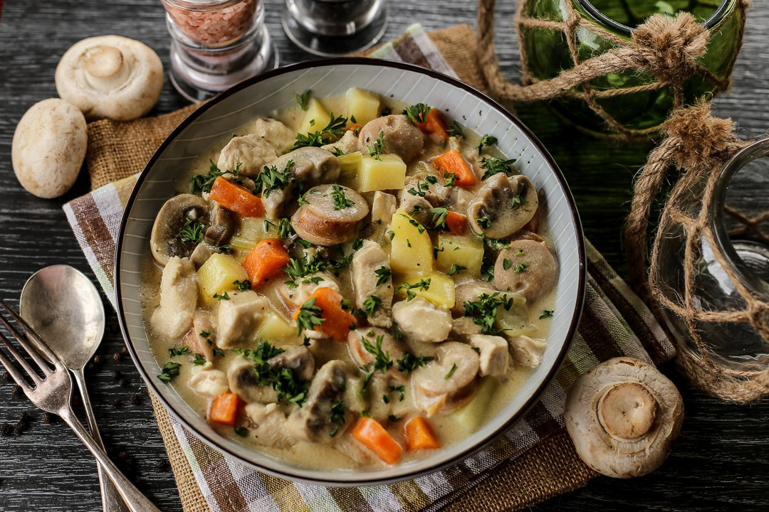
creamy garlic chicken and rice
Health Coach Group
fruits | veggies | grains | protein | dairy
grilled tofu

Slide 35
creamy garlic chicken and rice
Ingredients
2 tsp olive oil 4 small boneless skinless chicken breast halves 1/4 cup fat-free miracle whip dressing or fat-free mayo | 2 cups frozen stir fry vegetables 1 tbsp soy sauce (low sodium) 4 cloves garlic 3 cups hot cooked brown rice
Directions
Heat oil in large nonstick skillet on medium-high heat. Add chicken; cook 6 minutes, turning after 3 minutes Add dressing, vegetables, soy sauce and garlic; stir. Cook covered, 7 minutes or until chicken is cooked through, stirring occasionally. Serve over the hot cooked brown rice.
fruits | veggies | grains | protein | dairy
grilled tofu

Slide 36
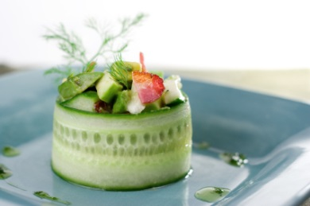
cucumber salad
fruits | veggies | grains | protein | dairy

Slide 37
cucumber salad
Ingredients
2 medium cucumbers, sliced and seeded Dressing: 1 tsp soy sauce 1 tbsp white vinegar 1 tbsp sugar 2 tsp sesame seed oil 1/4 tsp tabasco sauce 1/2 tsp salt
Directions
Combine cucumbers with dressing and chill. Makes a great side along a veggie burger or by itself as a snack.
fruits | veggies | grains | protein | dairy
grilled tofu

Slide 38
cucumber salad
Ingredients
2 cucumbers 1 small handful fresh dill 1 cup snap peas 2 cloves garlic 1/2 lemon peeled 1 tbsp olive oil 1 tbsp raw apple vinegar 1 tbsp raw honey sea salt and ground pepper to taste
Directions
This can be blended, juiced or chopped into small pieces and eaten as a salad!
Notes
Even the children love this one!
fruits | veggies | grains | protein | dairy
grilled tofu

Slide 39
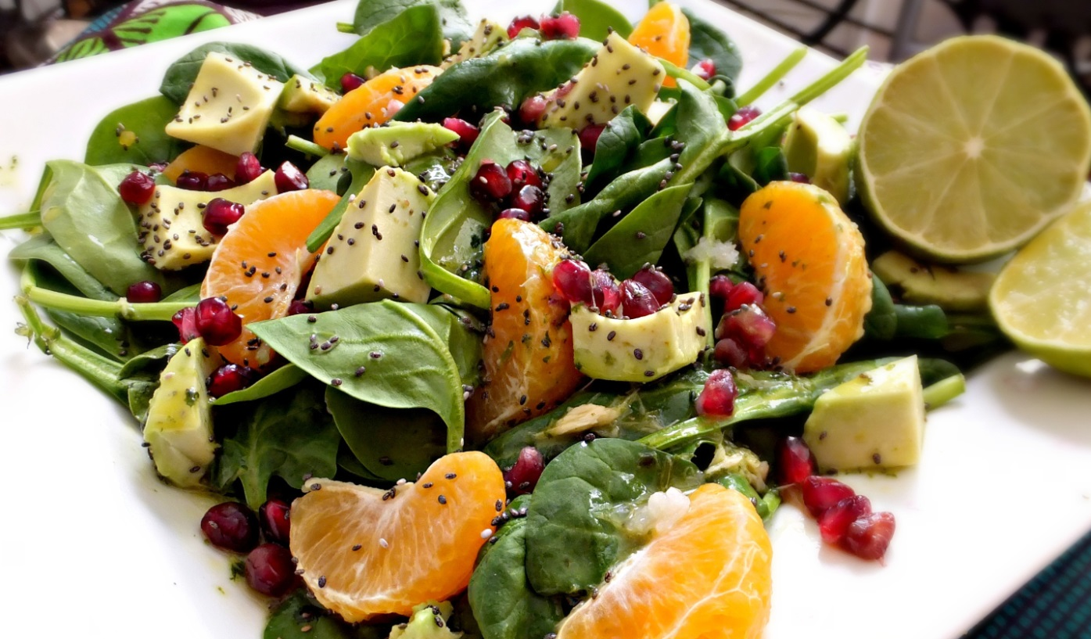
ginger and lime vinaigrette
fruits | veggies | grains | protein | dairy

Slide 40
ginger and lime vinaigrette
Ingredients
1-inch peeled fresh ginger Juice and zest of 1 lime 2 tablespoons apple cider vinegar 2 tablespoons extra virgin olive oil 1 cube frozen cilantro sea salt and pepper to taste
Directions
Combine all ingredients and blend in blender or with immersion blender.
Delicious over baby spinach, sliced avocado, mandarin slices, and pomegranate seeds. Top with chia seeds.
fruits | veggies | grains | protein | dairy
grilled tofu

Slide 41
gluten- & dairy-free pancakes
fruits | veggies | grains | protein | dairy

Slide 42
gluten- & dairy-free pancakes
Ingredients
1 cup almond flour ½ cup buckwheat flour ½ cup almond milk 4 eggs 1tsp baking powder 1tsp cinnamon 1tsp vanilla **blueberries or dark chocolate chips / cacao nibs (optional)
Directions
Combine ingredients and cook in pan with coconut oil until golden brown.
fruits | veggies | grains | protein | dairy
grilled tofu

Slide 43
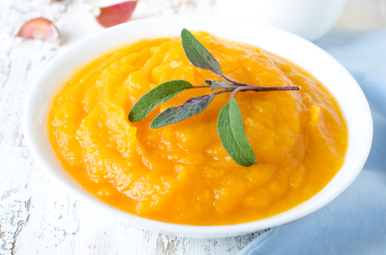
ginger and squash soup
fruits | veggies | grains | protein | dairy

Slide 44
ginger and squash soup
Ingredients
2 tbsp unrefined coconut oil or olive oil 1 butternut or acorn squash, skinned and cut up 2 medium carrots, coarsely chopped 1 medium onion, coarsely chopped | 2 celery stalks, chopped 3 cloves of garlic, minced 3 inches ginger root, grated 1 quart organic chicken stock or water sea salt to taste parsley (for garnish)
Directions
Sauté onions, carrots, celery and garlic in the oil.
Add squash and ginger then chicken stock or water.
Simmer for at least 30 minutes.
Puree into a creamy consistency.
Season with salt and simmer 5 more minutes.
You can garnish with parsley.
Notes
This is great on cold winter days. It can also be stored in the freezer for a quick soup to heat up when life gets busy.
fruits | veggies | grains | protein | dairy
grilled tofu

Slide 45
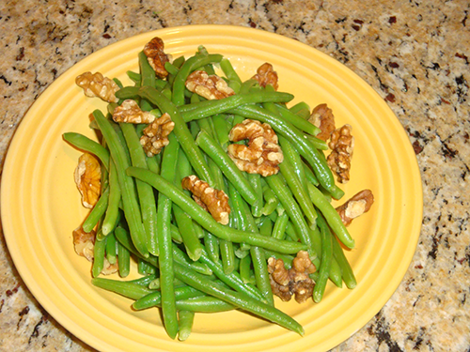
green beans with dijon vinaigrette
fruits | veggies | grains | protein | dairy

Slide 46
green beans with dijon vinaigrette
Ingredients
2 lbs organic green beans 1/2 tsp Himalayan Pink sea salt 1/4 tsp white pepper, freshly ground 1/2 cup whole walnuts | Walnut Dijon Vinaigrette 1/2 cup walnut oil 2 tbsp apple cider vinegar 3 tbsp dijon mustard 1 shallot, finely diced 1 tsp coconut nectar
Directions
Blanch green beans in a pot of water with a rolling boil for five minutes, drain. Put green beans into large bowl. Whisk the ingredients for the vinaigrette and pour over green beans. Serve on a plate and top with whole walnuts. Notes
Serves 4
fruits | veggies | grains | protein | dairy
grilled tofu

Slide 47
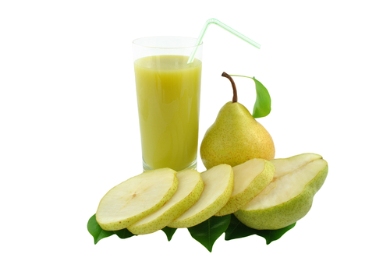
green juice for beauty
fruits | veggies | grains | protein | dairy

Slide 48
green juice for beauty
Ingredients
1 cucumber 1 pear (bosch) 3 stalks celery 1-inch ginger 1/8 cup watercress 1/4 cup mint 1 peeled lemon
Directions
Juice and drink!
Notes
This is hydrating and beautifying. Great for the skin.
fruits | veggies | grains | protein | dairy
grilled tofu

Slide 49
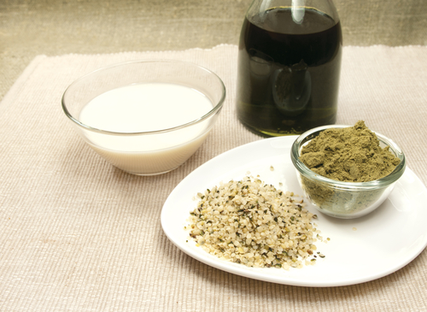
hemp milk
fruits | veggies | grains | protein | dairy

Slide 50
hemp milk
Ingredients
1/4 cup hemp seeds 16 oz coconut water small pinch raw vanilla small pinch sea salt
Directions
Blend hemp and coconut water on high until smooth. Add vanilla and salt and blend quickly on medium.
Notes
Enjoy this with fruit or granola. This is a great source of protein!
fruits | veggies | grains | protein | dairy
grilled tofu

Slide 51
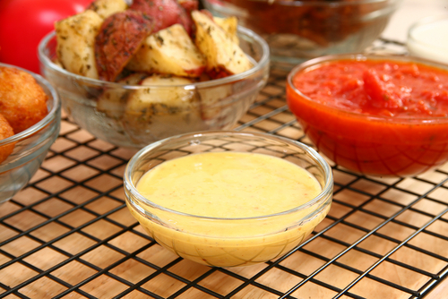
honey mustard dressing
fruits | veggies | grains | protein | dairy

Slide 52
honey mustard dressing
Ingredients
1/2 cup veganaise 1 tbsp pub-style dijjon mustard 2 tbsp apple cider vinegar 1 tbsp honey
Directions
Blend all ingredients well and use.
fruits | veggies | grains | protein | dairy
grilled tofu

Slide 53
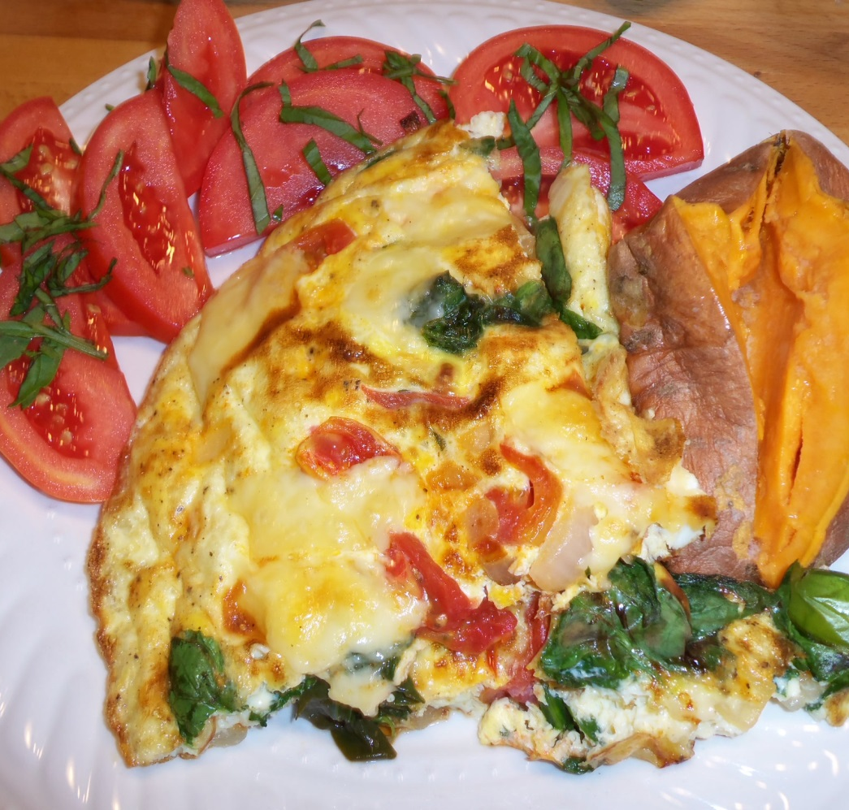
kale frittata
fruits | veggies | grains | protein | dairy

Slide 54
kale frittata
Ingredients
4 eggs bunch of kale, washed and rough chopped tomato, chopped med onion, chopped bell pepper, chopped (optional) | 2 tbsp water 1 tbsp coconut oil 1/2 cup grated parmesan or other cheese (optional) sea salt, red pepper flakes to taste
Directions
Set oven to broil. In an oven-safe skillet sauté onion in coconut oil until translucent. Add kale and cook until wilted and bright green. Add tomatoes and peppers and cook another 2 min. In a separate bowl whisk together eggs and water and pour over vegetables in the pan. Add seasonings. Reduce heat to low / med. Cook until the bottom is set (about 2 or 3 min). Sprinkle with cheese, if using, and put under broiler 2 minutes. Watch closely!! Take it out when it starts to lightly brown. This serves 2 hearty appetites, or 4 with other side dishes.
fruits | veggies | grains | protein | dairy
grilled tofu

Slide 55
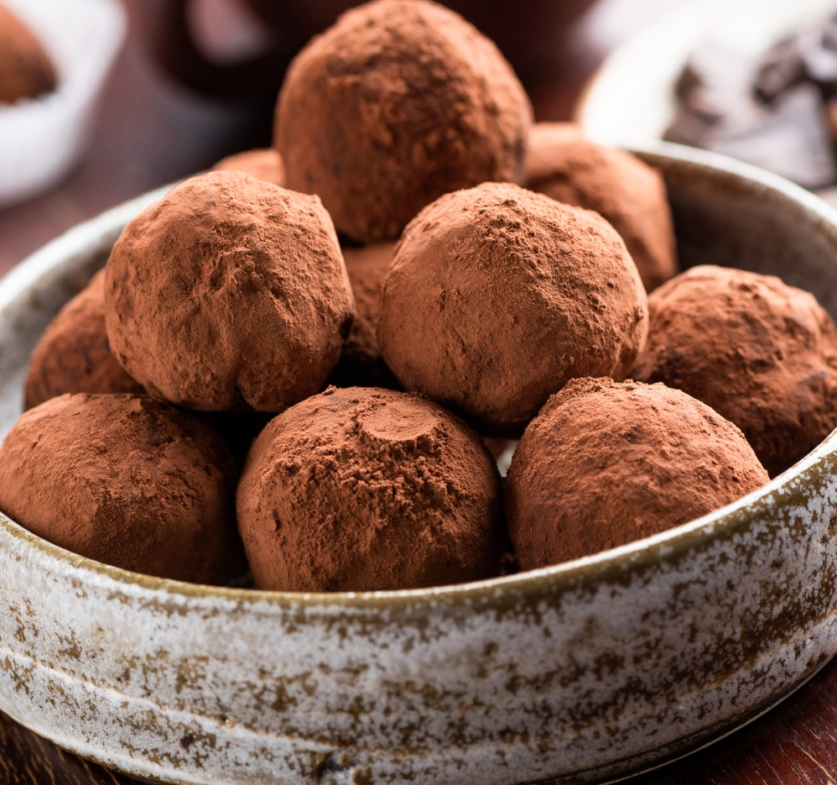
maca balls
fruits | veggies | grains | protein | dairy

Slide 56
maca balls
Ingredients
1/2 cup raw cacao 1/2 cup maca 2 cups dried apricots (chopped) 1 1/2 cup shredded coconut 2 cups macadamia nuts 1 cup grade A maple syrup 6 tbsp cashew butter 1 tbsp natural vanilla
Directions
Combine cacao, maca, apricots, coconut, macadamia nuts. In a separate bowl stir nut butter, vanilla and maple syrup. If it is too runny, add more coconut. Roll into balls and refrigerate.
Notes
You may also freeze these and thaw later.
fruits | veggies | grains | protein | dairy
grilled tofu

Slide 57
organic chicken apple sausage dish
Ingredients
1 pkg organic chicken apple sausage 2 organic apples 2 organic potatoes (whatever kind you like best) 1 tsp olive oil
Directions
Slice all ingredients into bite-size pieces. Add to skillet with olive oil and sauté for a bit, then drop heat to low and cook covered until potatoes are soft. Serve and enjoy!
fruits | veggies | grains | protein | dairy
grilled tofu

Slide 58
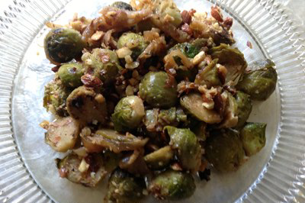
pan-grilled brussels sprouts
fruits | veggies | grains | protein | dairy

Slide 59
pan-grilled brussels sprouts
Ingredients
1/2 lb brussels sprouts - sliced in halves 1/2 onion - finely chopped 3 cloves of garlic - finely chopped 1 serrano chili pepper - sliced thin 1/2 tsp sea salt |  | 1/2 tsp black pepper 1/4 tsp cayenne pepper 1 tbsp apple cider vinegar 1 tbsp olive oil 1 tbsp agave syrup 1/2 cup chopped toasted almonds. (All ingredients are organic)
Directions
Place the olive oil in an 8-10" grill pan and heat on medium-high until it slightly sizzles. Place the sliced brussels sprouts, face down, in pan and grill until slightly browned. Add onion, garlic and serrano peppers. Fold gently into the brussels sprouts. Cover and allow to simmer on medium-low until onions are almost clear. Add salt, pepper, cayenne pepper and apple cider vinegar. Stir gently. Simmer for two minutes then stir in the agave syrup.
Taste and adjust seasonings according to your preferences. If using salted almonds, you may want to reduce the amount of sea salt. Sprinkle with chopped almonds.
Notes
Makes 4-6 servings. Variations of this recipe include experimenting with different spices, removing the sweetness, etc.
fruits | veggies | grains | protein | dairy
grilled tofu

Slide 60
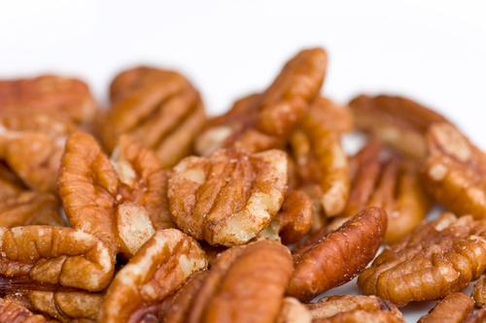
pecan treats
fruits | veggies | grains | protein | dairy

Slide 61
pecan treats
Ingredients
1 date 1 pecan 1 pinch hemp seeds
Directions
Slice open the date horizontally.
Insert a pecan into the slice in the date.
Sprinkle with hemp seeds.
Eat!
Notes
This is a recipe I got from Paul Risses's recipe book. It is the easiest pecan pie ever made!
fruits | veggies | grains | protein | dairy
grilled tofu

Slide 62
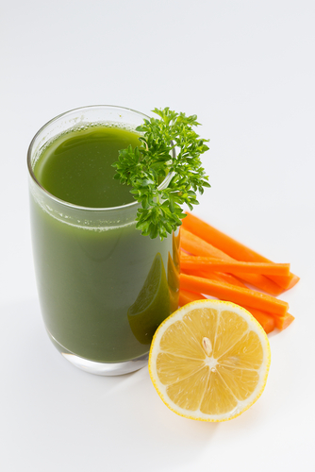
pick me up
fruits | veggies | grains | protein | dairy

Slide 63
pick me up
Ingredients
3 stalks of celery 3 medium carrots 1 medium apple 1/2 lemon
Directions
Run all ingredients through a juicer, If you don't have a juicer you can blend in a mixer and run through a strainer or cheesecloth to remove the pulp. Enjoy!
fruits | veggies | grains | protein | dairy
grilled tofu

Slide 64
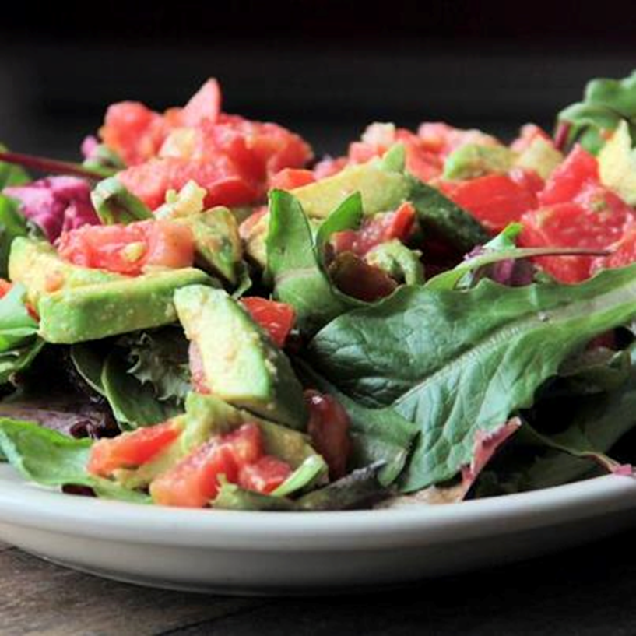
raw burrito
Health Coach Group
fruits | veggies | grains | protein | dairy
grilled tofu

Slide 65
raw burrito
Ingredients
Spring mix Green or black olives Diced organic tomatoes Green onions English cucumbers, diced | Avocado Lime Cumin Greek yogurt
Directions
Mash your avocado with a fork, add cumin to taste.
Set aside. Plate your spring mix top with tomatoes, cucumbers, onions and olives. Place avocado mixture on top of vegetables and a dollop of Greek yogurt on the side.
A splash of fresh-squeezed lime juice on burrito is optional.
fruits | veggies | grains | protein | dairy
grilled tofu

Slide 66
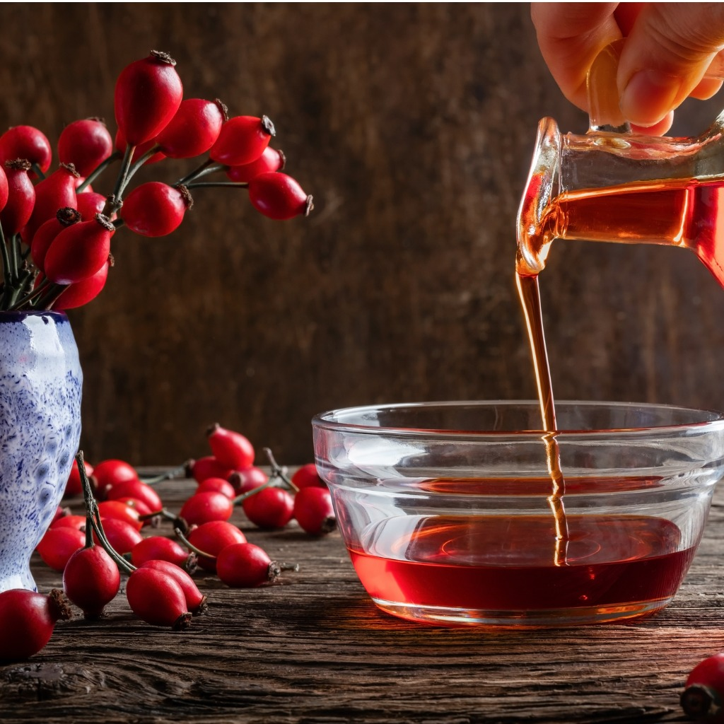
rose hip syrup
fruits | veggies | grains | protein | dairy

Slide 67
rose hip syrup
Ingredients
10 cups fresh rose hips 6 tbsp water 2 cups castor sugar
Directions
Wash the rose hips. Place in pan with water.
Bring to boil for three minutes. Strain with muslin cloth.
Add sugar and bring to boil again.
Bottle in sterilized bottles and use as and when required.
Notes
I was collecting the rose hips down a country lane when a little old lady came over and asked me to stop collecting the rose hips. I asked why and she advised me it was food for the birds and what would they do if I had taken their food! I told her this food was fantastic for the vitamins it contained, and she replied, “Well that's why the birds need it, you see. They have, to be able to fly!”
fruits | veggies | grains | protein | dairy
grilled tofu

Slide 68
shrimp e’toufee
fruits | veggies | grains | protein | dairy

Slide 69
shrimp e’toufee
Ingredients
1 lb wild caught shrimp 2 cups brown rice 1 1/2 cups sugar snap peas 1 can of bamboo shoots 1/2 cup water chestnuts, sliced 1/2 cup celery, sliced | 1/2 cup organic butter or ghee (clarified butter) 2 cloves of garlic, minced 1/4 tsp cayenne pepper 1 cup water 1/4 cup oat flour 1/4 cup chopped parsley
Directions
Peel shrimp and steam or sauté until pink on both sides, set aside. Melt butter or ghee in saucepan, add 1 clove of minced garlic.
When fully melted, stir in oat flour.
Add celery, water chestnuts, bamboo shoots and snap peas.
Add second clove of minced garlic.
Cook on low heat for 3-4 minutes. While the veggies are cooking, prepare rice.
Add shrimp to skillet along with water.
Simmer for 5-7 minutes. After sauce has thickened, sprinkle with chopped parsley. Serve over rice.
fruits | veggies | grains | protein | dairy
grilled tofu

Slide 70
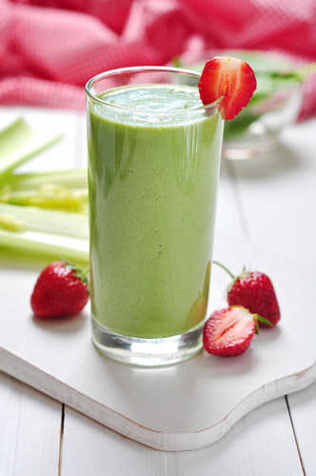
smoothie
fruits | veggies | grains | protein | dairy

Slide 71
smoothie
Ingredients
1 cup coconut water 6-10 strawberries 1 frozen or fresh banana 1-2 handfuls of spinach 1 scoop of your favorite protein powder | ice 1 tsp bee pollen (optional) Up to 1 tbsp chia seed (optional)
Directions
Blend all ingredients in blender. Top with bee pollen or stir in chia seed.
If you add chia seed, drink and chew.
If you eat later, it will be thick so you can eat as a pudding or may need to stir in more juice to thin out.
Enjoy!
fruits | veggies | grains | protein | dairy
grilled tofu

Slide 72
spring mix salad
fruits | veggies | grains | protein | dairy

Slide 73
spring mix salad
Ingredients
12 raw pistachios 2 tbsp dried cranberries 2 cups spring mix lettuce, rinsed 2 cremini mushrooms, rinsed and sliced 1 tbsp extra virgin olive oil ½ tsp raw honey ½ lime
Directions
Take the spring mix lettuce, mushrooms, dried cranberries and pistachios, and place them in a mixing bowl.
In a separate bowl mix together the oil, honey and lime together.
Combine all the ingredients together and gently mix well and serve immediately so the lettuce does not wilt.
fruits | veggies | grains | protein | dairy
grilled tofu

Slide 74
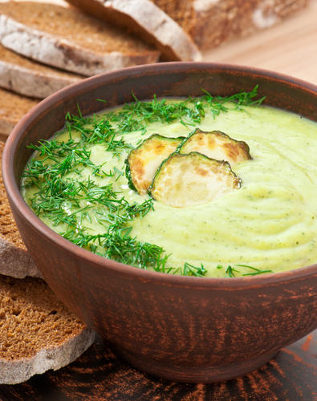
spring pea & leek soup
fruits | veggies | grains | protein | dairy

Slide 75
spring pea & leek soup
Ingredients
1 tbsp extra virgin olive oil 2 large leeks, white & tender green parts only, trimmed and sliced 1 tbsp fresh mint, chopped 1 lb fresh peas, shelled (or 1 3/4 cup frozen organic peas) |  | 1 cup canned organic navy beans (save the liquid) sea salt (to taste) 1/2 to 1 cup drained sauerkraut (to taste, and optional, but gives it a great boost!)
Directions
Heat olive oil in a medium pan. Add leeks, mint and 1/2 tsp salt and turn heat to medium low.
Cover and cook until leeks are tender (4-5 min).
Add beans, peas and 4 cups of the bean liquid (supplement with water or vegetable stock if you need to).
Cover, bring to a simmer, & cook until the peas are tender (about 5 min).
Add sauerkraut and simmer another 2 min. Season with salt to taste and enjoy!!
fruits | veggies | grains | protein | dairy
grilled tofu

Slide 76
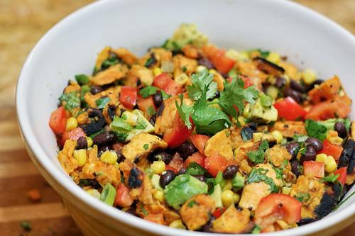
sweet potato salad
Health Coach Group
fruits | veggies | grains | protein | dairy
grilled tofu

Slide 77
sweet potato salad
Ingredients
3 small sweet potatoes 2 tsp flaxseed oil 2 tsp honey 1 tbsp fresh lemon juice | 1 orange peeled and sliced 8 oz goat cheese, cubed 5 oz baby spinach leaves 5 oz watercress 2 oz sunflower seeds
Directions
Preheat oven to 220. Place the sweet potato in a large bowl.
Drizzle with a little oil and season with sea salt.
Gently toss until well coated.
Place on a tray and bake for 25 minutes or until browned. Remove from oven and set aside for 30 minutes to cool. Combine the lemon juice, flaxseed oil & honey and stir until well combined. In a large bowl mix salad leaves, sweet potato and goat cheese,
Add sliced orange, sprinkle with sunflower seeds and drizzle with the dressing and gently toss!!! Enjoy!
Notes
This is a great light eat to have when friends are coming over... It is a real favorite when the girls come along for lunch.
fruits | veggies | grains | protein | dairy
grilled tofu

Slide 78
vegetarian beans & greens soup
fruits | veggies | grains | protein | dairy

Slide 79
vegetarian beans & greens soup
Ingredients
3-4 stalks organic celery, diced 1 large onion, diced 3 garlic cloves - 2 minced, save one whole 1 tbsp extra virgin olive oil 1 pinch crushed red pepper |  | 12 cups water or organic chicken stock (low-sodium) 1 loaf of ciabatta bread (or gluten-free) 1 bunch organic kale, chopped 1 bunch collard greens, chopped
Directions
Place the celery, onion, minced garlic, red pepper and half the olive oil in a large stock pot. Cover, stirring occasionally. When translucent, add 12 cups of water or low sodium organic chicken stock. Bring to a boil, then simmer 20 min. Add greens to the soup and simmer 10-20 min. Add beans, sea salt and pepper. When soup is done, slice ciabatta bread, drizzle with remaining olive oil, and toast in the oven on broil until golden brown. Then rub garlic clove over each slice. To serve: Tear pieces of toasted bread into the bottom of each large bowl, add soup, and cheese to garnish.
Notes
My greens & beans soup has warmed many a soul on cold winter nights and spring days when it just wasn't quite warm enough. My girls even help by gathering the greens from the garden and washing each leaf. Getting kids involved in the growing and preparation of our food has helped them to want to try new and different foods.
fruits | veggies | grains | protein | dairy
grilled tofu

Slide 80
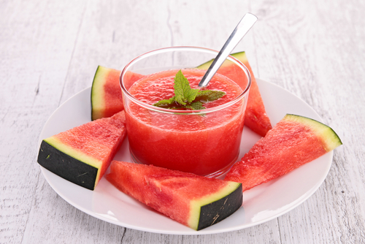
watermelon gazpacho
fruits | veggies | grains | protein | dairy

Slide 81
watermelon gazpacho
Ingredients
3 cup watermelon, pureed 1 cup watermelon, diced 1 cup tomato, diced 1 cup cucumber, peeled, diced small 2 tbsp (or so) lime juice 1 handful cilantro ½ cup red or green pepper diced small 1 teaspoon ginger minced, ½ small jalapeno, seeded and minced 1 green onion, chopped, sea salt & fresh black pepper
Directions
Mix everything & enjoy.
fruits | veggies | grains | protein | dairy
grilled tofu

Slide 82
Canaan Vibes LLC Address City, State Zip Phone # Website email

