Slide 1
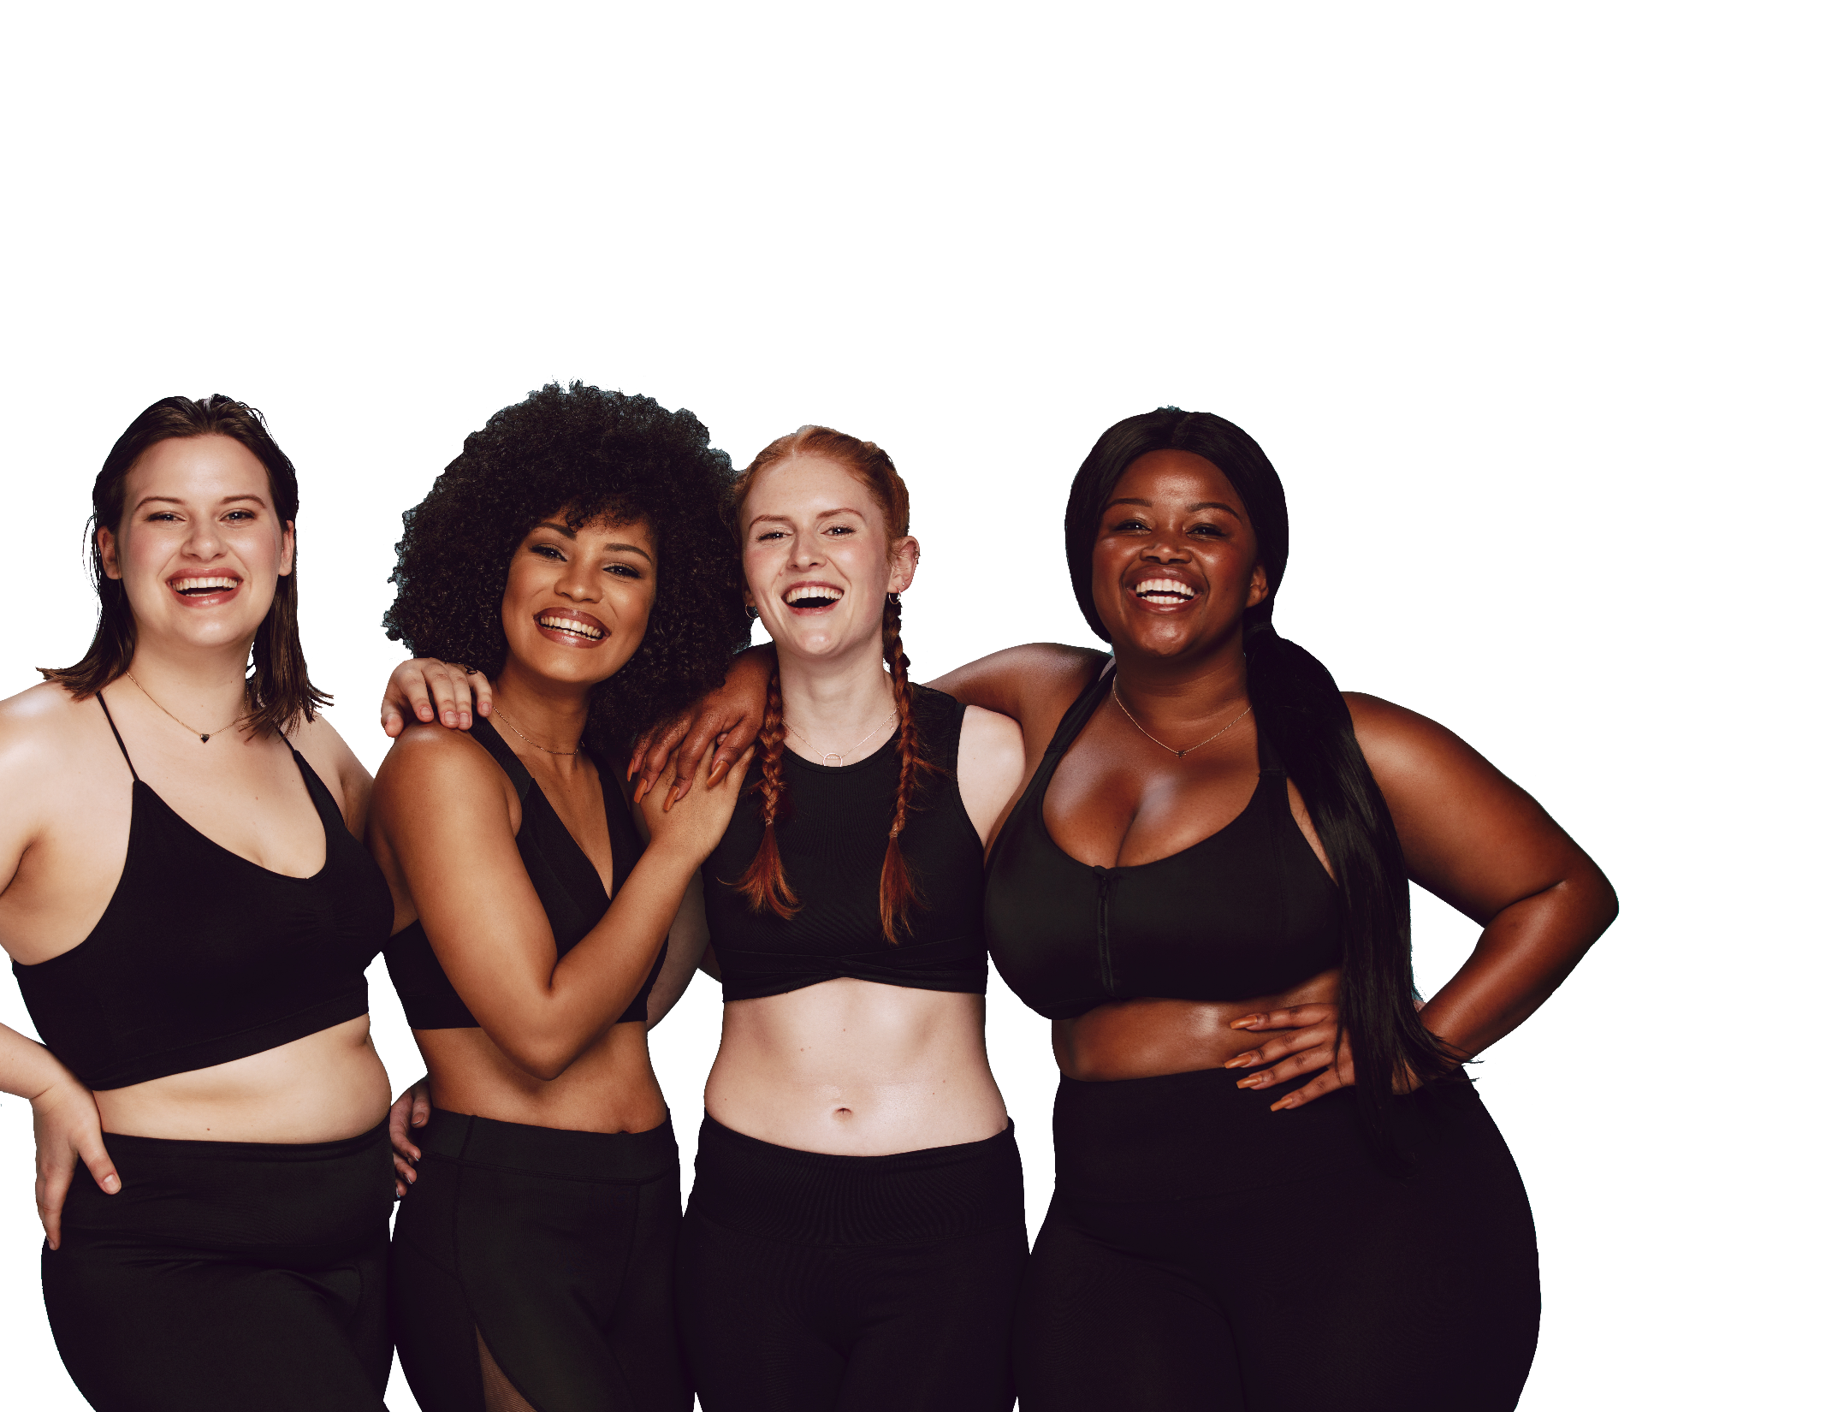
FUN &
HEALTHY
28 DAY WEIGHT LOSS JOURNEY
PREPARE MODULE

Slide 2
Index
 | Day 1 Goals | Day 2 Implement Audio-Self Esteem | Day 3 Journaling | Day 4 Vitamins | Day 5 Nutrition Basics Audio-Food | Day 6 Nutrition Basics
Day 7 Eating Out | Day 8 Exercise Audio-Exercise | Day 9 Yoga | Day 10 Caffeine | Day 11 Minerals | Day 12 Meditation | Day 13 De-Stressing
Day 14 Essential Oils | Day 15 Advanced Nutrition | Day 16 Traveling | Day 17 Lemon Water | Day 18 Beauty | Day 19 Positive Outlook | Day 20 Relationships
Day 21 De-Clutter | Day 22 Super Foods | Day 23 NEAT | Day 24 Organics | Day 25 Motivation | Day 26 Joy | Day 27 12 Easy Steps
Day 28 Congrats!

Slide 3
Good Morning!
It is a pleasure to welcome you to our 28-Day Slim, Sexy & Smart.
The information you receive today is the foundation of your program. You will be setting your own goals. This program is customized to your specific needs.
Remember, we are here for you throughout the 28-day period. Your success is important to us and is why we are here.
OVERVIEW
I am here with the intention that this program will powerfully change the course of your future. For that to happen, you must also be with me 100%. Please use this group. It is an incredible tool for you to use throughout the duration of the program and beyond. It will be tremendously beneficial for you to be comfortable with sharing your thoughts and concerns. From experience, when you feel yourself holding back, that is usually the time that you most need to vocalize what is happening, ask questions, ask for support and step out. This is why community is so powerful! You will always have someone on the same page willing to support you all the way. ☺
Congratulations again on enrolling in this program. You are in for one of the most exciting and powerful months of your life!

Slide 4
Welcome
Congratulations!
You just have embarked on quite the journey. You have made the important decision to make healthy changes in your life. We hope that you will take advantage of all that we have to offer. Please visit our website for health and lifestyle tips and news.

Slide 5
Checklist
You will get a shopping list of health foods that you may choose from.
You will learn that everyone is different! We are not going to tell you what you have, to eat. We are going to teach you how to discern this yourself. You will eat what is best for your body. You are going to learn the secrets the best health coaches know, bio-individuality.
You will learn all about super foods and how to select them.
You will find out which supplements you should have.
We are going to teach you about digestion and probiotics and enzymes.
You are going to learn that you can lose weight by adding in healthy foods.
We will teach which foods you should never eat. You may be surprised.
We encourage cooking at home with delicious whole foods.
Find out the truth about carbs.

Slide 6
Checklist
Learn how to eat out.
Yes, you can travel and eat healthy. We will show you how.
There are healthy fats and you will find out which ones.
What are primary foods? We will show you how getting those straightened around can influence your weight more than calorie counting and deprivation.
Beauty tips that can’t be found at the cosmetic counter.

Slide 7
Agreement
Client
Leads the session, asks for what he/she wants and lets the coach know what is working and not working in the health coaching relationship.
Defines, clarifies and commits to specific action steps.
Gives 24-hours notice in case of appointment reschedule.
Takes responsibility for actions.
Health Coach
Supports the client in his/her goals, action steps and outcomes.
Supports the client in defining and clarifying action steps.
Asks questions to assess the level of client commitment to the action steps.
Tracks the client’s progress.
Discusses options and possibilities while the client does the work.
Respects the client’s willingness to be truthful and keeps all information confidential and private.

Slide 8
Agreement
Both Coach and Client
Makes calls and appointments on time.
Commit to principles of accountability, honesty and respect.
I have read and agree to the provisions of this agreement. This agreement contains all the terms and provisions applicable within.
________________________ _________________ _________
Print Name Signature Date

Slide 9
Session Schedule
Session Date | Session Time | Session Title
Health Coach __________________________________
Phone number _________________________________
Best time to call ________________________________
Email: ________________________________________
I agree to the times listed above. I understand that if I do not cancel 24 hours in advance, I will pay for the session.
_____________________ ________________________ _______________
Print Name Signature Date

Slide 10
Steps To Prepare
Prepare your kitchen.
Clean your pantry, toss out the toxic foods.
Gather recipes and create a shopping list.
Plan your menus.
Journal and track your eating.
Listen to your hypnotic audios, there are 2 for each subject.
Listen to the intro first and then to the hypnotic audio.
Plan and schedule your exercise.
Make time for self care.
Get your doctor’s okay.
Let your family know what is happening.

Slide 11
Prepare Your Kitchen
You can get pretty fancy if you want, but it isn’t necessary. You will be receiving a grocery list for a pantry to be well stocked. You should subtract anything that doesn’t appeal to you or that you think will not get used….
but, please keep an open mind.
The better your pantry is stocked, the
more prepared you are to throw together
a last-minute meal.

Slide 12
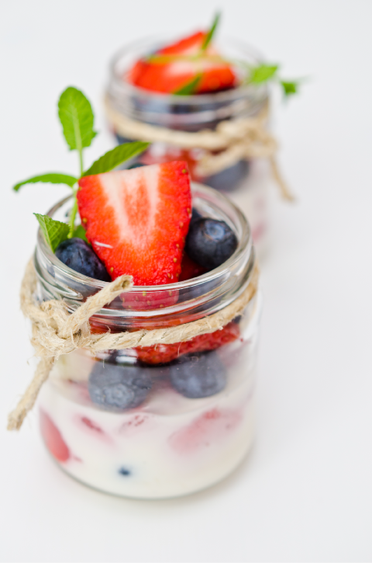
Prepare Your
Kitchen
The one thing you want is lots of fresh fruits, vegetables and herbs. You will want to buy foods that have not been grown with pesticides and fertilizers because we don’t want to be adding more toxins into your body.
In short, if you have the option, go all-organic for this cleanse. If that is not available near you, do the
best you can.
Glass jars, containers, cups and bowls are preferred
over plastic.

Slide 13
Planning Your Meals
The next slide outlines an example day of meals during cleanse. Feel free to mix and match to suit your personal tastes.
You also have a booklet full of recipes designed to use during this cleanse. Look over the recipes and decide what you’d like to make this week, so you can create your shopping list with those in mind.
The shopping list includes cleansing food items needed for suggested meals containing salads, broth and smoothies. The meal ideas are for your convenience to simplify your cleansing experience.
Keep in mind that you have the freedom to adjust the meals as you would like. If you replace meal items be sure to incorporate the basic cleansing foods from the shopping list to receive the maximum benefit of cleansing.

Slide 14
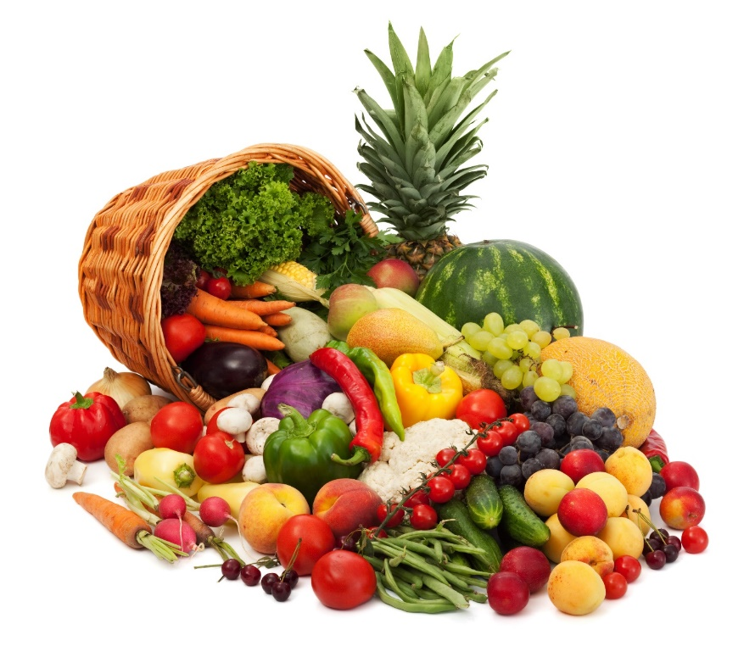
Meal Planning Tips
FUN & HEALTHY
Keep track of what you eat
Add some greens to your meals
Incorporate smoothies and/or juices (1 a day)
Be sure each meal contains healthy fats
Eat when you are hungry
Eat at home
Practice Mindful Eating

Slide 15
The “My Plate” Method
About half the plate is fruits and veggies
About a third of the plate is grains or other carbohydrate. Those with celiac or gluten intolerance will need to replace grains with starchy vegetables: potatoes, rutabaga, yams, etc.
About one quarter of the plate is protein
Dairy is included here as a small addition (not a main staple). It may be used sparingly and may be substituted
Planning your meals for your cleanse can feel a little overwhelming. Many people find the My Plate method simplifies that planning.
With My Plate you are assuring that you cover your nutritional bases at each meal and are including approximately the right amounts of a variety of foods in your meals. There is no weighing or measuring needed.

Slide 16
Cleaning The Kitchen
A few things you can feel comfortable eliminating as you feel ready:
Beer and alcohol
Cheese
Cookies
Cakes
Chips
Pies
Sugar
Aspartame
Crackers
Bologna

Slide 17
Restock
FUN & HEALTHY
Have fun with this. If there is anything on this list that you do not recognize, Google it and get an image.
The people at the store don’t always know what it is if it isn’t in a box with a name on it. You can ask and you may get lucky, but most of the time, if you want something healthy, you will need to find it yourself.
One thing to remember is that most whole foods do not have a 6-year shelf life like many of the things you may be used to. You will need to go to the grocery store at least once or twice a week.
If you do buy something with a label, read it!
Produce
Alfalfa Sprouts
Apple
Avocados
Bananas
Blueberries
Celery
Cilantro
Cucumbers
Fennel
Garlic
Ginger
Grapes
Kale
Lemons
Lettuce
Mung Bean Sprouts
Mushrooms
Nori Sheets
Peppers (red, yellow, green)
Onion
Oranges
Parsley
Raspberries
Scallions
Snap Peas
Strawberries
Sweet Potatoes
Tomatoes
Watercress
Zucchini

Slide 18
Restock
FUN & HEALTHY
Spices & Condiments
Beverages
Dried Fruits, Grains, Nuts & Legumes
Black Pepper
Bragg’s Liquid Aminos
Bragg’s Raw Apple Cider Vinegar
Cayenne Pepper
Chili Powder
Coconut Oil
Cumin
Dill
Extra Virgin Olive Oil
Golden Miso
Ground Cinnamon
Himalayan (non iodized) Salt
Nama Shoyu
Raw Agave Nectar
Raw Honey
Raw Soy Sauce
Raw Vanilla
Raw Cacao
Sea Salt
Tahini Coconut Water
Coconut Milk
Aloe Juice
Green Tea
Water (Clean, Spring)
Dates
Dried Lentils
Flax Seeds
Hemp Seeds
Kidney Beans
Lentils
Macadamia Nuts
Millet
Quinoa
Pecans
Pine Nuts
Pinto Beans
Pumpkin Seeds
Raisins
Rice
Sunflower Seeds
Teff
Walnuts
White Beans
Dried Fruits, Grains, Nuts & Legumes
Almonds
Amaranth
Apricots
Black Beans
Brazil Nuts
Buckwheat
Cashews
Chickpeas

Slide 19
Healthy Food Online
Check out these helpful online shopping sites. Try something new!
Available to US customers.
Nuts Online https://www.nuts.com
Amazon http://www.amazon.com
Sungrown Organics http://sungrownorganics.com
Healthy Traditions http://www.healthytraditions.com
Available to UK customers.
Amazon http://www.amazon.co.uk
Real Foods http://www.realfoods.co.uk
Planet Organic http://www.planetorganic.com

Slide 20
Healthy Food Online
Check out these helpful online shopping sites. Try something new!
Available to Australian customers.
Honest to Goodness http://www.goodness.com.au
Amazon http://www.amazon.com.au
Australian Organic Products http://www.australianorganicproducts.com.au
Available to Canadian customers.
Vita Health Fresh Market http://www.myvita.ca
Amazon http://www.amazon.ca
Raw Nutrition http://www.rawnutrition.ca
Truly Organic Foods http://www.trulyorganicfoods.com

Slide 21
Natural Food Stores
Listing of natural food stores and restaurants nationally and globally:
www.happycow.net
Find a natural foods co-op near you (US customers only):
www.coopdirectory.org
Find a health food store in your area:
http://www.vegetarianusa.com/downloadcity.html
http://www.nahs.co.uk
Find organic and natural food stores (US customers only):
http://www.organicstorelocator.com
Find food co-ops and health food stores:
https://www.organicconsumers.org/buying-guide

Slide 22
Remember
Take a moment to respond to the questions in the space provided below.
Why did I join this program?
____________________________________________________________________________________________________________________________________________________________________________
______________________________________________________________________________________
What do I hope to achieve by taking part in this program?
____________________________________________________________________________________________________________________________________________________________________________
______________________________________________________________________________________
How will healthy eating and being active help me and others?
____________________________________________________________________________________________________________________________________________________________________________
______________________________________________________________________________________

Slide 23
EXAMPLE
The Food Diary
Be honest. Write down what you really eat.
Be accurate. Measure portions and read labels.
Be complete. Include every little scrap you eat
Diary | Time | Portion | What | How do you feel?
Breakfast
Snack
Lunch
Snack
Dinner
Snack

Slide 24
CONGRATS
YOU DID IT!

