Slide 1
FUN &
HEALTHY
28 DAY WEIGHT LOSS JOURNEY
MODULE TWELVE

Slide 2
Task
DAY 12
Set aside 15 minutes to meditate or pray. Schedule this 15 minutes into the remainder of your 28 days.

Slide 3
DAY 12
Session Notes
Client Name _____________________ Date _______________
HEADLINE

Slide 4
DAY 12
Meditation
Whether you call it reflection, meditation or prayer, it calms and clears our minds and provides for necessary inner health. Our world is so busy and if we allow the external happenings around us to integrate with our inner peace, stress and physical illness can ensue.
In Latin, the word meditate means to connect and align with our center. Prayer is to align with our god. Either way, we are silencing our outer world and aligning with our true self.
Meditation and prayer have been around since ancient times. It is even more important now because of the “busyness” we surround ourselves with. If we can start out with just a few minutes a day and let the time grow, we will experience gains in many areas of our lives. One of the best things is that meditation is free! If we can find the time, we can do it almost anyplace.
We don’t have to dress up or have anything special.
Just make yourself comfortable and go for it.

Slide 5
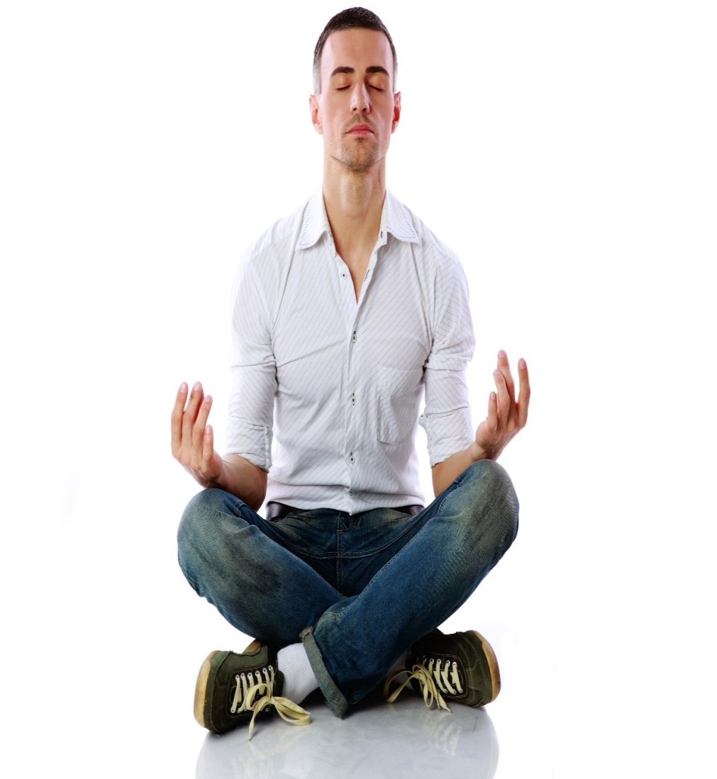
Day 12
Meditation
Benefits:
Clarity
Perspective
Wisdom
Creates inner peace
Understanding
Spiritual harmony
Relaxation
Enlightenment
Deepens relationship with our god
Introspection
Ideas
Assurance
Puts us in the present
Improves flow of oxygen to lungs
Improves blood flow
Reduces anxiety
Decreases tension

Slide 6
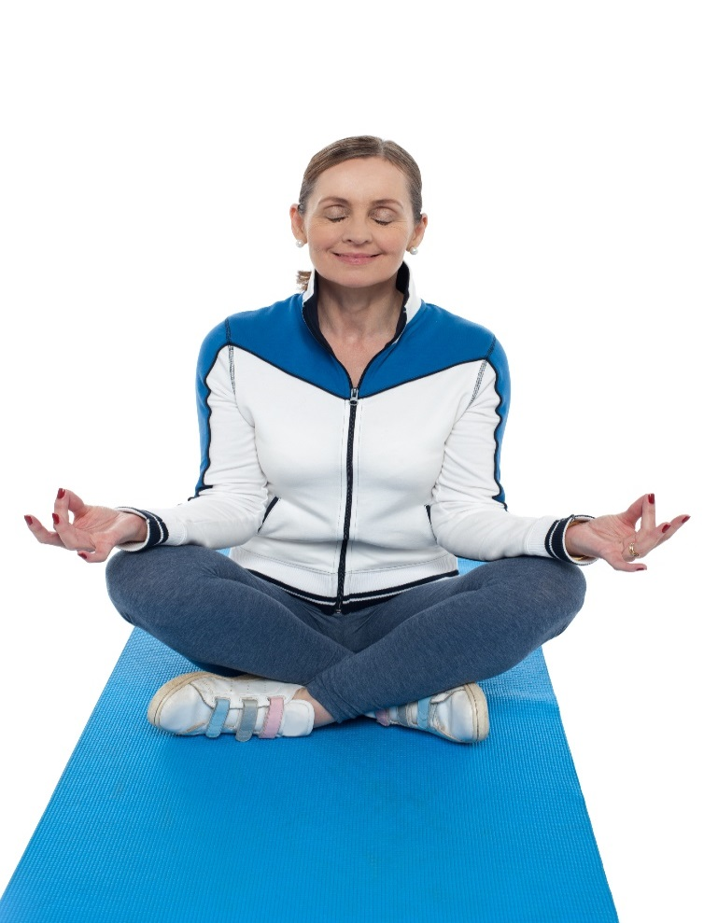
Day 12
Meditation
Benefits:
Reduces release of cortisol (weight gain)
Enhances immunity
Decreases aging
Raises DHEA level
Helps headaches
Increases self-confidence
Releases fears
Creativity
Focus
Intuition
Productivity
Purifies thoughts
More assertive, less aggression
Reduces worry
Reduces guilt
Increases tolerance
Centers

Slide 7
DAY 12
Meditation
Meditation
Where do you find the time and how do you stay focused? What’s the best way to get started?
To be honest, I’m still working on that. I’ll always be working on it! I started with guided meditations, which help me stay focused. I had never been particularly good at sticking with meditation, so I made a commitment that I would meditate every day. I kept hearing it would change my life. I loaded up my iPod with guided meditations, you can find them free all over the internet. Then I was stressing about having TOO many meditations! Not a great start.
You really have to stick with it and keep on meditating, even if you feel like you spend more time thinking about all the laundry you should be doing. My mind runs at 100mph most of my waking hours. I really wanted to learn how to turn it off on occasion! It does get better and better as you practice. I’m probably about five years into it now, and I see the benefits every day. The more I practice at quieting my mind for meditation, the quicker and easier quieting my mind is in my everyday life.

Slide 8
DAY 12
Meditation
It’s so important to really isolate yourself when you start to meditate. You need to really shut out the external and internal distractions as best you can. Not an easy thing to do, unless you live alone with no pets. My initial goal was to try to meditate first thing in the morning and last thing before I go to sleep. That almost never happens. I already get up before 6 a.m. every morning and unless I literally don’t get out of bed before I meditate, something grabs my attention first. I have to tiptoe into the bathroom and hope the puppy doesn’t hear me!
I downloaded some meditations so I can just grab my phone before I even get out of bed and start my weekday with some quiet time.
You can also bookmark meditations on YouTube, which are easy to find on the fly. On weekend mornings I get up, take care of the dog, get myself a cup of tea and head back to my room or out to my deck to meditate. I love morning meditations. It’s awesome to start your day with a clear mind.

Slide 9
DAY 12
Meditation
Evening meditations are wonderful. You’re sleepy, so it’s a very different experience. There are some nice guided meditations that are designed to listen to when you’re going to sleep. It’s a fabulous way to wind down your day and calm your mind for a good night’s rest. If there’s something in your life you’re hoping to manifest or focus on, meditating on that topic before you go to sleep is said to tune your dreams and soul into those desires. I find I dream so much more when I meditate before sleep! I’m keeping a dream journal, but that’s a topic for another day.
I’ve even tried to meditate during the day! On weekends that’s doable. On weekdays it’s a riot. I’ve tried to park in a quiet lot, sitting in a pretty place, hoping no cops come by and knock on my window wondering if I’m alive! There’s the delicate balance of needing the car battery on so I can listen to the meditation, and when it’s cold, so that the heat can run. I don’t want to asphyxiate myself, so then there must be open windows. You’re starting to get the picture. Not exactly the
stress-free environment I’m shooting for.

Slide 10
DAY 12
Meditation
Meditating, for me, is starting to feel like a splurge on myself—fabulous!
Making time to meditate is now as wonderful as making time for pedicures and massages. I had no idea I would be so enthusiastic about it! I love the little bit of tranquility it brings to my life. With all of the decisions that I have to make on a daily basis, this tranquility is much appreciated.
Progress, not perfection. Here are some resources to check out when you have some time:
For those of you who use iTunes, go the iTunes Store, search for meditations and narrow down to podcasts. They’re free and there are tons of them. Try and find the ones that feel right for you.
Here’s Deepak Chopra on learning to meditate. He did this clip for the Dr. OZ show awhile back. https://www.doctoroz.com/videos/deepak-chopra-meditation
There are many meditation techniques including Mantra, Chakra, Heart, Trataka and more. You really have to experiment and find what resonates with you. Here’s a good article describing different techniques. http://www.healthandyoga.com/html/meditation/meditationtechniques.html

Slide 11
DAY 12
The Food Diary
The Food Diary
Be honest. Write down what you really eat.
Be accurate. Measure portions and read labels.
Be complete. Include every little scrap you eat.
Diary | Time | Portion | What | How do you feel?
Breakfast
Snack
Lunch
Snack
Dinner
Snack
Liquids

Slide 12
CONGRATS
YOU DID IT!

