Slide 1
FUN &
HEALTHY
28 DAY WEIGHT LOSS JOURNEY
MODULE THIRTEEN

Slide 2
Task
DAY 13
De-Stress. Think of someone who is important to you and spend 30 minutes with them, just enjoying each other’s company. Put away your cell phone. Turn off the television. Enjoy one another’s company uninterrupted.

Slide 3
DAY 13
De-Stressing
Stress is a normal psychological and physical reaction to things that upset your balance. Studies show that most people experience some type of stress throughout the year. When your brain perceives a threat, it signals your body to release a burst of hormones to fuel your capacity for a response. The problem comes when we have non-stop stress and the release is constant.
Determining the cause of your stress is your first step. After identifying the cause you can start working on strategies to deal with it. Often it is as easy as staying away from the neighbor who drives you nuts or turning off the news. If you can’t avoid the stress inducer, the next step is to figure out ways to live with it.
Don’t try to do it on your own. Join a group who is going through the same stress as you. Seek help from family and friends. You also may benefit from daily practices that encourage stress reduction, like mindfulness, prayer, meditation, yoga or just going outside to enjoy nature.

Slide 4
Day 13
De-Stressing
In our world, it is unrealistic to expect stress to disappear from your life.
Managing stress isn’t a one-day thing. With consistent effort, you can learn to manage your levels of stress and increase your ability to handle the challenges that bring stress.

Slide 5
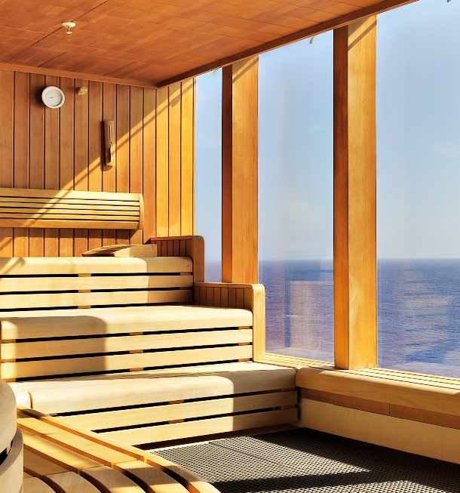
Day 13
De-Stressing
Stress relievers:
Laughter
Exercise
Proper nutrition
Meditation
Yoga
Prayer
Enjoying nature
Reading
Getting away from the cause
Taking a break
A steam shower
Deep breathing
A hug
Focusing on gratitude
Your favorite hobby
Anything on or around water
Running
An act of kindness
A good night’s sleep
A warm bath

Slide 6
DAY 13
Problem Solving
It is important to find the problem and then work on finding a solution. Ask yourself the following:
What is the problem?
Where and when is it happening?
Why is it happening?
Are certain people involved?
Is the problem really as big as you are making it?
If you could fix the problem, would life be better?
Do you have control over any part of the problem?
Find a solution.
Get a piece of paper and write down everything you can think of to solve the problem.
What are some of the ways you have solved these problems in the past?
Ask others what they would do.

Slide 7
DAY 13
The Food Diary
The Food Diary
Be honest. Write down what you really eat.
Be accurate. Measure portions and read labels.
Be complete. Include every little scrap you eat.
Diary | Time | Portion | What | How do you feel?
Breakfast
Snack
Lunch
Snack
Dinner
Snack
Liquids

Slide 8
CONGRATS
YOU DID IT!

