Slide 1
FUN &
HEALTHY
28 DAY WEIGHT LOSS JOURNEY
MODULE FIFTEEN

Slide 2
Task
DAY 15
Try some green juice. Consider cutting out your caffeine.

Slide 3
Session Notes
DAY 15
Client Name _____________________ Date _______________
HEADLINE

Slide 4
DAY 15
Green Vegetables
“As a shopper, you may pass by them many times, looking but not buying, noticing, the dazzling array of fresh, crisp, and nutritious greens – curly kale, red and green chard, collards, bok choy, mustard greens, arugula, frisee, mesclun and other exotic-looking lettuces. A little uncertain, a little confused, you tuck these impressions into a corner of your mind. Then, at a favorite restaurant, an exotic-looking salad is served, or perhaps tender beet greens with garlic and olive oil. The next trip to the market once again serves to conjure up these tasty dishes. This time, you buy some beet greens, some arugula, even frisee, and take them home. Now what?” Greens Glorious Greens
“Diets that are rich in vegetables and fruits are protective against many cancers – there is an enormous amount of work on this,” says Lee Wattenberg, a professor at the University of Minnesota who has been studying cancer prevention for 30 years. “Over the last decade a fairly large number of prevention compounds have been found in fruits and vegetables. When you look at the totality, it’s quite impressive.”
As impressive as the health benefits of greens may be, you should not picture a pile of tasteless, hard-to-chew greens on your plate. You don’t have to eat them just because they are healthy for you. We are here to say that leafy greens are not only beautiful to behold, but also tasty and capable of transporting us (through recipes) to far corners of the earth where greens have been a way of life for centuries.

Slide 5
DAY 15
Green Vegetables
Oxalates include some leafy greens, berries, fruits and vegetables high in vitamin C, some nuts and seeds, coffee, tea and chocolate. This is why it is important to have a nice variety of foods in your diet and not be extreme in any one thing.
Oxalate is a molecule that, under certain circumstances, links up with calcium and crystalizes. It is important to eat a low-oxalate diet if you suffer from kidney stones, fibromyalgia, inflammation or have had part of your intestine removed.
A food is considered high in oxalates when it has more than 10mg of the compound per serving.
Some of the foods high in oxalate include spinach, green beans, rhubarb, kidney beans, soy, sweet potatoes, strawberries, raspberries, tangerines and kiwis. Meat and dairy do not have oxalate.
To balance vegetables that are high in oxalates, combine them with richer foods like seeds, nuts, beans or oil.

Slide 6
DAY 15
Green Vegetables
Arugula
Cruciferous
Peppery taste
High in potassium
Manages blood pressure
Prevents osteoporosis
Boosts memory (phytochemicals)
Antioxidants
Collard Greens
Cruciferous and leafy
From the cabbage family
Good source of beta carotene
Helps prevent and manage arthritis, cataracts, macular degeneration
Endive
Bitter, leafy
Belgian endive, escarole and curly endive (frisee)
Good source of potassium (manages blood pressure and preventing osteoporosis)
Vitamin K (may prevent bone fractures)
Escarole
Leafy
Good source of potassium, a mineral involved in managing blood pressure and preventing osteoporosis
Good source of vitamin K (may prevent bone fractures)

Slide 7
DAY 15
Green Vegetables
Kale
Cruciferous and leafy from the cabbage
Good source of antioxidants, including vitamin C, beta carotene, lutein and zeaxanthin (helps maintain healthy eyes, hair and skin)
Calcium and potassium (keeps bones and teeth strong)
Quercetin (anti-inflammatory) (arthritis and memory loss)
Riboflavin (may protect against migraines)
Vitamin K (may prevent bone fractures)
Lettuce
Leafy
Romaine, green leaf, red leaf, bibb and butterhead
Good source of antioxidants, (helps prevent arthritis, cataracts, and macular degeneration, as well as maintain healthy hair and skin)
Good source of potassium (manages blood pressure and prevents osteoporosis)
Vitamin K (may prevent bone fractures)

Slide 8
DAY 15
Green Vegetables
Mustard Greens
Pungent, peppery flavor
Antioxidants (vitamin C, beta carotene,
lutein and zeaxanthin, which help prevent
arthritis and maintain healthy eyes, hair
and skin)
Contains folate (may help reduce the risk
of heart disease, enhance memory and
improve mood)
Vitamin K (may prevent bone fractures)
Radicchio
Leafy vegetable with a bitter taste
Good source of potassium (manages blood pressure and prevents osteoporosis)
Vitamin E
Lutein (maintains healthy eyes and skin)
Spinach
Dark green leafy vegetable
Nutrient-dense
High in fiber
Can help you manage type 2 diabetes
Good source of antioxidants (vitamin C, beta carotene, lutein and zeaxanthin)
Very high amounts of potassium
Vitamin K (may prevent bone fractures)
Iron and Vitamin B

Slide 9
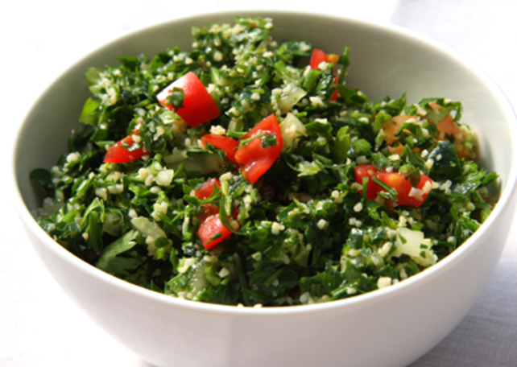
DAY 15
Green Vegetables
Swiss Chard
Leafy green vegetable
Similar to spinach
Good source of antioxidants (vitamin E, beta carotene, lutein and zeaxanthin)
Magnesium
Potassium
Vitamin K
Turnip Greens
Leafy green vegetable
Good source of antioxidants
Contains folate
Watercress
Leafy green vegetable
Peppery flavor
Good source of beta carotene, lutein
and zeaxanthin
Vitamin K

Slide 10
DAY 15
Phantastic Phacts
Do you understand the importance of alkaline and acid in the body?
The most important thing to know is that illness is cause by acid. Acid and alkaline balance is important to your health.
Illness is caused by acidification
Alkaline – acid balance is one of the big keys to health. Once you master this in your diet you will thrive. You will be surprised by all the diseases and ailments that are caused by acidity in the diet and then in the body. Acidity causes disturbance in your enzymes, demineralization and seriously harmful acidic activity.
If you are too acidic you may suffer from the following; lack of energy, depression, nervousness and agitation, low-stress threshold, tooth and gum disease, conjunctivitis, cracking at the corners of your lips, acidic diarrhea, mineral and calcium depletion of bones, osteoporosis, inflamed intestines, burning in the bladder, runny nose and chills, dry skin, thin nails, dull and dry hair, leg cramping, rheumatism, arthritis, sciatica, tendonitis and migrant joint pains.

Slide 11
DAY 15
The Dirty Dozen
Understanding pH balance:
The pH scale goes from 0 to 14
The numbers below 7 are acidic (low on oxygen)
The numbers above 7 are alkaline
THIS IS IMPORTANT…
Blood, lymph and cerebral spinal fluid in the human body are designed to be slightly alkaline at a pH of 7.4.
At a pH slightly above 7.4 cancer cells become dormant.
At pH 8.5 cancer cells will die while healthy cells will live.
This is what you must do to be optimally healthy:
60-80% of the diet should be alkaline
20-40% should be acidic for an optimum result.
Acidic diets eat up your minerals – Alkalizing diets replenish your minerals

Slide 12
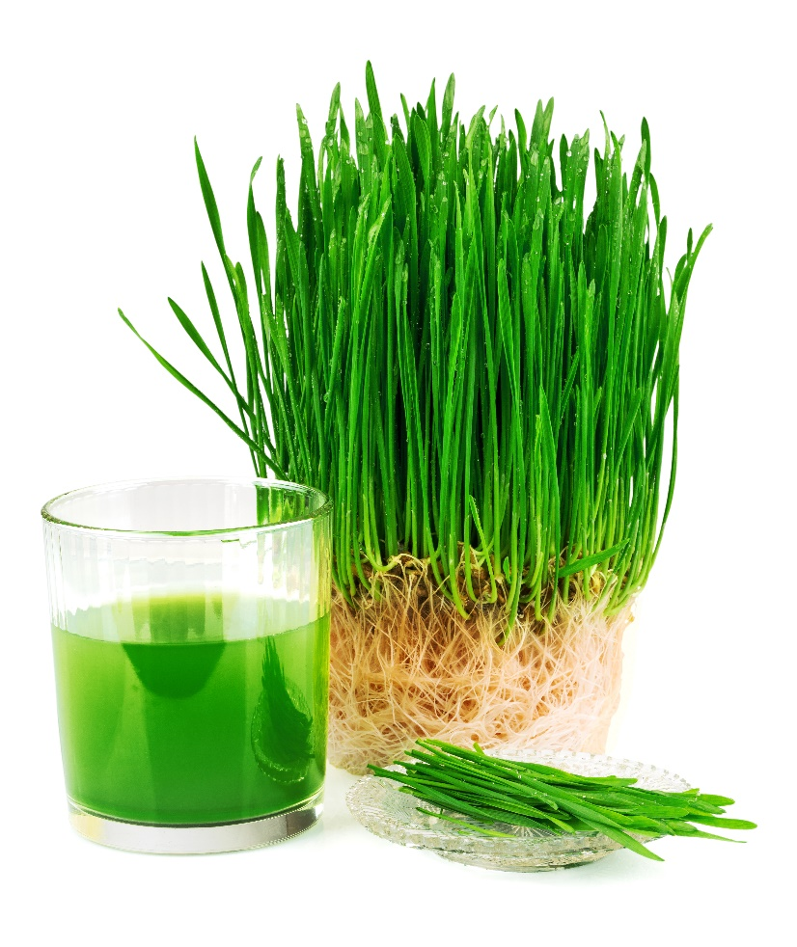
DAY 15
Phantastic Phacts
So, what is acidic? Fried foods, animal products ... you get it. Alkaline is the good green stuff. When you eat acidic food, your body works like crazy to bring it back to an alkaline state, and that is how you get sick. It robs your mineral stores to overcompensate, and this is where the trouble comes in.
The standard American diet (sad) is acidic: burgers, cheese and coffee. All the stuff that gets eaten every day is eating up all the good things in your body. Bottom line is you need your minerals. Your body does not replenish its minerals. Once you use them, they are gone. If you want more, you need to eat them. Minerals help your body to build essentials for your health; proteins, enzymes, hormones, etc. Foods that are high in minerals are alkaline.
You can exercise to improve your pH balance! Exercise helps the body to balance pH!

Slide 13
DAY 15
Phantastic Phacts
AVOID ENJOY
Cold-water fish Asparagus Melons Buckwheat
Beef Beets Avocados Millet
Venison Bell peppers Papayas Quinoa
Pork Broccoli Pomegranates Amaranth
Wild game Carrots Bananas Stevia
Poultry Cauliflower Strawberries Beans
Shellfish Chlorella Flax seed Peas
Eggs Celery Hemp seed Cold-pressed hemp
Milk (raw and pasteurized) Chicory White chia seed Apples
Butter Cucumber Sesame seed Cantaloupe
Cheese Kelp Almonds Flax seed oil
Cream Leafy greens Coconut Borage seed oil
Coffee Radishes Brazil nuts
Synthetic supplements Lemons Spirulina
Pharmaceutical drugs Limes Sprouts
Coffee Mangoes Zucchini
Roasted peanuts
Soft drinks
Isolated soy and whey protein

Slide 14
DAY 15
The Dirty Dozen
Apples – A tree fruit that always makes the list. More than 40 different pesticides have been detected on apples because fungus and insect threats prompt farmers to spray various chemicals on their orchards. Not surprisingly, pesticide residue is also found in apple juice and apple sauce, making all apple products smart foods to buy organic. Some recommend peeling apples to reduce exposure to pesticide residue but be aware that you're peeling away many of the fruit's most beneficial nutrients when you do so! Can't find organic apples? Safer alternatives include watermelon, bananas and tangerines.
Celery – Another perennial food on the dirty dozen list. It's a good one to commit to memory, since it doesn't fit the three main categories of foods with the highest pesticide residue (tree fruits, berries and leafy greens). USDA tests have found more than 60 different pesticides on celery. Can't find organic celery? Not to worry. Some safer alternatives with a similar crunch include broccoli, radishes and onions.
Strawberries – Strawberries are always on the list of dirty dozen foods, in part because fungus prompts farmers to spray and pesticide residue remains on berries sold at market. Nearly 60 different pesticides have been found on strawberries, though fewer are found on frozen strawberries. Can't find organic strawberries? No worries! Safer alternatives include kiwi and pineapples.

Slide 15
DAY 15
The Dirty Dozen
Peaches – Another tree fruit that always makes the list. More than 60 pesticides have been found on peaches and nearly as many in single-serving packs, but far fewer in canned peaches. Safer alternatives include watermelon, tangerines, oranges and grapefruit.
Spinach – Leading the leafy green pesticide residue category is spinach, with nearly 50 different pesticides. (While frozen spinach has nearly as many, canned has had fewer detected pesticides.)
Nectarines (imported) – Nectarines, at least imported ones, are among the most highly contaminated tree fruits. Domestic nectarines don't test with as much pesticide residue, but overall 33 pesticides have been detected on nectarines. Can't find organic nectarines? Try pineapple, papaya or mango instead.
Grapes – Another perennial entrant on the dirty dozen list, imported grapes can have more than 30 pesticides. Raisins, not surprisingly, also have high pesticide residue tests. Makes you wonder about wine, eh?
Sweet Bell Peppers – Another fruit that usually makes the dirty dozen list because it tends to have high pesticide residue is the sweet bell pepper, in all of its colorful varieties. Nearly 50 different pesticides have been detected on sweet bell peppers.

Slide 16
DAY 15
The Dirty Dozen
Potatoes – America's favorite vegetable is the potato; unfortunately, more than 35 pesticides have been detected on potatoes in USDA testing. Sweet potatoes offer a delicious alternative with less chance of pesticide residue.
Blueberries – Blueberries usually make the dirty dozen list, since more than 50 pesticides have been detected as residue on them. Frozen blueberries have proved somewhat less contaminated. Unfortunately, obvious alternatives like cranberries and cherries, while they may not make the dirty dozen list this year, are often contaminated themselves. For breakfast cereal, if you can't find blueberries, consider topping with bananas.
Lettuce – Joining spinach in the leafy greens category, lettuce makes the list of dirty dozen foods with the most pesticides. More than 50 pesticides have been identified on lettuce. If you can't find organic lettuce, alternatives include asparagus..
Kale – A superfood, traditionally kale is known as a hardier vegetable that rarely suffers from pests and disease, but it was found to have high amounts of pesticide residue when tested in each of the past two years. Can't find organic kale? Safer alternatives include cabbage, asparagus and broccoli. Dandelion greens also make a nutritious alternative.

Slide 17
DAY 15
Juice or Blend
Blenders retain everything from the food. They take the fiber and pulp and blend it all together.
Juicers separate the pulp from the juice, and we drink the juice only.
When you first start out, juicing is a lot easier on your body. Whether you are juicing to treat a health condition or just to stay healthy, you will experience a lot of detoxification if you are not used to all that fiber. The juice will still give you loads of energy.
When you get used to the juice, and if you enjoy the texture, go ahead and try smoothies.
When we juice green vegetables, we liberate the chlorophyll and our bodies immediately absorb it. Chlorophyll is a detoxifier, deodorant and is an incredible healer of inner and topical inflammation and wounds. The chlorophyll remakes our blood. It is centered on magnesium and our blood is centered on iron.
IMPORTANT JUICE NOTE
You need to be careful and use simple juices if you are on a lot of medication. If you are very sick, you will probably release toxins very quickly. This will happen in the form of bowel movements. Sometimes your liver dumps a lot of toxins. Chlorophyll is a neutralizer of toxins and can deal with anything you have. It is good for kidney, heart and liver conditions. Green juice is an amazing detoxifier.

Slide 18
DAY 15
Sugar Addiction
FACT! WE ARE ALL PROGRAMMED TO LIKE SUGAR.
New research shows some are genetically much more prone to sugar and food addiction than others. I have observed this in my patients, but now it is becoming clear why some have more trouble kicking the sugar habit than others.
The science demonstrating that people can be biologically addicted to sugar in the same way some can be addicted to heroin, cocaine or nicotine is clear. Bingeing and addictive behaviors are eerily similar in alcoholics and sugar addicts. In fact, most recovering alcoholics often switch to another easily available drug: sugar.
It seems that we all vary a bit in our capacity for pleasure. Some need a lot more stimulation to feel pleasure, thus driving us to a range of addictive pleasures that stimulate the reward center in our brain—drug and alcohol addictions, compulsive gambling, sex addiction and of course, sugar, food addiction and compulsive eating.
We often see these as failures or results of character defects. In fact, it may be that addicts of all stripes are simply unlucky and born with unfortunate genetic variations in our reward and pleasure mechanisms.
Adapted from Blood Sugar Solution, Dr. Mark Hyman

Slide 19
DAY 15
Sugar Addiction
The Genetics of Pleasure
In our brain, a little receptor, the dopamine receptor DRD2 (or D2 for short), must be activated or switched on for us to feel pleasure. The amino acid dopamine triggers this response. Sugar and other stimulating addictions increase dopamine in the short term.
The only problem is it appears that those with sugar addictions, compulsive eating and obesity have D2 systems that need much more stimulation to feel pleasure. Those who have sugar addiction, it seems have fewer D2 dopamine receptors and they need extra stimulation to make them “turn on”.(i)
Functional MRI studies of teenagers, both lean and obese, found that the obese teenagers whose brains didn’t light up as much in the dopamine reward centers were more likely to be obese and gain weight later.(ii) They also were more likely to have the D2 gene that coded for fewer receptors.
Some studies have pointed to drugs or nutrients that can modulate this defective dopamine reward response. In one study, naltrexone, an opioid blocker (blocks the effects of heroin and morphine on the brain) was used in sugar addicts. When they took this drug, which prevented them from getting the temporary high from sugar, they craved less and ate less.
Adapted from Blood Sugar Solution, Dr. Mark Hyman

Slide 20
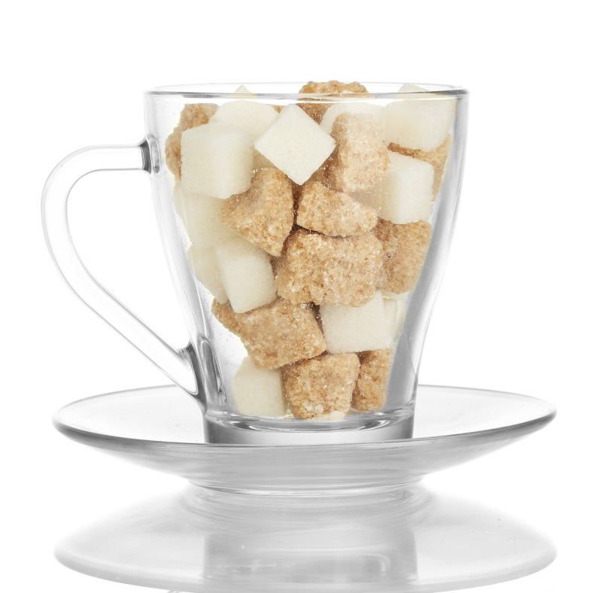
DAY 15
Sugar Addiction
There are also some promising studies of nutraceuticals that can modulate dopamine receptor function and appetite regulation.
Bruce Ames, Ph.D., found that high levels of nutrients can reduce disease in people with 50 different gene variants. Nutrients may modulate the function of our genes, improve their function, or affect the activity of enzymes that genes produce. In fact, one third of our entire DNA has one simple job: To code for and produce enzymes controlled by nutrient co-factors. This means that nutrients have a powerful ability to modify the expression of your genes.
Adapted from Blood Sugar Solution, Dr. Mark Hyman

Slide 21
DAY 15
Sugar Addiction
Overcoming Your Sugar Addiction
Despite being stuck with the sugar addiction low-pleasure gene, you may be able to modify its activity by modulating your brain chemistry and receptor function with the use of specific nutrients that either improve gene expression or modify the activity, the enzymes or the receptors, even if they are somewhat impaired.
Regulation of hormones and neurotransmitters that affect appetite and cravings is complex and involves many factors, including how quickly food spikes our blood sugar, stress, getting enough sleep, nutritional deficiencies, chemicals such as artificial sweeteners, food sensitivities which drive inflammation, and more.
For those with personal struggles with food addiction, remember it is not a moral failing or lack of willpower.
Adapted from Blood Sugar Solution, Dr. Mark Hyman

Slide 22
DAY 15
Sugar Addiction
Balance your blood sugar: Research studies say that low blood sugar levels are associated with LOWER overall blood flow to the brain, which means more BAD decisions. To keep your blood sugar stable:
Eat a nutritious breakfast with some protein, like eggs, protein shakes or nut butters. Studies repeatedly show that eating a healthy breakfast helps people maintain weight loss.
Have smaller meals throughout the day. Eat every 3-4 hours and have some protein with each snack or meal (lean animal protein, nuts, seeds or beans).
Avoid eating 3 hours before bedtime.
Eliminate sugar and artificial sweeteners and your cravings will go away. If you are addicted to narcotics or alcohol you can’t simply just cut down. You must stop for you brain to reset. Eliminate refined sugars, sodas, fruit juices and artificial sweeteners from your diet. These are all drugs that will fuel cravings.
Determine if hidden food allergies are triggering your cravings. We often crave the very foods that we have a hidden allergy to.
Get 7-8 hours of sleep. Research shows that lack of sleep increases cravings.
Optimize your nutrient status.
Adapted from Blood Sugar Solution, Dr. Mark Hyman

Slide 23
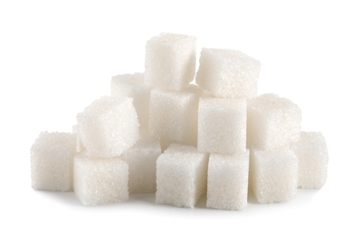
DAY 15
Sugar Addiction
Optimize your vitamin D level. According to one study, when Vitamin D levels are low, the hormone that helps turn off your appetite doesn’t work and people feel hungry all the time, no matter how much they eat.
Optimize Omega-3s. Low levels of Omega-3 fatty acids are involved in normal brain cell function, insulin control and inflammation
Consider taking natural supplements to control cravings. Glutamine, tyrosine and 5-HTP are amino acids that help reduce cravings. Stress reducing herbs such as Rhodiola can help. Chromium balances blood sugar and can help take the edge off cravings. Glucomannan fiber is very helpful to reduce the spikes in sugar and insulin that drive cravings and hunger.
Adapted from Blood Sugar Solution, Dr. Mark Hyman

Slide 24
DAY 14
Swapping Sweet
Sweetener | Substitution Ratio
Confectioners' sugar | 1 3/4 cups for each 1 cup sugar
Brown sugar | 1 cup firmly packed for each 1 cup sugar
Turbinado sugar | 1 cup for each 1 cup sugar
Maple syrup | 3/4 cup for each 1 cup sugar
Honey | 3/4 cup for each 1 cup sugar
Barley malt or rice syrup | 3/4 cup for each 1 cup sugar
Molasses | 1 1/4 cups for each 1 cup sugar
Stevia | Read packaging label
Dates | 1 cup pureed
Banana | 1 cup mashed
Figs | 8 oz pureed
Adapted from Whole Foods

Slide 25
DAY 15
Sugar & Aging
Sugar & Aging
Sugar in all of its forms (corn syrup, cane sugar, high-fructose corn syrup, etc.) is extremely damaging to the skin and, in fact, to all organ systems. Yes, enjoy that yogurt, but eat it plain or add fresh fruit. The sweetened varieties sabotage a healthy lifestyle.
Sugar suppresses the activity of our white blood cells, which makes us more susceptible to infectious disease (colds, flu, etc.) as well as cancer. The same dysfunction of the white blood cells can also make allergies worse.
Collagen's Natural Enemy I know that wrinkles, deep lines and sagging skin are a partial by-product of the process known as glycation. Sugar and other high-glycemic carbohydrates (breads, starches, potatoes, baked goods, pastas and desserts) are rapidly converted to glucose in your bloodstream. This overload can cause a reaction called glycation, in which the excess sugar molecules attach themselves to collagen fibers. Glycation occurs when a glucose (sugar) molecule binds to a protein molecule without the influence of enzymes. In scientific terms, we refer to these sugar/protein bondings as AGEs, an appropriate acronym for advanced glycosylation end products. This causes them to lose their strength and flexibility, leaving the skin less elastic and more vulnerable to sun damage, lines and sagging.
Adapted from 10/12, Dr. Perricone on Sugar

Slide 26
DAY 15
Sugar
Not Just Skin Deep While wrinkled skin is one of the visible appearances of AGEs, most degenerative diseases are affected in one way or another by disease-producing glycation reactions. These reactions result in major damage to the body, including arterial stiffening, atherosclerosis, the formation of cataracts, neurological impairment, diabetic complications, wrinkled or sagging skin, and more. In fact, AGEs lie at the very heart of the aging process across all specialties, from the skin to the brain. AGEs can be responsible for wrinkles, heart disease, cancer, diabetes, and much more, including the age-related memory loss and even Alzheimer's disease.
Simply put, the formation of AGEs is responsible for serious damage to the body, both internally and externally, and sugar is a major culprit.
Adapted from 10/12, Dr. Perricone on Sugar

Slide 27
DAY 15
Sugar
The Glycation Fighter: Alpha Lipoic Acid We also have a number of highly effective topical anti-glycation treatments for skin. Alpha lipoic acid (ALA), a very powerful nutrient when taken as a supplement, is also important as a topical treatment. It is highly recommended as a nutritional supplement because it has powerful anti-glycating effects and is an extremely important anti-inflammatory.
Alpha lipoic acid increases the cell's ability to take up glucose for metabolism. This removes it from the blood, thereby helping to prevent damaging glycation reactions. Because it is both fat- and water-soluble, it can reach all portions of the cell, providing complete protection. This is true whether it is taken as a supplement or used as a topical. ALA's fat solubility allows it to penetrate the skin where it can wield its anti-inflammatory power to great benefit. It protects the cells from free radical damage and halts the initiation of skin-damaging inflammatory cascade.
Adapted from 10/12, Dr. Perricone on Sugar

Slide 28
DAY 15
Sugar
What About Sweeteners? My patients often ask me if eating sugar and other forms of sweeteners can contribute to acne. The answer is yes. When our blood sugar and insulin levels rise, whether from a poor diet (sugary, starchy foods) or from stress, we experience a serious increase in inflammatory chemicals at a cellular level. This causes inflammatory diseases such as acne to worsen dramatically. Cortisol and other adrenal steroids can act as androgens (male hormones) and stimulate the sebaceous (oil) glands, resulting in a flare-up of acne.
If you are concerned about your health, and not accelerating the aging process, it is best to avoid all forms of refined sugar as well as chemical artificial sweeteners. There are natural sugars found in fruits and vegetables that should be our only source of sugar. These foods help stabilize blood sugar and are high in anti-inflammatory antioxidants and nutrients that promote beautiful skin and a healthy body.
Adapted from 10/12, Dr. Perricone on Sugar

Slide 29
DAY 15
The Food Diary
The Food Diary
Be honest. Write down what you really eat.
Be accurate. Measure portions and read labels.
Be complete. Include every little scrap you eat.
Diary | Time | Portion | What | How do you feel?
Breakfast
Snack
Lunch
Snack
Dinner
Snack
Liquids

Slide 30
CONGRATS
YOU DID IT!

