Slide 1
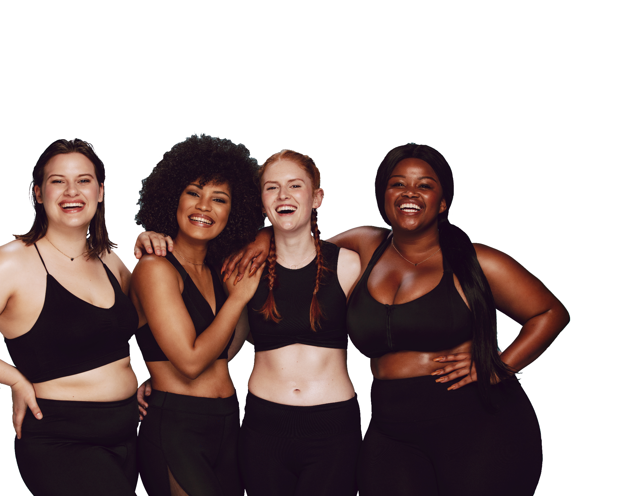
FUN &
HEALTHY
28 DAY WEIGHT LOSS JOURNEY
MODULE SIXTEEN

Slide 2
Task
DAY 16
Practice an act of kindness with no expectation in return.

Slide 3
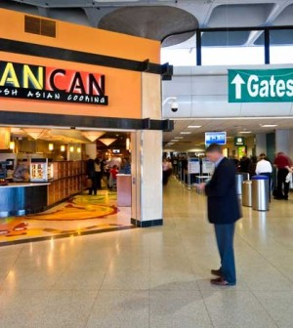
Journaling
DAY 16
Ask for the foods you want:
Ask for low-fat, low-calorie foods.
Ask if foods can be cooked in a different way.
Do not be afraid to ask for foods that are not on the menu.
Ask for the amounts you want:
Ask how large the serving size is.
Order salad dressing, gravy, sauces or spreads on the side.
Ask for less cheese or no cheese.
Split a main dish or dessert with someone.
Order a small size (appetizer, children’s size, half portion).
Before or after the meal, have the amount you do not want to eat put in a container to take home.

Slide 4
DAY 16
Traveling
How to ask for what you want:
Use a firm and friendly tone of voice that can be heard.
Look the person in the eye.
Repeat your needs until you are heard.
Keep your voice calm.
If the server brings you something you didn’t ask for:
Avoid being threatening or the opposite (wishy-washy)
Be firm and friendly.
“This looks very nice. But I asked for broiled fish, not fried. Please may I have some broiled fish?”
Take Charge of What’s Around You
Here are some important tips for taking charge of what is around you that will help you continue to make healthy choices when you are not eating at home.
Be the first to order.
You will be less likely to order unhealthy meals that other people order.
Keep foods off the table that you do not want to eat.
Ask the server to remove bread and butter from the table.
Ask the server to remove your plate as soon as you finish.
You’ll be less likely to pick at the leftover food on your plate.

Slide 5
DAY 16
Traveling
Do’s | Dont’s | More Don’ts
Baked | Au Gratin | Parmesan
Boiled | Breaded | Pastry
Broiled | Buttered | Rich
Grilled | Cheese Sauce | Sautéed
Poached | Creamed | Escalloped
Roasted | Fried | Scalloped
Steamed | Gravy | Seasoned
Stir-fried | Hollandaise | Southern Style

Slide 6
DAY 16
Traveling
Planning ahead is the secret to healthy eating when you travel.
Stick to whole foods, with just a little packaged foods if necessary.
Plane travel may cause water retention, bloating and gas. Skip the soft drinks and alcohol. Drink water, lots of water. Try it one time and you will understand the importance. It is the difference between getting off the plane with giant ankles and swollen feet and comfortably walking off the plane.
Focus on enjoying your family, friends and the relaxation and atmosphere.
Check out available restaurants and menus before you leave home.
Bring foods with you. Pack a bag of homemade protein bars, fruit, nuts and celery.
Stop at the farmer’s market when you arrive at your destination. You will not only enjoy nice, fresh, whole foods, but you will get to be introduced to a part of the culture that most people don’t encounter.
Bring any bottles, tools or utensils that you may need in preparing foods you bring with you.
Talk to people who live in the area and find out good places to shop or eat out.

Slide 7
DAY 16
The Food Diary
The Food Diary
Be honest. Write down what you really eat.
Be accurate. Measure portions and read labels.
Be complete. Include every little scrap you eat.
Diary | Time | Portion | What | How do you feel?
Breakfast
Snack
Lunch
Snack
Dinner
Snack
Liquids

Slide 8
CONGRATS
YOU DID IT!

