Slide 1
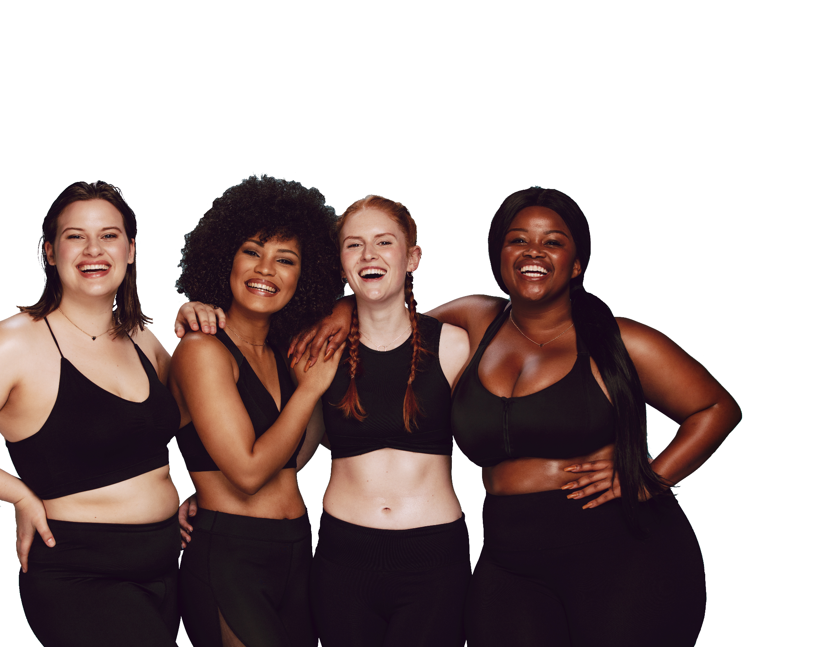
FUN &
HEALTHY
28 DAY WEIGHT LOSS JOURNEY
MODULE EIGHTEEN

Slide 2
Task
DAY 18
Make a list of 10 ways you are beautiful.

Slide 3
Beauty
DAY 18
Internal cleanliness creates external beauty. This is the great surprise. All the things you do in this 28-day program lead you to a way of life that creates a beauty that glows from the inside out. The principles you have learned, nutrition and exercise. The advanced principles of pH balance, acid and alkaline are key factors in creating external beauty.
“Proper nutrition is an art. It is an art form. Every bite is a brush stroke. Every swallow is a new color. Each meal is a cloud or a tree or a flower. – a piece of the beautiful painting you are becoming. You are becoming an even more attractive work of art each day. You are truly a work of art in progress.” David Wolfe
If you apply the lessons contained within this program to improve your appearance, vitality and health, beauty is the natural outcome of healthy living.

Slide 4
DAY 18
Inflammation
It has become increasingly obvious that chronic inflammation is the main cause of many chronic illnesses, including heart disease, many cancers and Alzheimer's disease.
We recognize inflammation as redness, heat, swelling and pain. It is a natural healing response to bring nourishment and immunity to an injury or infection. When the inflammation serves no purpose and refuses to go away, it causes illness.
Some of the things that contribute to inflammation include stress, lack of exercise, dietary choices, genetics and exposure to toxins (like secondhand tobacco smoke, prescription drugs like steroids and NSAIDs, and metals). Learning how to adjust dietary choices is one of the best ways to deal with chronic inflammation.
There is a blood test that detects inflammation. You should talk to your doctor and have them check your CRP or C-reactive protein (a protein that is found in the blood and is the major red flag for inflammation).

Slide 5
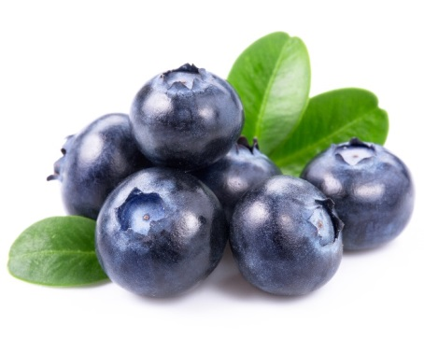
DAY 18
Inflammation
Anti-inflammatory Foods
Blueberries
Chocolate (dark, uncooked)
Cruciferous vegetables
Extra Virgin Olive Oil
Ginger
Garlic
Green Tea
Kelp
Sweet Potato
Turmeric
Watercress
Wild Alaskan Salmon
Inflammatory Foods
Sugar
Cooking Oils
Trans Fats
Dairy
Feedlot-Raised Meat
Red and Processed Meat
Alcohol
Refined Grains
Artificial Food Additives: Aspartame and MSG
Any food that you are allergic to and eat anyway

Slide 6
DAY 18
Inflammatory Foods
Sugar – Sugar is in many processed foods and we don’t even realize it.
Cooking Oils – Corn, cottonseed, safflower, soy and sunflower.
Trans Fats – Check all labels and NEVER eat trans fats.
Dairy – Milk is a common allergen that can trigger inflammation, stomach problems, skin rashes, hives and even breathing difficulties.
Feedlot-Raised Meat – Animals are fed the foods that cause inflammation for us. They are also given hormones and antibiotics.
Red and Processed Meat – We develop antibodies that cause inflammation.
Alcohol – Regular alcohol use creates irritation and inflammation to numerous organs, which can lead to cancer.
Refined Grains – "Refined" products have no fiber and have a high glycemic index. These include white rice, flour, bread and pasta.
Artificial Food Additives – Aspartame and MSG
Allergens – Any food that you are allergic to and eat anyway.

Slide 7
DAY 18
The Food Diary
The Food Diary
Be honest. Write down what you really eat.
Be accurate. Measure portions and read labels.
Be complete. Include every little scrap you eat.
Diary | Time | Portion | What | How do you feel?
Breakfast
Snack
Lunch
Snack
Dinner
Snack
Liquids

Slide 8
CONGRATS
YOU DID IT!

