Slide 1
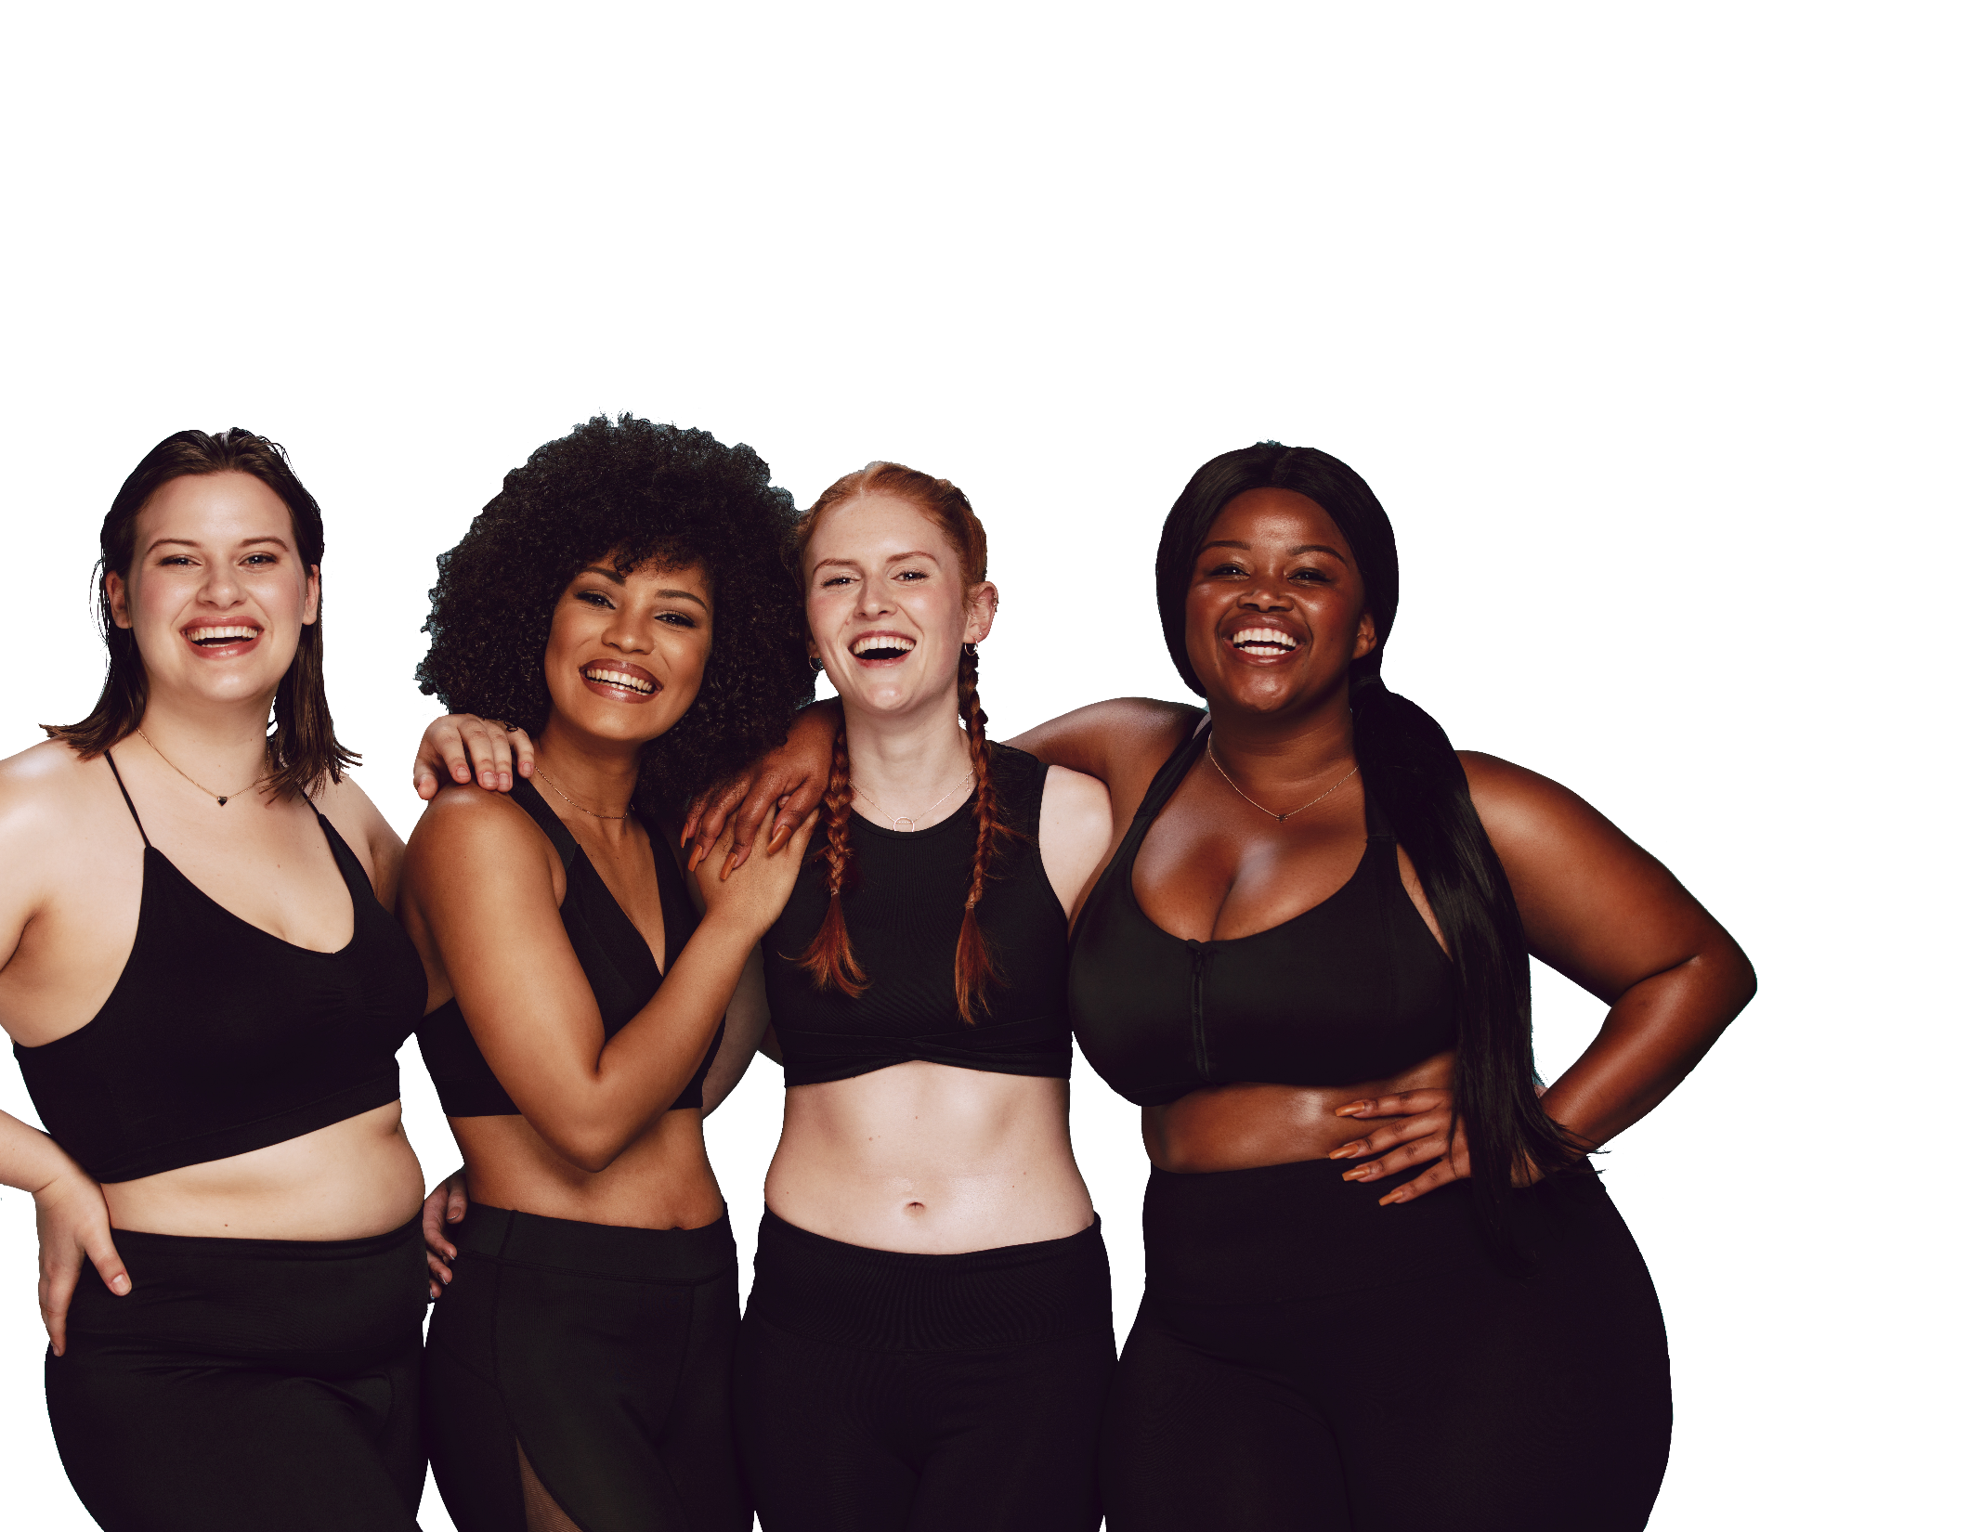
FUN &
HEALTHY
28 DAY WEIGHT LOSS JOURNEY
MODULE TWENTY

Slide 2
Task
DAY 20
Focus on relationships! Practice an act of kindness with no expectation in return.

Slide 3
DAY 20
Relationships
Relationships
“Whenever you’re in conflict with someone, there is one factor that can make the difference between damaging your relationship and deepening it. That factor is attitude.” – William James
Relationships are like houses: in order for them to stand the tests of time, they need a good foundation. The very first thing you do when constructing a home is to decide what kind of foundation you want and need. Similar things are required when starting a new relationship. You have to do your due diligence and make sure the person you are interested in has the right attitude, good communication skills and a solid emotional interest in pursuing something real. If you are both in the same place and most everything fits together, your new relationship has a good foundation and a much better chance of success.
When you have a positive foundation, you have the knowledge, strength and confidence necessary to create anything you want and to take it as far as you like. It also gives you the ability to take a risk. This is a basic truth that those who have accomplished their dreams all share.
Barton Goldsmith, Ph.D. “The Best Tools for Building a Healthy Relationship Foundation.”

Slide 4
DAY 20
Relationships
Relationships
Even if you don’t have what you need right now, there is nothing wrong with doing a little work to make your foundation as strong as possible. Self-actualized people take the steps necessary to get the support they need to heal the issues that always arise.
Like homes, all relationships need regular maintenance and perhaps even serious repairs along the way. This doesn't mean you have failed; these are things that happen over time. Most contractors will tell you that if your house has good bones, you can fix whatever you need to or even remodel and expand. This goes for the rest of your life as well.
Judging yourself or your mate harshly because something didn't go right (welcome to the human race) won't help you out of your problem. Relying on the foundation of what you have created together and trusting that you can accomplish anything, makes dealing with those expected but unforeseen problems much easier. If you have the right tools, such as a belief that you belong together, a willingness to accept assistance and a loving partner, you can handle whatever it is that comes along.
Barton Goldsmith, Ph.D. “The Best Tools for Building a Healthy Relationship Foundation.”

Slide 5
DAY 20
Relationships
Relationships
Having a good foundation doesn't require any special training or education. You can rely on your talents, experiences and the abilities of those you are with to create the life, love or home that you desire.
Our foundations can come from anywhere. Perhaps your dad taught you how to build and fix things, or maybe your mom gave you a talent for and interest in decorating and you've always been good at it but never really knew quite why. If they were good together, your parents also taught you how to build a good relationship, which is one of the best gifts they could give you.
Having respect for a strong foundation, whether it comes easily to you or you've had to struggle to build it, is the way you create a life for yourself and for those you love.
Human beings crave intimacy and a need to love and be loved, yet people struggle to do so.
It's clear from the many letters I get that lots of folks have no idea what a healthy relationship even looks like.
Barton Goldsmith, Ph.D. “The Best Tools for Building a Healthy Relationship Foundation.”

Slide 6
DAY 20
Relationships
Relationships
This list is a collaboration from sources and experts. This is by no means an exhaustive list, but it's a start. Print them out and put them on your refrigerator door. I won't test you on them, but life will.
Choose a partner wisely and well. We are attracted to people for all kinds of reasons. They remind us of someone from our past. They shower us with gifts and make us feel important. Evaluate a potential partner as you would a friend; look at their character, personality, values, their generosity of spirit, the relationship between their words and actions and their relationships with others.
Know your partner's beliefs about relationships. Different people have different and often conflicting beliefs about relationships. You don't want to fall in love with someone who expects lots of dishonesty in relationships; they'll create it where it doesn't exist.
Adapted from Marano, Hara Estroff. "Relationship Rules."

Slide 7
DAY 20
Relationships
Relationship Tips
Don't confuse sex with love. Especially in the beginning of a relationship, attraction and pleasure in sex are often mistaken for love.
Know your needs and speak up for them clearly. A relationship is not a guessing game. Many people fear stating their needs and, as a result, camouflage them. The result is disappointment at not getting what they want and anger at a partner for not having met their (unstated) needs. Closeness cannot occur without honesty. Your partner is not a mind reader.
Respect, respect, respect. Inside and outside the relationship, act in ways so that your partner always maintains respect for you. Mutual respect is essential to a good relationship.
View yourselves as a team, which means you are two unique individuals bringing different perspectives and strengths.
Know how to manage differences; it's the key to success in a relationship. Disagreements don't sink relationships, name calling does. Learn how to handle the negative feelings that are the unavoidable byproduct of the differences between two people. Stonewalling or avoiding conflicts is NOT managing them. If you don't understand or like something your partner is doing, ask about it and why he or she is doing it. Talk and explore; don't assume.
Adapted from Marano, Hara Estroff. "Relationship Rules."

Slide 8
DAY 20
Relationships
Relationship Tips
Solve problems as they arise. Don't let resentments simmer. Most of what goes wrong in relationships can be traced to hurt feelings, leading partners to erect defenses against one another and to become strangers or enemies.
Learn to negotiate. Modern relationships no longer rely on roles cast by culture. Couples create their own roles, so virtually every act requires negotiation. It works best when goodwill prevails. Because people's needs are fluid and change over time and life's demands change too, good relationships are negotiated and renegotiated all the time.
Listen, truly listen, to your partner's concerns and complaints without judgment. Often just having someone listen is all we need for solving problems. It can open the door to confiding. And empathy is crucial. Look at things from your partner's perspective as well as your own.
Work hard at maintaining closeness. Closeness doesn't happen by itself. In its absence, people drift apart and are susceptible to affairs. A good relationship isn't an end goal; it's a lifelong process maintained through regular attention.
Take a long-range view. A marriage is an agreement to spend a future together. Check out your dreams with each other regularly to make sure you're both on the same path. Update your dreams regularly.
Adapted from Marano, Hara Estroff. "Relationship Rules."

Slide 9
DAY 20
Relationships
Relationship Tips
Never underestimate the power of good grooming.
Sex is good. Pillow talk is better. Sex is easy; intimacy is difficult. Intimacy requires honesty, openness, self-disclosure, confiding concerns, fears, sadness as well as hopes and dreams.
Adapted from Marano, Hara Estroff. "Relationship Rules.”
“Every person you see has stories,
and every person you see has a few that would break your heart.
We deserve each other’s respect simply because
we’ve survived all that we have and kept going anyway.”
-Victoria Moran

Slide 10
DAY 20
Relationships
It has been said that “he who lives for himself alone lives for the meanest mortal known.” Compassion expands us. It extends our scope of positive influence beyond our immediate situation. Any success is hollow without it.
The literal definition of compassion is “to feel with.” It means living with the knowledge that your life is as important as mine, your dreams as valid, your children as precious and your pain as real. Compassion gives us a more valid view of the world by taking us out of its center. Every person you see has stories, and every person you see has a few that would break your heart. We deserve each other’s respect simply because we’ve survived all that we have and kept going anyway.
Compassion fuels kindness, gentleness and patience. It helps you realize that everybody else is doing the best they can, just as you are. It makes it easier to give other imperfect people the benefit of the doubt. Compassion is also an invaluable aid in accepting others as they are and allowing them to be different from us.
Enhance your compassion by starting close to home, with yourself. We can be so hard on ourselves. Find the midpoint between putting yourself down and rationalizing mistakes away. Accept responsibility, but don’t waste time with guilt.
Victoria Moran, Creating a Charmed Life

Slide 11
DAY 20
Relationships
Treat yourself as you would a treasured friend!
Go from showing more compassion toward yourself to showing more compassion to those closest to you. These are the people we love so dearly that feeling their pain splits us in two. Love without compassion, however, gets twisted. It results in emotional oddities like feeling angry because loved ones aren’t happy, or letting our fear of losing them overshadow their needs for growth, experience, and self-determination.
Express more compassion toward other people in your world. Listen and help out as much as you can. A little thoughtfulness goes a long way. Avoid overextending yourself for others: misappropriated compassion can deplete your resources, thereby short-circuiting the process.
Be on guard for overextending as you go beyond those you know to express compassion to those you don’t. There is no shortage of suffering. The sheer magnitude can make us want to retreat into the comfort of more agreeable circumstances. One way to protect yourself while allowing your compassion to grow is to choose one cause that speaks to you and support it actively with your labor, your capital or both. That way, you can know that even though you can't save the world, you can make a difference in one piece of it.
Victoria Moran, Creating a Charmed Life

Slide 12
DAY 20
Relationships
Finally, let your compassion go beyond the boundaries of human need to encompass other creatures too. “Until he extends the circle of his compassion to all living things,” wrote Dr. Albert Schweitzer, “man will not himself find peace.” Become conversant with the notion that there really is a majestic web of life and that all members of it hold their own lives dear.
Follow your compassion where it takes you, even though some people are bound to disapprove. Perhaps your cause isn’t theirs or the suffering that pierces your soul doesn’t seem real to them. They may simply be so involved with their own concerns that little else matters. Save some compassion for them too!
Victoria Moran, Creating a Charmed Life

Slide 13
DAY 20
The Food Diary
The Food Diary
Be honest. Write down what you really eat.
Be accurate. Measure portions and read labels.
Be complete. Include every little scrap you eat.
Diary | Time | Portion | What | How do you feel?
Breakfast
Snack
Lunch
Snack
Dinner
Snack
Liquids

Slide 14
CONGRATS
YOU DID IT!

