Slide 1
FUN &
HEALTHY
28 DAY WEIGHT LOSS JOURNEY
MODULE TWENTYONE

Slide 2
Task
DAY 21
Find a spot in your house that is cluttered and clear it out.

Slide 3
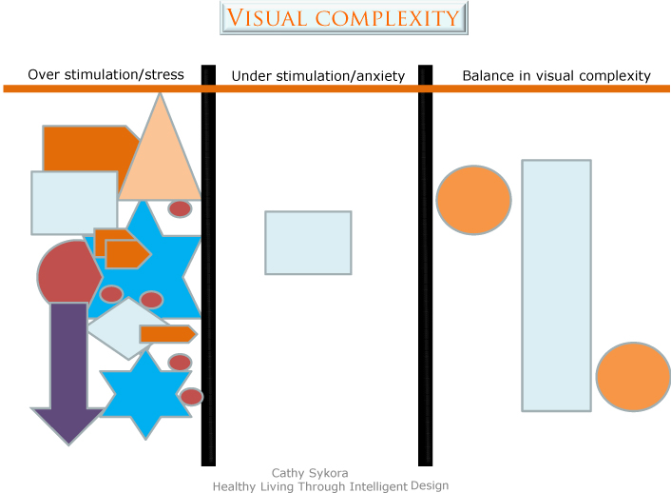
DAY 21
De-Clutter
Let’s look at our environment and see what is challenging or helping your efforts.
There have been many studies that show that visual complexity affects our feelings. This diagram illustrates the results.

Slide 4
DAY 21
De-Clutter
We react to sensory stimulation. Sensory information comes from sight, sound, touch, taste and smell. Any of our five senses can be over-stimulated. The important thing to understand in your home is your stimulation threshold. It is important to reach a healthy balance between what is too much and what is not enough.

Slide 5
DAY 21
De-Clutter
There are many elements that add visual stimulation to a space. “Stuff” is one of our bigger problems: kids’ toys, moms’ books, dads’ video games. These all add to visual complexity when left out. Furniture, accessories, window treatments and wall hangings as well as lighting can add to visual complexity.
Other clutter in the house can also be draining. This is a good time to go through your house and office and clear out all the items that clutter your life. Be ruthless! Sell, donate or toss anything that you do not have a use for and haven’t used for the past 3 years. We have become so enamored with collecting “stuff” that our lives are overflowing with it and we sometimes form unhealthy attachments.
What you are going for is a healthy, energizing space that promotes physical and spiritual well being.
“Collaborate with nature. Value beauty. Respect your intuitive inklings about the colors, shapes, textures and patterns that populate your personal world. Create an environment that entices fortune.” -Victoria Moran
.

Slide 6
DAY 21
De-Clutter
We as humans are limited to the amount of information we can process. We can experience overload in a cluttered space. This overload causes stress. The tricky part is that we all have different thresholds. Under-stimulation can cause anxiety. If we have been living in an
environment with high stimulation, then we may have adapted and enjoy the arousing and pleasurable environment. It would take a lot of stimulation to overstimulate us.
If we are overstimulated in our workplace, we will probably relax better in a home that has less visual complexity. If our career has us in a very sterile environment, we may look for more complexity to offer intellectual and spiritual stimulation.
People with attention deficit disorders will not have the same threshold as a person who requires less time to understand and retain information. There is also research and theory that an effortless attention can restore the capacity to pay attention. The best example of this would be to draw ourselves to nature in our surroundings.

Slide 7
DAY 21
De-Clutter
If you want to determine if you have a high threshold for visual complexity, look at the following homes. Which one are you drawn to?
The first has a good deal of visual stimulation. The second blends with the environment and would offer less visual stimulation.

Slide 8
DAY 21
The Food Diary
The Food Diary
Be honest. Write down what you really eat.
Be accurate. Measure portions and read labels.
Be complete. Include every little scrap you eat.
Diary | Time | Portion | What | How do you feel?
Breakfast
Snack
Lunch
Snack
Dinner
Snack
Liquids

Slide 9
CONGRATS
YOU DID IT!

