Slide 1


FUN &
HEALTHY
28 DAY WEIGHT LOSS JOURNEY
MODULE TWENTYTHREE

Slide 2

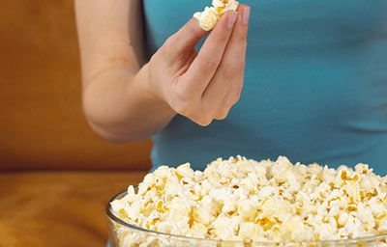
Task
DAY 23
What unhealthy habits do you have? Consider taking steps to eliminate them. Talk to your health coach about it.
Thi

Slide 3
DAY 23
Neat
Your body will expend or burn energy in three ways during each day.
Metabolic Rate
Each person has their own metabolic rate (how the body burns/expends energy while resting). Your unique metabolic rate accounts for roughly 60% of the energy your body uses in a day, and that’s before you add in any activities!
Eating Food
It takes energy to eat your food! Consumption of food and the associated processes (digestion, absorption and food storage) accounts for another 10% of your body’s energy expenditure during each day.
Activity
Non-exercise activities (like standing, sitting, doing the dishes, etc.) and exercise activities make up the final 30% of your body’s energy burn.
NEAT stands for Non-Exercise Activity Thermogenesis.

Slide 4

DAY 23
Neat
Activity accounts for about a third of your calorie burn each day. Exercise is the smaller part of that activity equation.
The most significant portion of your calorie burn from activity comes from NEAT (Non-Exercise Activity Thermogenesis).
The difference in daily calories from NEAT can be up to 2,000 calories PER DAY, so it’s critical to know your NEAT levels and tailor your activity program to your specific lifestyle. If you aren’t accounting for NEAT to manage your balance of energy in vs. energy out, your goals will be harder to achieve.
With a detailed activity log, you will learn your average daily NEAT.
Why does this matter? NEAT is the fastest and easiest way to burn more calories (energy) in your day!

Slide 5
DAY 23
The Food Diary
The Food Diary
Be honest. Write down what you really eat.
Be accurate. Measure portions and read labels.
Be complete. Include every little scrap you eat.
Diary | Time | Portion | What | How do you feel?
Breakfast
Snack
Lunch
Snack
Dinner
Snack
Liquids

Slide 6
CONGRATS
YOU DID IT!

