Slide 1
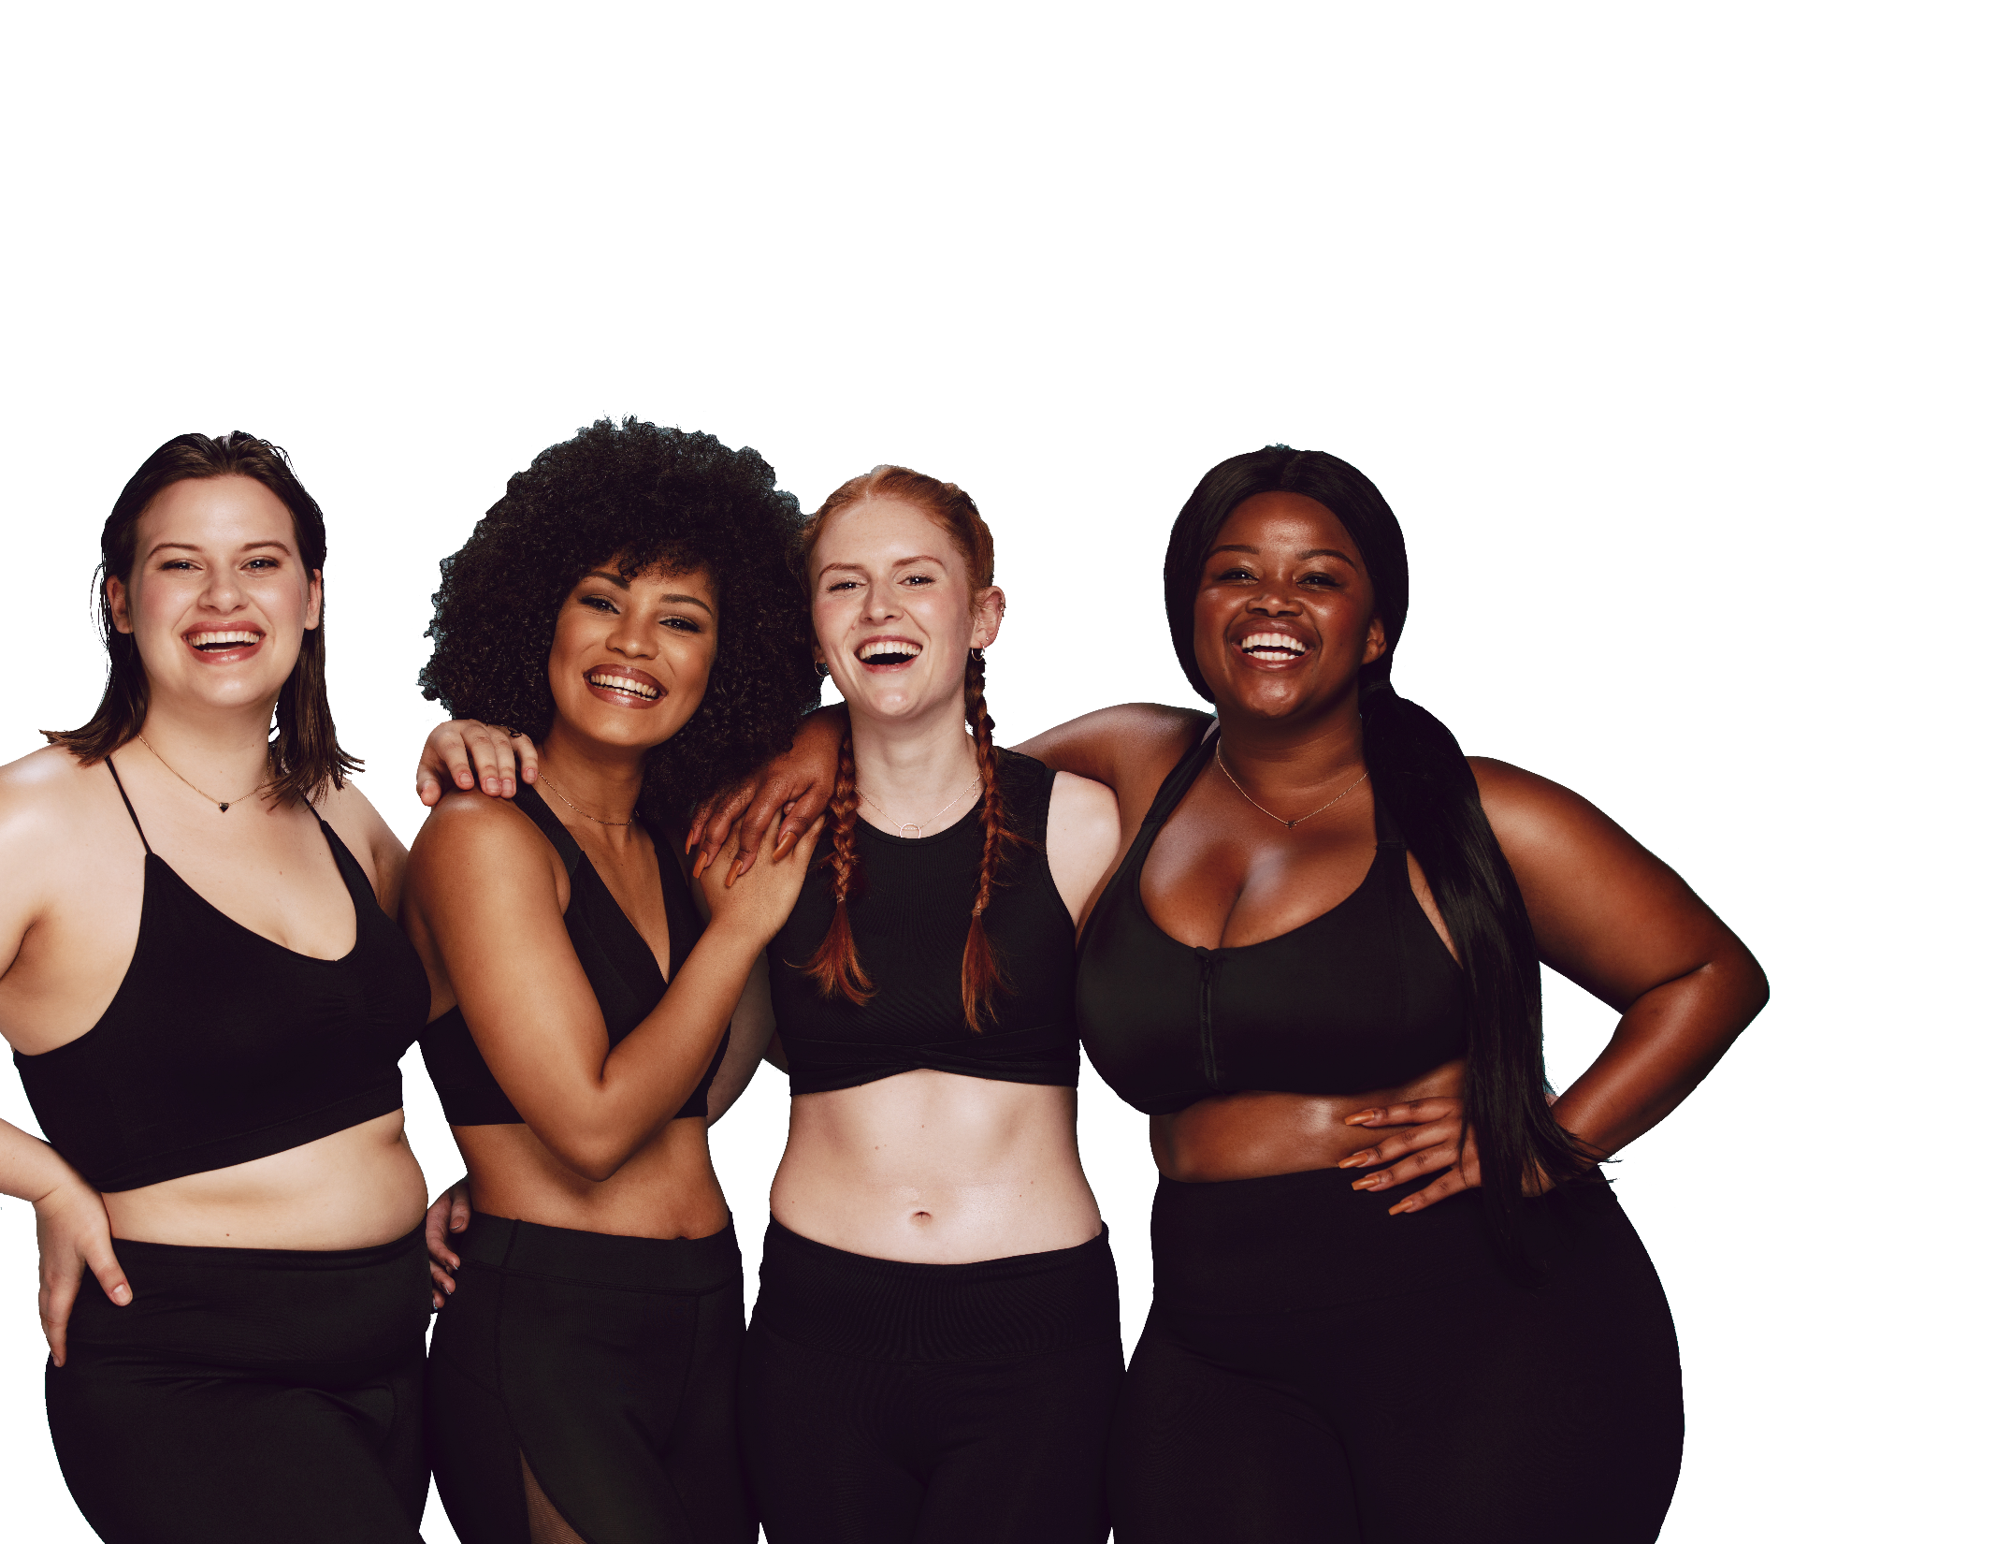
FUN &
HEALTHY
28 DAY WEIGHT LOSS JOURNEY
MODULE TWENTYFOUR

Slide 2
Task
DAY 24
Today, make sure you are eating vegetables at every meal. Continue through to day 28!

Slide 3
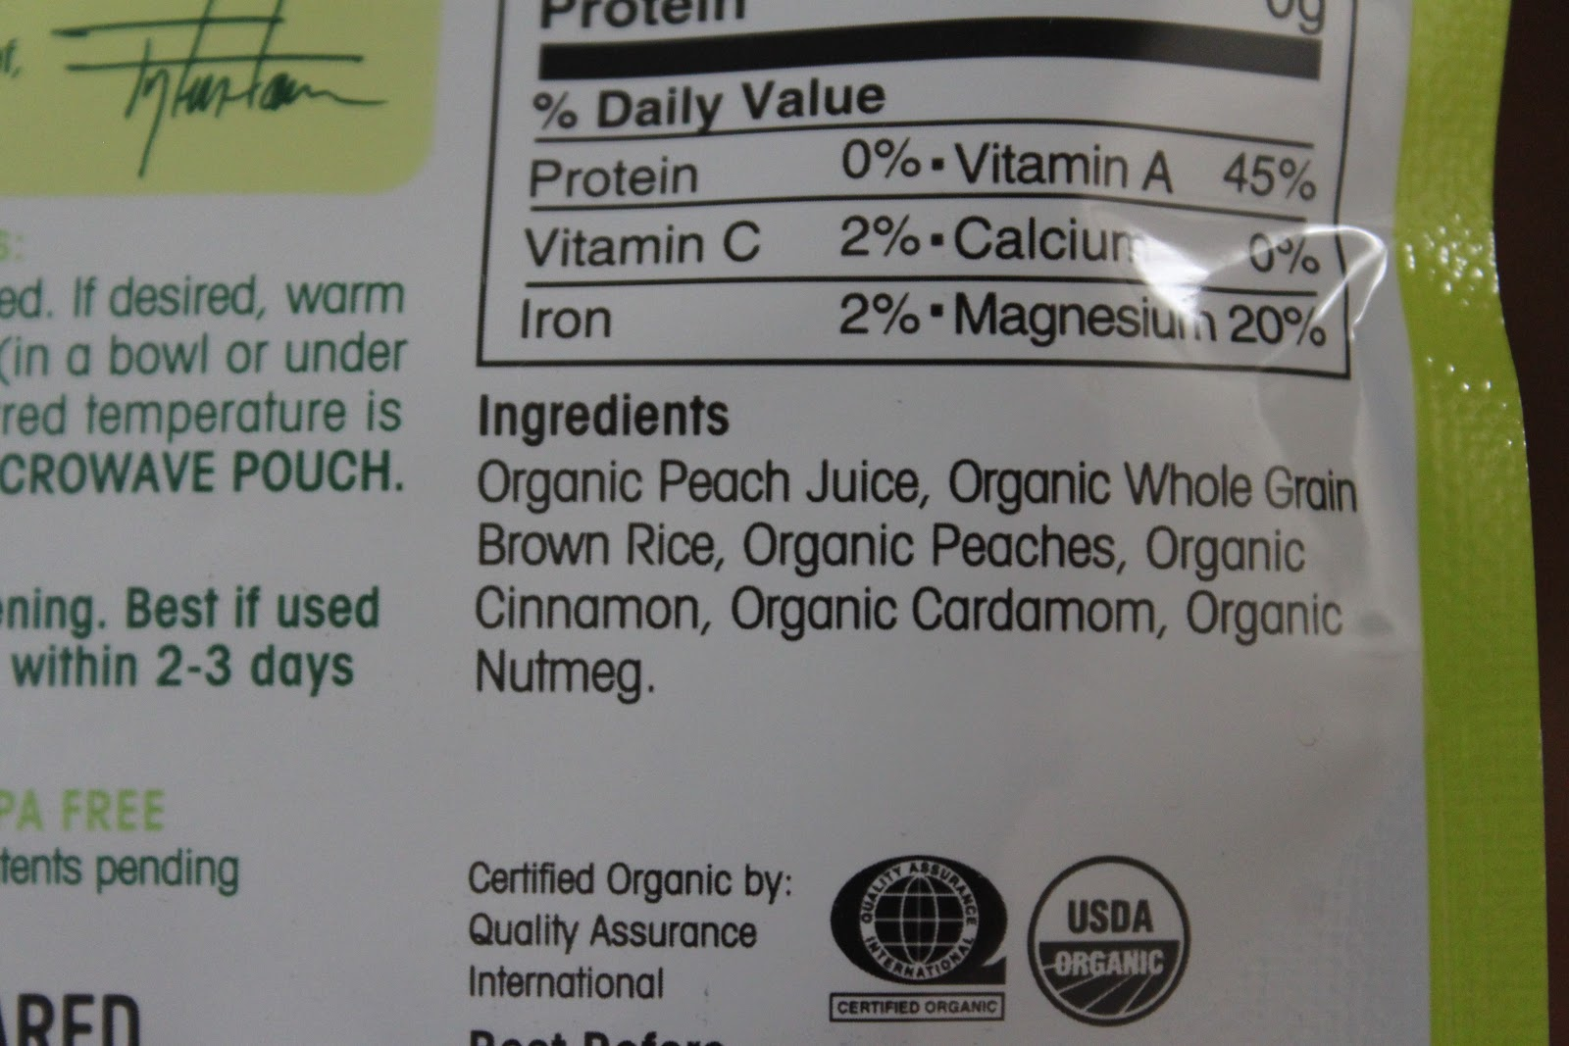
DAY 24
Organics
Bust Out of Food Label Overwhelm and Let Go of 8 Extra Pounds!
Reading nutritional labels can make an 8-pound difference in your weight! According to a 2012 Agricultural Economics report, women who scrutinize nutritional labels have a body mass index (BMI) 1.49 points lower than women who ignore them.
In this series, I'd like to help clarify some of the label wording for you. Keep in mind that, while many of the labels are used for marketing, they are clearly defined and may not mean everything we want them to mean.
Last night at a party during a really juicy conversation I was asked some questions I get asked often. Maybe you've been puzzled about them too…
Why buy organic?
What is Organic?
Why should I be concerned about organic?

Slide 4
DAY 24
Organics
What is Organic?
Organic has become a huge marketing term these days. It's everywhere and on everything! The USDA has specific guidelines that must be verified by a USDA-approved independent agency.
All organic agricultural farms and products must:
Abstain from the application of prohibited materials which include synthetic fertilizers, pesticides and sewage sludge for 3 years prior to certification, and then continually throughout their organic license.
Prohibit the use of genetically modified organisms and irradiation.
Employ positive soil building, conservation, manure management and crop rotation practices.
Provide outdoor access and pasture for livestock.
Refrain from antibiotic and hormone use in animals.
Sustain animals on 100% organic feed.
Avoid contamination during the processing of organic products.
Keep records of all operations.

Slide 5
DAY 24
Organics
Because the USDA currently has very clear and publicly stated guidelines on the use of the word 'organic' in the description of food, you can purchase products labeled organic with the expectation of a better, cleaner product.
Organic Bore-ganic. Why should I care?
Well, not to be a smart aleck, but take another look at the bullet points on the previous slide. To qualify for organic the land must be free of synthetic fertilizers AND sewage sludge—for 3 years! Yikes! I've only just learned that fertilizer from sewage sludge—human waste material—is used in conventional agriculture.
I've known for a while that gray water, storm runoff and un-potable water is used in many municipal irrigation systems, but learning about sewage sludge has helped me understand why we have viral outbreaks of E. coli and salmonella through contaminated produce.

Slide 6
DAY 24
Organics
There are many reasons I choose organic when it is both available and affordable, but human waste-based fertilizer…it's a real turn off. Always wash your produce, conventional and organic, before storing in your pantry or refrigerator.
Is organic food really better than conventional food?
Stanford University made big food news when they released the results of their meta-analysis comparing the nutritional value of organic food compared to conventionally grown food. They concluded that there was little nutritional difference between organic and conventional foods.
They did not address, however, the real differences between organic and conventional foods, which revolve around chemicals, pesticides (reproductive disruptors), synthetic fertilizers (environmental toxins), sewage sludge (virus- and disease-breeding grounds), antibiotics, hormones and GMOs.
Now guess what: one year earlier Newcastle University in England completed a similar decade-long study and found the opposite to be true—that organic is the preferred choice for health and wellness. How confusing is that?

Slide 7
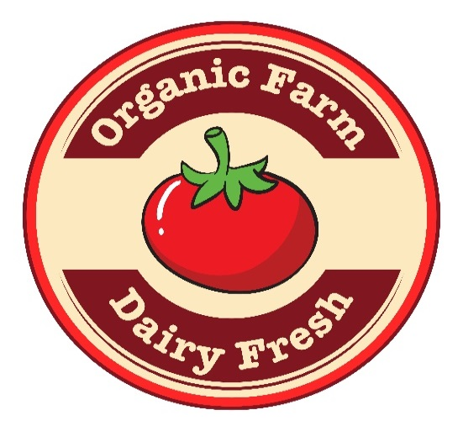
Day 24
Organics
So is Organic better?
That's up to you. If organic food is better for the environment because of the way it is produced, isn't loaded with chemicals, bacteria, foreign DNA (GMO) and has the same or slightly better nutritional properties, do you think it is better for your health and longevity?
Organic food can be more affordable when you join a CSA. Check out Local Harvest to find a CSA near you now so you can get in on the spring garden and sometimes winter goodies!
Rommy Kirby, CHC Radiant Optimum Wellness

Slide 8
DAY 24
The Food Diary
The Food Diary
Be honest. Write down what you really eat.
Be accurate. Measure portions and read labels.
Be complete. Include every little scrap you eat.
Diary | Time | Portion | What | How do you feel?
Breakfast
Snack
Lunch
Snack
Dinner
Snack
Liquids

Slide 9
CONGRATS
YOU DID IT!

