Slide 1
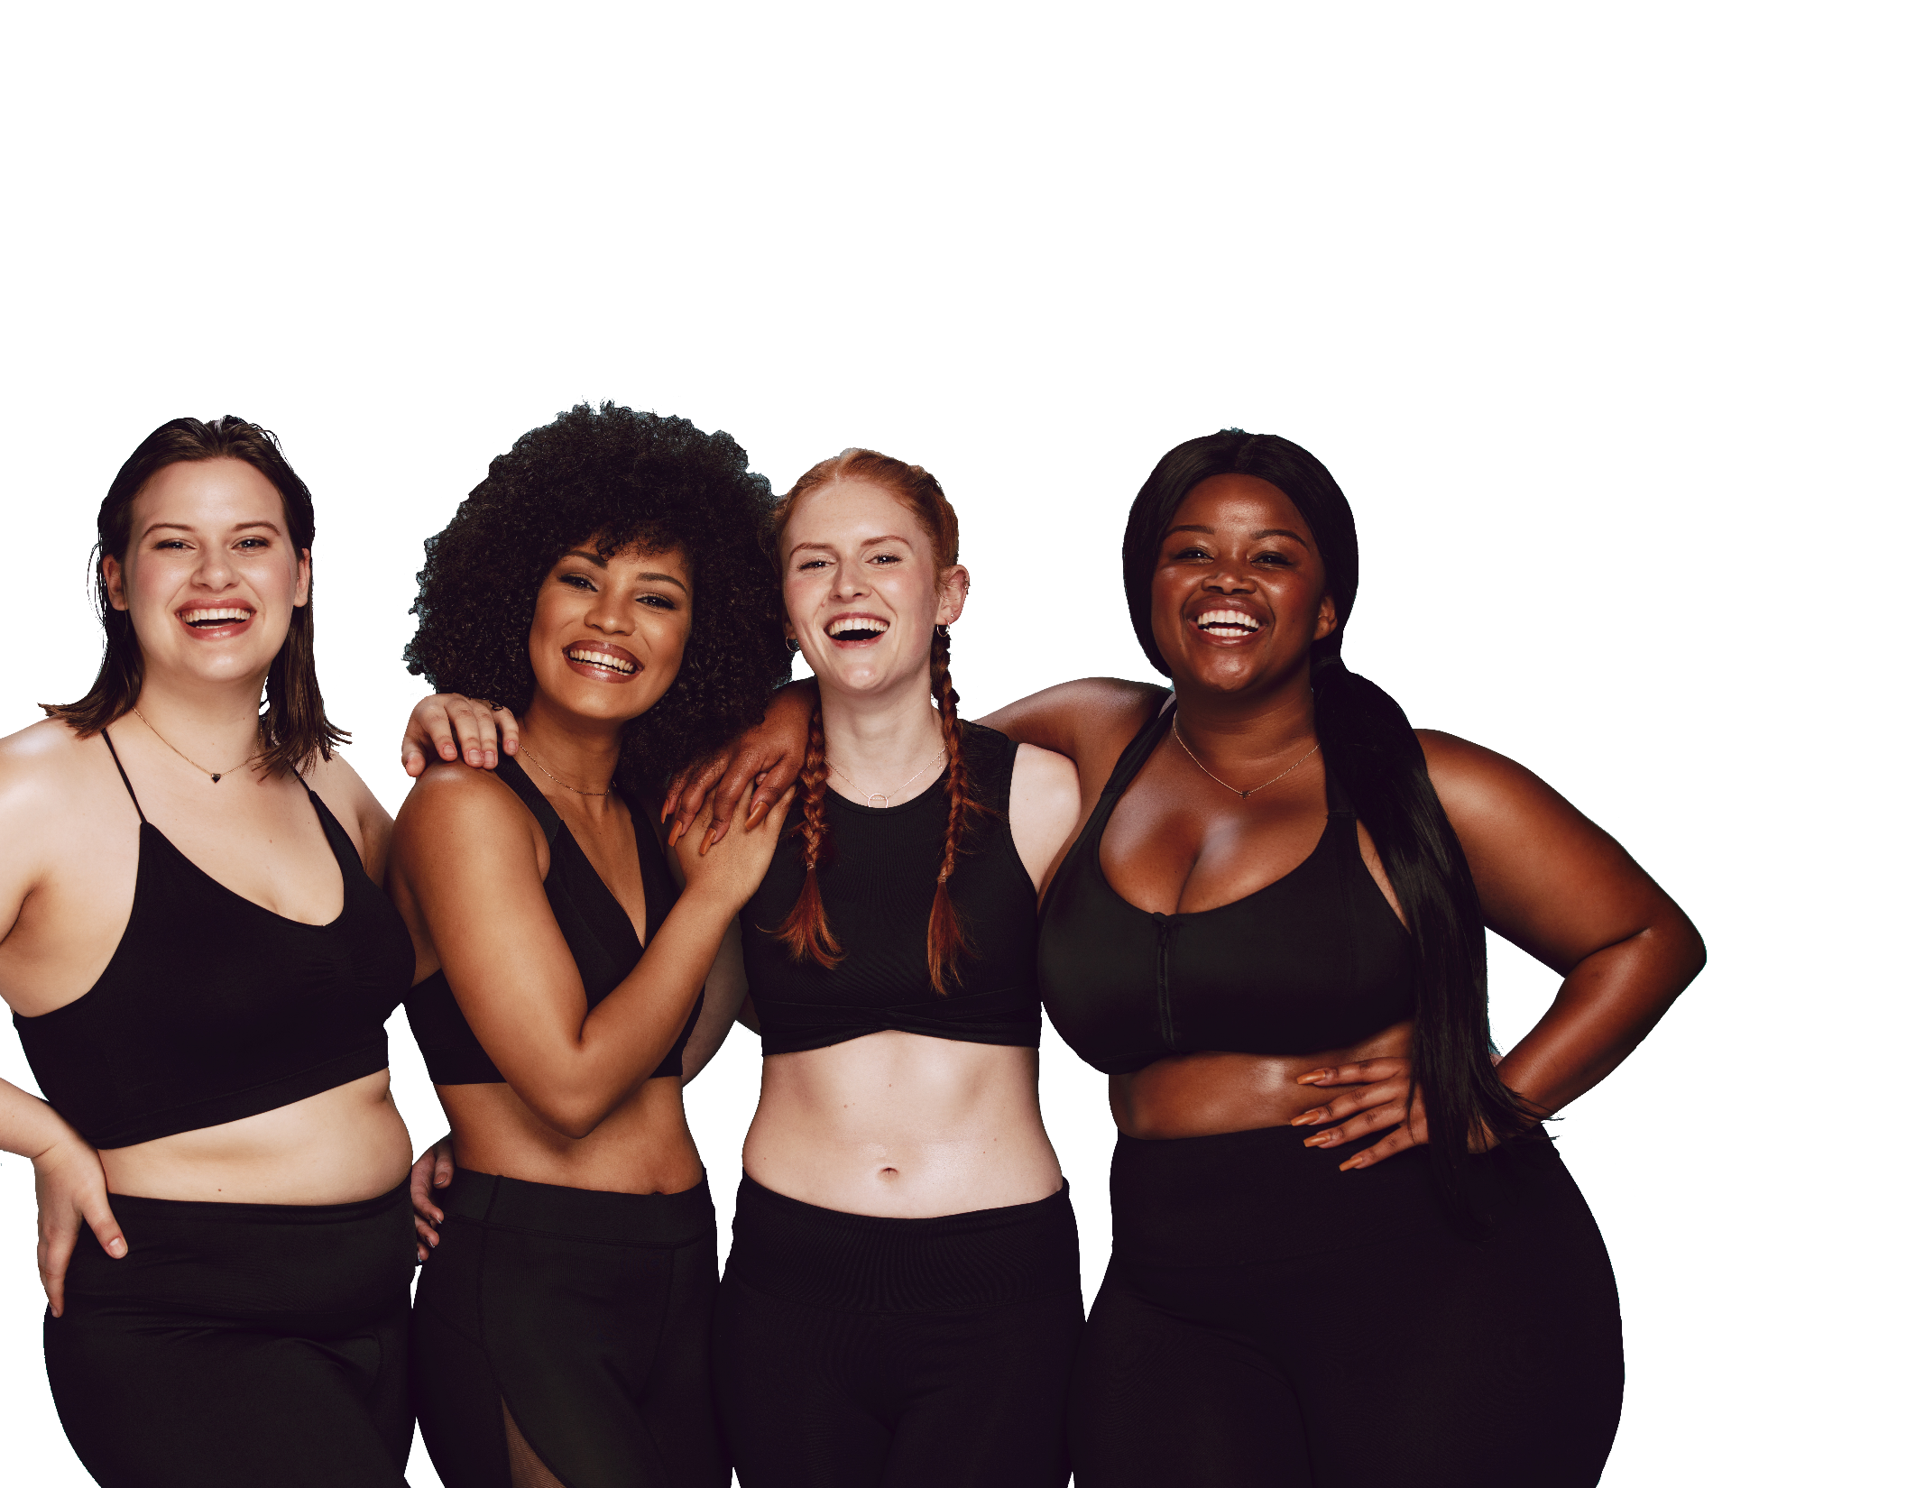
FUN &
HEALTHY
28 DAY WEIGHT LOSS JOURNEY
MODULE TWENTYSIX

Slide 2
Task
DAY 26
Make a list of 3 of your all-time funny movies and pick one to watch. Enjoy the laughter!

Slide 3
DAY 26
12 Easy Steps
We are drawn to laughter much in the way that we are drawn to sugar. It makes us feel good. Laughter affects stress hormones, the immune system and the disease process. Laughter has actual therapeutic properties.
A study at Johns Hopkins shows that laughter, when used with teaching, improves memory, learning and test scores. When the left brain hears a joke, the right brain is activated when the person gets the joke, then the whole brain activity creates optimal mental and emotional “well-being.”
Laughter:
Relaxes the effect on the nervous system, controlling things like our heart rhythm, blood pressure, breathing and mental tension.
Shifts perspective, allowing us to see situations in a less threatening way.
Relaxes the whole body.
Rejuvenates the body by lowering cortisol levels, adrenaline and producing natural pain blockers and human growth hormone.
Helps boost the immune system.
Dissolves negative emotions.
Brings people together and passes the good feelings on.
Adapted from Bill Phillips, Transformation

Slide 4
DAY 26
12 Easy Steps
We all have star qualities! Don’t be afraid to show off yours!
Enjoy the spotlight and the ability to enjoy the gifts you have been blessed with.
If you love to sing, sing loud! Put some feeling into it and shine it for everyone to hear. Show off your humor, your compassion, your cooking ability, your gardening, your intelligent conversation, whatever it is that you are gifted with. Use it!
Start looking at accepting and clarifying your gifts. Experiment with them and find what you love. Experiment and fearlessly throw yourself into the things that call to you. You are laying the foundation for many good things to come.

Slide 5
DAY 26
The Food Diary
The Food Diary
Be honest. Write down what you really eat.
Be accurate. Measure portions and read labels.
Be complete. Include every little scrap you eat.
Diary | Time | Portion | What | How do you feel?
Breakfast
Snack
Lunch
Snack
Dinner
Snack
Liquids

Slide 6
CONGRATS
YOU DID IT!

