Slide 1
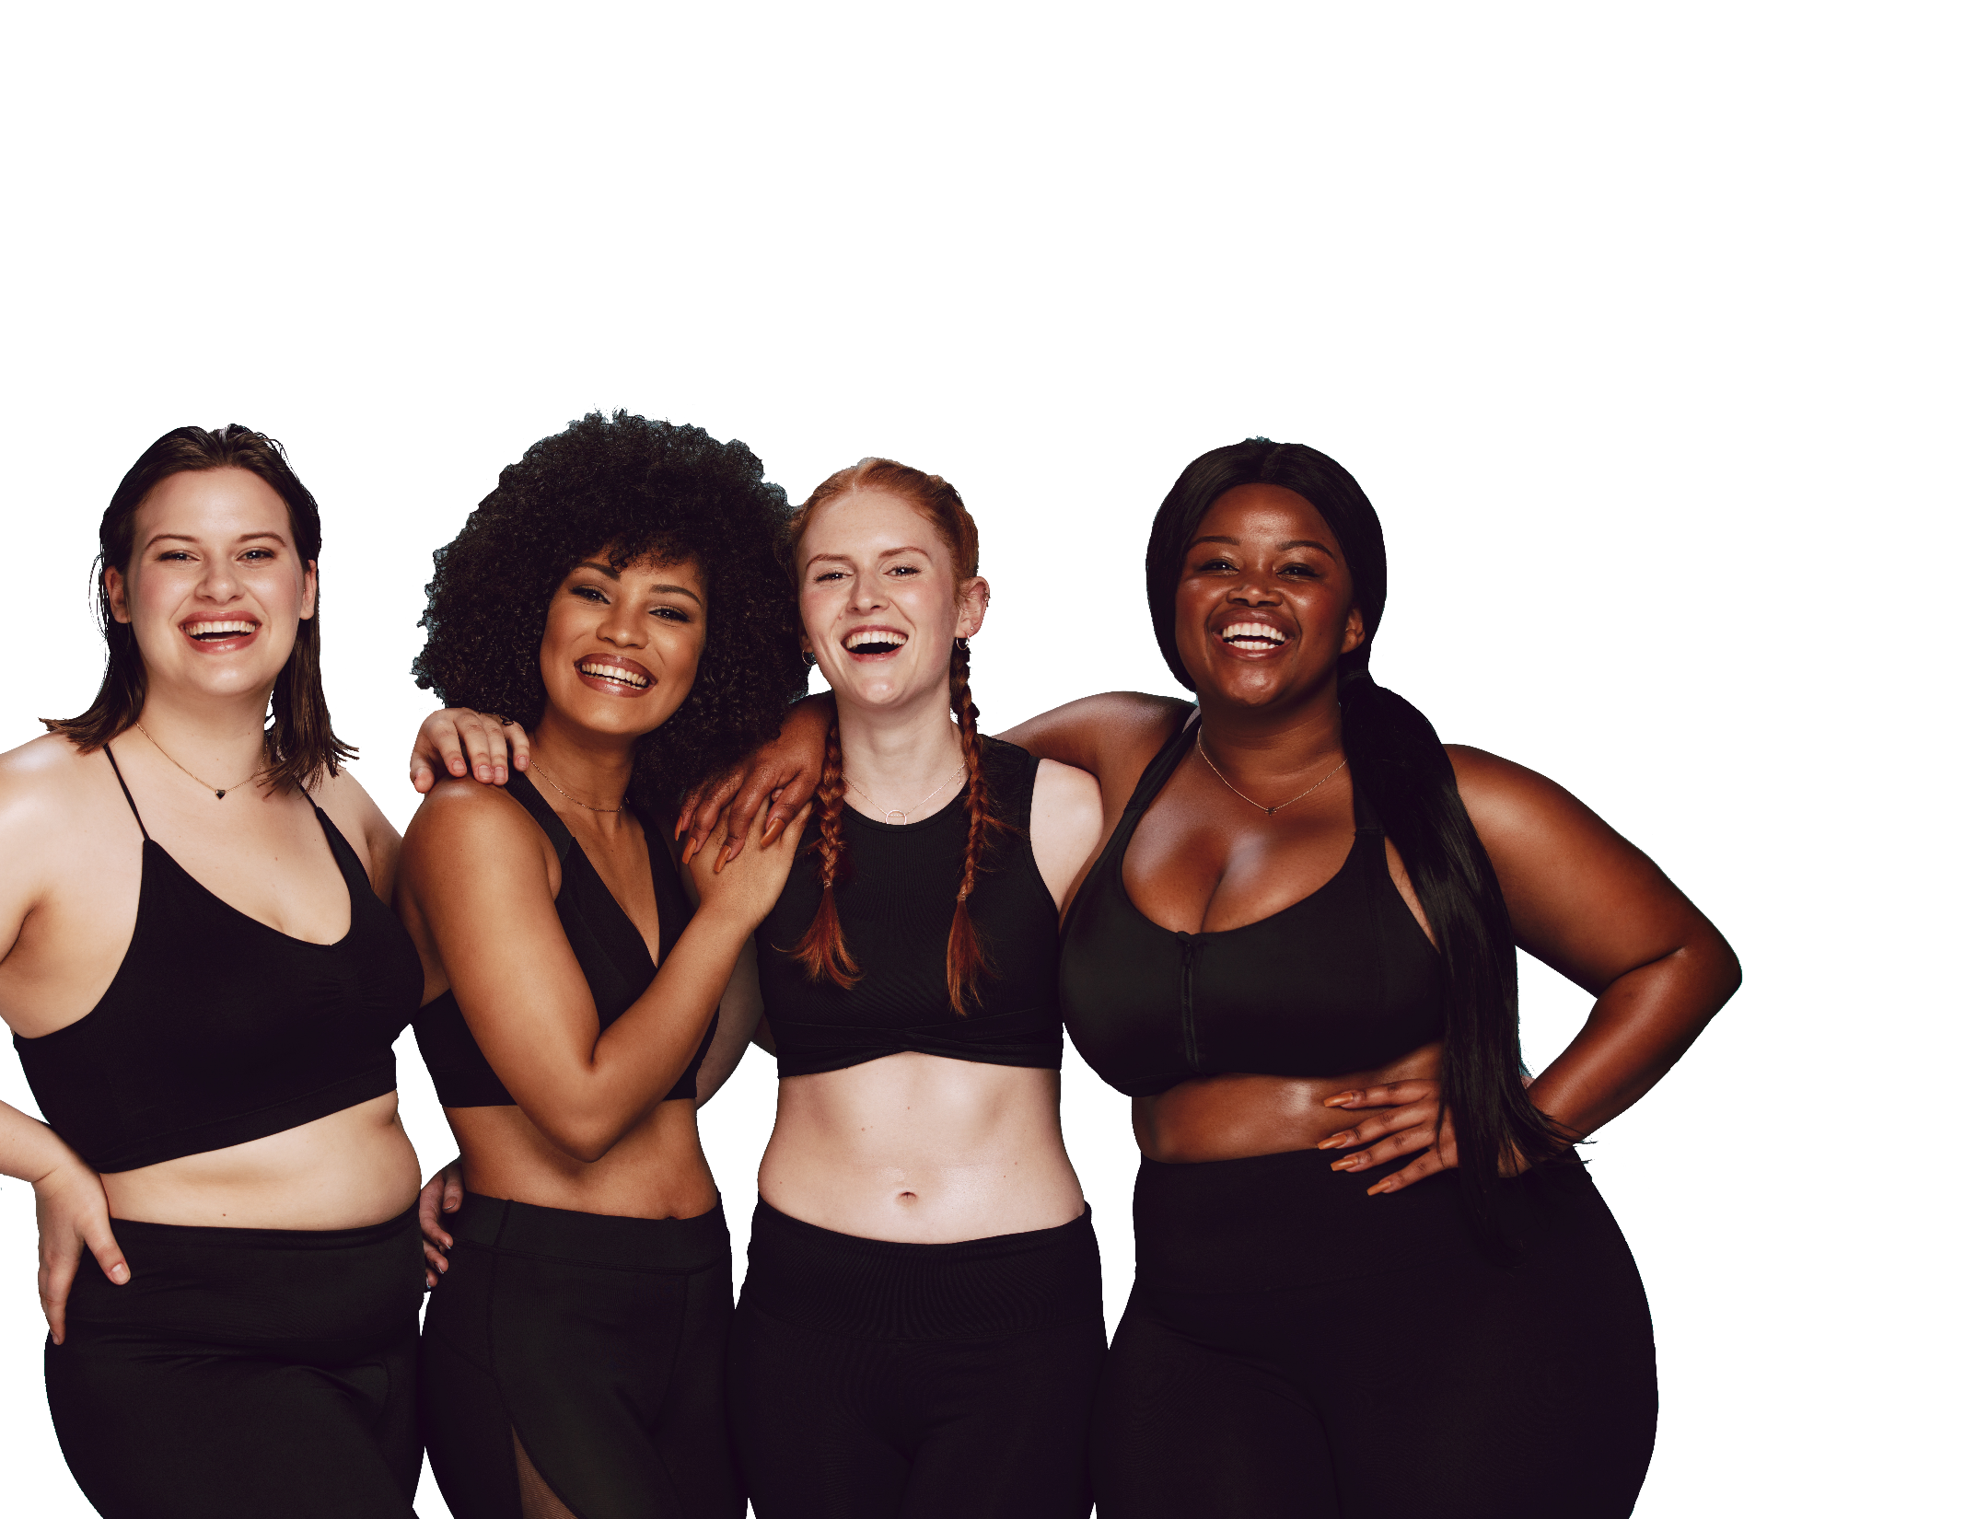
FUN &
HEALTHY
28 DAY WEIGHT LOSS JOURNEY
MODULE TWENTYSEVEN

Slide 2
Task
DAY 27
Learn about 12 Steps to take that will lead you to incredible health. Congratulate yourself on 28 days of progress! Celebrate!

Slide 3
DAY 27
12 Easy Steps
Over the past 28 days, you have learned a lot of life-changing information.
Here is a list you can keep nearby as a reminder.
The first secret is that everyone's secrets are different. It is called bio-individuality. Vegan eating can be right for you, but not for your neighbor. The more you learn about nutrition and the more you listen to your body, the easier it will be to figure out what is right for you.
Hunger doesn't always signal a need for food. Sometimes hunger means you need some attention. Maybe you are sad, lonely, confused or bored. If you take a minute before heading to the kitchen, try and think what it is you really want. You may just be thirsty. If you pay attention to the urge you are feeling, you can learn from it and let it go.
Eat healthy 90% of the time. This way you don't look at a food you really want and think "I better eat it now because I can never have it again“ or worse "oh poor me, I am so deprived". Just be sure you are up on your math and 90% doesn't turn to 50%.
Eat at home. Prepare your food with love and enjoy it.
Eat whole foods. You will notice a difference in how you feel almost immediately (YES, that means no more Lucky Charms).

Slide 4
DAY 27
12 Easy Steps
Meditate or pray to reduce stress.
Move your body every chance you get.
Journal! I can't say it enough. If it is down on paper, you reap treasure.
Eat more green veggies.
Get a good night's sleep.
Drink more water and throw some lemon in there while you are at it!
EAT -
small amounts of protein
fruits and vegetables
whole grains
small amounts of healthy fats
(nuts, coconut oil, virgin olive oil, avocado)

Slide 5
DAY 27
The Food Diary
The Food Diary
Be honest. Write down what you really eat.
Be accurate. Measure portions and read labels.
Be complete. Include every little scrap you eat.
Diary | Time | Portion | What | How do you feel?
Breakfast
Snack
Lunch
Snack
Dinner
Snack
Liquids

Slide 6
CONGRATS
YOU DID IT!

