Slide 1
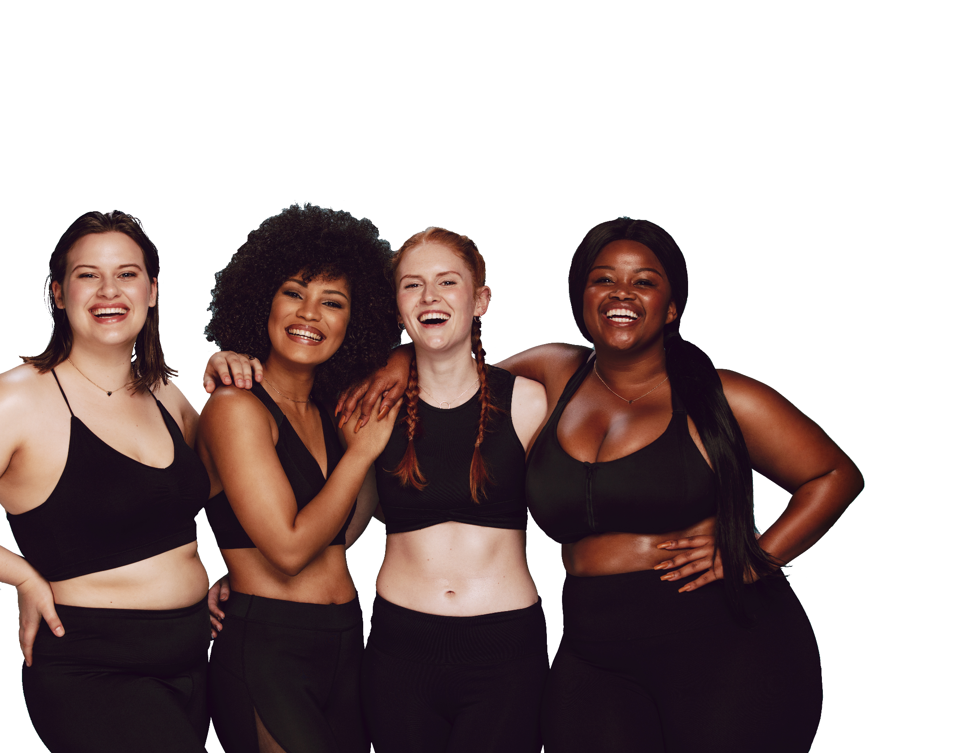
FUN &
HEALTHY
28 DAY WEIGHT LOSS JOURNEY
MODULE FOUR

Slide 2
TASK
DAY 4
Start your day today by squeezing ½ a lemon into a warm glass of water. Continue this through the end of the program.

Slide 3
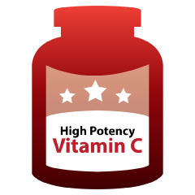
DAY 4
Vitamins
Vitamins are organic compounds containing carbon, which is essential for life. They are either water- or fat-soluble, meaning they either need water or fat to be digested and absorbed.
Water-soluble include (all are B-vitamins expect for Vitamin C):
Vitamin C
Thiamin
Riboflavin
Niacin
B6
B12
Folic acid
Biotin
Pantothenic acid
Fat-soluble include:
Vitamin A
Vitamin D
Vitamin E
Vitamin K

Slide 4
Vitamins
DAY 4
Vitamin A
Active form is retinal
Inactive form (which is activated by the body) is carotene (i.e., beta carotene found in carrots)
Vital for vision, especially night vision
Needed for repair of tissue and bone
Involved in reproduction and fetal development
Helps immune system function
Food sources include whole eggs, dairy, beef liver, dark green vegetables, yellow/orange colored vegetables

Slide 5
DAY 4
Vitamins
B-Vitamins
A group of vitamins that are all involved in turning the food we eat into useable energy by the body. They include thiamin, riboflavin, niacin, B6, B12, folic acid, biotin, pantothenic acid.
Some B vitamins work solely to turn the food we eat into useable energy, others have additional roles:
Thiamin (B1) assists the nervous system, heart muscle and regulates appetite
Riboflavin (B2) plays a role in mucous membrane formation and skin formation
B6 helps maintain normal homocysteine levels in the blood. Homocysteine is an amino acid that helps reduce the risk of heart disease
Folic acid (B9) helps form the brain and spinal cord during fetal development and is involved in cell division and red blood cell formation
B-vitamins are widespread in the food supply. Found mostly in green vegetables, meats, dairy and fortified foods
B12 is the only B-vitamin not found in plant foods and therefore needs to be supplemented for those who are vegan

Slide 6
DAY 4
Vitamins
Vitamin C
Also known as ascorbic acid
Functions as an antioxidant
Assists the formation of collagen
Needed for wound healing
Decreases risks of cancer and heart disease
Found in fruits and vegetables (especially citrus), bell peppers, kiwi, broccoli, strawberries, tomatoes, watermelon, potatoes, bananas and carrots
Vitamin D
Known as the sunshine vitamin because we get most of what we need from sun exposure
Needed for calcium absorption
Helps maintain bones and teeth
Prevents rickets and osteoporosis
Assists in immune function, cell growth and fetal development
Lately has been shown to reduce risks of some cancers
Found in fatty fish, cod liver oil, dairy that has been fortified, egg yolks and beef liver

Slide 7
DAY 4
Daily Intentions
Journal
Homemade food
Mindful eating
Reduce one food
Tongue scraper
Dry skin brush
Conscious breathing
Fresh air and sunshine
Physical activity
Prayer/meditation
Meaningful connections
Loving work
Laughter
Alone time
Visualization
Quality sleep

Slide 8
DAY 4
Food Diary
Be honest. Write down what you really eat.
Be accurate. Measure portions and read labels.
Be complete. Include every little scrap you eat.
Diary | Time | Portion | What | How do you feel?
Breakfast
Snack
Lunch
Snack
Dinner
Snack
Liquids

Slide 9
CONGRATS
YOU DID IT!

