Slide 1
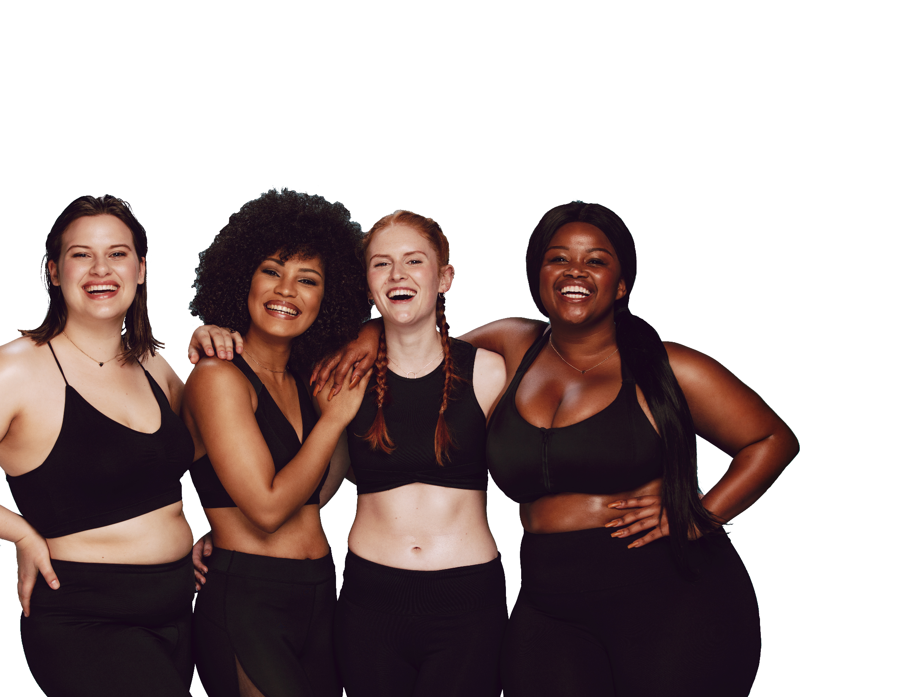
FUN &
HEALTHY
28 DAY WEIGHT LOSS JOURNEY
MODULE FIVE

Slide 2
Task
Day 5
Add a fun salad to your lunch. Any kind of lettuce, some colorful fruits and veggies, and some protein, either nuts, beans or lean meat. Give your salads themes or nationalities. Have fun with your salads. You will have a salad for lunch each day until day 28.
Listen to your hypnotic video on food choices. There are two videos. Listen to the Intro first and the hypnotic video second.
by Unknown Author is licensed

Slide 3
DAY 5
Session Notes
Client Name _____________________ Date _______________
HEADLINE

Slide 4
DAY 5
Ways to Eat Healthy
Eating less fat and fewer calories is an important part of losing weight. However, that is only one important part of healthy eating. Another part of healthy eating is changing the way we eat and what we eat.
Here are a few tips to help:
Spread out your calories throughout the day. This will help keep you from getting too hungry and losing control. Eat 3 meals each day and let yourself have 1 or 2 healthy snacks.
Don’t skip meals. Try to eat at the same time each day. Regular meals also will keep you from getting too hungry and losing control.
Eat slowly. Try pausing between bites. Put down your fork and take a break between bites. Drink water with meals and enjoy the taste of your food. Eating slowly will help you digest your food better, be more aware of what you are eating and be more aware when you are full.
Don’t worry about cleaning your plate. Serve yourself smaller portions to begin with and understand that the greatest waste of food is eating more than you want or need.
Change your eating environment. Eat with others, do not eat while watching television or doing anything else that can take your attention away from your meal. When it is meal or snack time, really create your atmosphere and let it be an experience.

Slide 5
Ways to Eat Healthy
DAY 5
Before you eat, think about what goes on your plate or in your cup or bowl. Foods like vegetables, fruits, whole grains, low-fat dairy products and lean protein foods contain the nutrients you need without too many calories. Try some of these options:
Fill half of your plate with fruits and vegetables.
Switch to skim or 1% milk.
Make at least half your grains whole.
Vary your protein food choices.
Keep your food safe to eat - learn more at http://www.FoodSafety.gov.
Cut back on foods that are high in solid fats, added sugars and salt (sodium).
Added sugars and fats load foods with extra calories you don't need. Too much salt may increase your blood pressure.
Choose foods and drinks with little or no added sugars.
Look out for salt in foods you buy. It all adds up.
Eat fewer foods that are high in solid fats.

Slide 6
Ways to Eat Healthy
DAY 5
Eat the right amount of calories for you. Everyone has a personal calorie limit. Staying within yours can help you get to or maintain a healthy weight. People who are successful at managing their weight have found ways to keep track of how much they eat in a day, even if they don't count every calorie.
Enjoy your food, but eat less.
Cook more often at home, where you are in control of what's in your food.
When eating out, choose lower-calorie menu options.
Write down what you eat to keep track of how much you eat.
If you drink alcoholic beverages, do so sensibly. Limit yourself to 1 drink a day for women, or 2 drinks a day for men.

Slide 7
DAY 5
Ways to Eat Healthy
DAY 5
Be physically active. Pick activities that you like and start by doing what you can, at least 10 minutes at a time. Every bit adds up, and the health benefits increase as you spend more time being active.
Note to parents: What you eat and drink, and your level of physical activity are important not just for your own health, but also for your children's health. You are your children's most important role model. Your children pay attention to what you do more than what you say. Help your children develop healthy habits for life by providing and eating healthy meals and snacks.

Slide 8
DAY 5
Weight Management
Why is weight management important?
In addition to helping you feel and look better, reaching a healthier body weight is good for your overall health and well being. If you are overweight or obese, you have a greater risk of developing many diseases including type 2 diabetes, heart disease and some types of cancer.
The secret to success is making changes and sticking with them.
First - Find out what you eat and drink. A key step in managing your weight is taking an honest assessment of where you are.
Next - Find out what to eat and drink. Get a personalized daily food plan, just for you, to help guide your food choices.
Then – Begin making better choices and notice how doing so changes how you feel. Everyone is different. Compare what you eat and drink to what you should eat and drink. The ideas and tips in this section can help you make better choices, which can have a lasting impact on your weight over time.
The advice in this section is for adults. If your child is overweight or obese, consult a health care provider to determine appropriate weight management for him or her.

Slide 9
F

Slide 10
F
DAY 5
Food Groups
The food groups of the food pyramid are listed below. Write down your ideas for healthy food choices in each of these food groups.
Grains Vegetables
____________________________ ___________________________
____________________________ ____________________________
____________________________ ____________________________
Fruits Meat and Beans (Protein)
____________________________ ____________________________
____________________________ ____________________________
____________________________ ____________________________
Milk (Dairy)
____________________________
____________________________
____________________________

Slide 11
DAY 5
Food Intentions
Food | Breakfast | Lunch | Dinner | Snacks
Grains
Vegetables
Fruits
Milk (Dairy)
Meat and Beans (Protein)

Slide 12
DAY 5
The Food Diary
The Food Diary
Be honest. Write down what you really eat.
Be accurate. Measure portions and read labels.
Be complete. Include every little scrap you eat.
Diary | Time | Portion | What | How do you feel?
Breakfast
Snack
Lunch
Snack
Dinner
Snack
Liquids

Slide 13
CONGRATS
YOU DID IT!

