Slide 1
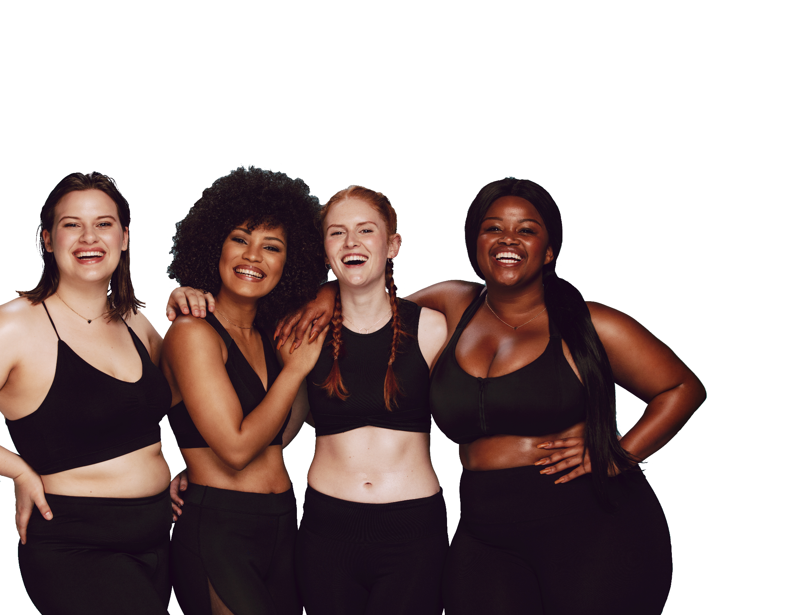
FUN &
HEALTHY
28 DAY WEIGHT LOSS JOURNEY
MODULE SIX

Slide 2
TASK
DAY 6
Learn more about healthy nutrition and maintain your new habits!

Slide 3
Session Notes
DAY 6
Client Name _____________________ Date _______________
HEADLINE

Slide 4
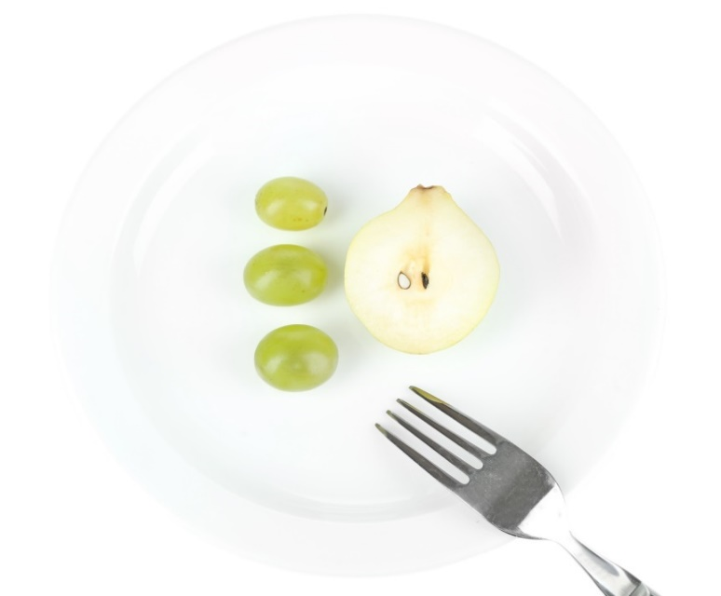
DAY 6
Lifestyle vs. Diet
Let’s be honest, diets that restrict don’t work. They are potentially dangerous and almost always lead to weight gain in the end. The only way to lose weight and maintain the loss is to change your lifestyle. When you maintain a healthy lifestyle, you maintain energy, weight loss and health.
Eating right is the answer. Once you learn what you need to know about healthy eating, you will always know what to eat.

Slide 5
DAY 6
Instead…
Pick low-fat foods
Choose fresh fruit and vegetables for snacks
Serve meatless dinners several times each week
Eat fruit for dessert
Pick low-fat meats
Buy lean cuts and trim off all the fat
Remove the skin from chicken and turkey
Choose white meat
Drain the fat after cooking meat and blot the meat with a paper towel
Avoid frying foods.
Poach, boil or scramble eggs or egg whites
Use two egg whites instead of one whole egg
Steam, bake or boil vegetables in a small amount of water
Bake, roast, broil, barbecue or grill
Stir-fry: heat the pan to high, add no more than 1 tsp. oil or use cooking spray, stir until cooked

Slide 6
About Calories
DAY 6
There is a reason we eat calories: our bodies need them to survive. Calories fuel everything we do. The number of calories we use for an activity depends on the type of activity, the amount of time we are active and how much we weigh.
Calorie Balance – The calories we take in through eating and drinking should equal those we use through physical activity and our body’s other energy needs (breathing, digesting food, sleeping).
Energy Use Through Activity – A rule of thumb is that one mile of brisk walking uses about 100 calories. Most people walk a mile in 15 to 20 minutes. You can calculate how many miles it would take to burn off a high-fat meal.

Slide 7
About Calories
DAY 6
Tipping the Balance – How many calories and how much physical activity is needed to tip the balance in favor of losing weight?
The amount varies from person to person. This program has many tools to help you tip the balance in the healthy direction. Just remember, the best way to tip the balance is to both reduce the amount we eat and drink and increase the time we are physically active

Slide 8
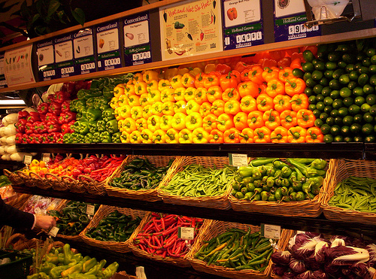
DAY 6
Eat Whole Foods
Only eat food in its natural state or lightly processed, ‘real food.’ Limit or avoid processed foods that are boxed or canned. Food is processed to make it safe, available and easy to use. The processing may do bad things like adding fat, sugar, salt, chemicals and calories.
Whole foods are packed with vitamins, minerals, fiber, antioxidants and other nutrients. Fast food is often calories with no nutrients. Whole food is usually grown locally and doesn’t have packaging. Food is always best when it doesn’t have a label on it.
You can prepare a healthy meal almost as quickly as something that is processed and convenient. Preparation is the key.
Plan your menus with fresh fruits and vegetables. Add whole grain pastas as sides or as a base for the main meal.

Slide 9
DAY 6
Eat Whole Foods
Freezing preserves the nutrients in vegetables and fruits. The process changes the appearance slightly. These foods easily can be thawed and added to meals.
If you use processed foods, get the ones with the shortest list of ingredients.
Rinse canned foods in water to eliminate salt.
Keep a stockpile of easy menu ideas for rainy days. Recipes that include common ingredients and can be prepared in 20 minutes or less are best to have on hand.
Find ways to ease your meal preparation. Cut and chop fresh ingredients the night before or on Sundays for the week.

Slide 10
DAY 6
Measurements
Although many countries use an International System of Units (SI) for weights and measures, it has not been universally adapted. Some countries use the metric system, some use the imperial system, and some use a mixture of both. As this program initially started in the United States, the measurements throughout are presented in the imperial system. When you need to convert between imperial, metric and vice versa, look to these tables for help.
Dry Measure Equivalents
3 teaspoons | 1 tablespoon | 1/2 ounce | 14.3 grams
2 tablespoons | 1/8 cup | 1 ounce | 28.3 grams
4 tablespoons | 1/4 cup | 2 ounces | 56.7 grams
5 1/3 tablespoons | 1/3 cup | 2.6 ounces | 75.6 grams
8 tablespoons | 1/2 cup | 4 ounces | 113.4 grams
12 tablespoons | 3/4 cup | 6 ounces | .375 pound
32 tablespoons | 2 cups | 16 ounces | 1 pound

Slide 11
DAY 6
Measurements
Weight (Mass) (Dry) Volume (Dry)
American Standard | Metric (Grams)
1/2 ounce | 15 grams
1 ounce | 30 grams
3 ounces | 85 grams
3.75 ounces | 100 grams
4 ounces | 115 grams
8 ounces | 225 grams
12 ounces | 340 grams
16 ounces or 1 pound | 450 grams
American Standard | Metric (liters)
1/8 teaspoon | .5 ml
1/4 teaspoon | 1 ml
1/2 teaspoon | 2 ml
3/4 teaspoon | 4 ml
1 teaspoon | 5 ml
1 tablespoon | 15 ml
1/4 cup | 59 ml
1/3 cup | 79 ml
1/2 cup | 118 ml
2/3 cup | 158 ml
3/4 cup | 177 ml
1 cup | 225 ml
2 cups or 1 pint | 450 ml
4 cups or 1 quart | 1 liter
1/2 gallon | 2 liters
1 gallon | 4 liters

Slide 12
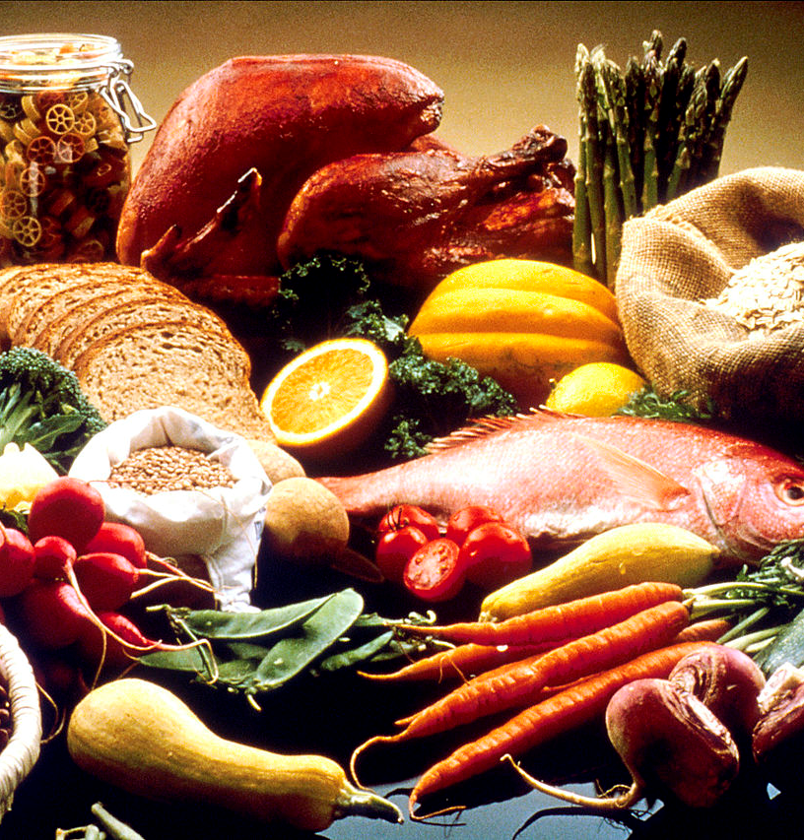
Serving Size
DAY 6
Serving Size Based on Food Groups
Fruits
½ banana 1 small apple, orange, or pear ½ cup of chopped, cooked or canned fruit
Vegetables
1 cup of raw leafy vegetables ½ cup of other vegetables; cooked, raw (chopped) or canned ½ cup of vegetable juice
Bread, Cereal, Rice, Starchy Vegetables and Pasta
1 slice of bread 1/2 English muffin, small bagel or pita bread 1 6-inch tortilla 1 ounce ready-to-eat cereal ½ cup cooked cereal, pasta or bulgur 1/3 cup cooked rice 1 small potato or ½ large potato ½ cup sweet potatoes or yams ½ cup corn kernels, beans or peas

Slide 13
Serving Size
DAY 6
Serving Size Based on Food Groups
Nuts, Poultry, Fish, Eggs, Dry Beans, Cheese and Meat
2-3 ounces cooked lean beef, veal, pork, lamb, chicken, turkey or fish 2-3 ounces low-fat natural cheese (such as swiss, cheddar, muenster, parmesan, mozzarella) ½ cup of cooked dry beans 1/4 cup tofu (bean curd) 1 egg (or equivalent serving of egg substitute) 2 tablespoons of peanut butter ½ cup low-fat cottage cheese ½ cup canned tuna (packed in water)
Milk and Yogurt
1 cup of low-fat milk 1 cup of low-fat yogurt
Not all foods fit into this guideline.

Slide 14
DAY6
Vegetables
Vegetables are nutritional powerhouses, but they’re too often treated as accompaniments or side dishes. Use their vibrant flavors, colors and textures to expand their role in your diet. Corn and potatoes are listed as carbohydrates. Green peas are listed with protein.
Item (25 calories per serving) | One Serving
Cabbage, Bok Choy | 2 cups chopped or 1 cup cooked
Cabbage, Green or Red | 1 cup chopped or ½ cup cooked
Carrots | ½ cup
Cauliflower | 1 cup florets (8)
Celery | 4 med stalks
Collard Greens | ½ cup
Cucumber | 1 cup sliced
Eggplant (cooked) | 1 cup cubed
Jicama (yambean) | ½ cup sliced
Kale, cooked | 2/3 cup
Leek, cooked | ½ cup
Lettuce | 2 cups chopped
Marinara | 2 tbsp.
Mushrooms | ½ cup
Okra | ½ cup (3 pods)
2010 Mayo Foundation for Medical Education and Research

Slide 15
DAY6
Vegetables
Item (25 calories per serving) | One Serving
Onions, Sweet, White or Red | ½ cup sliced
Onions, Young Green (Scallions) | ¾ cup or 8 shoots
Radishes | 25 medium
Shallots | 3 tbsp. chopped
Spinach | 2 cups
Spinach, cooked | ½ cup
Squash, summer | ¾ cup sliced
Tomatillo | ½ cup diced or med
Tomato | 1 medium
Tomato, Cherry or Grape | 1 cup (about 8)
Tomato, stewed | ½ cup
Tomato paste | 2 tbsp.
Tomato sauce | 1/3 cup
Water Chestnuts, sliced | ¾ cup
Zucchini | ¾ cup
2010 Mayo Foundation for Medical Education and Research

Slide 16
DAY6
Fruits
Fruits shrink when they are dried. A small piece of dried fruit can contain a lot of calories. Dried fruits like apples, raisins, dates and bananas are still okay to eat but should be eaten in moderation.
Fruits like cranberries and rhubarb are tart and often prepared with sugar before eating. These fruits are found in the sweets listing.
Fruit juices are in the beverages list.
Item (60 calories per serving) | One serving
Apple | 1 small
Apple, dried | ½ cup
Applesauce, sweetened | 1/3 cup
Applesauce, unsweetened | ½ cup
Apricot | 4 whole
Banana | 1 small
Berries, mixed | ¾ cup
2010 Mayo Foundation for Medical Education and Research

Slide 17
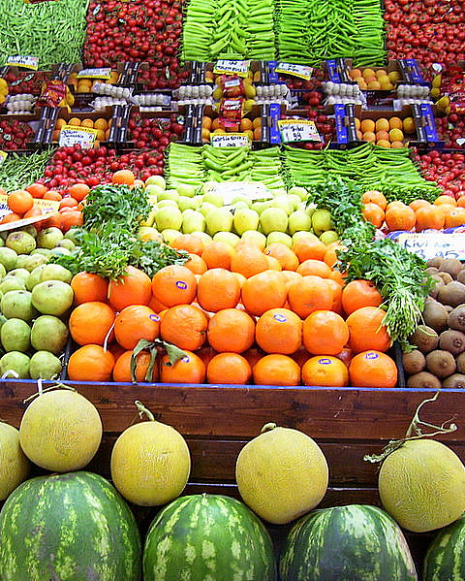
DAY6
Fruits
Item (60 calories per serving) | One serving
Blackberries | 1 cup
Blueberries | ¾ cup
Breadfruit | ¼ cup
Cantaloupe (muskmelon) | 1 cup cubed or 1/3 small melon
Cherries | 15 fruits
Clementine | 2 small
Dates | 3 fruits
Figs | 2 small
Grapefruit | ¾ cup sections or ½ large
Grapes | 1 cup (about 30)
Honeydew Melon | 1 cup cubed
Kiwi | 1 large
Lemon | 3 medium
Litchi (Lychee) | 10 fruits ( ½ cup)
Mango | ½ cup diced
2010 Mayo Foundation for Medical Education and Research

Slide 18
DAY6
Fruits
Item (60 calories per serving) | One serving
Melon Balls | 1 cup (8 balls)
Mixed Fruit, dried | 3 tbsp.
Mixed Fruit Cocktail, canned | ¾ cup
Nectarine | 1 fruit
Orange | ¾ cup sections or 1 medium
Papaya | 1 cup cubes or 1 medium
Mango | ½ cup diced
Melon Balls | 1 cup (8 balls)
Mixed Fruit, dried | 3 tbsp.
Mixed Fruit Cocktail, canned | ¾ cup
Nectarine | 1 fruit
Orange | ¾ cup sections or 1 medium
Papaya | 1 cup cubes or 1 medium
Peach | ¾ cup sections or 1 medium
Peach, canned in juice | ½ cup slices
2010 Mayo Foundation for Medical Education and Research

Slide 19
DAY6
Fruits
Item (60 calories per serving) | One serving
Pineapple | 1/2 cup cubed or 2 rings
Pineapple, canned in juice | 1/3 cup crushed or 2 rings
Plums | 2 fruit
Pomegranate | ½ cup
Prunes | 3 fruit
Quince | 1 fruit (3 oz.)
Raisins | 2 tbsp.
Raspberries | 1 cup
Star Fruit or Carambola | 2 medium to large
Strawberries | 1 ½ cup whole
Tangerine | 1 large or 2 small
Watermelon | 1 1/3 cups cubed or small wedge
2010 Mayo Foundation for Medical Education and Research

Slide 20
DAY6
Carbohydrates
Refined carbohydrates have had most of their nutrients stripped away during processing. Although some vitamins and minerals may be added back into products, such as white rice and white flour, they still don’t have as many other nutrients as whole grains do.
Item (70 calories per serving) | One serving
Animal Crackers | 6 crackers
Bagel | ½ bagel (3 inch)
Barley, cooked | 1/3 cup
Biscuits, from dry mix | 1 small
Bread | 1 slice
Breadsticks, crispy | 2 sticks (6-8”)
Bulgur, cooked | ½ cup
Bun or Roll, whole grain | 1 small
Cereal, cold, bran type | ½ cup
Cereal, cold, flake type | ¾ cup
Cereal, granola, low fat | ¼ cup
2010 Mayo Foundation for Medical Education and Research

Slide 21
DAY6
Carbohydrates
Item (70 calories per serving) | One serving
Pita Bread, whole-wheat | ½ round (6 inch)
Potatoes, baby | ½ medium
Potatoes, baked | ½ medium
Potatoes, mashed | ½ cup
Pumpkin, cooked | 1 ½ cups
Rice, brown, cooked | 1/3 cup
Rice, white, cooked | 1/3 cup
Rice, wild, cooked | ½ cup
Rutabaga, cooked | ¾ cup
Squash, winter, cooked | 1 cup
Sweet Potatoes, baked | ½ large
Taco Shell, hard | 1 medium (5 inch)
Tortilla, corn | 1 round (6 inch)
Turnips, cooked | 1/3 cup
Waffle, frozen | 1 (4 inch)
2010 Mayo Foundation for Medical Education and Research

Slide 22
DAY6
Protein and Dairy
Item (110 calories per serving) | One serving
Bacon, Canadian style | 2 ½ oz.
Beans, Baked, canned | ½ cup
Beans, Black | ½ cup
Beans, Chickpeas | 1/3 cup
Beans, Kidney | ½ cup
Beans, Navy | ¾ cup
Beans, Refried, low fat | ½ cup
Beef, ground, regular | 2 oz. patty
Beef, steak, trim fat | 2 oz.
Beef jerky | 1 oz.
2010 Mayo Foundation for Medical Education and Research

Slide 23
DAY6
Protein and Dairy
Item (110 calories per serving) | One serving
Burger, vegetarian | 3 oz. patty
Cheese, American | 3 oz.
Cheese, Cheddar or Colby | 2 oz. or ½ cup shredded
Cheese, Cottage, low-fat | 2/3 cup
Cheese, Feta | 1 2/3 oz. or ¼ cup
Cheese, Gouda | 1 oz.
Cheese, Mozzarella, part skim | 1 ½ oz. or ½ cup shredded
Cheese, Parmesan | ¼ cup grated
Cheese, Ricotta | 1/3 cup
Cheese, Swiss | 1 oz.
Chicken, breast, boneless | 2 ½ oz.
Chicken, drumstick, skinless | 2 ½ oz.
Clams, fresh or canned | 3 oz. (10 small)
Crab | 4 oz.
Duck, breast, skinless, trimmed of fat | 2 ½ oz.
2010 Mayo Foundation for Medical Education and Research

Slide 24
DAY6
Protein and Dairy
Item (110 calories per serving) | One serving
Egg, whole | 1 large
Egg whites | 1 cup
Fish, Atlantic Salmon, grilled or broiled | 2 oz.
Fish, Cod, grilled or broiled | 3 oz.
Fish, Haddock, grilled or broiled | 3 oz.
Fish, Halibut, grilled or broiled | 3 oz.
Fish, Orange Roughy, grilled or broiled | 3 oz.
Ham | 3 oz.
Lamb, lean | 2 oz.
Lentils | ½ cup
Lobster, boiled | 4 oz.
Milk | 8 oz.
Mussels | 2 oz.
Peas, green canned | ½ cup
Peas, green, fresh, frozen | ½ cup
2010 Mayo Foundation for Medical Education and Research

Slide 25
DAY6
Protein and Dairy
Item (110 calories per serving) | One serving
Pheasant, breast, skinless | 3 oz.
Pork Chops, boneless, trimmed of fat | 3 oz.
Pork Sausage, smoked | 2 small links
Pork Tenderloin, roasted trimmed of fat | 3 oz.
Scallops | 3 oz.
Shrimp | 4 oz.
Soy Milk, low fat | 8 oz.
Tempeh | 2 oz. or ½ cup
Tofu | 2 slices (1 inch wide)
Tuna | 3 oz. or ½ cup
Turkey, white meat skinless | 3 oz.
Turkey, breast, lunch meat, fat free | 4 oz.
Turkey, ground, cooked | 2 oz.
Veal | 3 oz.
Venison | 3 oz.
2010 Mayo Foundation for Medical Education and Research

Slide 26
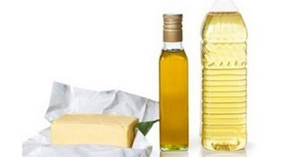
DAY6
Fats
Monounsaturated and polyunsaturated fats are found in vegetable oils, fish, olives and nuts. Saturated and trans fats are unhealthy and found in animal products. All fats are calorie dense and should be eaten in moderation.
Item (45 calories per serving) | One serving
Avocado | 1/6 section of fruit
Butter | 1 tsp.
Coconut, shredded, sweetened | 1 ½ tbsp.
Cream, heavy | 1 tbsp. liquid, 4 tbsp. whipped
Cream cheese | 1 tbsp.
Gravy | 1/3 cup
Guacamole | 2 tbsp.
Half and Half | 2 tbsp.
Honey Mustard dressing | 1 ½ tbsp.
Margarine | 1 tsp.
Mayonnaise | 2 tsp.
2010 Mayo Foundation for Medical Education and Research

Slide 27
DAY6
Fats
Item (45 calories per serving) | One serving
Nuts, Almonds | 4 tsp. slivered or 7 whole
Nuts, Brazil | 1 whole
Nuts, Cashews | 4 whole
Nuts, Hickory | 2 whole
Nuts, Peanuts | 8 whole
Nuts, Pecans | 4 halves
Nuts, Walnuts | 4 halves
Oil | 1 tsp.
Olives | 9 large or 12 small
Peanut Butter | 1 ½ tsp.
Seeds | 1 tbsp.
Sour Cream | 2 tbsp.
2010 Mayo Foundation for Medical Education and Research

Slide 28
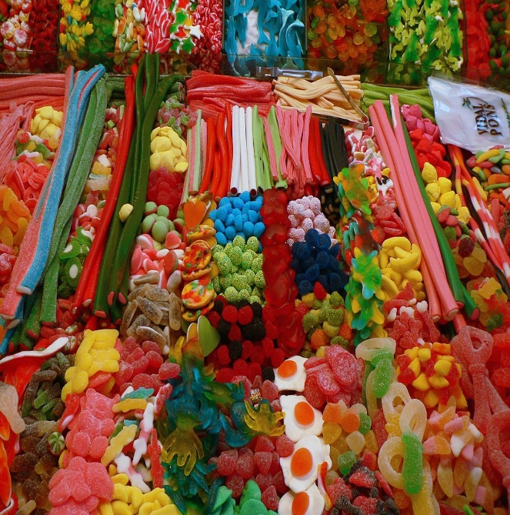
DAY6
Sweets
Sweet cravings are learned. You can change your taste for sweets by gradually reducing sugar intake and substituting healthier foods.
Item (75 calories per serving) | One serving
Chocolate Chips, unsweetened | 4 tbsp.
Cranberry Sauce, sweetened | 3 tbsp.
Frosting, ready to eat | 1 tbsp.
Fruit Butter, Apple | 2 ½ tbsp.
Gelatin | ½ cup
Hard Candy | 4 pieces
Honey | 1 tbsp.
Jellies, Jams, Preservatives | 1 ½ tbsp.
Jelly Beans | 20 small or 8 large
Molasses | 1 ½ tbsp.
Rhubarb, cooked and sweetened | ¼ cup
Sugar, brown, unpacked | 2 tbsp.
2010 Mayo Foundation for Medical Education and Research

Slide 29
DAY6
Sweets
Item (75 calories per serving) | One serving
Sugar, granulated, white | 4 tsp.
Sugar, powdered | 2 tbsp.
Syrup, Maple | 1 ½ tbsp.
Topping | 1 ½ tbsp.
2010 Mayo Foundation for Medical Education and Research

Slide 30
DAY 6
The Food Diary
Be honest. Write down what you really eat.
Be accurate. Measure portions and read labels.
Be complete. Include every little scrap you eat.
Diary | Time | Portion | What | How do you feel?
Breakfast
Snack
Lunch
Snack
Dinner
Snack
Liquids

Slide 31
CONGRATS
YOU DID IT!

