Slide 1
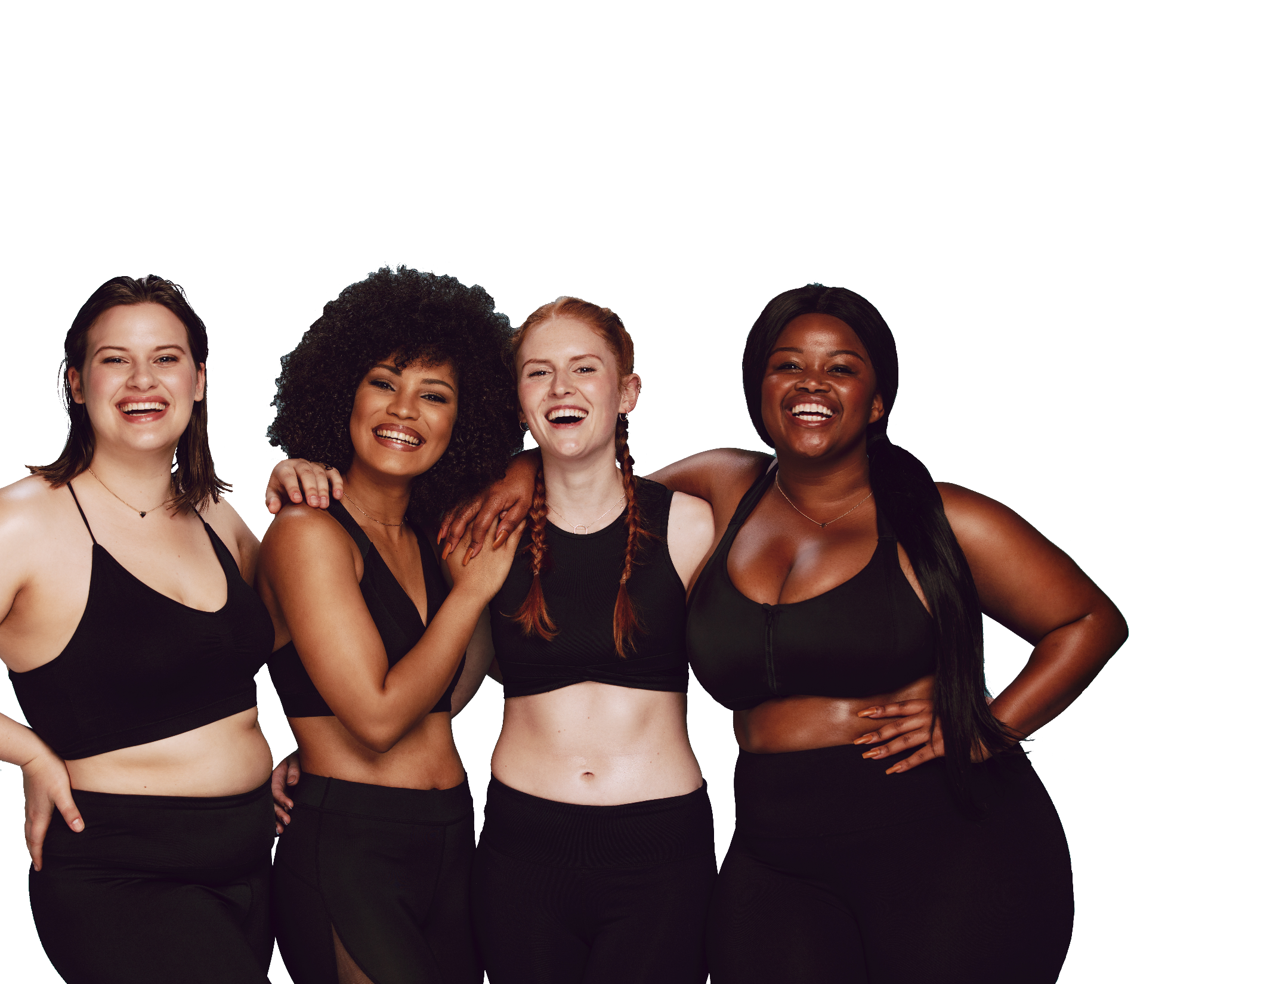

FUN &
HEALTHY
28 DAY WEIGHT LOSS JOURNEY
MODULE SEVEN

Slide 2

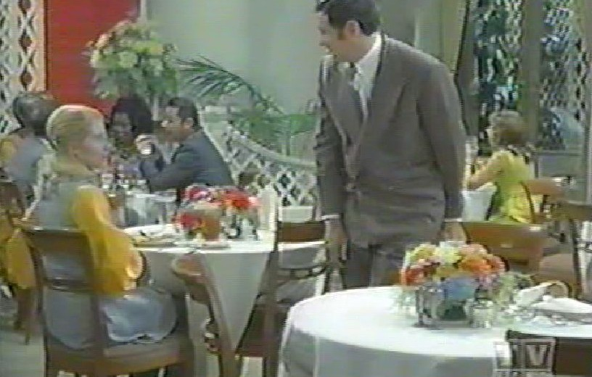
Task
DAY 7
Learn about eating out! Notice someone else doing something well and comment.

Slide 3

DAY 7
Eating Out
Eating out successfully requires that you pre-plan. In the restaurant, it is important to ask for what you want. Be firm, yet polite (assertive). It is in a server’s best interest to try to give you what you want.
Asking for what we need, especially in public does not come easily for some of us. So asking for and getting what you want takes practice.
A big challenge in eating out is finding and making good food choices. Often, a restaurant, dinner party, or event will not have exactly what you want. Be creative, stay committed and do not worry if the situation is less than perfect. You will learn from every situation and be more prepared in the future.

Slide 4
DAY 7
Eating Out
Four Keys to Healthy Eating Out
Pre-plan
Having a plan will help you prepare for difficult situations and handle them more easily. If you
pre-plan, you are less likely to run into roadblocks.
Ask for what you want
It is up to you to ask for what you want. A good restaurant will want to meet your needs. After all, you are paying for the meal. Be firm and friendly.
Take charge of what’s around you
Take steps to surround yourself with things that will support your goal of eating healthy, such as choosing a restaurant with low-fat options and going with people who support your lifestyle. If you can, remove the things that get in the way or tempt you.
Choose foods carefully
There are usually more food choices when you eat away from home. Take care when choosing foods and stay focused on your goals.

Slide 5
DAY 7
Pre-Plan
Here are some tips for how to pre-plan when eating out.
Call restaurants or go to their websites to find out about healthy, low-calorie choices on the menu.
Select a restaurant that offers low-fat, low-calorie choices.
Eat less fat and few calories than usual during other meals during the day when you plan to eat out in the evening.
Eat a small, healthy snack or drink a large, low-calorie or calorie-free beverage before you go out.
Plan what to order before you get to the restaurant and order without looking at the menu.
Do not drink alcohol before eating.
For parties or dinner parties, bring a healthy, low-calorie dish to share with others.
Pre-planning is the secret to healthy eating when you travel.
Stick to whole foods, with just a little packaged food if necessary.
Plane travel may cause water retention, bloating and gas. Skip the soft drinks and alcohol. Drink water, lots of water. Try it one time and you will understand the importance. It is the difference between getting off the plane with giant ankles and swollen feet and comfortably walking off the plane.
Focus on enjoying your family, friends and the relaxation atmosphere.

Slide 6
DAY 7
The Food Diary
The Food Diary
Be honest. Write down what you really eat.
Be accurate. Measure portions and read labels.
Be complete. Include every little scrap you eat.
Diary | Time | Portion | What | How do you feel?
Breakfast
Snack
Lunch
Snack
Dinner
Snack
Liquids

Slide 7
CONGRATS
YOU DID IT!

