Slide 1
Bonus 0002
Identifying Whole Foods vs
Processed Foods
Love in Every Bite: Nourishing Wellness

Slide 2
0002 Bonus Culinary Arts
IDENTIFYING WHOLE FOODS VS
PROCESSED FOODS
Objective:
To enhance your ability to distinguish between whole foods and processed foods, aiding in making healthier dietary choices.
Instructions:
This exercise involves categorizing a list of foods into "Whole Foods" or "Processed Foods." You'll be given a series of food items, and your task is to classify them accordingly. Remember, whole foods are items that are eaten in their natural state or with minimal processing, while processed foods have been altered from their original form through processing techniques.

Slide 3
0002 Bonus Culinary Arts
IDENTIFYING WHOLE FOODS VS
PROCESSED FOODS
Materials Needed
Pen and paper (or a digital device for note-taking).
A list of food items (see images and list).
A basic understanding of whole foods (minimally processed, no added ingredients) vs. processed foods (altered from their natural state, may contain added ingredients like sugar, salt, or fat).

Slide 4
0002 Bonus Culinary Arts
IDENTIFYING WHOLE FOODS VS
PROCESSED FOODS
Activity Steps:
Review the Food Item List and Images: Start by viewing the images and then read through the list of food items provided.
Categorize Each Item: Next to each food item, write "Whole Food" if you believe the item is consumed in its natural state or with minimal processing. Write "Processed Food" if the item has been significantly altered from its original form.
Justification: For each item you've categorized, briefly jot down your reasoning. For example, if you categorized "Apple" as a whole food, you might note, "Eaten in its natural state, no added ingredients."
Check Your Answers: Use a reliable source, such as a nutrition textbook or a credible website, to verify your categorizations. Reflect on any misconceptions you may have had.

Slide 5
0002 Bonus Culinary Arts
IDENTIFYING WHOLE FOODS
VS PROCESSED FOODS
Food Item List
Apple
Canned vegetables with added salt
Fresh salmon
White bread
Raw almonds
Frozen pizza
Quinoa
Instant noodles
Spinach leaves
Chocolate chip cookies
Olive oil
Breakfast cereal

Slide 6
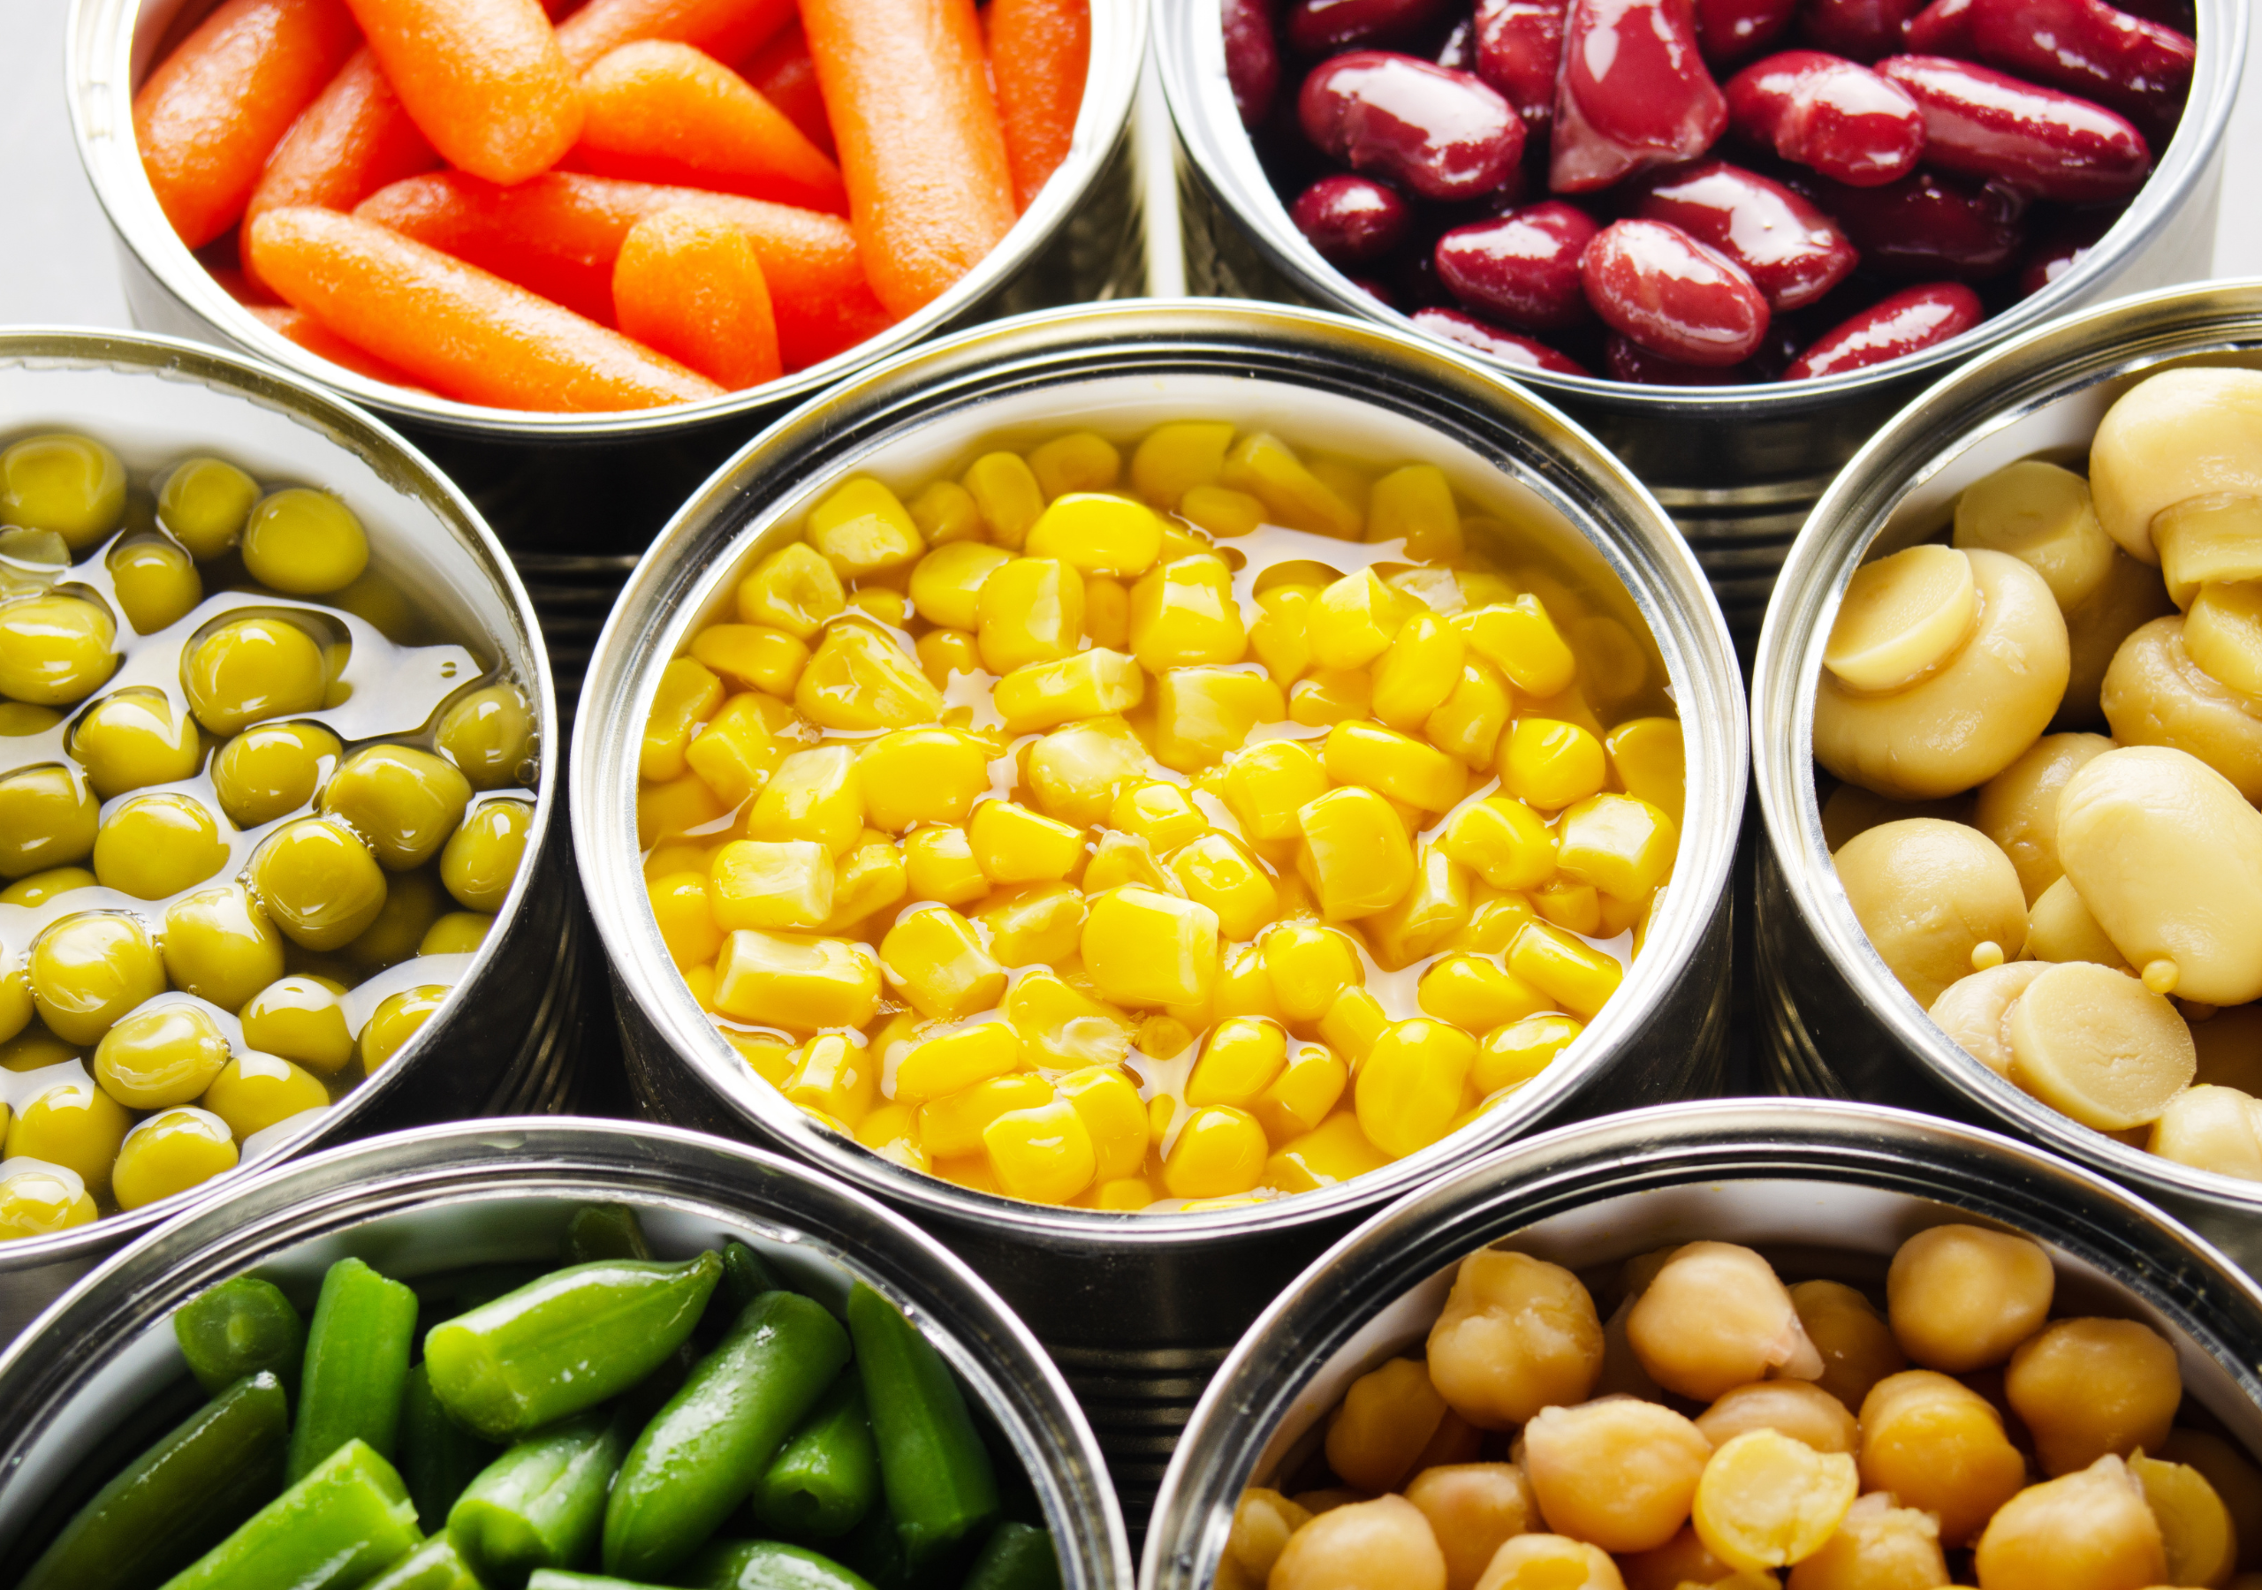
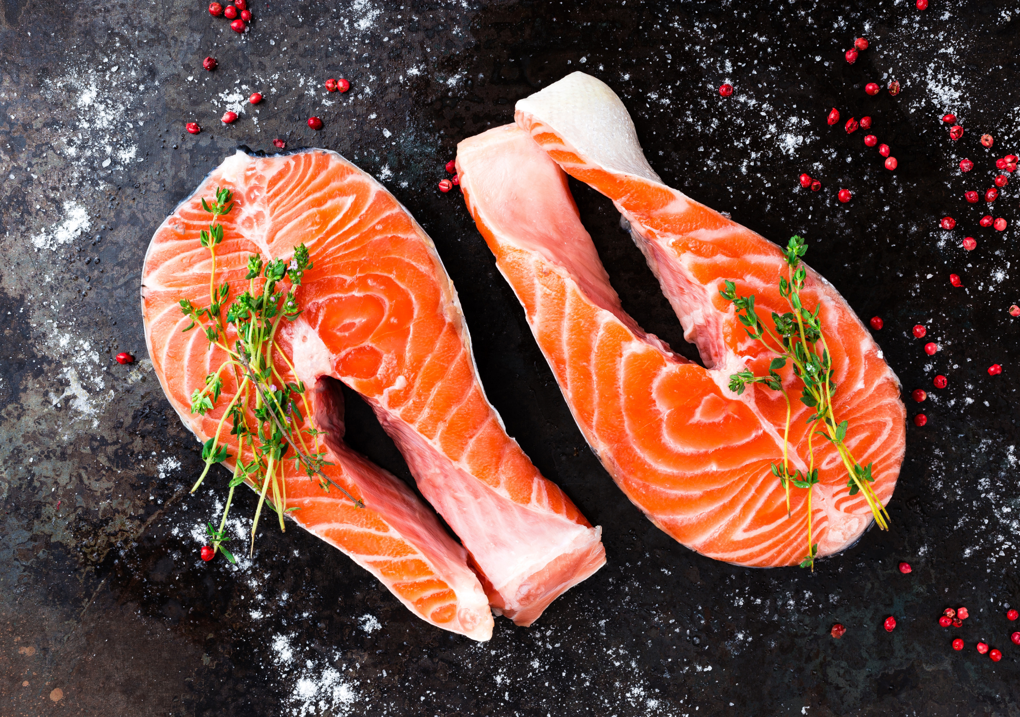
0002 Bonus Culinary Arts
Whole Food or Processed Food? Justify your reasoning here.
Apple
Canned Vegetables
Fresh Salmon

Slide 7
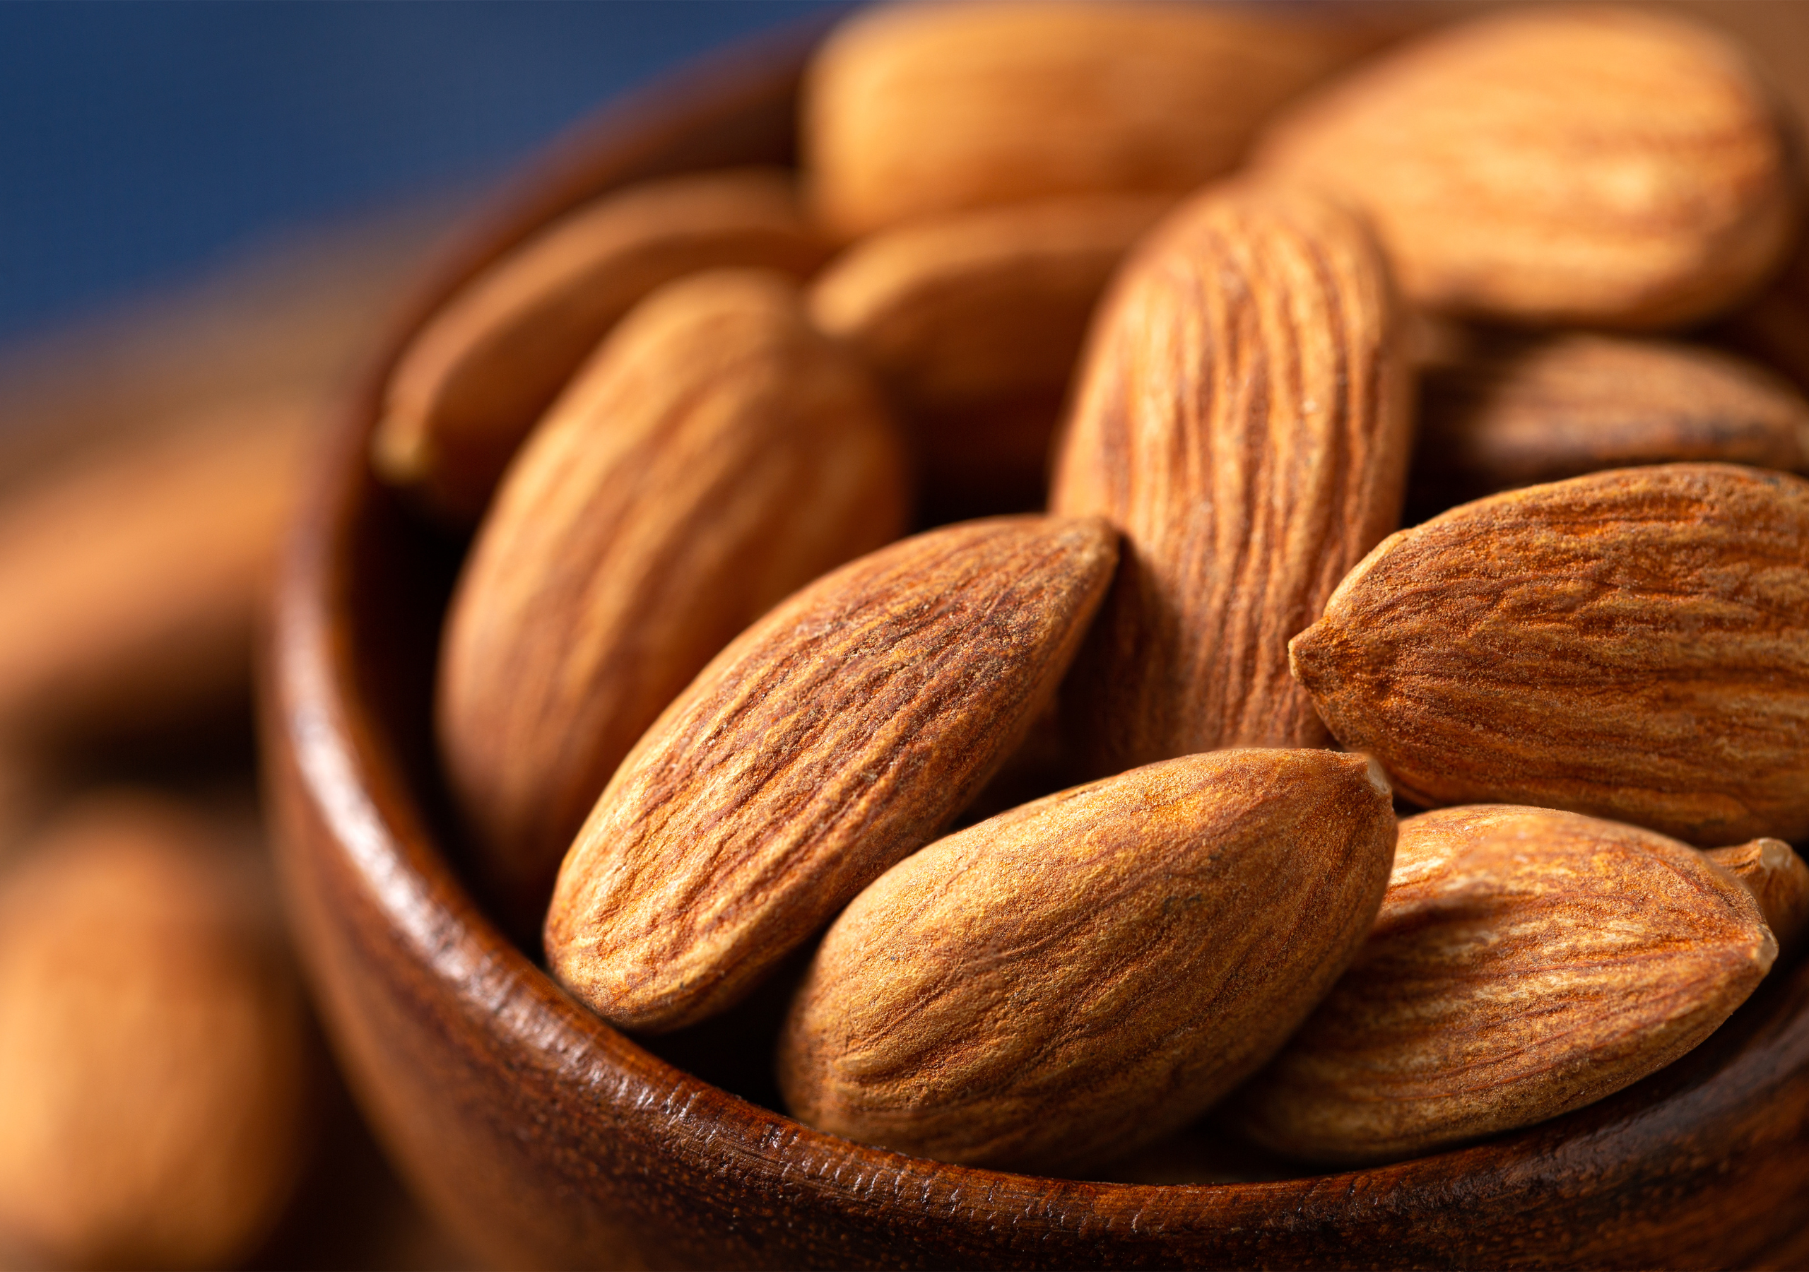
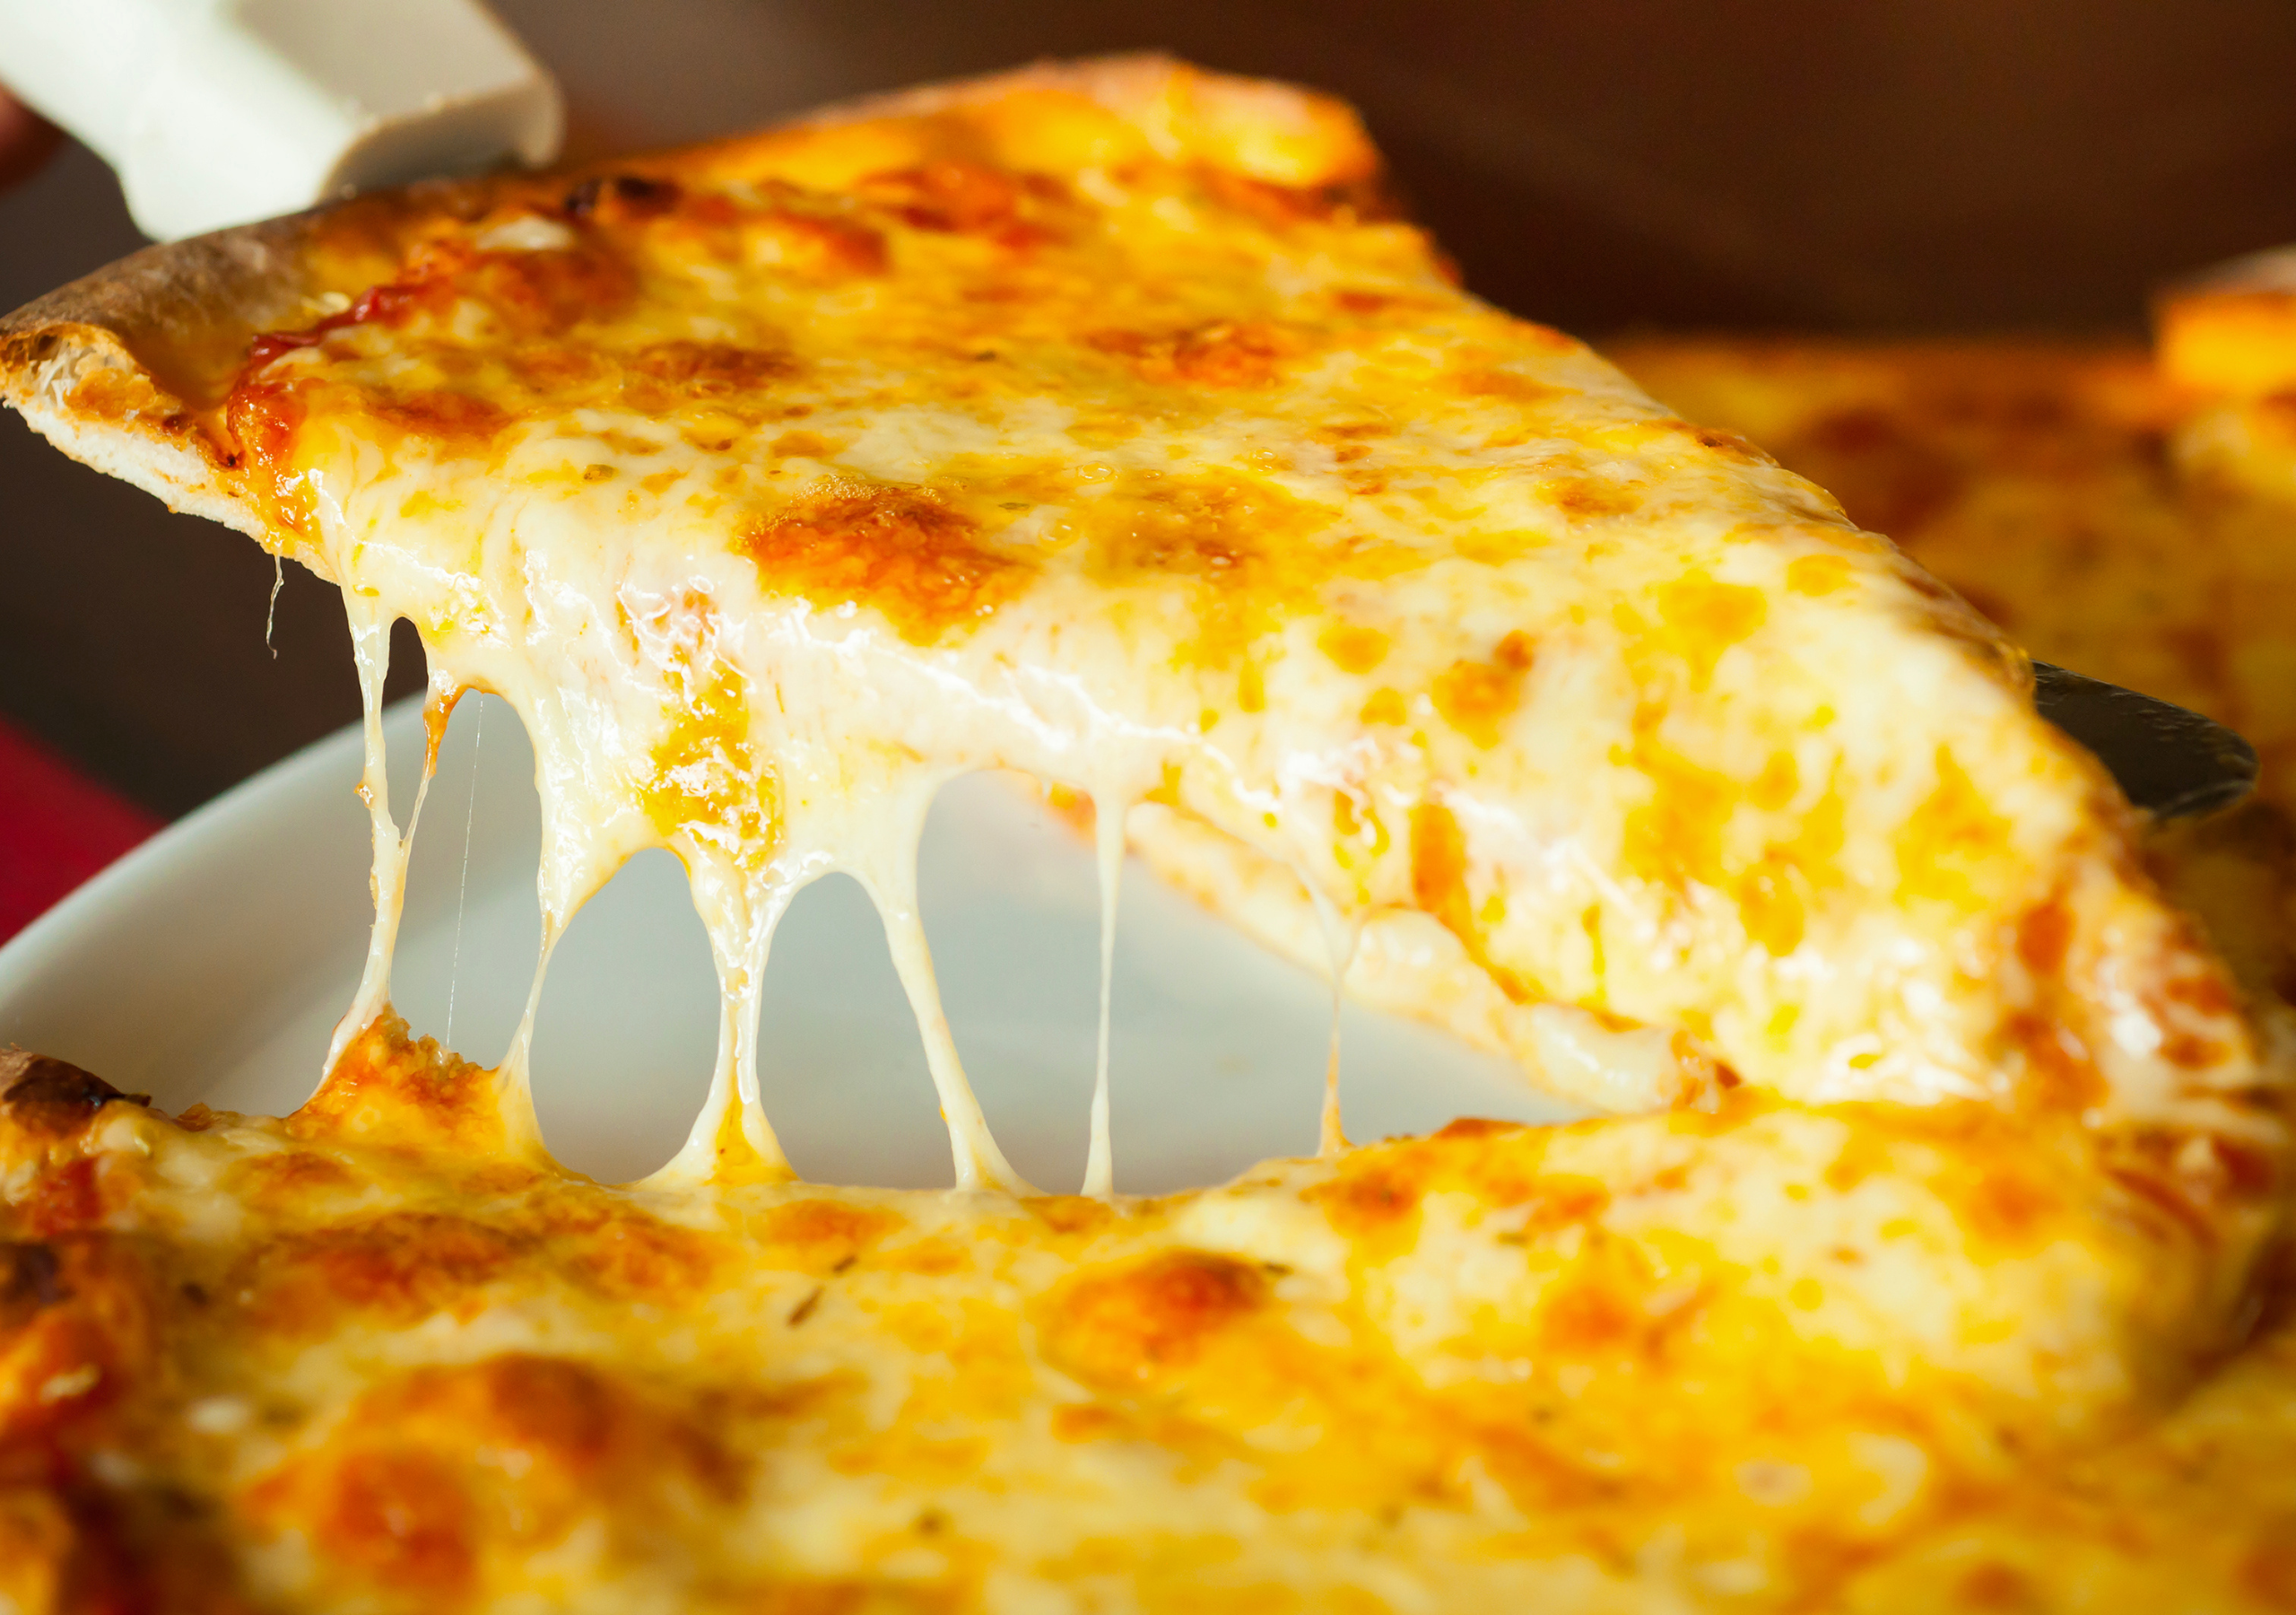
0002 Bonus Culinary Arts
Whole Food or Processed Food? Justify your reasoning here
White Bread
Raw Almonds
Frozen Pizza

Slide 8
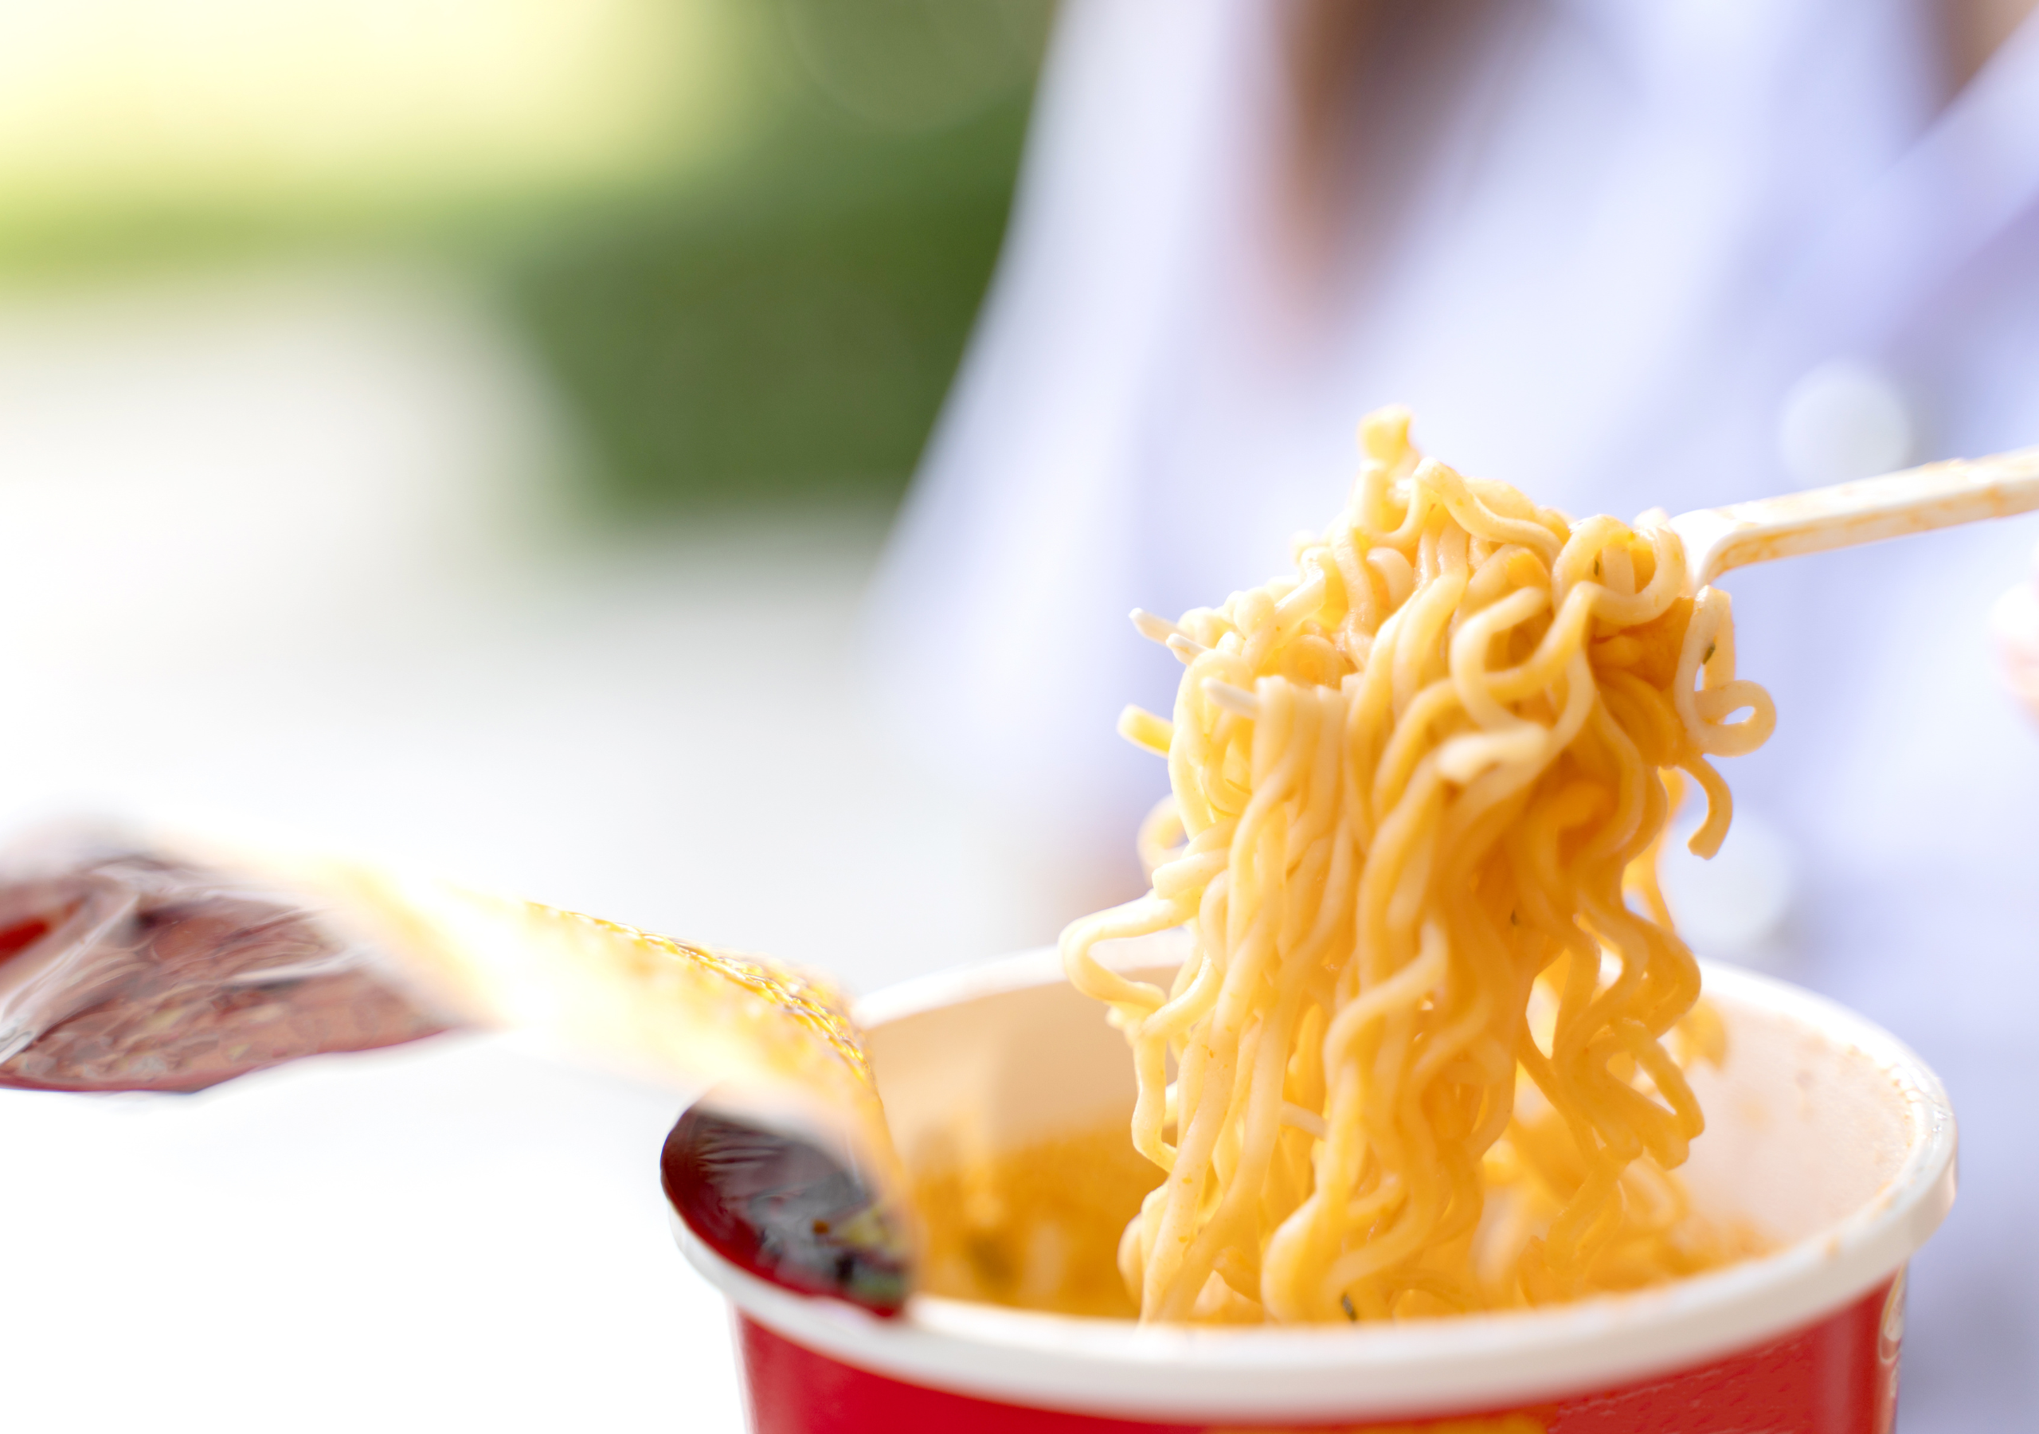
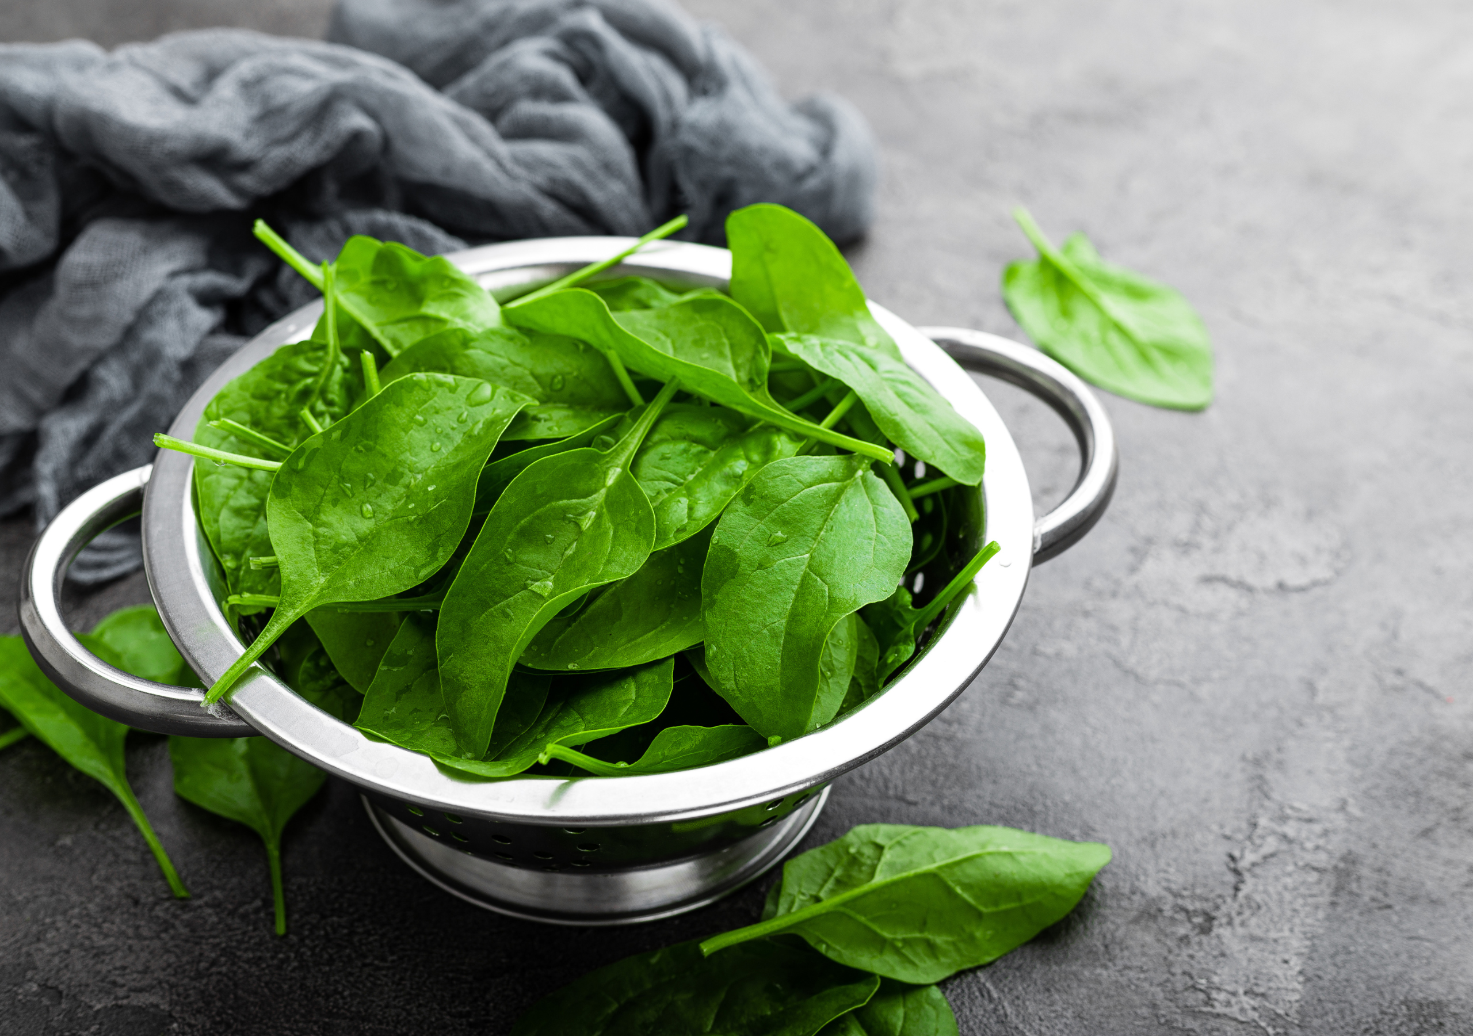
0002 Bonus Culinary Arts
Whole Food or Processed Food? Justify your reasoning here
Quinoa
Instant Noodles
Fresh Spinach Leaves

Slide 9
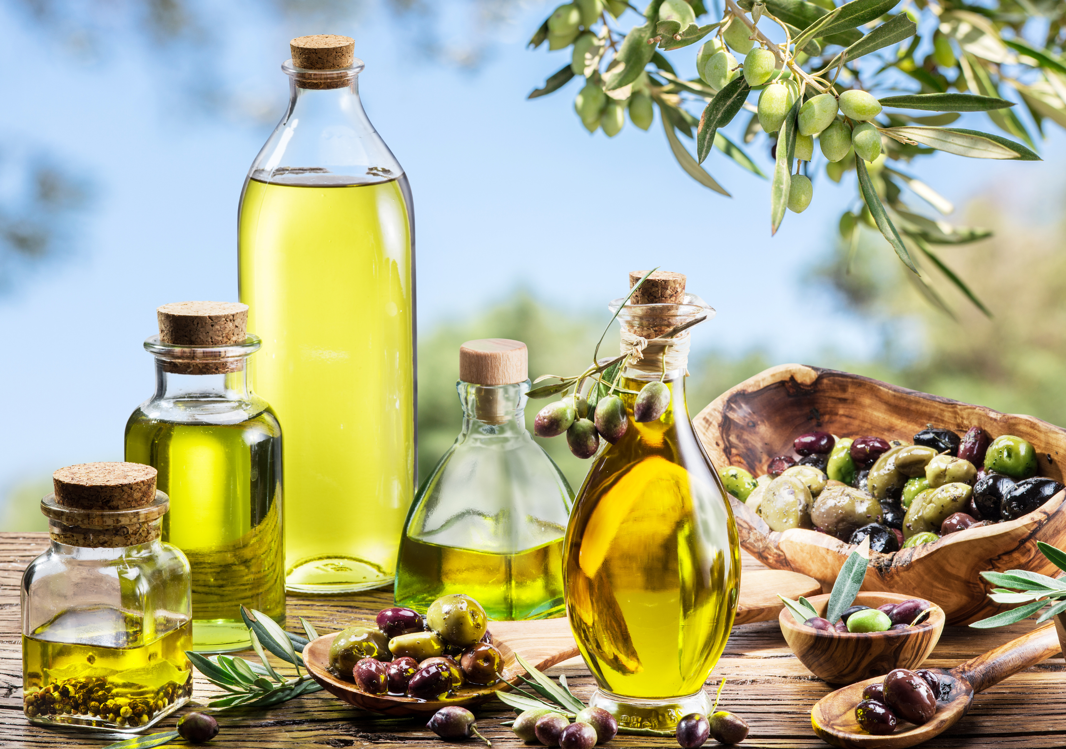
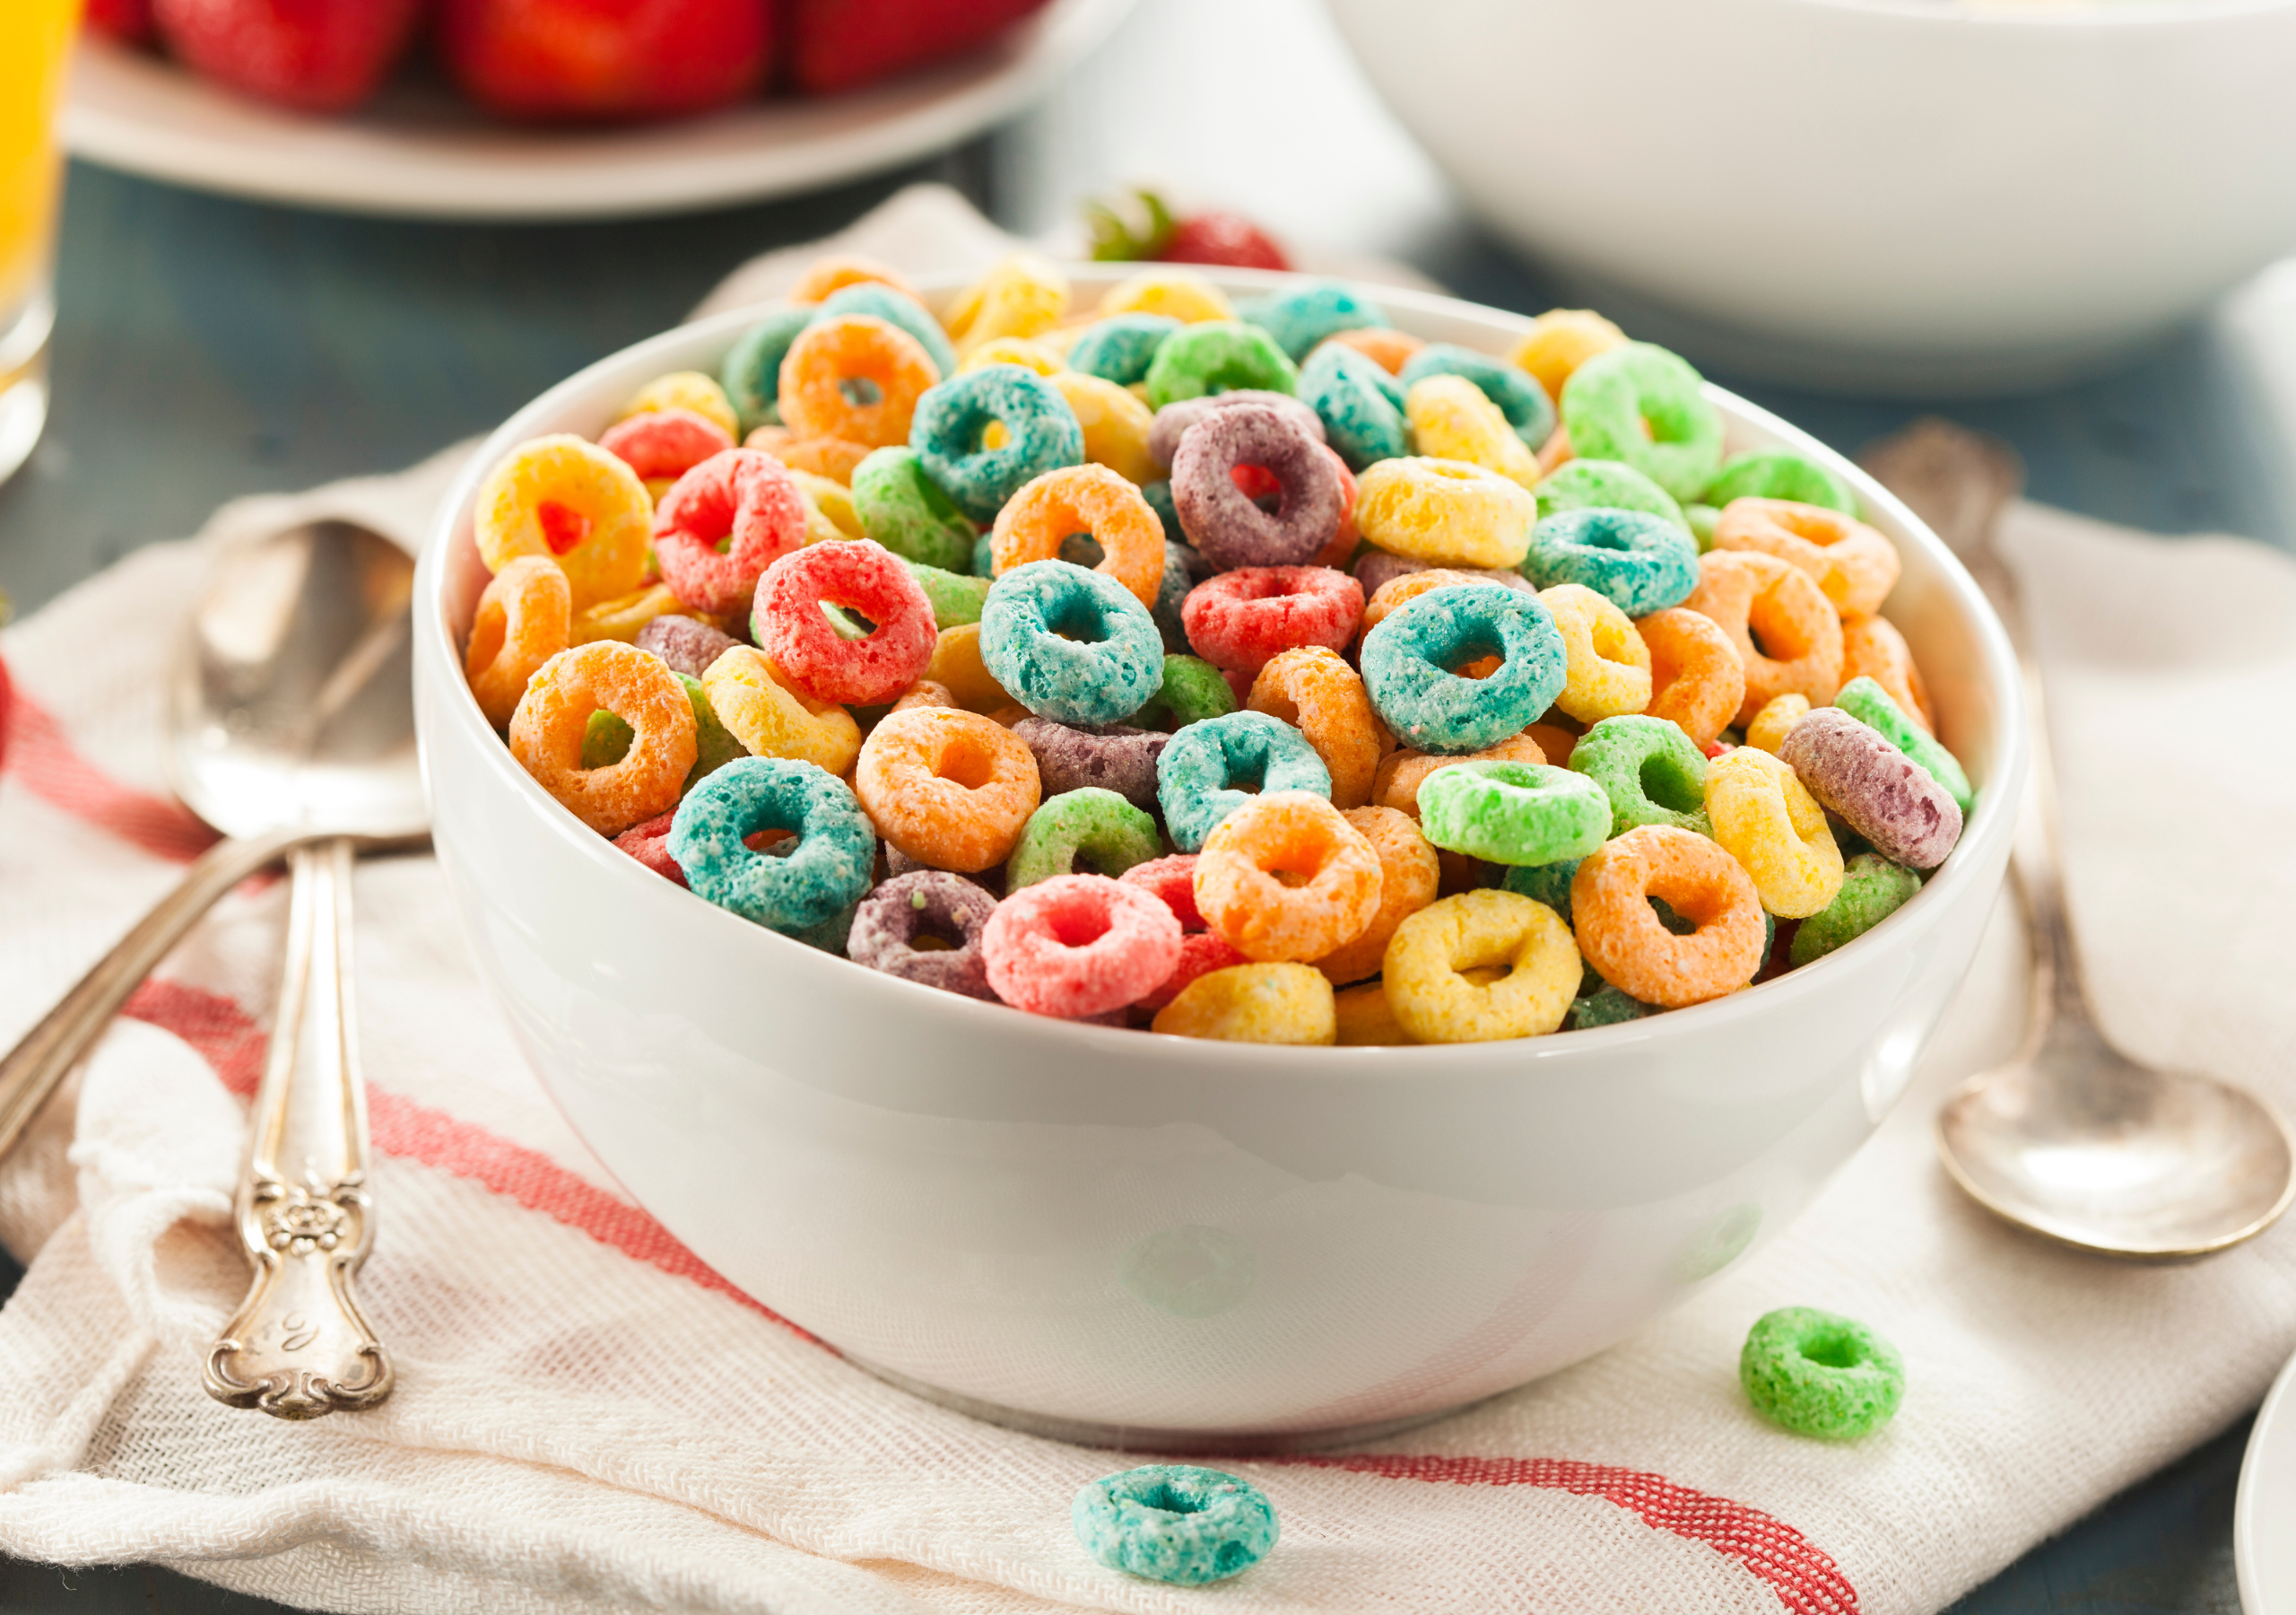
0002 Bonus Culinary Arts
Whole Food or Processed Food? Justify your reasoning here
Chocolate Cookies
Olive Oil
Breakfast Cereal

Slide 10
0002 Bonus Culinary Arts
Reflection Questions.
Reflect on the exercise. Were you surprised by how many foods you consume regularly are processed?
Has this exercise changed your perspective on whole vs. processed foods?

Slide 11
0002 Bonus Culinary Arts
Reflection Questions.
What did I learn about the foods I regularly consume?
How will this exercise influence my food choices in the future?

Slide 12
0002 Bonus Culinary Arts
Reflection Questions
What steps can I take to incorporate more whole foods into my diet?
This exercise was designed to sharpen your awareness of the foods you eat and encourage a shift towards more whole food choices, promoting better health and wellness. Note additional benefits you may have gained by this exercise.

Slide 13
0003 Bonus Culinary Arts
Journal

Slide 14
0003 Bonus Culinary Arts
Journal

Slide 15
Bonus 0002
Identifying Whole Foods vs
Processed Foods
Love in Every Bite: Nourishing Wellness

