Slide 1
Bonus 0008
Organize Your Kitchen
Love in Every Bite: Nourishing Wellness

Slide 2
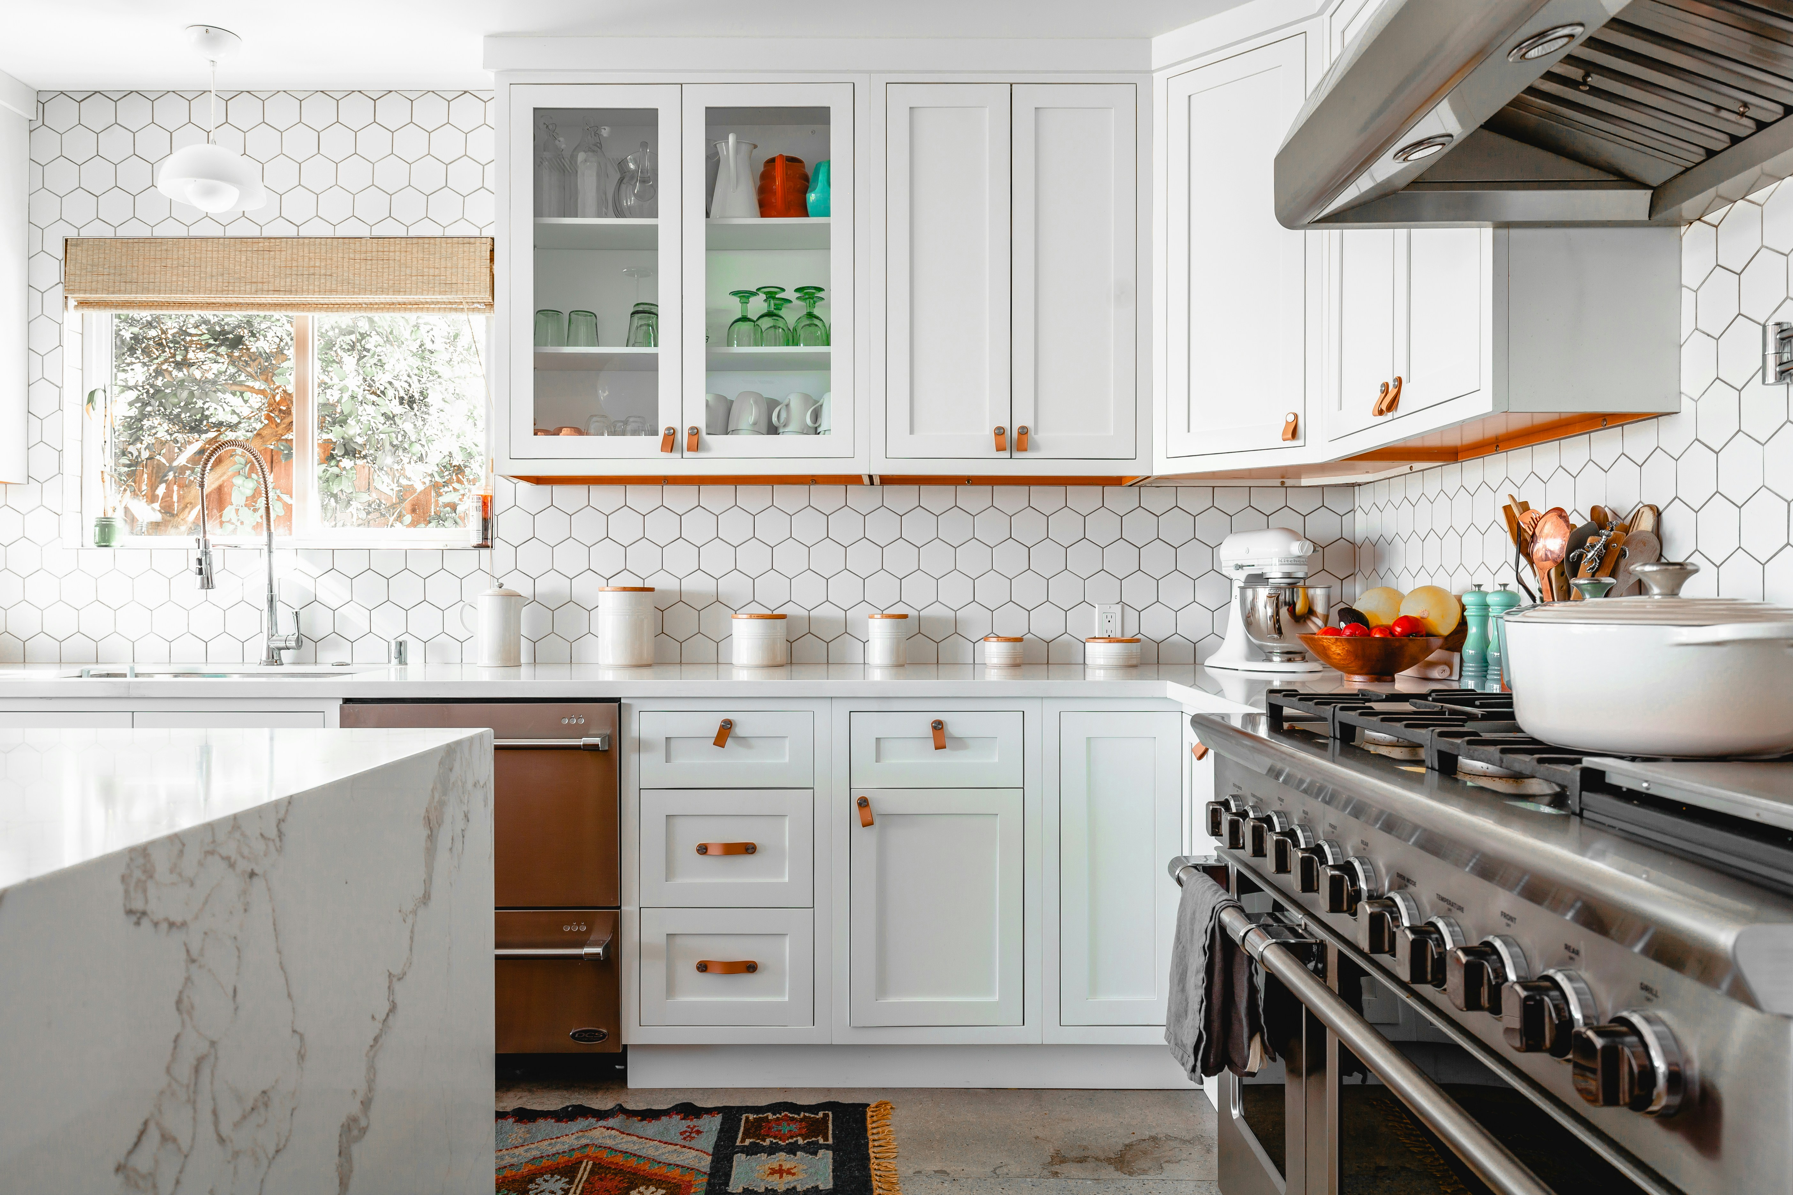
0008 Bonus Organize Your Kitchen
ORGANIZE YOUR KITCHEN
Revitalizing your kitchen space aims to create an environment where simplicity meets functionality, promoting culinary creativity and health. A well-organized kitchen, free from clutter and stocked with purposeful ingredients, not only streamlines your cooking process but also enriches your overall well-being. It's akin to performing a thorough spring cleaning, but for your culinary sanctuary.

Slide 3
0008 Bonus Organize Your Kitchen
ORGANIZE YOUR KITCHEN
Organizing Your Refrigerator
Objectives: Ensure cleanliness, maximize space, and maintain food freshness.
Storage Designs:
Upper Shelves: Designate for beverages, ready-to-eat foods, and herbs in clear containers.
Lower Shelves: Use for storing raw materials, preferably in airtight containers to prevent cross-contamination.
Drawers: Utilize for segregating fruits and vegetables; adjust humidity settings if available.
Door Shelves: Ideal for storing condiments, sauces, and frequently used items that are stable at slightly higher temperatures.
Pro Tips:
Implement a FIFO (First In, First Out) system to rotate perishables.
Clean shelves monthly to maintain hygiene and order.

Slide 4
0008 Bonus Organize Your Kitchen
ORGANIZE YOUR KITCHEN
Organizing Your Freezer
Objectives: Organize to prevent freezer burn and optimize storage space.
Storage Designs:
Bins and Boxes: Use stackable, clear, labeled bins to categorize items by type, such as meats, vegetables, and desserts.
Door Racks: Store smaller items and ice packs to ensure they are accessible without blocking larger items inside.
Pro Tips:
Vacuum seal items to preserve freshness and prevent freezer burn.
Regularly check and purge old or unused items to maintain efficiency.

Slide 5
0008 Bonus Organize Your Kitchen
ORGANIZE YOUR KITCHEN
Organizing Your Food Pantry
Objectives: Streamline access and minimize waste.
Storage Designs:
Adjustable Shelving: Customize shelf heights to fit items such as cereal boxes and beverage bottles.
Lazy Susans: Use for spices and condiments to maximize corner storage and accessibility.
Clear Storage Bins: For bulk items like rice and pasta, which should be labeled and dated.
Pro Tips:
Keep a pantry inventory to track what you have and what needs replenishing.
Place rarely used items on higher shelves and everyday items at eye level.

Slide 6
0008 Bonus Organize Your Kitchen
ORGANIZE YOUR KITCHEN
Organizing Pots, Pans, & Baking Cupboards
Objectives: Make cookware accessible and protect it from damage.
Storage Designs:
Vertical Organizers: Use for lids and flat items like baking sheets.
Hanging Racks: Install inside cupboard doors for pots and pans with detachable handles.
Slide-Out Racks: Ideal for heavy items to avoid lifting and stacking.
Pro Tips:
Consider installing a pull-out shelf system for easier access to back items.
Use soft liners to protect the surface of nonstick cookware.

Slide 7
0008 Bonus Organize Your Kitchen
ORGANIZE YOUR KITCHEN
5. Organizing Cooking Utensils
Objectives: Streamline meal preparation by making tools easy to find.
Storage Designs:
Hanging Strips: Magnetic strips for metal utensils, mounted on backsplash.
Utensil Holders: Separate holders or dividers for cooking versus serving utensils.
Pro Tips:
Group utensils by use: one area for cooking tools, another for serving tools.
Regularly declutter gadgets that are rarely used.

Slide 8
0008 Bonus Organize Your Kitchen
ORGANIZE YOUR KITCHEN
Organizing Dishes
Objectives: Keep dishes easily accessible and neatly stacked.
Storage Designs:
Cabinet Inserts: Use inserts to subdivide large shelves and stack dishes vertically.
Under-Shelf Baskets: Utilize the space beneath shelves for small items like saucers and cups.
Pro Tips:
Store everyday dishes on lower shelves for easy access, and special occasion items higher up.
Nest similar items together to save space.

Slide 9
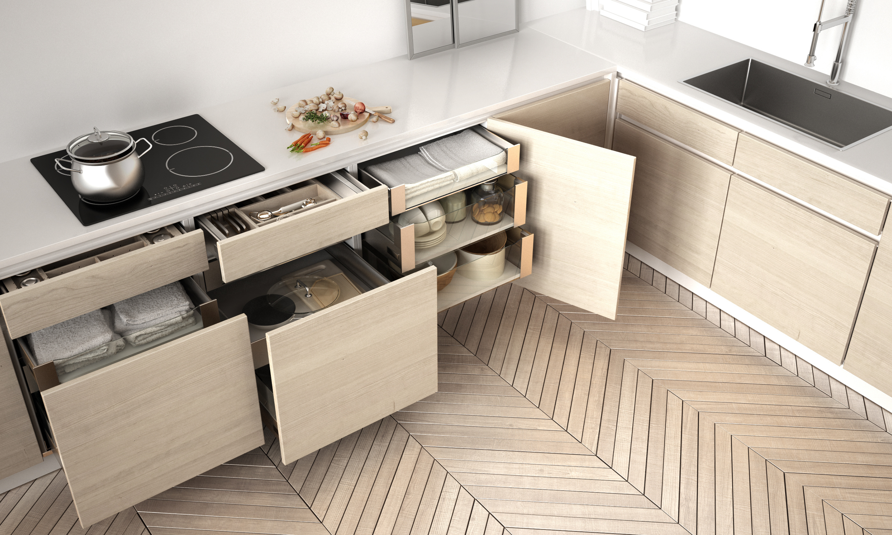
0008 Bonus Organize Your Kitchen
ORGANIZE YOUR KITCHEN
Organizing Kitchen Drawers
Objectives: Maintain an organized and functional drawer space.
Storage Designs:
Modular Drawer Organizers: Custom-fit to hold utensils and gadgets neatly.
Deep Drawer Dividers: Use for larger items like dish towels, measuring cups, and mixing bowls.
Pro Tips:
Prioritize drawers for items used daily near the cooking area.
Label sections inside drawers if not immediately visible.

Slide 10
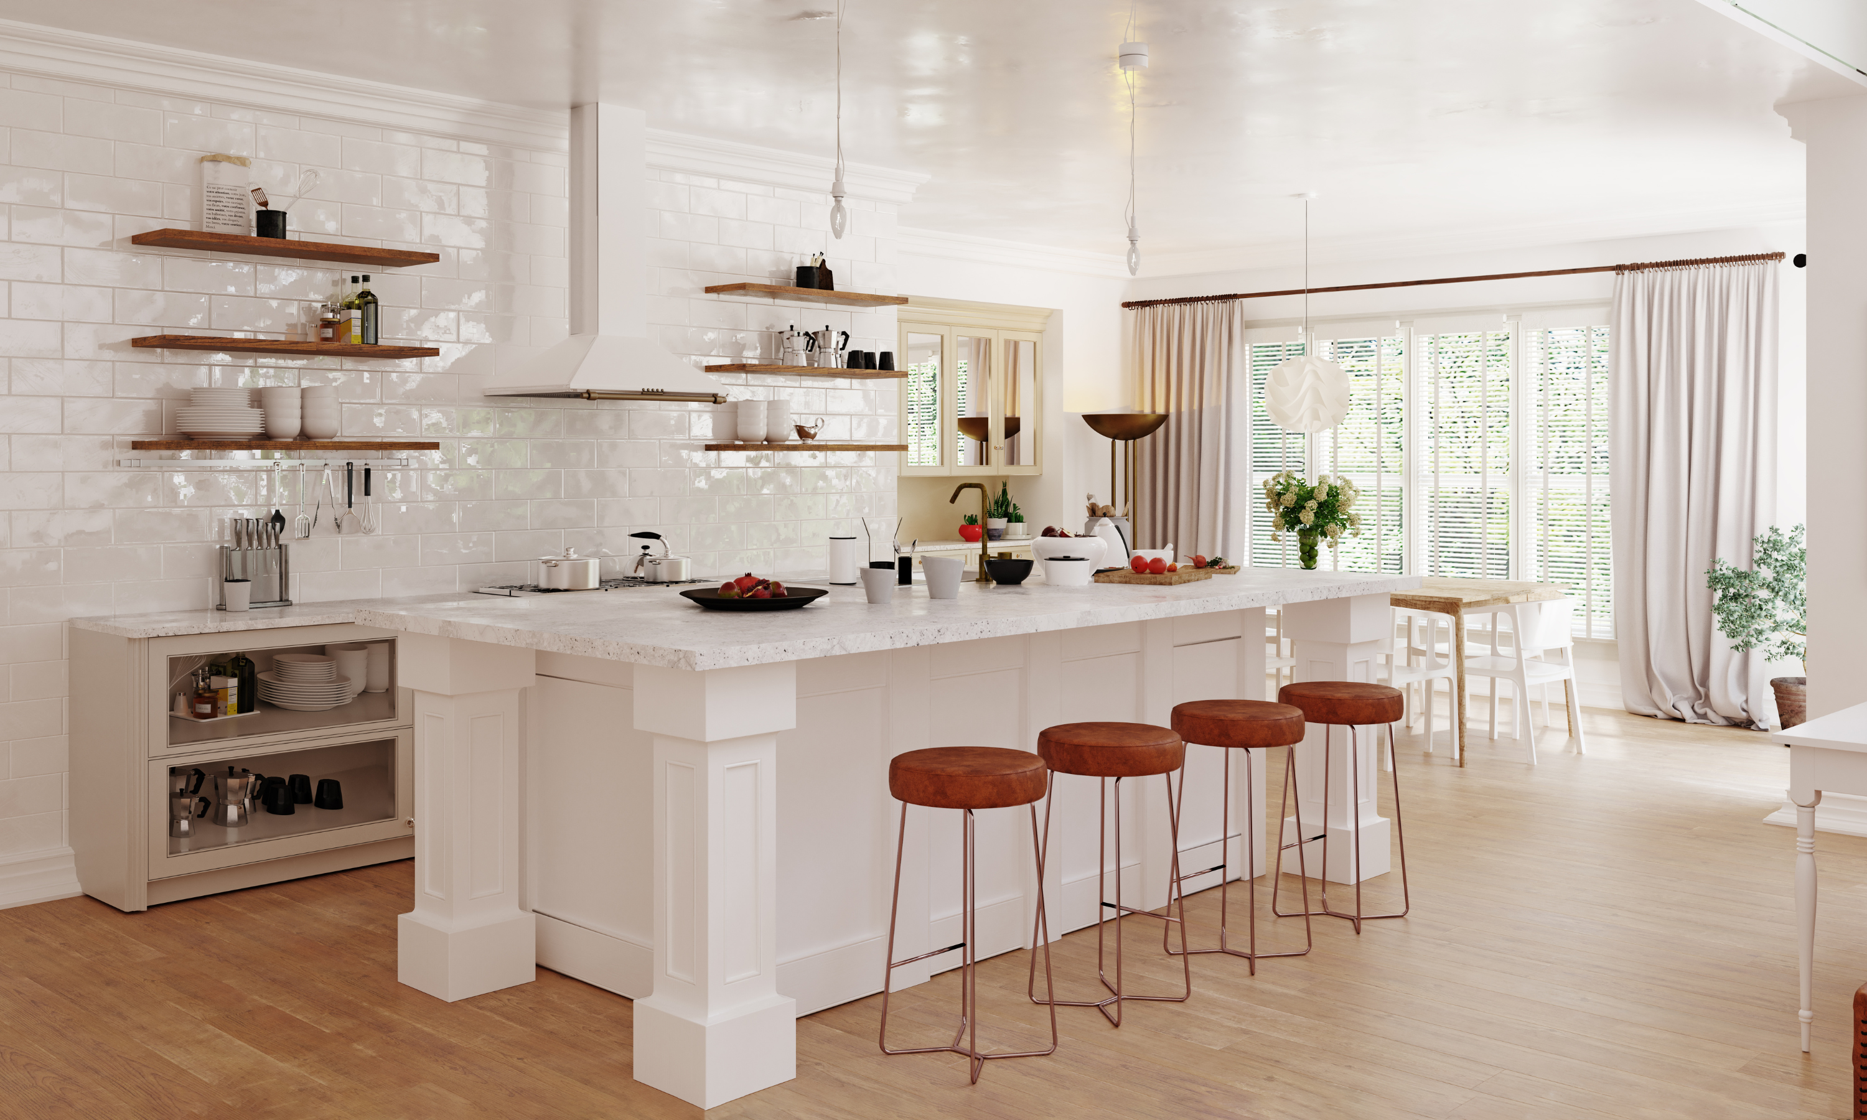
0008 Bonus Organize Your Kitchen
ORGANIZE YOUR KITCHEN
Organizing Your Kitchen Countertop
Objectives: Reduce clutter and maintain a clean working area.
Storage Designs:
Vertical Storage: Use wall-mounted shelves or hanging grids for items like cutting boards and colanders.
Essential Tool Jars: Group frequently used utensils in decorative jars or containers.
Pro Tips:
Keep counters clear except for essential appliances.
Regularly reassess what needs to be on the counter.

Slide 11
0008 Bonus Organize Your Kitchen
ORGANIZE YOUR KITCHEN
Organizing Under the Kitchen Sink
Objectives: Enhance functionality and protect items from water damage.
Storage Designs:
Waterproof Mats: Protect the cabinet base from leaks and spills.
Stackable Bins: Organize cleaning supplies, ensuring they are easily reachable.
Pro Tips:
Use a tension rod to hang spray bottles, maximizing vertical space.
Regularly check for leaks to prevent damage to stored items.

Slide 12
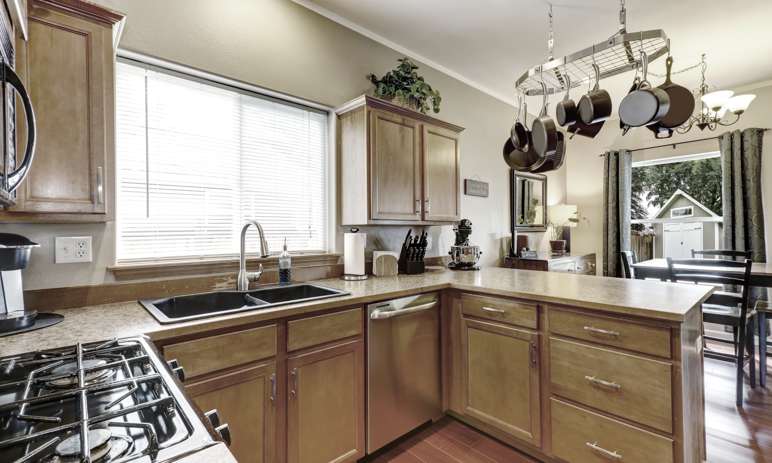
0008 Bonus Organize Your Kitchen
ORGANIZE YOUR KITCHEN
The Ideal Method For a Ceiling Rack for Pots & Pans
Design Considerations:
Location: Central but out of the main kitchen traffic flow.
Material: Opt for heavy-duty materials capable of supporting weight, like steel or solid wood.
Adjustability: Choose hooks and placements that can be rearranged as needs change.
Installation Tips:
Anchor securely into ceiling beams to support the weight.
Distribute pots and pans evenly to maintain balance and prevent sagging.

Slide 13
Bonus 0008
Organize Your Kitchen
Love in Every Bite: Nourishing Wellness

