Slide 1
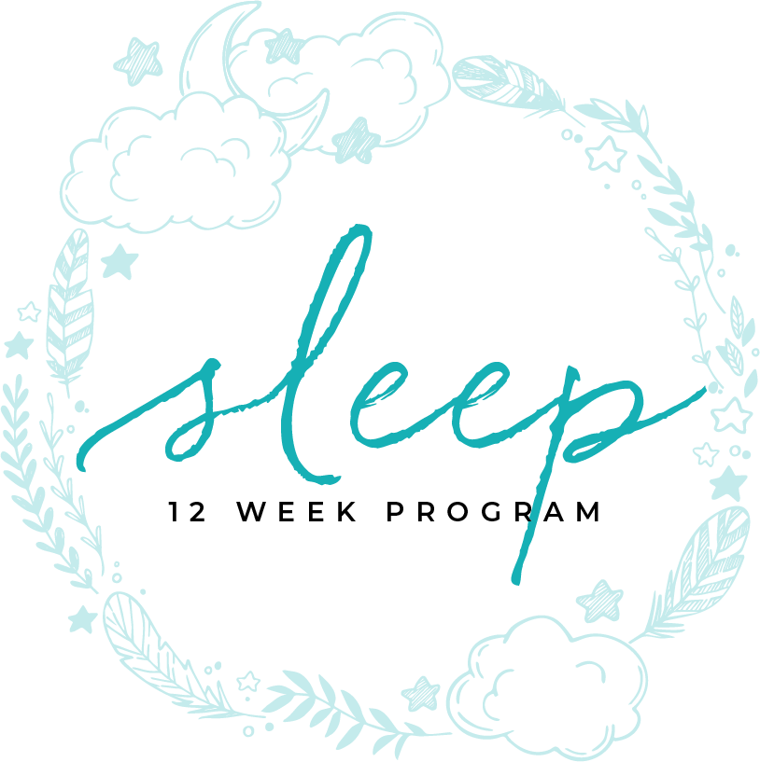
ADOPTING HABITS
RESOURCE MANUAL

Slide 2
17 SLEEP HABITS
TO ADOPT

Slide 3
The Habits
ONE
Go to bed at the same time every night and wake up at the same time every morning. That includes weekends. You stay asleep longer and fall asleep easier with a routine.
For most people, the most logical way to set your sleep and wake time, is to figure out what time you have to be awake for work or school and then work backwards. Allowing 90 minutes for morning routine would require you to subtract that and any travel time from your time to get to work.

Slide 4
The Habits
ONE (continued)
Pick a wake up time that’s reasonable and easy to maintain. If you make it too early or too late, it will be unnatural and hard to keep up.
Once you’ve arrived at your wake up time, just subtract 8 hours from that for your sleep time, then another 30-60 minutes for when you need to begin your evening routine.
Give yourself a few weeks to adjust. If after that, it’s not working out, tweak it and try again.

Slide 5
The Habits
TWO
Relax before you go to bed. Everyone is a little different. See what works for you. The best practice would be to decrease the light you are experiencing between 20 to 40 minutes before you go to bed.
Make it a routine to go to bed. You might set your alarm for 9:00, take the dog out, get anything ready for the morning you may need, drink some non-caffeine tea, take a shower or relaxing bath, brush your teeth, set the alarm (for the house if you have one), read for 20 minutes, and go to sleep. By doing the same thing every night, your body and mind know it’s time to sleep.

Slide 6
The Habits
THREE
Avoid stress and arguments before bed time. Even with a winning relaxation strategy, if you’re tired and cranky, and the slightest comment sets you off, relaxation is lost.
Studies show that better sleep comes when you do not argue at night. The conflict from an argument raises your arousal level, adrenaline, and cortisol and keeps you awake.
The best way to deal with it is to agree not to disagree at bedtime. If you can’t do that, sleeping in a separate room will remove you from the tension of the argument.

Slide 7
The Habits
FOUR
Exercise daily. One increment of time that is dedicated to vigorous workout helps you to sleep better. Light exercise is better than no exercise.
Morning exercise ensures that you get your exercise in and sets the tone for the rest of the day. Your morning routine is just as important as your night time routine. Make this a part of a strong morning routine.
Studies show that those who worked out at 7 a.m. fell asleep faster, slept longer, and experienced more deep sleep and REM sleep than those who exercise later.

Slide 8
The Habits
FOUR (continued)
Make your morning workout and get outside in the sunshine for even better sleep.
Aside from the benefit to sleep, getting your workout in in the morning is an easier way to stay consistent because you have less tendency to put it off as the day’s activities and occurrences take precedence.
For the best night’s sleep, avoid late night cardio or other stimulating exercise.
Yoga and stretching can be a nice part of your evening routine to relax.

Slide 9
The Habits
FIVE
Sleep in cool temperatures. You can get sheets and blankets that are woven to keep you from overheating. It’s really nice if you can open the windows and let cool air in.
There are a million products out there for you to keep your cool at night. It’s nice if there’s a warranty.
Suggested bedroom temperature should be between 60-67 degrees Fahrenheit for the best night’s sleep. Your body temperature decreases to initiate sleep and these temps can help to facilitate this change. Babies do a little better with temperature 3-5 degrees higher.

Slide 10
The Habits
SIX
Close off the noise. There are several noise-blocking wall finishes and fabrics if you’re close to an interstate or have noisy neighbors. Some people live by the airport and trains. Noise canceling headphones are handy when you can’t change your environment.
Upholstered walls, noise blocking drapery, and wall finishes with mixed media will block noise. There are special panels created to absorb sound. One of the most popular products to use is a white noise machine. This is nice for sleep and relaxation.

Slide 11
The Habits
SEVEN
Block all light from entering through windows and doors. Blackout shades or drapes are perfect for windows, skylights, and passageways. If nothing else, get eyeshades and cover your eyes.
It’s nice to wake up to skylights covered with motorized shades and timed to open and close. Drapery that has a blackout lining can be bought ready-made or custom made and are beautiful solutions to blocking lights. There are many shades that are made that block the light completely. Even if you purchase blackout blinds, most let a little light in through the slats.

Slide 12
The Habits
EIGHT
Leave work, television, mobile electronics out of the bedroom, especially at night.
Email, video games, internet, and television all provide distraction through the day and sometimes, if we let it, into the night. These distractions can keep us from falling asleep, sleeping well, and waking well in the morning.
Aside from the light, stress, and distraction, all of these technologies result in stimulation that makes it difficult to turn off our brain.

Slide 13
The Habits
EIGHT (continued)
What’s the fix? This sounds easy, though it takes some determination and will power. Turn it all off, after a certain hour and in our bedrooms.
Set that routine at night and make sure your electronics are not a part of the routine.
Don’t check email or correspond from bed. That not only causes trouble sleeping, it can cause trouble in your communication as well.
Disconnect your kids just like you disconnect yourself. Give them some time to detach from technology at night.

Slide 14
The Habits
NINE
Avoid big meals within 3 hours of bedtime. Consuming large meals in the evening may increase our susceptibility to obesity. It doesn’t really matter what time you eat it, it’s that it shortens the “fasting” time between dinner and breakfast and gives us more time to consume calories.
Gastroesophageal Reflux Disease can be a problem when you eat to close to bedtime. When you lie down, the acid flows back up through your esophagus.
Your metabolism kicks in and makes it difficult to fall and stay asleep.

Slide 15
The Habits
TEN
Caffeine can cause sleep problems. Caffeine is considered the most popular drug in the world. You can consume it from a coffee bean, tea leaf, kola nut, and cacao pod.
There is worldwide use of caffeine on a daily basis in coffee, tea, cocoa, chocolate, some soft drinks, and some drugs.
Short-term, it makes us feel more alert by blocking chemicals that cause sleep and increasing adrenaline production. Sun is better for wakeup and no caffeine before bedtime is best.

Slide 16
The Habits
ELEVEN
Alcohol and sleep don’t mix. If you consistently wake up at 1:00 am and can’t get back to sleep, review what you drank before bed.
Alcohol disrupts circadian functioning, by directly interfering with the ability of the master biological clock to synchronize itself. Disruptive effects of alcohol can affect sleep as well by adding to liver disfunction, leaky gut, depression, and disrupted sleep-wake cycles.
People who go to bed with alcohol in their system are more likely to wake in the middle of the night and not be

Slide 17
The Habits
ELEVEN (continued)
able to fall back asleep.
Other sleep disruptions associated with alcohol consumptions include:
•More frequent need to get up and go to the bathroom, especially during the second half of the night
•Increased risk for parasomnias including sleep walking and sleep eating
•Greater risk for snoring and sleep-disordered breathing. Alcohol can lead to excessive relaxation of the muscles in

Slide 18
The Habits
ELEVEN (continued)
the head, neck, and throat, which may interfere with normal breathing during sleep.
•Alcohol consumption can trigger new sleep disorders or exacerbate existing ones, including insomnia and obstructive sleep apnea.
Sleep and circadian rhythm disruption from alcohol also contribute to next-day tiredness, fatigue, irritability, and difficulty concentrating. Even if it doesn’t present as a full-fledged hangover, alcohol-related sleep loss negatively affects mood and performance.

Slide 19
The Habits
ELEVEN (continued)
There’s also a gender factor in the effects of alcohol on sleep: Women appear to experience the sleep-disrupting impact of alcohol more significantly than men do, according to research.

Slide 20
The Habits
TWELVE
Keep a sleep journal. Tracking daily habits and sleep quality helps to make adjustments. Journals allow you to meander on your thoughts, when you do that, clarity and magic can happen. The bonus is that it’s all written down so you can reference your thoughts, make comparisons, and grow.
By keeping a journal, it will not only help you to clarify, it helps to prioritize and sometimes saves you all kinds of time, trouble, and money with solutions.,

Slide 21
The Habits
TWELVE (continued)
—Tips for Finding Time to Journal— It can be very difficult to make time for journaling every morning.
• Make journaling part of your nighttime or morning routine.
• You may find 15 minutes in a coffee shop or juice stop on your way to work gives you the time you need to write, and, will add to the pleasure.
• 15 minutes before you start your work routine may be the time for you. You may think it will cause you to stay later at work to get everything accomplished. Writing is

Slide 22
The Habits
TWELVE (continued)
like your morning workout, it is amazing how spending the time can buy you more time through the day. Your head is clearer and you can do your job and handle people more efficiently and effectively.
Journaling in the morning allows you to clear the cobwebs in your brain. You’ll notice effects almost immediately, it helps to focus you. You will find that you do things that you would have skipped over otherwise. Try to journal every day. If you don’t…then sometimes will work too.

Slide 23
The Habits
TWELVE (continued)
It is established that it takes 6 months to form a habit. Commit to journaling for 6 months.

Slide 24
The Habits
THIRTEEN
Sleep on a comfortable supportive bed. If it’s over 10 years old, it’s time to replace it. It used to be you’d go to the bed store and move from bed to bed and pick the one that feels the best. Now, with technology and study, beds are made to fill all kinds of needs. luxury, non-toxicity, and pain-relief are only some of the options.
Beds are now recommended by doctors! Mattresses are very important to our sleep. One mattress is created to “keep the spine in alignment, takes pressure off the discs, improves the curves of the spine, prevents wear and tear and gives you better quality sleep.” Dr. Nick Athens

Slide 25
The Habits
FOURTEEN
Keep your sleep area clutter free and free from allergens. Clearing away and decluttering your space can help to eliminate stress.
We have our detoxes; our spiritual cleanses, and if you haven’t already, there’s another cleanse you should consider. There have been many studies that show that visual complexity has an effect on our feelings.
We react to sensory stimulation. Sensory information comes from sight, sound, touch, taste, and smell. Any of our five senses can be over stimulated.

Slide 26
The Habits
FOURTEEN (continued)
The important thing to understand in your home is our stimulation threshold. That is how much is too much or not enough. Reaching a healthy balance is important.
We are limited to the amount of information we can process. We can experience overload in a cluttered space. This overload causes stress.
The tricky part is that we all have different thresholds. Under stimulation can cause anxiety. If we have been

Slide 27
The Habits
FOURTEEN (continued)
living in an environment with high stimulation, then we may have adapted and enjoy the arousing and pleasurable environment. It would take a lot to overstimulate us.
If we’re overstimulated in our workplace, we will probably relax better in a home that has less visual complexity. If our career has us in a very sterile environment, we may look for more complexity to offer intellectual and spiritual stimulation.
People with attention deficit disorders will not have the

Slide 28
The Habits
FOURTEEN (continued)
same threshold as an individual who requires less time to understand and retain information. There is also research and theory that an effortless attention can restore the capacity to pay attention. The best example of this would be to draw ourselves to nature in our surroundings.
If you want to determine if you have a high threshold for visual complexity, look at the homes to the left. Which one are you drawn to?
The first has a good deal of visual stimulation. The second

Slide 29
The Habits
FOURTEEN (continued)
blends with the environment and would offer less visual stimulation.
Many elements add visual stimulation to space. “Stuff” is one of our bigger problems, kids toys, mom’s books, dad’s video games, these all add to visual complexity when left out. Furniture, accessories, window treatments and wall hangings, as well as lighting, can add to the visual complexity.
Whichever you prefer, be sure that what you feel to be clutter is picked up and out of the bedroom by bedtime.

Slide 30
The Habits
FOURTEEN Part Two
Toxins in the bedroom can wreak havoc with your health and your sleep.
Replace your pillows every 6 months
Use natural fabrics
Cotton
Silk
Wool
Linen
Say goodbye to polyester, acrylic, nylon (all thermoplastics)

Slide 31
The Habits
FOURTEEN Part Two (continued)
Get rid of anything with formaldehyde. It can aggravate asthma, irritate mucous membranes, cause contact dermatitis, and aggravate lung conditions. Formaldehyde is used in furniture, fabrics, and flooring.
Floors that are easy to clean like tile and wood are better choices.
Benjamin Moore has 100% clean, not just no VOC paint. Spend the extra money in your bedroom for your health and your sleep.
Keep shoes out of your bedroom. They are dirty. Put a

Slide 32
The Habits
FOURTEEN Part Two (continued)
rack or tray outside your door.
Replace your mattress every ten years. Clean mattresses with all natural materials are now available. Worse case scenario, get an organic barrier cloth to encase the mattress.

Slide 33
The Habits
FIFTEEN
Check your medications to see if they cause trouble with regular sleep cycles. We’ve listed a lot of sleep disruptors in the medication module. Just to be sure, check with your pharmacist.
Who should you turn to with questions about your medicines? The answer should be your pharmacist but you may not know what your pharmacist can do for you. Your doctor and your pharmacist are a powerful team, working to ensure the best selection and management of your prescription and nonprescription medicines.

Slide 34
The Habits
FIFTEEN
Ultimately, you have the responsibility for managing your health care, but your pharmacist can help if you keep him or her up-to-date about your health and the medications you are taking. For this reason, it is important to use the same pharmacy for all of your prescription services, especially when seeing multiple health care providers. This ensures that your pharmacist has access to your complete medication history when checking for problems or possible interactions.
You should also check with your pharmacist before taking any nonprescription medication.

Slide 35
The Habits
SIXTEEN
Go to the bathroom right before sleeping. This is an obvious and simple answer to some people’s sleep disturbance. If you wake up a few hours after you’ve gone to sleep, try using the bathroom before you go to sleep.
Waking up in the middle of the night because of a full bladder disrupts your sleep and affects the quality of your sleep.
That’s another reason to avoid any diuretic like alcohol or coffee before bedtime.

Slide 36
The Habits
SEVENTEEN
Develop a morning routine.
Get up early.
Work out in the morning.
Don’t touch your phone until your routine is complete.
Exercise.
Get some morning sunlight, between 20-60 minutes.
Plan for your day.
Pray or meditate.
Journal.

Slide 37
ADOPT THESE 17 SLEEP HABITS
AS YOU GO THROUGHOUT
YOUR PROGRAM
REMEMBER, FOCUS ON
PROGRESS AND NOT
PERFECTION

