Slide 1
SLEEP ACROSS THE LIFESPAN
MODULE TWO

Slide 2
SLEEP ACROSS THE LIFESPAN

Slide 3
Table of contents
4 | Infants to 1 year
6 | Toddlers
8 | Child
10 | Adolescents
12 | Adults

Slide 4
MODULE TWO
part one
INFANTS TO 1 YEAR

Slide 5
baby’s sleep cycle
Infants To 1 Year
TIME ASLEEP
Notes:
Babies at 2-4 months of age require about 14 hours of sleep a day.
Infants sleep short periods that can be varied in length. Depending on the child they start to develop a sleep cycle between 2-4 months.
When infants reach 6-12 months they start to develop a longer sleep cycle of 6-9 hours followed immediately by the longest period of wakefulness.

Slide 6
MODULE TWO
part two
TODDLERS

Slide 7
naps usually stop between ages 3-5
Toddlers
Notes:
Toddlers continue to need 12 to 14 hours, however the sleep times shift as they grow to a longer afternoon nap of about 180 minutes and night time of 7-9 hours.
Naps usually stop between ages 3-5 depending on the child and also their culture and their ethnic heritage.

Slide 8
MODULE TWO
part three
CHILD

Slide 9
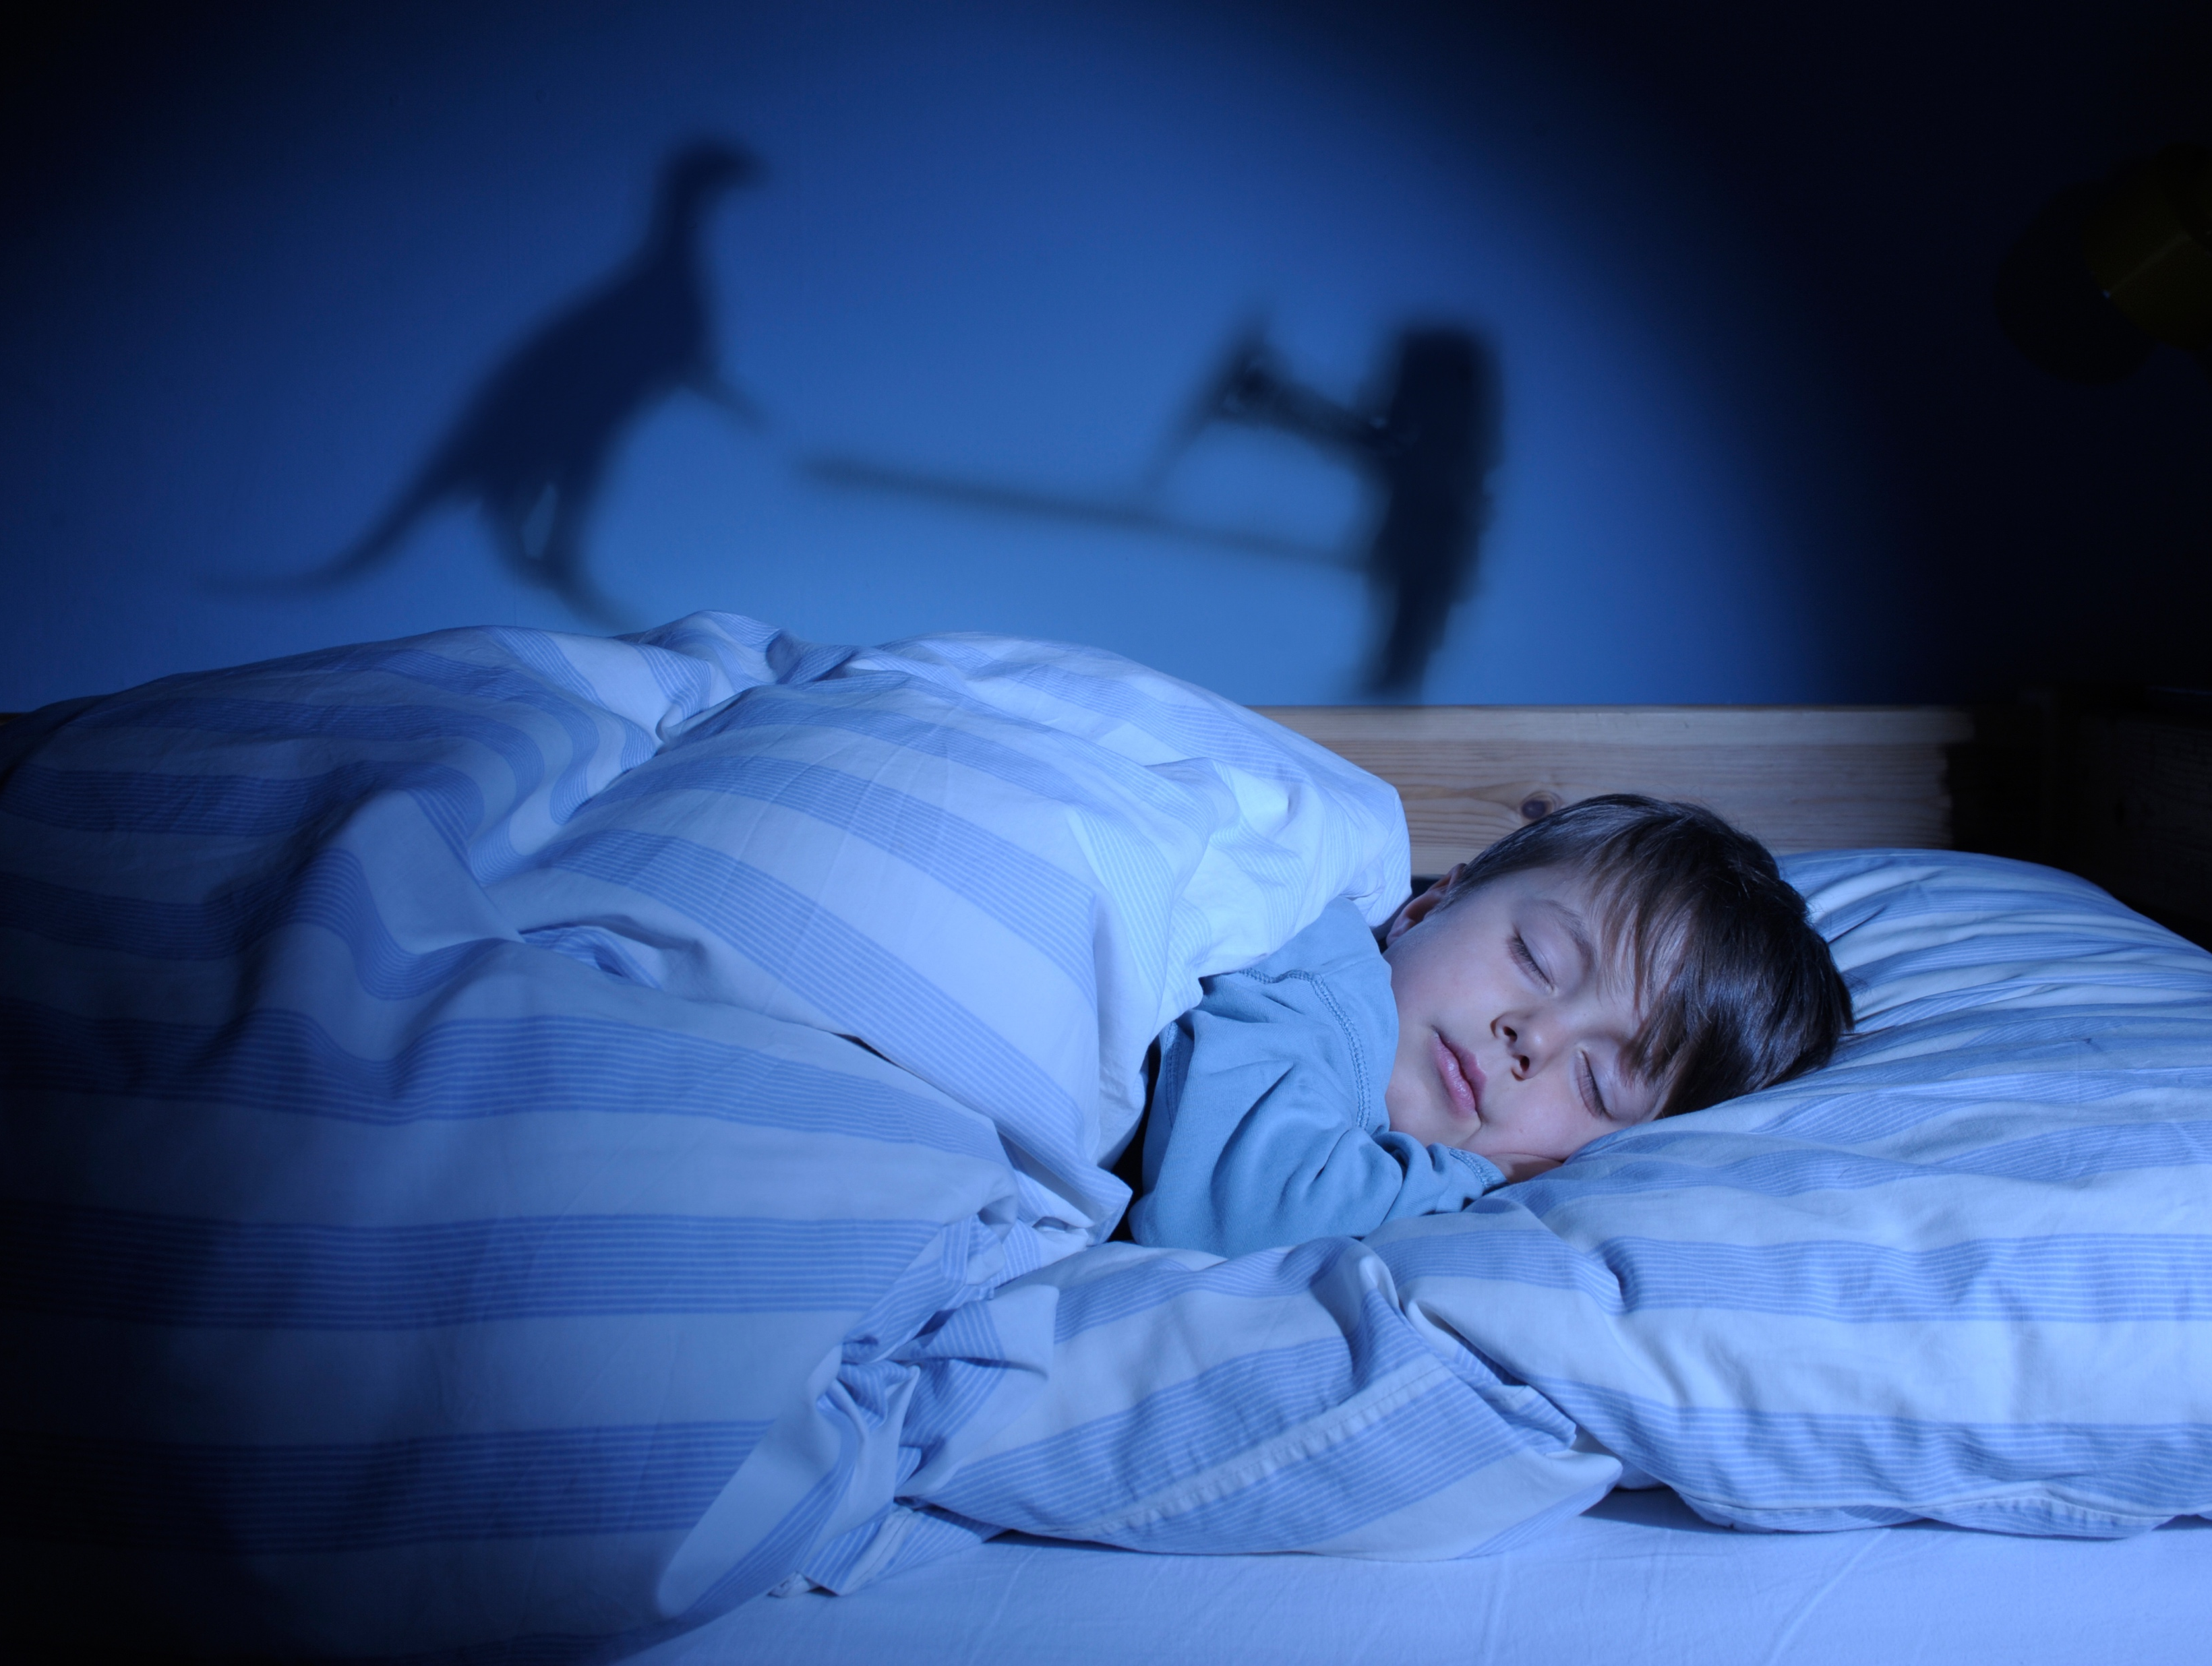
have very few sleep disorders
Child
Notes:
A young child’s need for sleep is 10 hours a night
They have very few sleep disorders, they may have:
Nightmares
Sleepwalking/Sleep Talking
Snoring (treatment generally is tonsils removed)
Sleep apnea/Sleep deprivation in children looks like ADD/ADHD

Slide 10
MODULE TWO
part four
ADOLESCENTS

Slide 11
Adolescents
need for going to bed later and waking later
Notes:
Adolescents need 9-10 hours of sleep each night
During puberty there is a natural inclination for going to bed later and waking later
This has been noted world wide
This also causes insufficient sleep and sleep debt
This causes more morning sleepiness and desire to sleep longer on days off
Many times sleep deprivation is noted due to falling asleep in class or low grades

Slide 12
MODULE TWO
part five
ADULTS

Slide 13
Adults
sleep lighter
Notes:
Adults need 7.5-8.5 hours depending on the individual person
Most people underestimate their personal need for sleep
As we age the number of hours needed Does Not Change
Sleep does become more fragmented and we have less slow wave sleep
Our body also does not change temperature and our brain waves attenuate making our sleep lighter
This is when advanced sleep phase disorder happens due to changes in response to light and dark
Other conditions are movement disorders and insomnia

Slide 14
You Are Ready
For The Next Module

