Slide 1
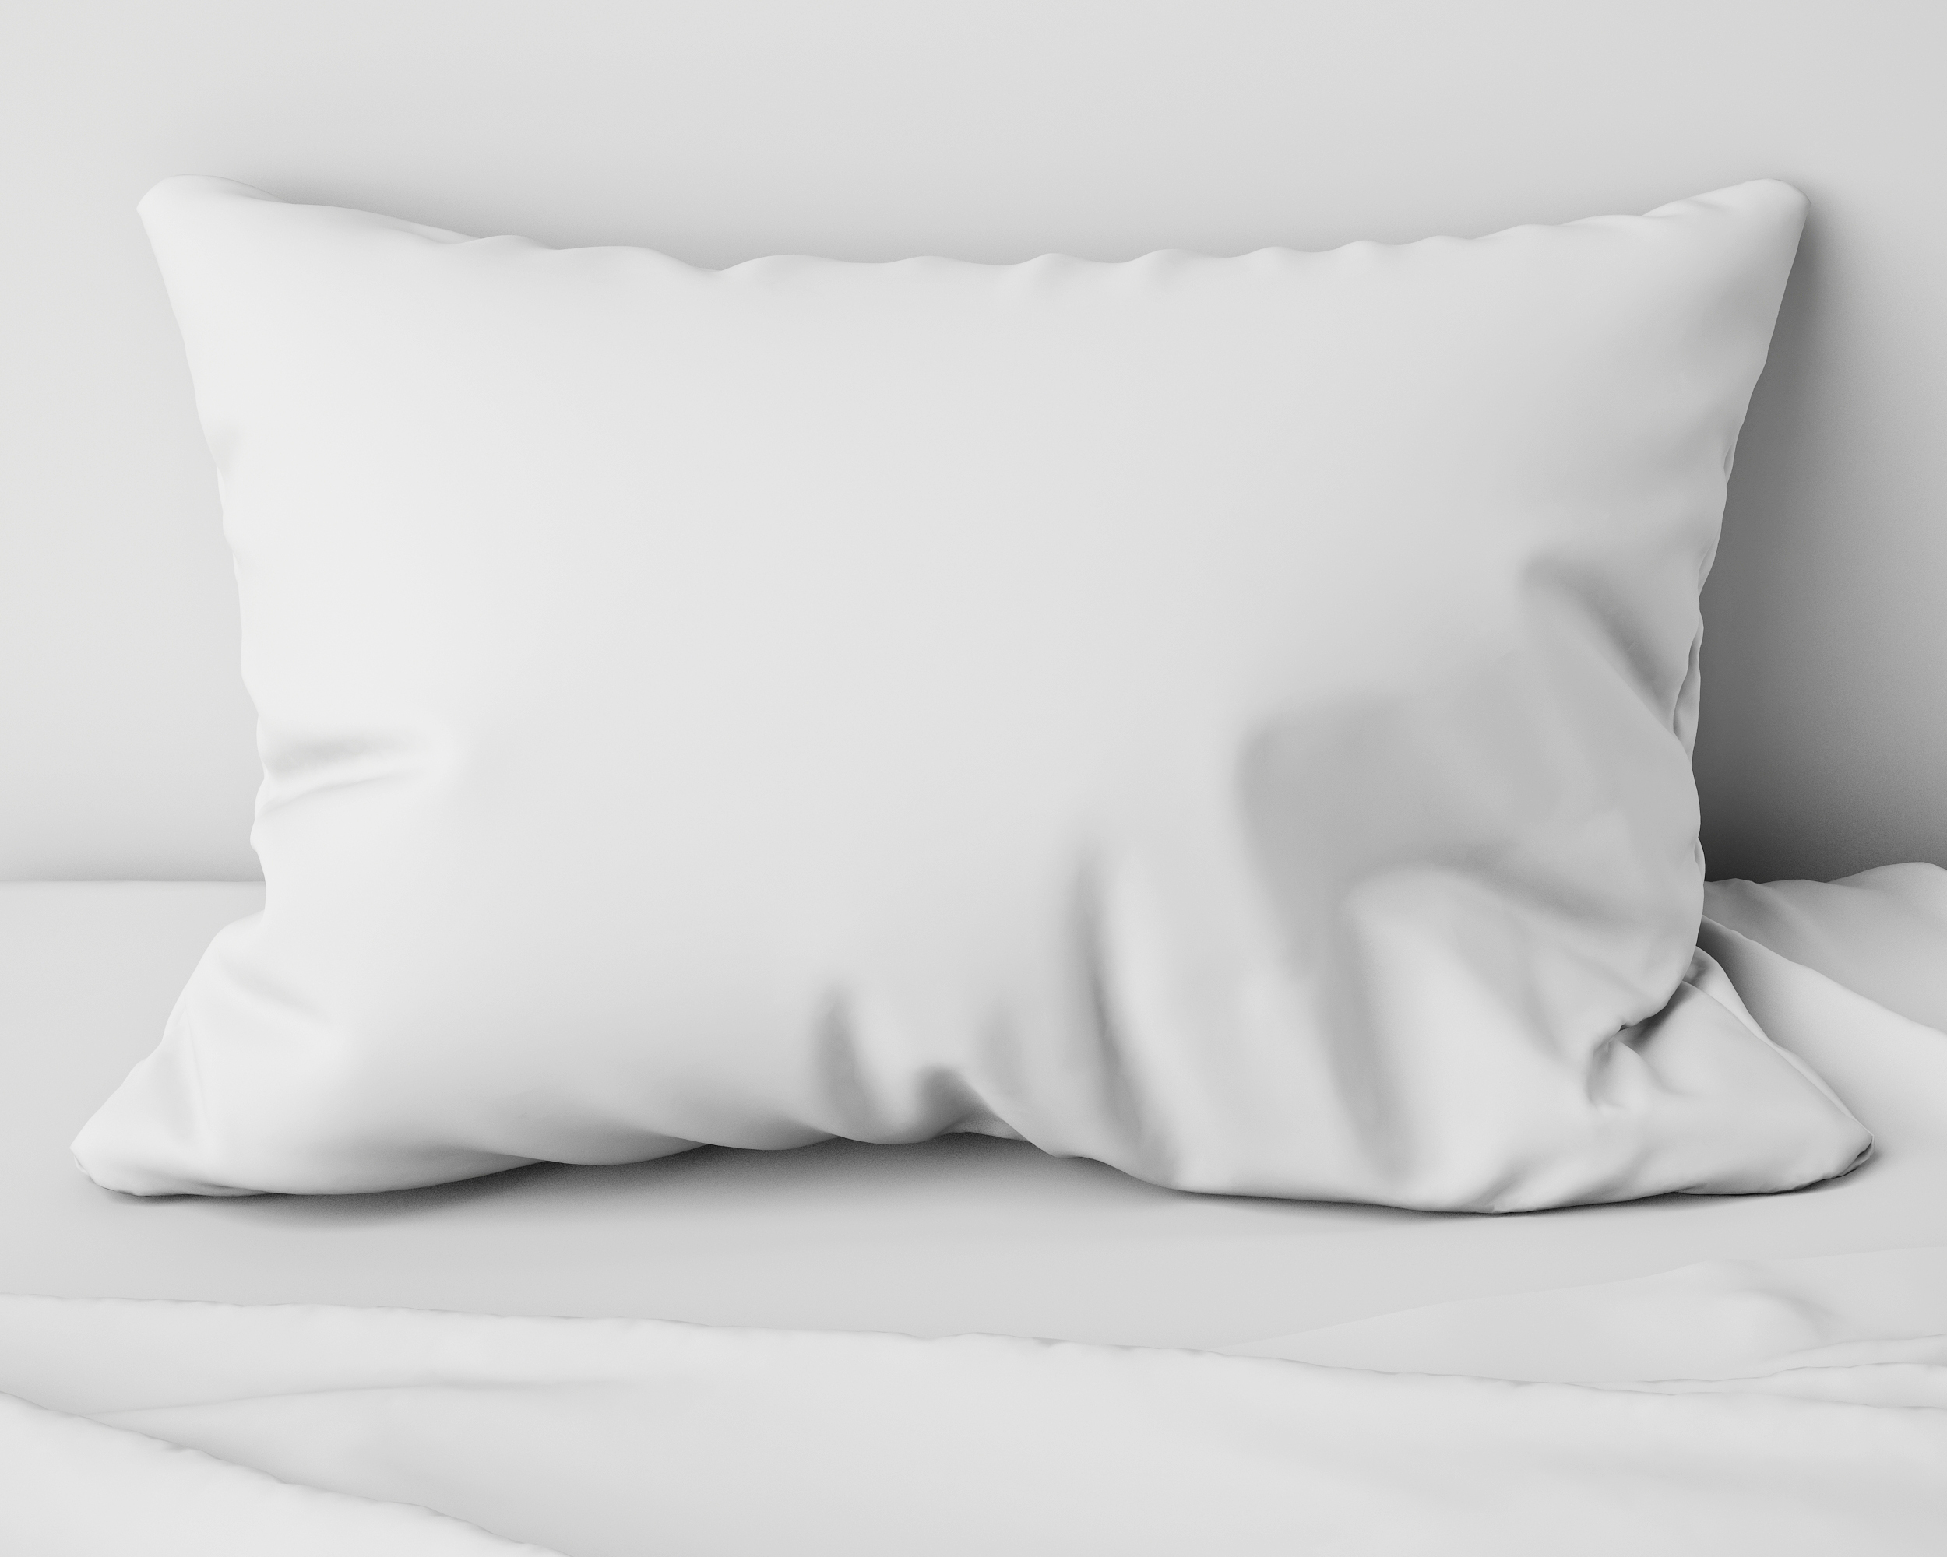


THE BEDROOM
MODULE FIVE

Slide 2
YOUR BEDROOM
Make it sleep comfortable

Slide 3
Table of contents
4 | Temperature
6 | Sound
8 | Light
10 | Mattress
12 | Pillow
14 | Bedding

Slide 4

MODULE FIVE
part one
TEMPERATURE

Slide 5

Temperature
TIME ASLEEP
the intangibles
Notes:
Our body needs to be cool to sleep well. Our body reduces temperature to a low
at between 3am and 4am. 60-67 degrees Fahrenheit is considered optimal sleep temperature.
Set your thermostat to cooler temperatures at night.
Get lightweight sheets and bedding that is breathable and crisp. There are 500 thread count sheets that have a breathable two sided weave for comfort.

Slide 6

the intangibles
Temperature
TIME ASLEEP
Notes:
Staying cool:
Shower/bathe at night
Cool cloth at the back at your neck
You may need to consider bedding or sleepwear as a way of be comfortable
A fan can serve more than 1 purpose

Slide 7
MODULE FIVE
part two
SOUND

Slide 8

the intangibles
Sound
TIME ASLEEP
Notes:
Reduce the sound in your bedroom.
Check your windows. Do they need to be replaced? New windows that are soundproof can do wonders. If this isn’t in the budget, seal off any air gaps with foam or an acoustic sealant. You can add thick insulation tape . Drapery, with special sound blocking lining, can do wonders for the sound.
Once you’ve taken care of your windows, it’s time to soundproof the walls. Insulation in the walls is important. Sound can be absorbed in walls with upholstery, just cover the walls with batting and apply fabric and trim over. It’s beautiful and soundproofing. There are also special wall treatments that can be painted on as well as acoustic panels that are attractive and can be hung to absorb sound.

Slide 9
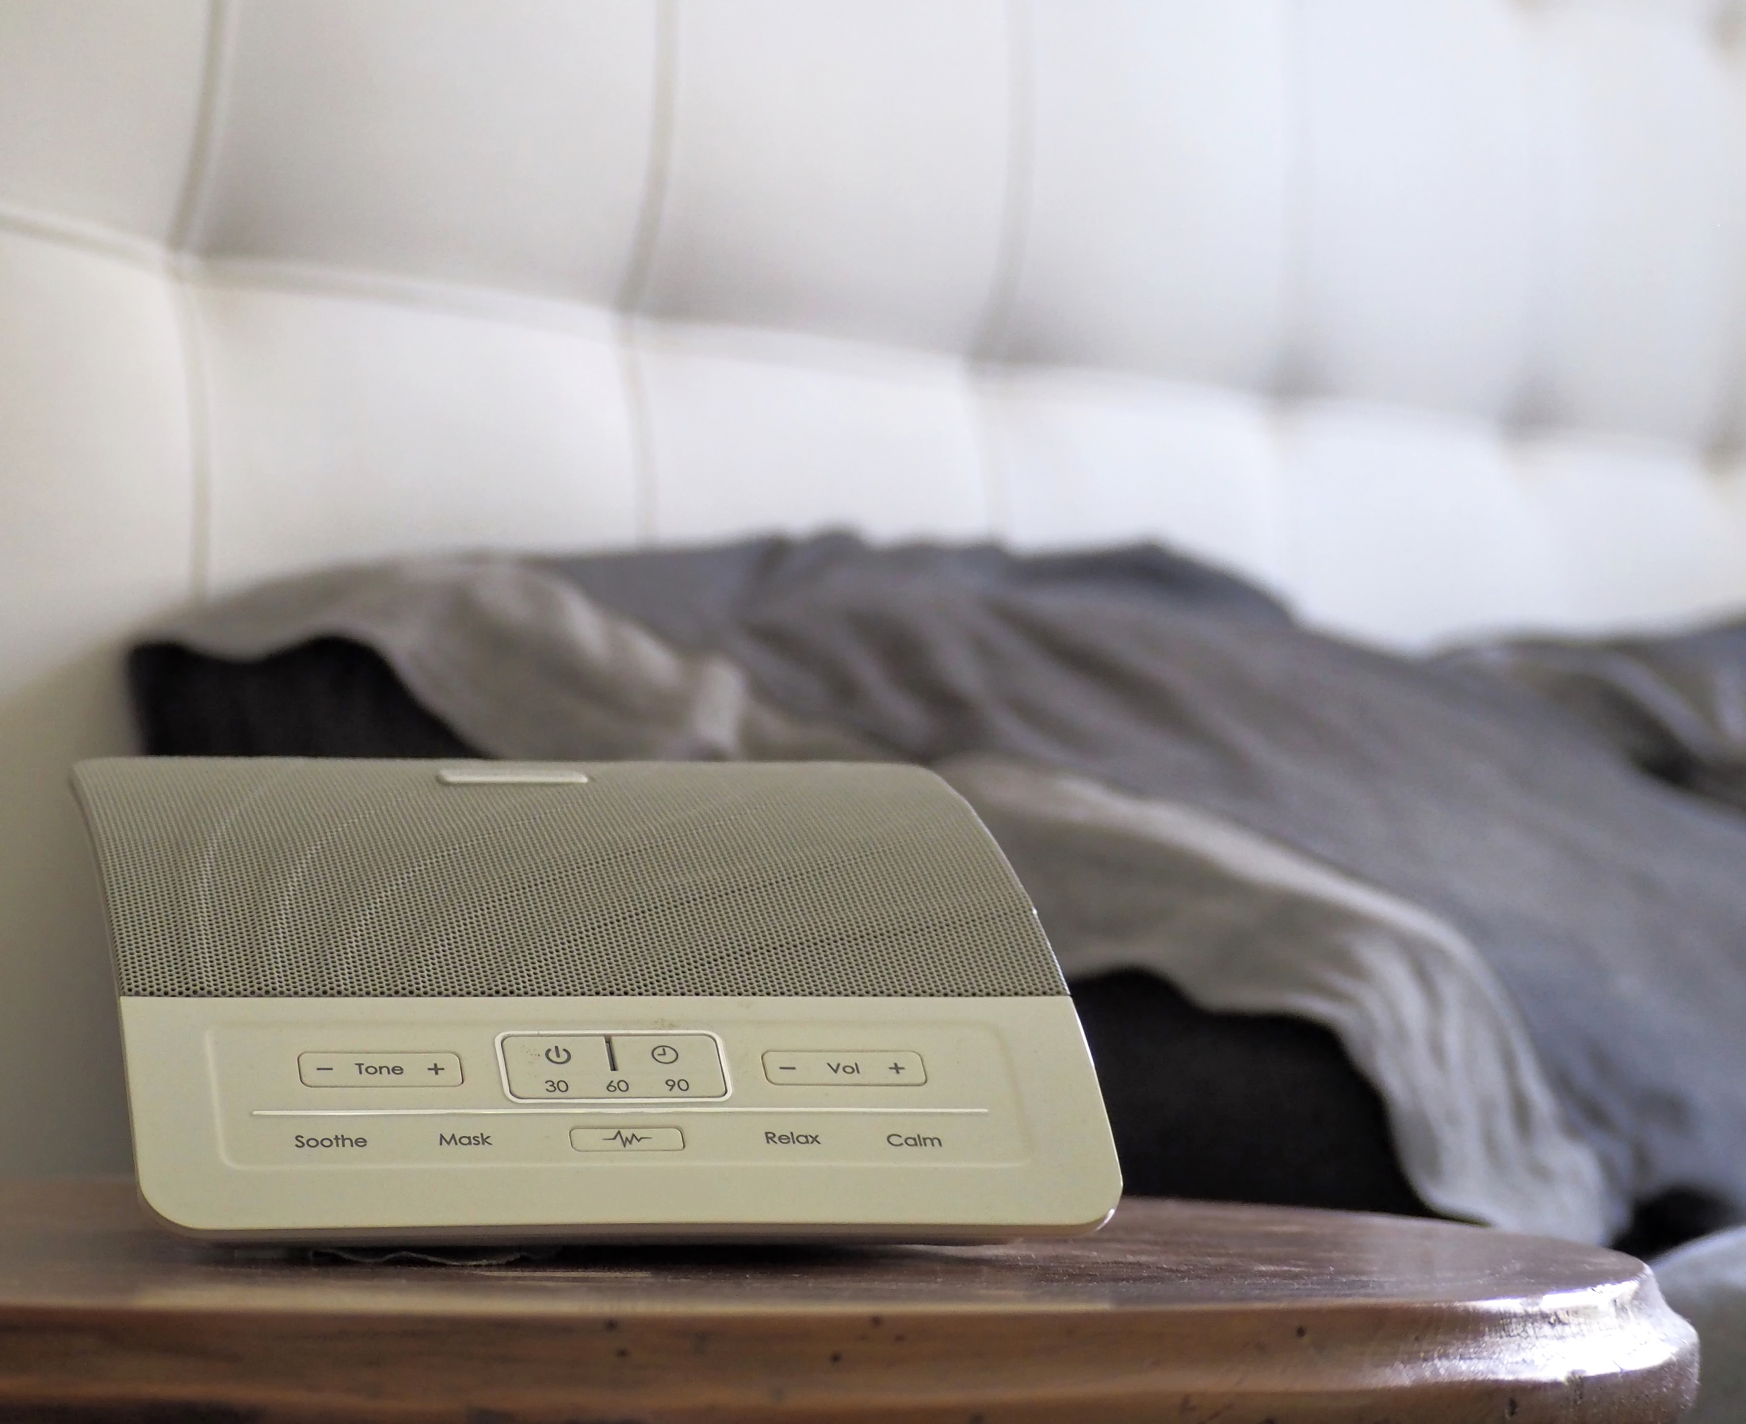
the intangibles
Sound
TIME ASLEEP
Notes:
If you have distracting noise at night, you may want to consider some white noise to help balance sound. White noise can also help people who have a ringing or buzzing in the ear. Choose the white noise that you prefer, whether its rain or ocean waves. You can get a machine that puts the sound out into the room or something beautiful like an indoor water wall with the real sound of falling water.
Having trouble sleeping because of a snoring partner or pet? You could try to help them find a solution with a saline spray, neti-pot, refraining from alcohol, an air filter, a wall of pillows between you to absorb the sound, or if worst comes to worst, a trip to the guest bedroom.

Slide 10
MODULE FIVE
part three
LIGHT

Slide 11
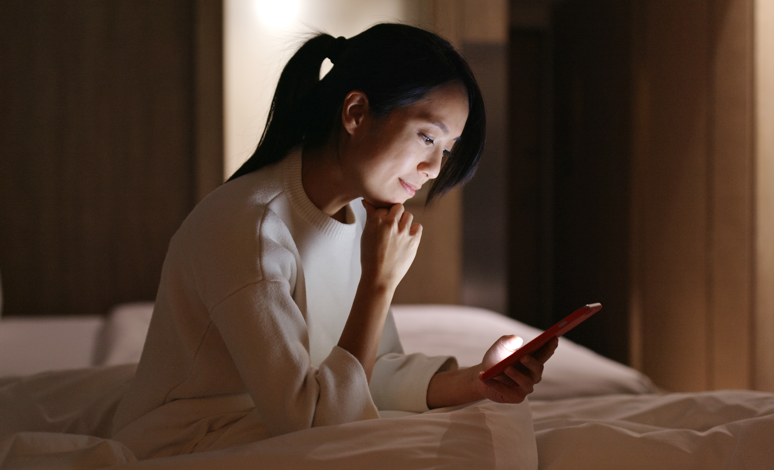
the intangibles
Light
TIME ASLEEP
Notes:
Television may seem like a great answer to clearing the mind to fall asleep, but it’s generally accepted that the light is bad for your sleep. Find another way to clear your head; meditation, prayer, or sex are more beneficial.
Turn your phone off. Turn the lights on your phone off. Many people wake in the middle of the night to check their phone for email, social media, work, or news. Doing this not only keeps you from relaxing, it also subjects you to the blue light, which your brain interprets as daylight. Blue light suppresses natural melatonin and stimulates your brain.

Slide 12

the tangibles
Light
TIME ASLEEP
Notes:
Drapery not only absorb sound, if lined with a good blackout lining, can block light and keep your room darker, and easier to sleep in. Roller shades come in room darkening materials, are inexpensive, and cut the light if close enough to the window to cover gaps. Blinds will always have a little light escaping through slats and holes.
Why cut the light? You need 20-40 of reduced light prior to lights out, so get ready for bed by turning off technology and dialing down the overhead lighting.
If you feel you need a night light try one that is 7lutz (the small one that uses a Christmas tree light.)

Slide 13
MODULE FIVE
part four
MATTRESS

Slide 14
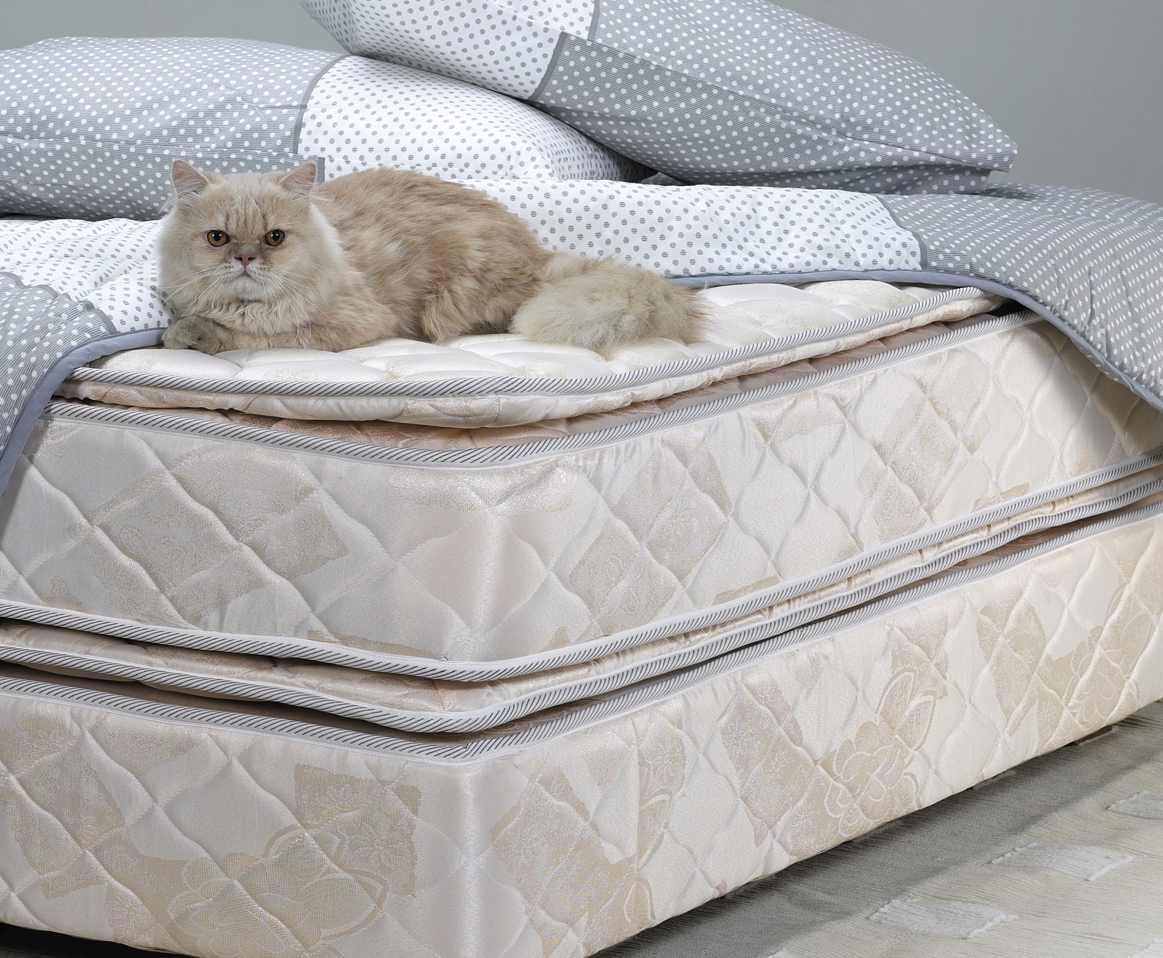
Mattress
TIME ASLEEP
the tangibles
Notes:
92% of those interviewed by the National Sleep foundation say that a mattress that is comfortable is important for a good night’s sleep. Like nutrition, everyone has different needs, so shopping for a good bed is very personal and important. If you need help, we can offer some suggestions for good companies.
Support is important. When in doubt go with firmer and buy a pillow top or mattress topper.
Mattresses last about 8-10 years. How old is your bed? Time flies. It may be time for a replacement.
Turning your mattress is important.

Slide 15

the tangibles
Mattress
TIME ASLEEP
Notes:
What to look for in a bed:
Durability – 10 years.
Motion Isolation – Can your partner feel every time you move in bed?
Off-gassing – Due to toxins in the materials.
Conforming to the body – Does the mattress conform to your body?
Sex – Is there enough support and density?
Temperature – Are there good materials and airflow?
Edge Support – Is there enough support at the edge of the bed to prevent rolling off when you sit?
Noise – Is the mattress quiet?

Slide 16

the tangibles
Mattress
TIME ASLEEP
Notes:
Choose by
Materials
Soft/Medium or Firm
Cost
Good for hot sleepers
Good for people with back problems

Slide 17
MODULE FIVE
part five
PILLOW

Slide 18

the tangibles
Pillow
TIME ASLEEP
Notes:
Firmness has to do with what your primary sleep position is
If you are a back sleeper you do not want one that forces your chin down
Side sleepers need a pillow that will adequately support the head and neck
Body pillows allow support for knees and comfort for some people
Wedge pillows are great for people with GERD or pregnant women
If you are a back sleeper you may consider a pillow for behind your knees
Pillows do need to be washed and replaced every 6 months

Slide 19
MODULE FIVE
part six
BEDDING

Slide 20

the tangibles
Bedding
TIME ASLEEP
Notes:
Its about the comfort.
Thread count is a sales tool and does not make a difference
Copper and Silver threads are used because of their antibacterial properties
and should be considered for those with weak immune systems
Blankets are there for comfort so choose ones that give you the most comfort
They or your pillow may be good to take when you travel to help
overcome first night effect

Slide 21
You Are Ready
For The Next Module

