Slide 1
ELECTRONIC TRACKING
MODULE SIX

Slide 2
SLEEP
TRACKING

Slide 3
Table of contents
4 | Electronic Tracking
6 | Apple Watch App Download
9 | Fitbit 1 Week
12 | Fitbit 1 Night
15 | Phone App Sleep Tracking
18 | Home Sleep Studies

Slide 4
MODULE SIX
ELECTRONIC SLEEP TRACKING
part one

Slide 5
know what you are viewing
We are able to monitor many of out biological processes now. That does not mean we understand what the trackers are sharing.
There are trackers you wear and there are tracking apps you can download as well as smart beds and devices that sit next to your bed.
You will see a limited number of these as well as a home sleep study report so you understand what you are viewing.
The personal devices are designed to give you an overview and it works best when you look at trends rather than individual nights.
Electronic Tracking
TIME ASLEEP

Slide 6
MODULE SIX
APPLE WATCH APP
DOWNLOAD
part two

Slide 7
In bed at | Until | Duration | Asleep | Time awake | Fell asleep in | Quality sleep | Deep sleep | Heartrate | Tags | Notes
11/11/2018 23:20 | 11/12/2018 6:26 | 8:09 | 8:07 | 0:02 | -- | 5:21 | -- | 71 | -- | --
11/12/2018 23:12 | 11/13/2018 6:59 | 7:47 | 7:32 | 0:15 | -- | 5:12 | 0:58 | 70 | -- | --
11/14/2018 0:21 | 11/14/2018 7:56 | 7:35 | 7:12 | 0:23 | -- | 5:26 | 1:29 | 71 | -- | --
11/15/2018 0:11 | 11/15/2018 8:50 | 8:39 | 8:22 | 0:17 | -- | 6:09 | 0:14 | 74 | -- | --
11/15/2018 23:55 | 11/16/2018 6:28 | 7:31 | 7:31 | 0:00 | -- | 4:57 | 0:43 | 74 | -- | --
11/17/2018 23:04 | 11/18/2018 8:22 | 9:18 | 8:48 | 0:30 | -- | 6:57 | 0:46 | 79 | -- | --
11/18/2018 23:39 | 11/19/2018 6:58 | 7:19 | 6:47 | 0:32 | -- | 4:57 | 1:27 | 72 | -- | --
11/19/2018 23:27 | 11/20/2018 6:50 | 7:23 | 7:19 | 0:04 | -- | 5:26 | 0:30 | 78 | -- | --
11/21/2018 0:51 | 11/21/2018 7:17 | 6:26 | 6:26 | 0:00 | -- | 4:43 | 1:43 | 80 | -- | --
11/25/2018 23:06 | 11/26/2018 5:44 | 6:38 | 6:38 | 0:00 | -- | 5:21 | 2:42 | 79 | -- | --
11/26/2018 23:29 | 11/27/2018 6:28 | 7:26 | 6:39 | 0:47 | -- | 4:33 | 1:40 | 73 | -- | --
11/27/2018 23:44 | 11/28/2018 6:30 | 6:46 | 6:45 | 0:01 | -- | 5:50 | 3:15 | 75 | -- | --
11/28/2018 23:00 | 11/29/2018 7:32 | 8:32 | 8:13 | 0:19 | -- | 6:00 | 0:29 | 76 | -- | --
11/29/2018 23:13 | 11/30/2018 7:26 | 9:59 | 8:45 | 1:14 | -- | 6:00 | 0:29 | 77 | -- | --
11/30/2018 23:30 | 12/1/2018 7:58 | 8:28 | 8:28 | 0:00 | -- | 5:40 | 0:44 | 82 | -- | --
12/3/2018 23:13 | 12/4/2018 7:36 | 8:23 | 8:09 | 0:14 | -- | 5:50 | 1:43 | 72 | -- | --
12/5/2018 1:13 | 12/5/2018 7:48 | 6:35 | 6:20 | 0:15 | -- | 4:28 | -- | 73 | -- | --
12/6/2018 0:13 | 12/6/2018 6:44 | 6:31 | 6:14 | 0:17 | -- | 3:50 | 0:28 | 76 | -- | --
12/6/2018 23:53 | 12/7/2018 7:29 | 7:36 | 7:16 | 0:20 | -- | 4:48 | 0:31 | 78 | -- | --
12/8/2018 0:47 | 12/8/2018 9:14 | 8:27 | 8:07 | 0:20 | -- | 5:26 | -- | 83 | -- | --
12/9/2018 23:00 | 12/10/2018 7:12 | 8:12 | 7:58 | 0:14 | -- | 6:00 | 0:29 | 75 | -- | --
12/10/2018 23:00 | 12/11/2018 7:37 | 8:37 | 8:06 | 0:31 | -- | 5:45 | 0:29 | 73 | -- | --
12/12/2018 0:14 | 12/12/2018 7:09 | 6:55 | 6:33 | 0:22 | -- | 4:19 | 1:27 | 75 | -- | --
Apple Watch App Download
TIME ASLEEP

Slide 8
evaluate health issues and daytime habits
This download shows an a normal amount of time falling asleep. It does show many nights of longer sleep.
Evaluation of health issues that may be contributing to the need for excessive sleep.
Evaluate also for daytime habits that may reduced wakefulness such as not enough sunlight or exercise.
Apple Watch App Download
TIME ASLEEP

Slide 9
MODULE SIX
FITBIT 1 WEEK
part three

Slide 10
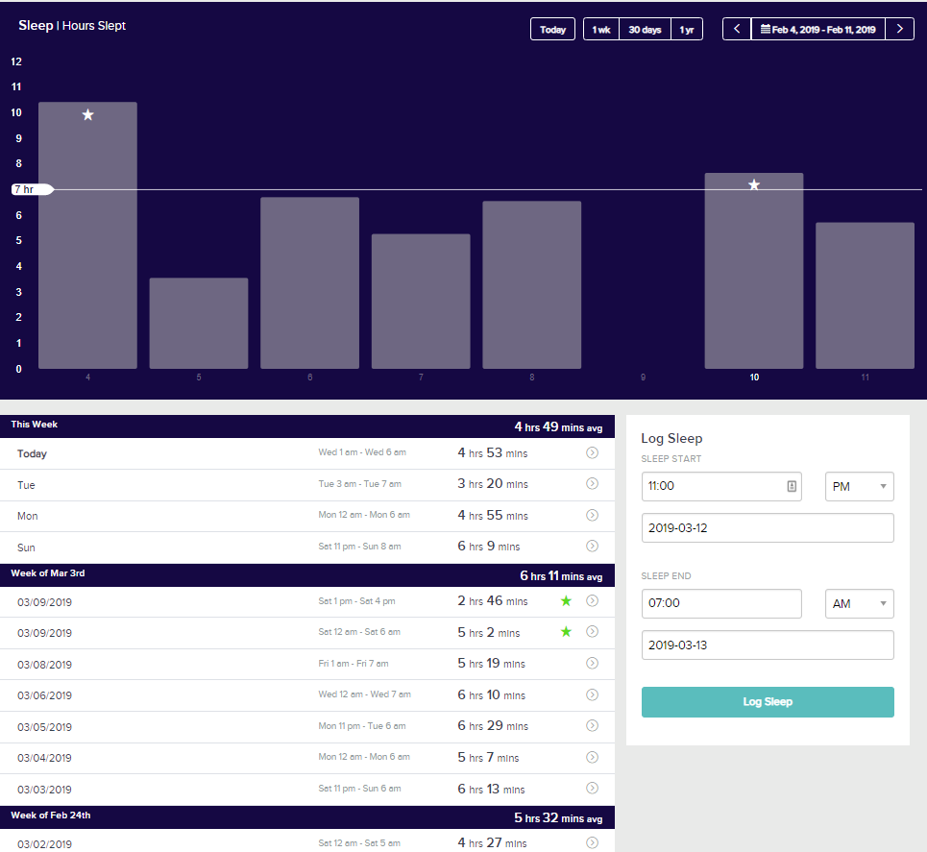
Fitbit 1 Week
TIME ASLEEP

Slide 11
trends help create a better sleep routine
This one week trend showed several issues short sleep, inconsistent bed times and late bedtimes.
This gives information about what areas to focus on when attempting to create a better sleep routine.
It also shows a nap after several days of short sleep which shows excessive fatigue.
Fitbit 1 Week
TIME ASLEEP

Slide 12
MODULE SIX
FITBIT 1 NIGHT
part four

Slide 13
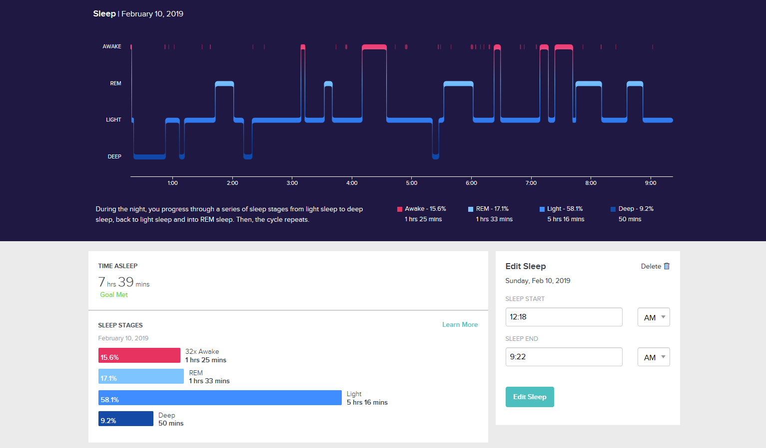
Fitbit 1 Night
TIME ASLEEP

Slide 14
people change positions before and after sleep
You will see that there is usually arousals or awakenings right before or right after REM sleep. This is normal as people change positions before and after sleep. Rems occurred spaced out about every 120 minutes. (REM occurs between every 90-120 minutes.)
You will also see that the first third of the night was when deep sleep occurred. This again is normal.
Fitbit 1 Night
TIME ASLEEP

Slide 15
MODULE SIX
PHONE APP SLEEP TRACKING
part five

Slide 16
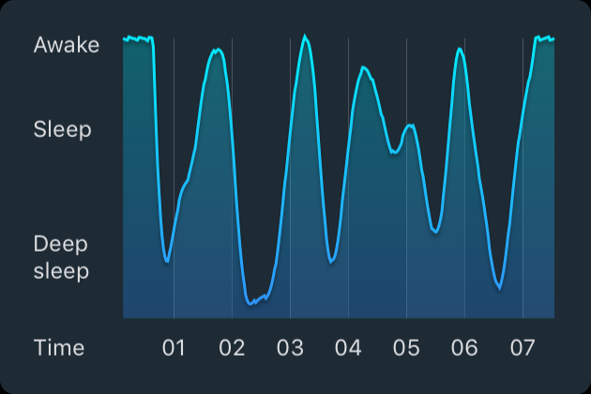
Phone App Sleep Tracking using Microphone
TIME ASLEEP

Slide 17
used to determine the best time for an alarm
Phone App Sleep Tracking using Microphone
Using the microphone to pick up movements this tracker is used as a way to determine the best time for an alarm to go off. It also can show someone who is restless during sleep.
It may have issues if you do not sleep alone or if you have a pet in bed.
TIME ASLEEP

Slide 18
MODULE SIX
HOME SLEEP STUDIES
part six

Slide 19
Home sleep studies always have some basic person information on them. The name, sex, height, weight, BMI and Epworth sleepiness scale score.
You will also see any symptoms that are associated with sleep apnea.
Home Sleep Studies
TIME ASLEEP

Slide 20
This is the page that gives the physician all the clinical information.
AHI ( sometimes it will say RDI or REI) is the number of times per hour on average that a person stops breathing. Each events is at least 10 seconds long and will meet specific criteria to be counted.
OAI is the complete obstruction of the airway /per hour.
CAI is central events. These are times when the brain does not tell the body to breath.
You will see the middle box breaks down the respiratory events by body position as this is important when treating sleep apnea.
The bottom three boxes give information about the oxygen levels in the blood and how low they dropped, the heart rate including the highest and sometimes the lowest and snoring and how much of the night the person spent snoring.
Home Sleep Studies
TIME ASLEEP

Slide 21
This is a picture of the night sleep in a form that the physician can look at quickly. The colored lines are each respiratory event by type and the length of time.
The green and blue slightly thicker lines right above them are the heart rate and oxygen level.
The bottoms shows body position.
Home Sleep Studies
TIME ASLEEP

Slide 22
MODULE ONE
SLEEP ON THIS
Stress
part seven

Slide 23
Stress
Stress is a normal psychological and physical reaction to things that upset your balance. Studies show that most people experience some type of stress throughout the year. “When your brain perceives a threat, it signals your body to release a burst of hormones to fuel your capacity for a response.” The problem comes when we have non stop stress and the release is constant.

Slide 24
Signs of Too Much Stress
Eating
Sleep
Procrastination
Addictions
Habits
Chest pain and racing heart
Memory
Concentration
Judgement
Negativity
Anxiety
Worry
Aches
Digestive distress
Nausea
Libido
immunity
Mood swings
Aggressiveness
Overwhelm
Agitation
Isolation
Depression

Slide 25
Get Help
Determining the cause of your stress is your first step. After identifying the cause is the time to start working on strategies to deal with them. Often it is as easy as staying away from the neighbor who drives you nuts or turning off the news. If you can’t avoid the stress inducer, then next step is to figure out ways to live with it.
Don’t try to do it on your own. Join a group who is going through the same stress as you, seek help from family and friends. You may also benefit from daily practices that encourage stress reduction, like mindfulness, prayer, meditation, yoga, or just going outside to enjoy nature.

Slide 26
Get Help
Determining the cause of your stress is your first step. In our world, it is unrealistic to expect stress to disappear from your life. Managing stress isn’t a one day thing. With consistent effort, you can learn to manage your levels of stress and increase your ability to handle the challenges that bring stress.

Slide 27
Relieve Stress
Enjoying nature
Reading
Getting away from the cause
Take a break
Laughing
Exercise
Proper nutrition
Meditation
Yoga
Prayer
Relieving stress is as easy as watching a movie that makes you laugh until you cry. Try a new way to relieve stress weekly and you’ll notice a difference.

Slide 28
You Are Ready
For The Next Module

