Slide 1
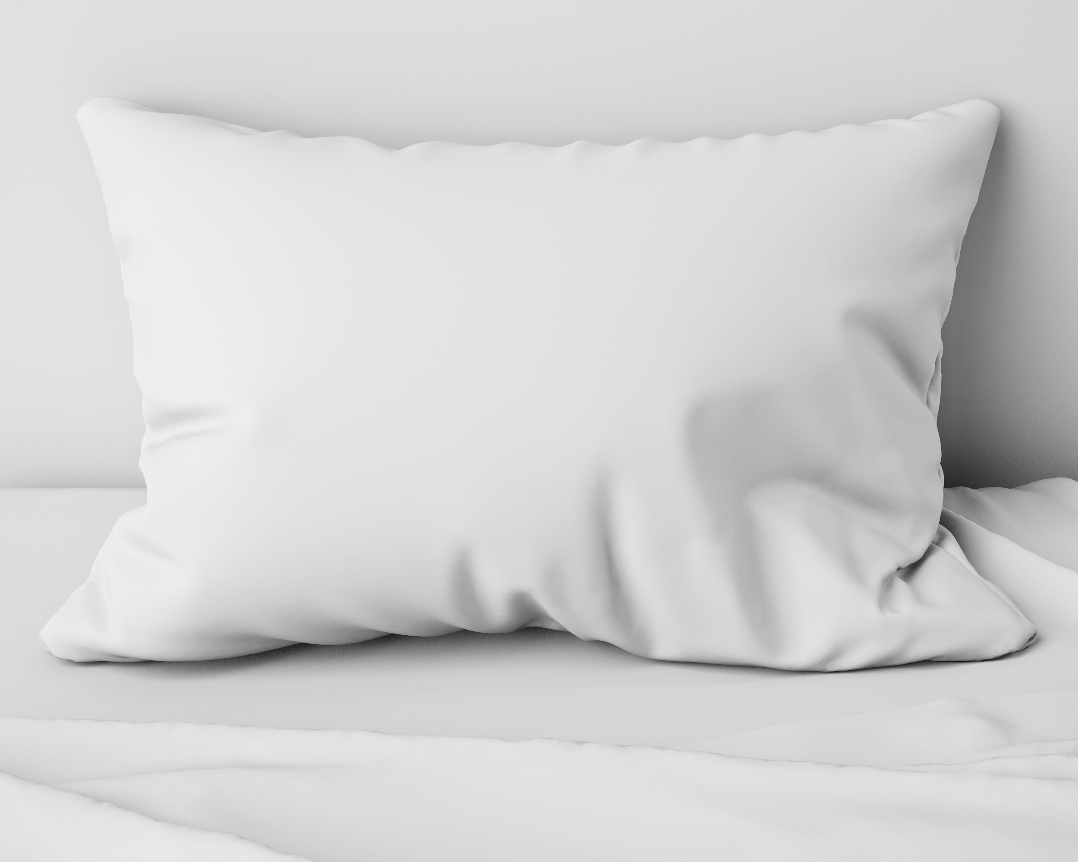
ELECTRONIC TRACKING
MODULE SIX

Slide 2
ELECTRONIC
TRACKING

Slide 3
Table of contents
4 | Electronic Tracking
6 | Apple Watch App Download
9 | Fitbit 1 Week
12 | Fitbit 1 Night
15 | Phone App Sleep Tracking
18 | Home Sleep Studies

Slide 4
MODULE SIX
part one
ELECTRONIC TRACKING

Slide 5
know what you are viewing
Electronic Tracking
Notes:
We are able to monitor many of out biological processes now. That does not mean we understand what the trackers are sharing.
There are trackers you wear and there are tracking apps you can download as well as smart beds and devices that sit next to your bed.
You will see a limited number of these as well as a home sleep study report so you understand what you are viewing.
The personal devices are designed to give you an overview and it works best when you look at trends rather than individual nights.

Slide 6
MODULE SIX
part two
APPLE WATCH APP DOWNLOAD

Slide 7
In bed at | Until | Duration | Asleep | Time awake | Fell asleep in | Quality sleep | Deep sleep | Heartrate | Tags | Notes
11/11/2018 23:20 | 11/12/2018 6:26 | 8:09 | 8:07 | 0:02 | -- | 5:21 | -- | 71 | -- | --
11/12/2018 23:12 | 11/13/2018 6:59 | 7:47 | 7:32 | 0:15 | -- | 5:12 | 0:58 | 70 | -- | --
11/14/2018 0:21 | 11/14/2018 7:56 | 7:35 | 7:12 | 0:23 | -- | 5:26 | 1:29 | 71 | -- | --
11/15/2018 0:11 | 11/15/2018 8:50 | 8:39 | 8:22 | 0:17 | -- | 6:09 | 0:14 | 74 | -- | --
11/15/2018 23:55 | 11/16/2018 6:28 | 7:31 | 7:31 | 0:00 | -- | 4:57 | 0:43 | 74 | -- | --
11/17/2018 23:04 | 11/18/2018 8:22 | 9:18 | 8:48 | 0:30 | -- | 6:57 | 0:46 | 79 | -- | --
11/18/2018 23:39 | 11/19/2018 6:58 | 7:19 | 6:47 | 0:32 | -- | 4:57 | 1:27 | 72 | -- | --
11/19/2018 23:27 | 11/20/2018 6:50 | 7:23 | 7:19 | 0:04 | -- | 5:26 | 0:30 | 78 | -- | --
11/21/2018 0:51 | 11/21/2018 7:17 | 6:26 | 6:26 | 0:00 | -- | 4:43 | 1:43 | 80 | -- | --
11/25/2018 23:06 | 11/26/2018 5:44 | 6:38 | 6:38 | 0:00 | -- | 5:21 | 2:42 | 79 | -- | --
11/26/2018 23:29 | 11/27/2018 6:28 | 7:26 | 6:39 | 0:47 | -- | 4:33 | 1:40 | 73 | -- | --
11/27/2018 23:44 | 11/28/2018 6:30 | 6:46 | 6:45 | 0:01 | -- | 5:50 | 3:15 | 75 | -- | --
11/28/2018 23:00 | 11/29/2018 7:32 | 8:32 | 8:13 | 0:19 | -- | 6:00 | 0:29 | 76 | -- | --
11/29/2018 23:13 | 11/30/2018 7:26 | 9:59 | 8:45 | 1:14 | -- | 6:00 | 0:29 | 77 | -- | --
11/30/2018 23:30 | 12/1/2018 7:58 | 8:28 | 8:28 | 0:00 | -- | 5:40 | 0:44 | 82 | -- | --
12/3/2018 23:13 | 12/4/2018 7:36 | 8:23 | 8:09 | 0:14 | -- | 5:50 | 1:43 | 72 | -- | --
12/5/2018 1:13 | 12/5/2018 7:48 | 6:35 | 6:20 | 0:15 | -- | 4:28 | -- | 73 | -- | --
12/6/2018 0:13 | 12/6/2018 6:44 | 6:31 | 6:14 | 0:17 | -- | 3:50 | 0:28 | 76 | -- | --
12/6/2018 23:53 | 12/7/2018 7:29 | 7:36 | 7:16 | 0:20 | -- | 4:48 | 0:31 | 78 | -- | --
12/8/2018 0:47 | 12/8/2018 9:14 | 8:27 | 8:07 | 0:20 | -- | 5:26 | -- | 83 | -- | --
12/9/2018 23:00 | 12/10/2018 7:12 | 8:12 | 7:58 | 0:14 | -- | 6:00 | 0:29 | 75 | -- | --
12/10/2018 23:00 | 12/11/2018 7:37 | 8:37 | 8:06 | 0:31 | -- | 5:45 | 0:29 | 73 | -- | --
12/12/2018 0:14 | 12/12/2018 7:09 | 6:55 | 6:33 | 0:22 | -- | 4:19 | 1:27 | 75 | -- | --
Apple Watch App Download
TIME ASLEEP

Slide 8
evaluate health issues and daytime habits
Apple Watch App Download
Notes:
This download shows a normal amount of time falling asleep. It does show many nights of longer sleep.
Evaluation of health issues that may be contributing to the need for excessive sleep.
Evaluate also for daytime habits that may reduced wakefulness such as not enough sunlight or exercise.

Slide 9
MODULE SIX
part three
FITBIT 1 WEEK

Slide 10
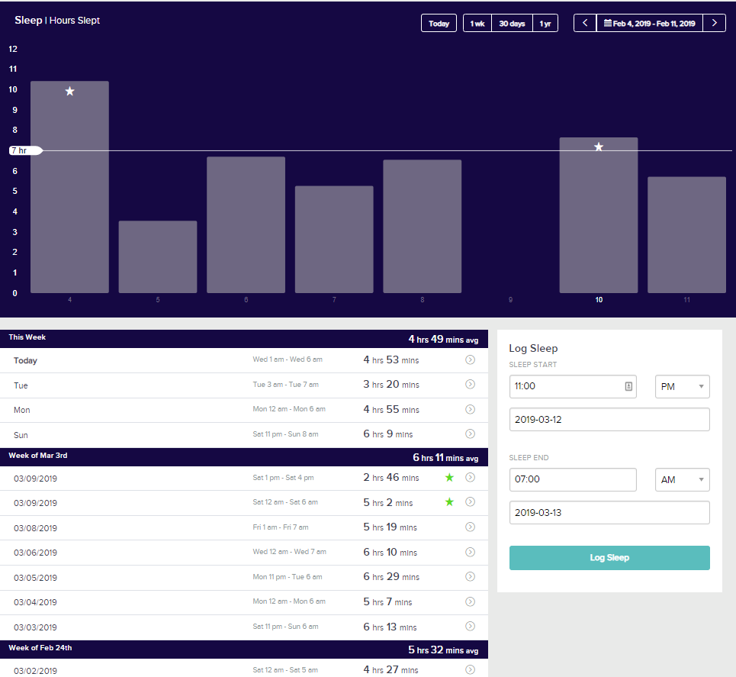
Fitbit 1 Week
TIME ASLEEP

Slide 11
trends help create a better sleep routine
Fitbit 1 Week
Notes:
This one week trend showed several issues short sleep, inconsistent bed times and late bedtimes.
This gives information about what areas to focus on when attempting to create a better sleep routine.
It also shows a nap after several days of short sleep which shows excessive fatigue.

Slide 12
MODULE SIX
part four
FITBIT 1 NIGHT

Slide 13
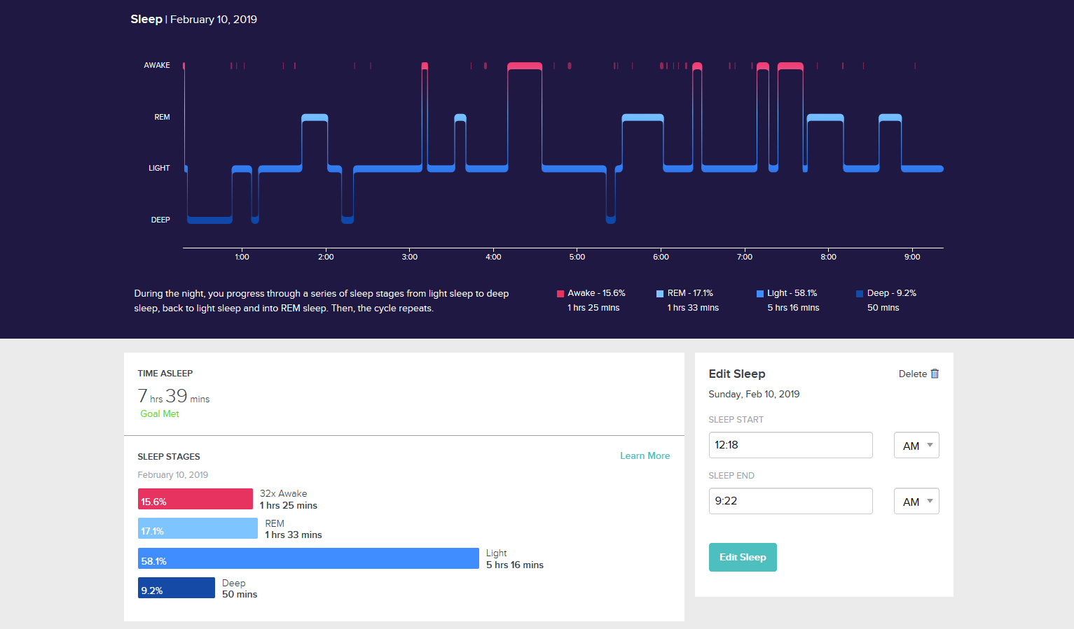
Fitbit 1 Night
TIME ASLEEP

Slide 14
people change positions before and after sleep
Fitbit 1 Night
Notes:
You will see that there is usually arousals or awakenings right before or right after REM sleep. This is normal as people change positions before and after sleep. Rems occurred spaced out about every 120 minutes. (REM occurs between every 90-120 minutes.)
You will also see that the first third of the night was when deep sleep occurred. This again is normal.

Slide 15
MODULE SIX
part five
PHONE APP SLEEP TRACKING

Slide 16
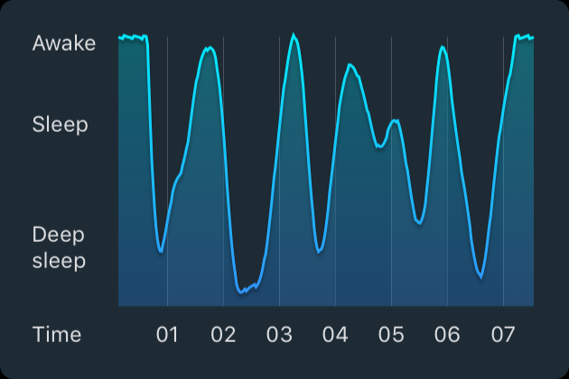
Phone App Sleep Tracking using Microphone
TIME ASLEEP

Slide 17
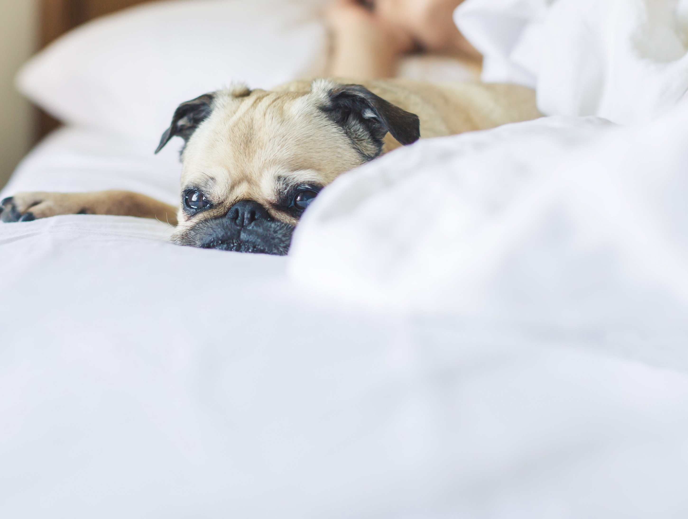
Phone App Sleep Tracking using Microphone
used to determine the best time for an alarm
Notes:
Using the microphone to pick up movements this tracker is used as a way to determine the best time for an alarm to go off. It also can show someone who is restless during sleep.
It may have issues if you do not sleep alone or if you have a pet in bed.

Slide 18
MODULE SIX
part six
HOME SLEEP STUDIES

Slide 19
Home sleep studies always have some basic person information on them. The name, sex, height, weight, BMI and Epworth sleepiness scale score.
You will also see any symptoms that are associated with sleep apnea.
Home Sleep Studies
TIME ASLEEP

Slide 20
This is the page that gives the physician all the clinical information.
AHI ( sometimes it will say RDI or REI) is the number of times per hour on average that a person stops breathing. Each events is at least 10 seconds long and will meet specific criteria to be counted.
OAI is the complete obstruction of the airway /per hour.
CAI is central events. These are times when the brain does not tell the body to breath.
You will see the middle box breaks down the respiratory events by body position as this is important when treating sleep apnea.
The bottom three boxes give information about the oxygen levels in the blood and how low they dropped, the heart rate including the highest and sometimes the lowest and snoring and how much of the night the person spent snoring.
Home Sleep Studies
TIME ASLEEP

Slide 21
This is a picture of the night sleep in a form that the physician can look at quickly. The colored lines are each respiratory event by type and the length of time.
The green and blue slightly thicker lines right above them are the heart rate and oxygen level.
The bottoms shows body position.
Home Sleep Studies
TIME ASLEEP

Slide 22
You Are Ready
For The Next Module

