Slide 1
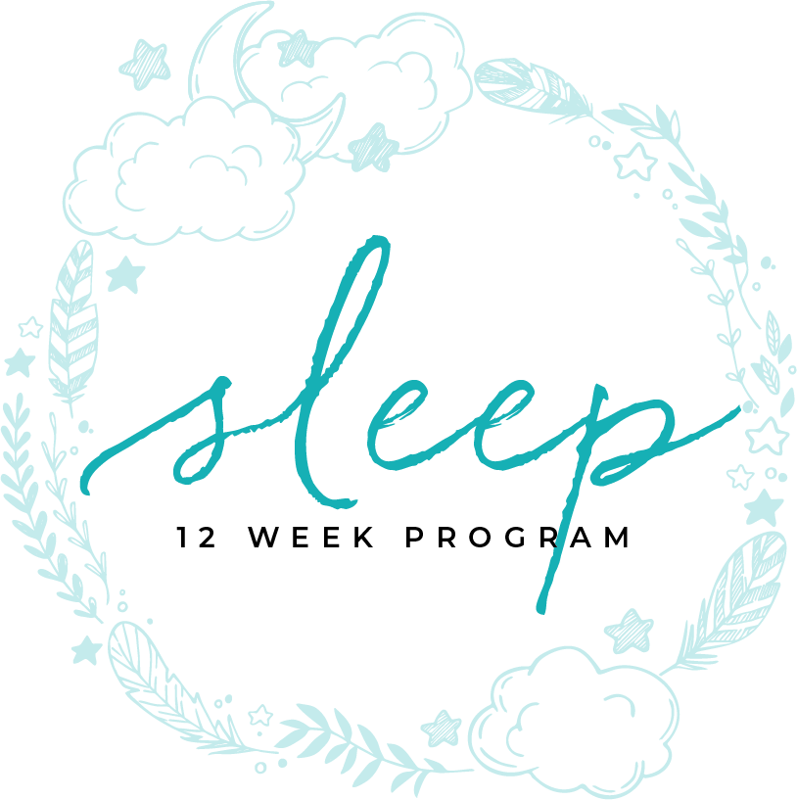
HYPERSOMNIA
MODULE NINE

Slide 2
HYPERSOMNIA

Slide 3
Table of contents
4 | What is Hypersomnia
6 | Disorders
8 | Narcolepsy
11 | Kleine Levin Syndrome
14 | Idiopathic Hypersomnia
17 | Insufficient Sleep Syndrome

Slide 4
MODULE SEVEN C
WHAT IS HYPERSOMNIA
part one

Slide 5
unprovoked sleep attacks
Hypersomnia, or excessive tiredness during the day is also called EDS (Excessive Daytime Sleepiness). These are unprovoked sleep attacks. Hypersomnia shouldn’t be confused with fatigue which is being tired.
Those with hypersomnia can fall asleep at any time, including while they are driving or working. According to the National Sleep Foundation, up to 40% of people have some symptoms of hypersomnia from time to time.
The study of hypersomnia is in it’s infancy compared to other medical disorders.
What Is Hypersomnia
TIME ASLEEP

Slide 6
MODULE SEVEN C
DISORDERS
part two

Slide 7
hypersomnia disorders
Narcolepsy type 1 and 2
Kleine Levin Syndrome
Idiopathic hypersomnia
Insufficient sleep syndrome
Disorders
TIME ASLEEP

Slide 8
MODULE SEVEN C
NARCOLEPSY
part three

Slide 9
excessive sleepiness
Narcolepsy is characterized by the classic tetrad of excessive daytime sleepiness (EDS), cataplexy, hypnagogic hallucinations, and sleep paralysis. Narcolepsy is thought to result from genetic predisposition, abnormal neurotransmitter functioning and sensitivity, and abnormal immune modulation.
Narcolepsy
TIME ASLEEP

Slide 10
excessive sleepiness
Symptoms
Caraplexy, the weakness of extremities during extreme emotions
Excessive daytime sleepiness
Sleep hallucination
Sleep paralysis
Automatic behaviors
Disrupted night time sleep
Narcolepsy
TIME ASLEEP

Slide 11
exercise and nutrition
Primary Treatment is medication
Secondary treatments
Exercise
Nutrition
Planned naps
Strong sleep and morning routines
Social Support
Narcolepsy
TIME ASLEEP

Slide 12
MODULE SEVEN C
KLEINE LEVIN
SYNDROME
part four

Slide 13
bouts of sleepiness
Kleine-Levin syndrome (KLS) is a rare disorder that starts during adolescence and has a male gender preference (68%). The patients have recurrent episodes of hypersomnia, which are often associated with compulsive overeating and hypersexuality. The periods of hypersomnia occur for days to weeks at a time and recur several times a year. In between the symptomatic periods, the patients have normal sleep requirements and do not have excessive daytime sleepiness. Some patients may develop symptoms of irritability, impulsive behavior, depersonalization, hallucinations, depression, and confusion. The etiology of this disorder is not known, but genetic factors are believed to contribute.
The median age of onset is 15 years and the syndrome may last up to 8 years. The episodes recur every 3–4 months and may last up to 10 days, but they may last longer in women.
Kleine Levin Syndrome
TIME ASLEEP

Slide 14
bouts of sleepiness
KLS may be precipitated by infections (72%), alcohol consumption (23%), sleep deprivation (22%), unusual stress (20%), physical exertion (19%), traveling (10%), head trauma (9%), and marijuana use (6%). Symptoms of infection-triggered KLS generally occur shortly after onset of fever (3 to 5 days).
Kleine Levin Syndrome
TIME ASLEEP

Slide 15
bouts of sleepiness
Kleine Levin Syndrome
Very rare however there are people that have menstrual related symptoms similar to this disorder
This includes bouts of sleepiness and can last a few days to a few weeks
Other more rare symptoms
Excessive eating and unusual cravings
Irritability, aggressiveness, and child like behavior
Kleine Levin Syndrome
TIME ASLEEP

Slide 16
bouts of sleepiness
Usually starts in the teens
Kleine Levin Syndrome
TIME ASLEEP
There is no specific treatment
Nutrition and exercise

Slide 17
MODULE SEVEN C
IDIOPATHIC HYPERSOMNIA
part five

Slide 18
excessive daytime sleepiness
Idiopathic hypersomnia (IH) is a neurological sleep disorder that can affect many aspects of a person's life. Symptoms often begin between adolescence and young adulthood and develop over weeks to months. People with IH have a hard time staying awake and alert during the day (chronic excessive daytime sleepiness, or EDS). They may fall asleep unintentionally or at inappropriate times, interfering with daily functioning. They may also have difficulty waking up from nighttime sleep or daytime naps. Sleeping longer at night does not appear to improve daytime sleepiness. IH is a chronic disorder. Symptoms may remain generally stable over time, or severity may fluctuate over time.
The cause of IH is not known. Some people with IH have other family members with a sleep disorder such as IH or narcolepsy. Currently there is no treatment approved by the FDA specifically for IH.
Idiopathic Hypersomnia

Slide 19
excessive daytime sleepiness
Idiopathic Hypersomnia
It can be with or without longer sleep times or need to nap
It is excessive daytime sleepiness
Will feel refreshed after a nap but that will only last a short time
A person may have :
Sleep onset hallucination
Sleep paralysis
Vivid dreams
Idiopathic Hypersomnia
TIME ASLEEP

Slide 20
sleep hygiene
Treatment
Medication generally does not help
Sleep hygiene
Exercise
Nutrition
Idiopathic Hypersomnia
TIME ASLEEP

Slide 21
MODULE SEVEN C
INSUFFICIENT SLEEP
SYNDROME
part six

Slide 22
time needed for sleep depends on the individual
Insufficient sleep syndrome occurs when you regularly fail to get enough sleep at night. The result is sleep deprivation. This keeps you from feeling alert and well rested during the day.
It is a result of choices you make that keep you from getting enough sleep. It is voluntary, but unintentional. You are normally unaware that you need more sleep than you are getting. An exam shows that you are able to sleep well when given the chance. It also detects no medical reason for you to be sleepy. A mental exam also reveals nothing abnormal.
Insufficient Sleep Syndrome
TIME ASLEEP

Slide 23
time needed for sleep depends on the individual
Someone with Insufficient Sleep Syndrome may:
Routinely spend less than 8 hours in bed at night
Have a close friend or family member note that they need much more sleep than they get
Have their symptoms improve if they sleep for a longer period of time
Be free of any other medical or sleep disorders that might cause their symptoms of excessive sleepiness
Have concentration and attention problems, lowered energy level, reduced alertness, distractibility, irritability or fatigue.
Insufficient Sleep Syndrome
TIME ASLEEP

Slide 24
time needed for sleep depends on the individual
Risk Factors
It affects about two percent of people who go to a sleep center for help. It tends to begin in adults who are in their mid-to-late 30s. It often goes undetected until they reach their 40s. It affects a slightly greater number of men than women. It can be caused by a day-shift work schedule. This requires you to be at work at an early hour. Other time demands may then keep you from getting to bed early enough. This reduces your total sleep time. People with this disorder often ignore the obvious cause.
Insufficient Sleep Syndrome
TIME ASLEEP

Slide 25
time needed for sleep depends on the individual
Insufficient Sleep Syndrome
For a medical diagnosis the symptoms must exist for at least 3 months
The amount of time needed for sleep depends on the individual (averages do not mean that an individual does not need more time)
Most adults need 7-8 hours
Teens need 9-10 hours
Insufficient Sleep Syndrome
TIME ASLEEP

Slide 26
planning for enough sleep
Treatment
Excellent sleep hygiene
Change in daytime planning for enough sleep
Nutrition
Exercise
Insufficient Sleep Syndrome
TIME ASLEEP

Slide 27
You Are Ready
For The Next Module

