Slide 1
PARASOMNIAS
MODULE TEN

Slide 2
PARASOMNIAS

Slide 3
Table of contents
4 | Classifications
12 | REM Associated Parasomnias
17 | Other Parasomnias
24 | Other Issues Associated With Parasomnias

Slide 4
MODULE SEVEN D
part one
CLASSIFICATIONS

Slide 5
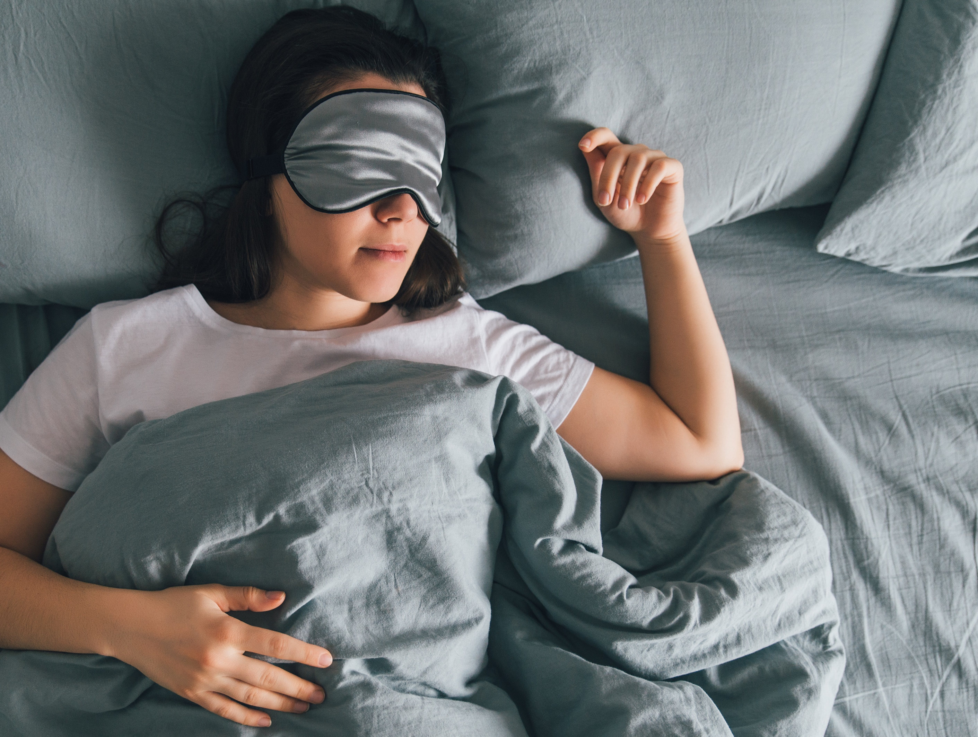
parasomnias
Classifications
Notes:
Parasomnias are all the abnormal happening while a person is asleep, apart from sleep apnea. Some examples include “sleep eating”, sleep walking, nightmares, sleep paralysis, sleep sex, and sleep aggression. Parasomnias affect about 10% of Americans.
Children are often affected more than adults because their slow wave sleep is longer. For this reason, they often grow out of it.
Parasomnias occur during Non REM sleep and generally occur during the first third of the night.
There may be a genetic component, it tends to run in families. Sleepwalking specifically has been tied back to the DQB1 gene

Slide 6
Classifications
speech slow or illogical
Notes:
Confusional arousals
Speech will often be slow or slurred
Speech is illogical
No memory the next morning
Treatment includes strong sleep hygiene. It’s important to be aware of the issue if you wake someone from sleep.

Slide 7
will not remember the event
Classifications
Notes:
Sleepwalking
Person will not remember the event
The person will be difficult to wake
The events usually start with sitting up and then continue
Walking
Running
Driving
Eyes will be open
Person will usually not communicate

Slide 8
sleepwalking treatment
Treatment
Protection from harm
Keep the doors and windows locked
Keep the sleep area free of harmful, sharp, or heavy objects
Cover the windows with heavy drapery
Place an alarm on the sleep walker and the door
Hypnotherapy
Scheduled awakening
Medications (By physician)
Relaxation techniques
Classifications
Notes:
Treatment
Protection from harm
Keep the doors and windows locked
Keep the sleep area free of harmful, sharp, or heavy objects
Cover the windows with heavy drapery
Place an alarm on the sleep walker and the door
Hypnotherapy
Scheduled awakening
Medications (By physician)
Relaxation techniques

Slide 9
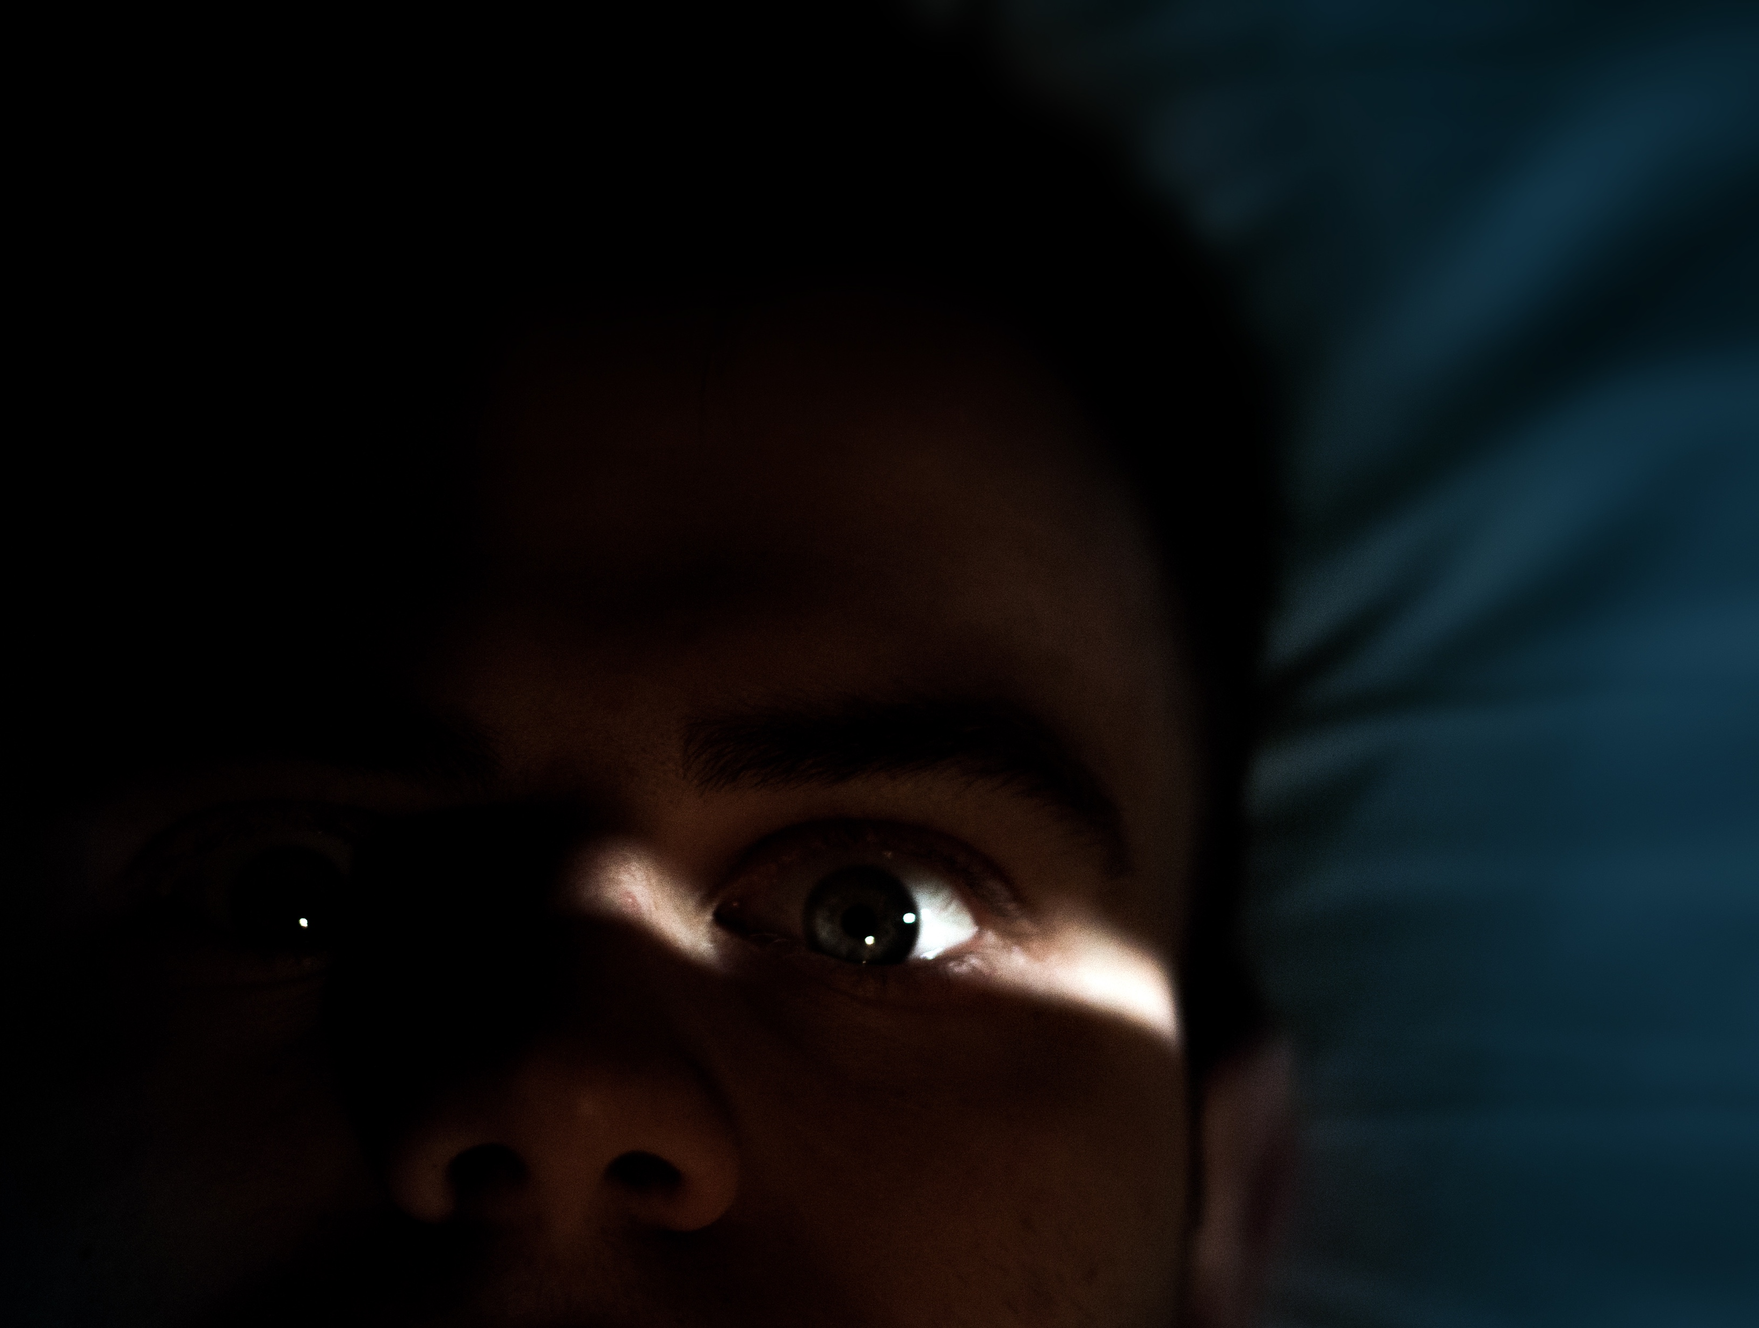
general sense of fear
Classifications
Notes:
Night Terrors
Person will scream, cry, and have a general sense of fear
Increased heart rate, increased respiratory rate, and sweating may be seen
Children usually occur during the first third of the night
Adults can happen any time of the night
Treatment
Increasing sleep time
Improve sleep hygiene
Scheduled awakening
Medication
Hypnosis

Slide 10
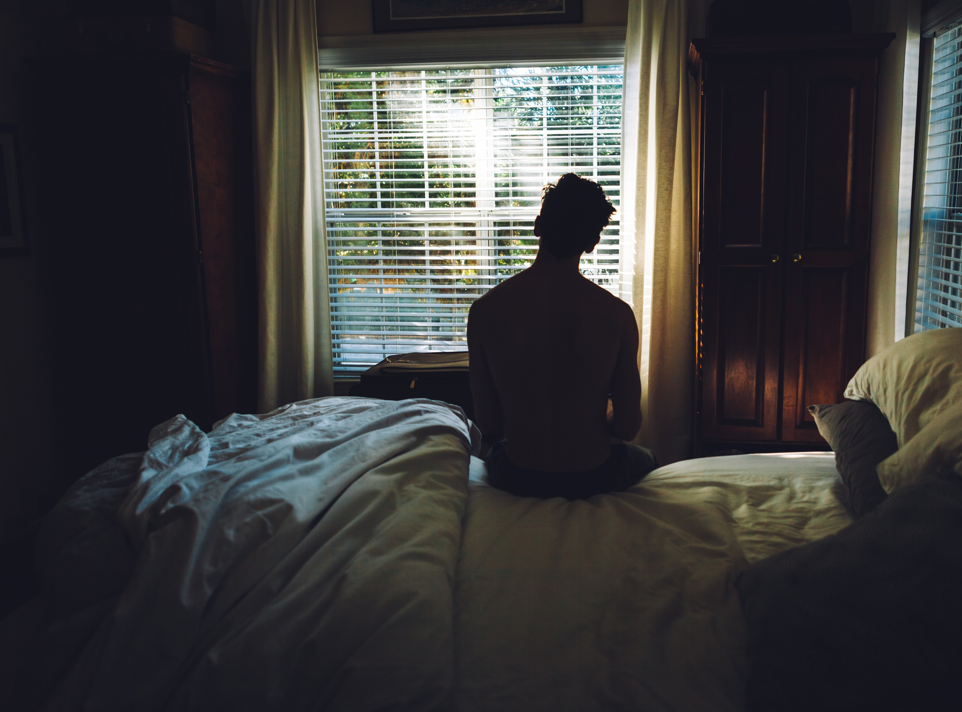
Classifications
will not remember
Notes:
Sexsomnia
Patient will not remember this when they wake
They may want to perform sexual activities that they do not normally participate in
May have a history of sleepwalking
Males tend to be more physical and can include sexual fondling and intercourse
Females tend to be more vocal and to masturbate

Slide 11
sexsomnia treatment
Classifications
Notes:
Treatment
Avoid alcohol and other substances
Decrease stress/Relaxation techniques
Therapy for past traumas
Medication (by physician)

Slide 12
MODULE SEVEN D
part two
REM ASSOCIATED PARASOMNIAS

Slide 13
REM associated
REM Associated Parasomnias
Notes:
For most people, dreaming is purely a "mental" activity: dreams occur in the mind while the body is at rest. But people who suffer from REM sleep behavior disorder (RBD) act out their dreams. They physically move limbs or even get up and engage in activities associated with waking. Some engage in sleep talking, shouting, screaming, hitting or punching. Some even fly out of bed while sleeping! RBD is usually noticed when it causes danger to the sleeping person, their bed partner, or others they encounter. Sometimes ill effects such as injury to self or bed partner sustained while asleep trigger a diagnosis of RBD. The good news is that RBD can usually be treated successfully.

Slide 14
REM associated
What we call "sleep" involves transitions between three different states: wakefulness, rapid eye movement (REM) sleep, which is associated with dreaming, and non rapid eye movement (N-REM) sleep. There are a variety of characteristics that define each state, but to understand REM sleep behavior disorder it is important to know that it occurs during REM sleep. During this state, the electrical activity of the brain, as recorded by an electroencephalogram, looks similar to the electrical activity that occurs during waking. Although neurons in the brain during REM sleep are functioning much as they do during waking, REM sleep is also characterized by temporary muscle paralysis.
REM Associated Parasomnias

Slide 15
REM associated
REM Associated Parasomnias
TIME ASLEEP
Notes:
In some sleep disorders such as narcolepsy and parasomnias, like REM sleep behavior disorder, the distinctions between these different states breaks down; characteristics of one state carry over or "invade" the others. Sleep researchers believe that neurological "barriers" that separate the states don't function properly, though the cause of such occurrences is not entirely understood.
Thus, for most people, even when they are having vivid dreams in which they imagine they are active, their bodies are still. But, persons with RBD lack this muscle paralysis, which permits them to act out dramatic and/or violent dreams during the REM stage of sleep. Sometimes they begin by talking, twitching and jerking during dreaming for years before they fully act out their REM dreams.

Slide 16
REM behavior disorder
Nightmares
Recurrent isolated sleep paralysis
REM Associated Parasomnias
Notes:
REM behavior disorder
Nightmares
Recurrent isolated sleep paralysis

Slide 17
consult neurologist
REM Behavior Disorder
If you think this is a possibility a sleep specialist/neurologist should be consulted
Occurs during the second half of the night/early morning
This is enactment of a dream and can be very complex with vocalizations and complex movements (a person can injure themselves or their bed partner).
The eyes will be closed
It will end with the person being awake and alert
Most commonly seen in males 60+
REM Associated Parasomnias
Notes:
REM Behavior Disorder
If you think this is a possibility a sleep specialist/neurologist should be consulted
Occurs during the second half of the night/early morning
This is enactment of a dream and can be very complex with vocalizations and complex movements (a person can injure themselves or their bed partner).
The eyes will be closed
It will end with the person being awake and alert
Most commonly seen in males 60+

Slide 18
cannot move extremities
REM Associated Parasomnias
Notes:
Sleep Paralysis
Can occur at sleep onset or upon waking
The person cannot move their extremities or head
The person may recall their dreams
Usually starts during young adulthood
Poor sleep hygiene can contribute to this
Treatment
Consider adjusting wake time
It can be associated with other disorders or medication effects

Slide 19
feel they are in danger
REM Associated Parasomnias
Notes:
Nightmares
Occur later in the night or early morning
It is usually scary and the person can feel they are in imminent danger
The person can usually describe the episode
Recurrent nightmares can result in sleep avoidance insomnia and anxiety
Treatment
Relaxation techniques prior to bed
Image rehearsal
Better sleep hygiene

Slide 20
MODULE SEVEN D
part three
OTHER PARASOMNIAS

Slide 21
Enuresis (bedwetting)
Sleep Related Groaning
Exploding Head Syndrome
Sleep Related Eating Disorder
Sleep Related Hallucinations
Other Parasomnias
Notes:
Enuresis (bedwetting)
Sleep Related Groaning
Exploding Head Syndrome
Sleep Related Eating Disorder
Sleep Related Hallucinations

Slide 22
bladder training
Other Parasomnias
Notes:
Enuresis
Occurs in children over five
Usually occurs the first third of the night
Primary: the person or child did not develop bladder control (has family history).
Secondary: occurs when no bedwetting has occur for at least 6 months. Usually in adults who had Primary Enuresis during childhood. It is usually caused by other sleep or health issues.
Treatment
Bladder training
Alarms
Medications

Slide 23
no specific treatment
Sleep Groaning
It occurs during exhalation
Although the person who is doing it may not know it the bed partner will
The patient may have a slow respiratory rate
It may occur in clusters
Other Parasomnias
Notes:
Treatment
There is no specific treatment
Sleep Groaning
It occurs during exhalation
Although the person who is doing it may not know it the bed partner will
The patient may have a slow respiratory rate
It may occur in clusters

Slide 24
loud imagined sound
Exploding Head syndrome
It is the loud imagined sound that occurs while the brain is transitioning from wake to sleep
There may be a body jerk a light flash or a sense of fear or falling that occurs with it
Other Parasomnias
Notes:
No treatment is necessary as this is natural
Exploding Head syndrome
It is the loud imagined sound that occurs while the brain is transitioning from wake to sleep
There may be a body jerk a light flash or a sense of fear or falling that occurs with it

Slide 25
occurs due to severe stress
Sleep Related Eating Disorder
This can occur multiple times during the night
A person will arouse (not necessarily fully awaken) and eat or drink
The individual is usually unaware of the behavior
Occurs due to severe stress or when discontinuing an addictive behavior such as smoking
Other Parasomnias
Notes:
Treatment
Treat the disorder that is disrupting sleep
Relaxation techniques
Sleep hygiene

Slide 26
can be visual, auditory or tactile
Sleep Related Hallucinations
Occur during the transition from wake to sleep or sleep to wake
They can be visual, auditory or tactile
Person may also experience sleep paralysis
Other Parasomnias
Notes:
Treatment
Consider adjusting wake time
It can be associated with other disorders or medication effects

Slide 27
MODULE SEVEN D
part four
OTHER ISSUES ASSOCIATED WITH PARASOMNIAS

Slide 28
Other Issues Associated With Parasomnias
TIME ASLEEP
Notes:
Medications can contribute to parasomnias
Alcohol consumption will contribute to disorders that are associated with fragmented sleep
Sleep hygiene and stress contribute to these disorders and its severity
Many of these disorders may have a familial ties

Slide 29
You Are Ready
For The Next Module

