Slide 1
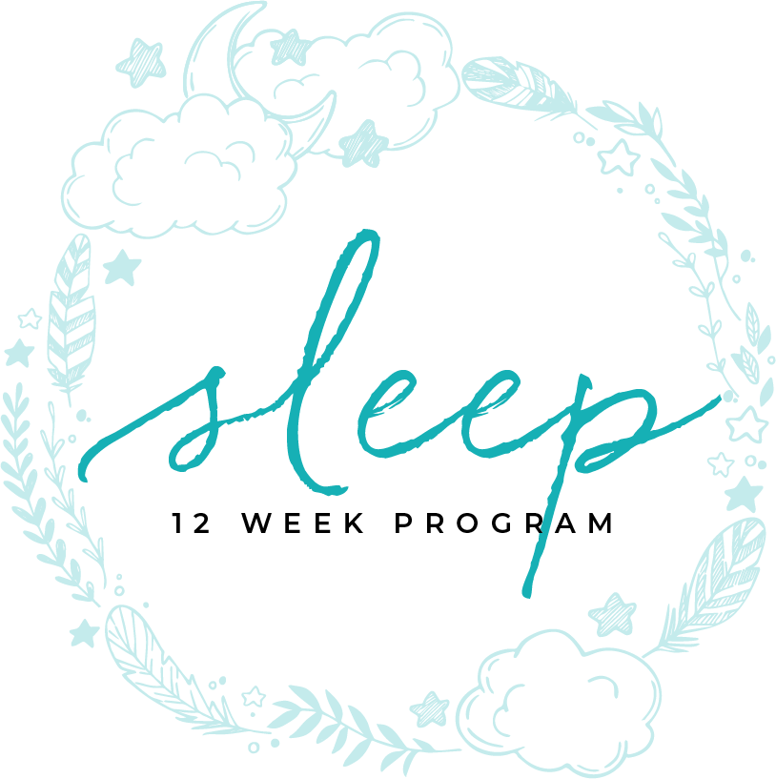
CIRCADIAN RHYTHM DISORDERS
MODULE ELEVEN

Slide 2
CIRCADIAN RHYTHM
DISORDERS

Slide 3
Table of contents
4 | What is the Circadian Rhythm
6 | Night Owl/ Morning Lark
8 | Advanced Sleep Phase
10 | Delayed Sleep Phase
12 | Free Flowing Circadian Rhythm
14 | Shift Work Disorder
16 | Jet Lag
18 | Treatment

Slide 4
MODULE SEVEN E
part one
WHAT IS THE CIRCADIAN RHYTHM

Slide 5
sleep cycle has 3 drives
What Is The Circadian Rhythm
Notes:
Your Sleep Cycle has 3 drives
C drive which is the rhythm
S drive which is the drive from Wakefulness to Sleepiness
Social or Societal Drive that is how culture influences sleep behavior

Slide 6
transient vs chronic
What Is The Circadian Rhythm
TIME ASLEEP
Notes:
Disturbances in circadian rhythm—the approximately 24-hour cycles that are endogenously generated by an organism—can be categorized into 2 main groups: transient disorders (eg, jet lag or a changed sleep schedule due to work, social responsibilities, or illness) and chronic disorders (eg, delayed sleep-phase syndrome [DSPS], advanced sleep-phase syndrome [ASPS], and irregular sleep-wake cycle). Sleeplessness (insomnia) is defined as difficulty initiating or maintaining sleep.

Slide 7
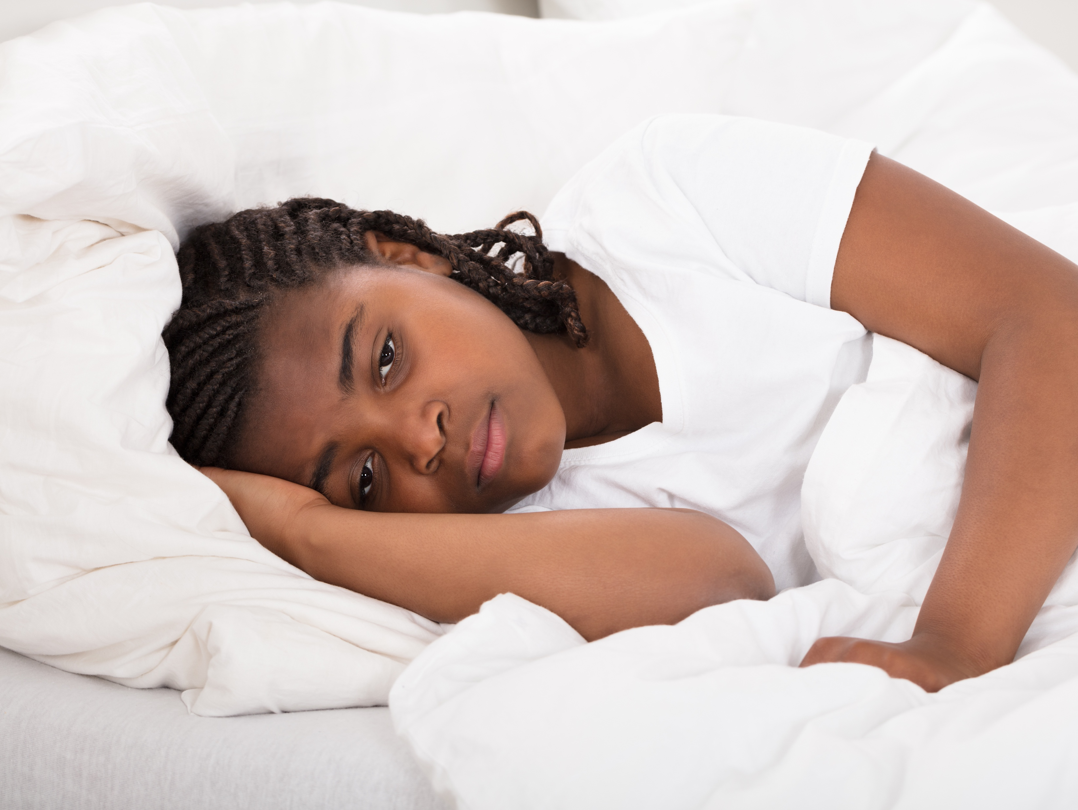
transient vs chronic
What Is The Circadian Rhythm
Notes:
Consider the following to determine the nature of the patient’s circadian rhythm disorder:
Duration of symptoms (transient vs chronic)
Pattern of the sleep-wake cycle: Allows diagnosis within chronic subtypes
Shift work (rotating morning/evening/night shifts vs a consistent shift)
Total sleep time (normal vs shortened)
Peak alertness (late evening/night vs early morning vs no pattern)
Recent travel: Symptoms from high-altitude flight in general (< 24 h) versus those from jet lag (persist for days; more likely to occur if ≥3 time zones are crossed)
Daytime sleepiness: Seen in all circadian rhythm disorders, with varying severity/timing
Psychological assessment: Psychophysiological insomnia, depressive disorders, other psychiatric disorders (symptoms may be similar to those of circadian rhythm disorders)

Slide 8
transient vs chronic
Consider the following to determine the nature of the patient’s circadian rhythm disorder: (continued)
Cognition (ie, impact of circadian rhythm disorder on complex cognitive tasks such as selective attention and executive function)
Patient attempts at treatment (sleep aids) (eg, alcohol, herbal preparations, nonprescription/over-the-counter drugs)
Medication history and timing of administration
Snoring, with/without witnessed apnea
Other medical conditions (eg, congestive heart failure [CHF], chronic obstructive pulmonary disease, chronic pain syndromes, thyroid disease)
Environmental cues (light intensity, noise level, environmental temperature) and sleep hygiene (exercise and/or stimulant intake before bedtime)
Any history of motor vehicle accidents or other accidents due to decreased alertness and/or excessive sleepiness
What Is The Circadian Rhythm
Notes:
Consider the following to determine the nature of the patient’s circadian rhythm disorder: (continued)
Cognition (ie, impact of circadian rhythm disorder on complex cognitive tasks such as selective attention and executive function)
Patient attempts at treatment (sleep aids) (eg, alcohol, herbal preparations, nonprescription/over-the-counter drugs)
Medication history and timing of administration
Snoring, with/without witnessed apnea
Other medical conditions (eg, congestive heart failure [CHF], chronic obstructive pulmonary disease, chronic pain syndromes, thyroid disease)
Environmental cues (light intensity, noise level, environmental temperature) and sleep hygiene (exercise and/or stimulant intake before bedtime)
Any history of motor vehicle accidents or other accidents due to decreased alertness and/or excessive sleepiness

Slide 9
MODULE SEVEN E
part two
NIGHT OWL/ MORNING LARK

Slide 10
effects wake and sleep cycles
Night Owl/ Morning Lark
Notes:
These are normal variances however they will effect your wake and sleep cycle
Morning people wake early but they get tired later in the day
Night owls have more energy and are more alert later in the day

Slide 11
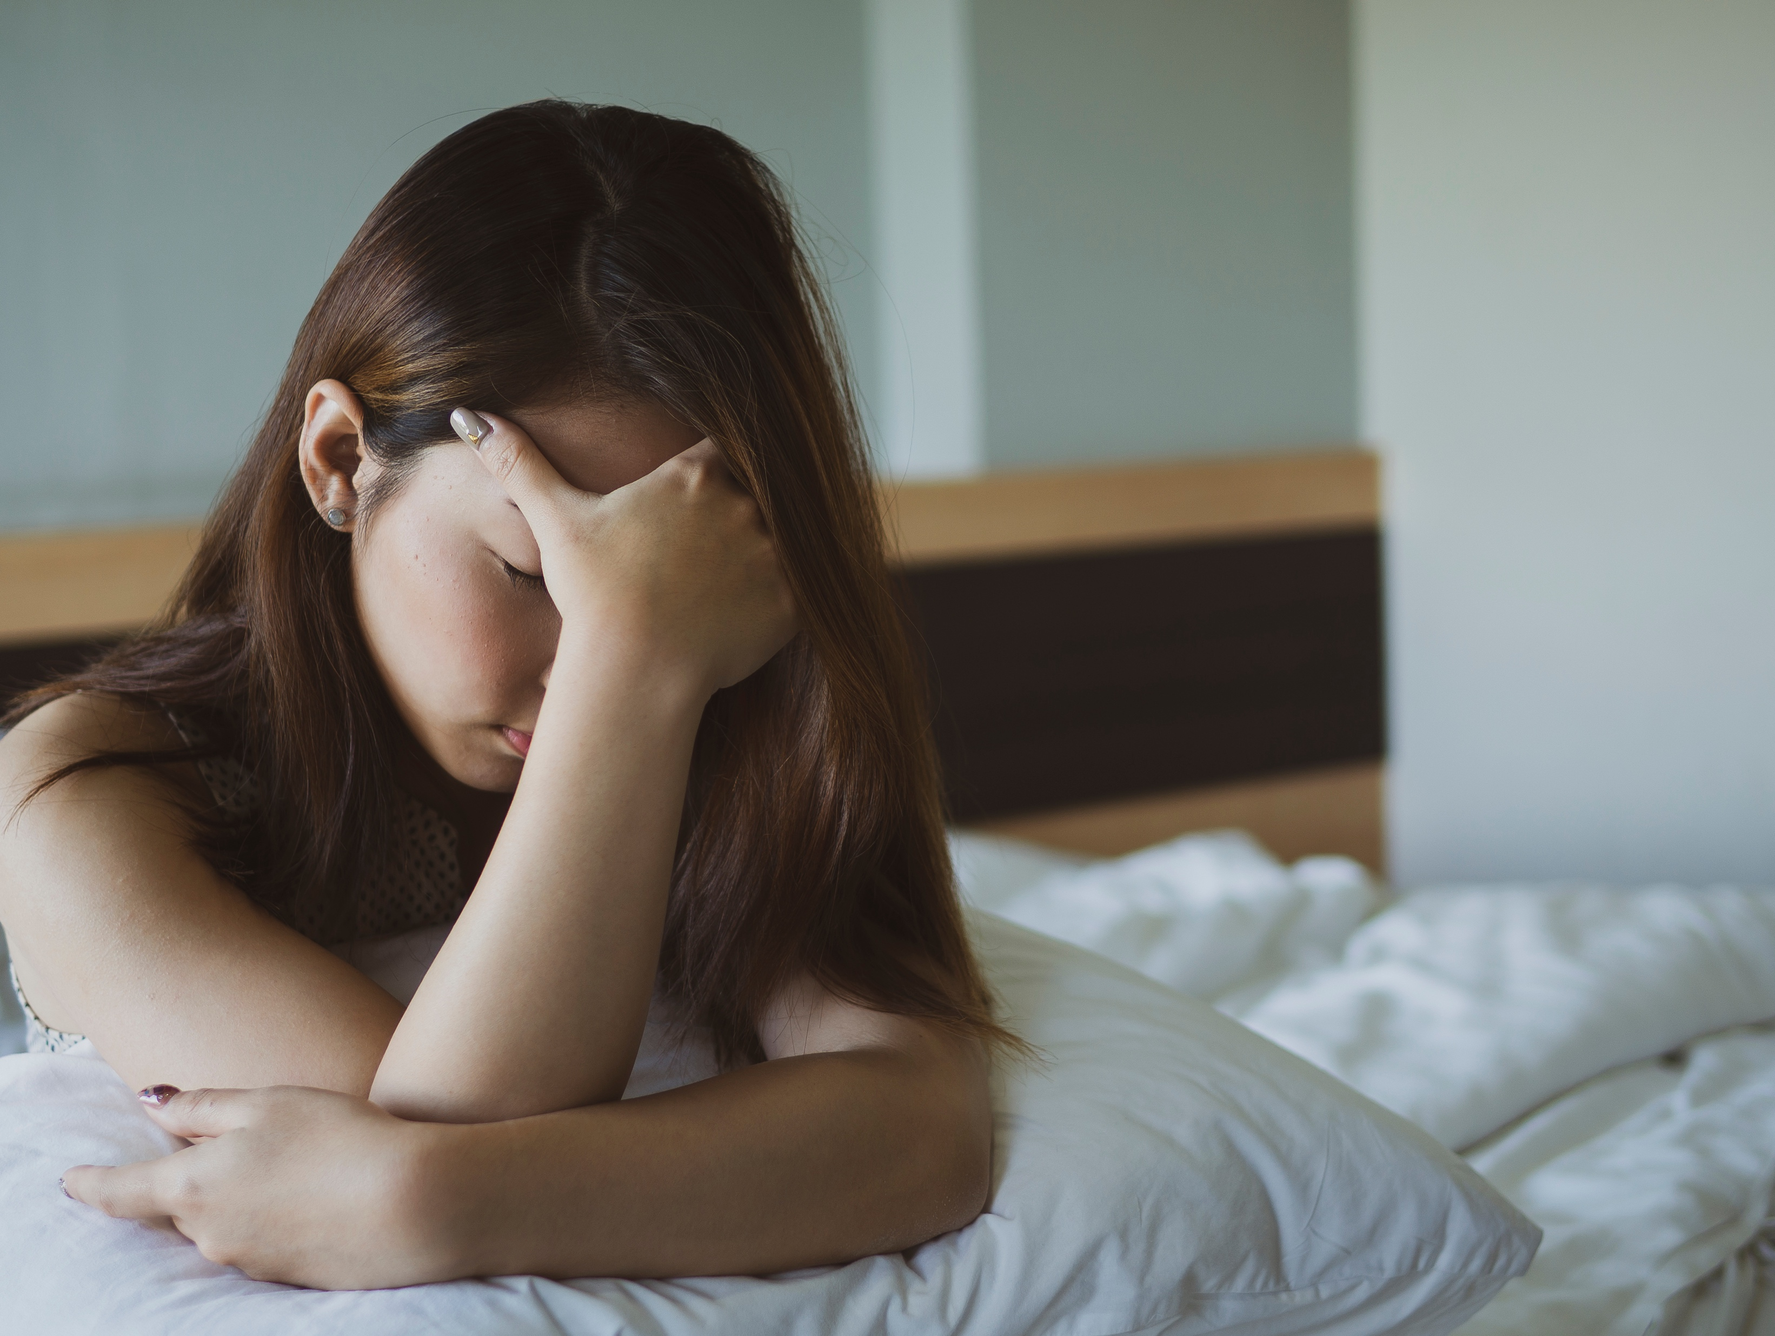
effects wake and sleep cycles
Night Owl/ Morning Lark
Notes:
Even though most adults need 7-9 hours of sleep in a 24-hour day, exactly when our bodies naturally tend to fall asleep and wake up each day can vary. Scientists believe that people have inherent differences in when they sleep and wake best. This natural pattern is a chronotype. Whether you’re a night owl (an evening person), or a lark (morning person) is partly determined by your genetics.
If you know your natural tendency it might help you understand how you adjust to a particular shift schedule. For example, if you’ve always been a night person and feel most productive in the evening hours, an evening shift might work best for you, because your circadian rhythm allows you to be alert in those hours. If you’ve always woken up early and felt sharp and energetic in the morning, a night shift may be particularly hard for you. Some people fall in the middle of the two tendencies. If you

Slide 12
effects wake and sleep cycles
Night Owl/ Morning Lark
Notes:
don’t have a strong day or night tendency (and your employer is flexible) you may try different shift hours to see which fits best for you.
Certain people are also more affected by schedule changes overall—their internal clock has a harder time adjusting, and changes in sleep hit them harder than others. These people should be diligent about protecting their sleep time if they are working night or rotating shifts.

Slide 13
MODULE SEVEN E
part three
ADVANCED SLEEP PHASE

Slide 14
go to bed early and wake early
Advanced Sleep Phase
Notes:
Usually seen in older people
It usually causes people to go to bed early and wake between 2 am and 4 am.
The quantity and quality of sleep is generally normal

Slide 15
go to bed early and wake early
Advanced Sleep Phase
Notes:
Advanced sleep phase syndrome is a disorder in which the timing of sleep and the peak period of alertness are advanced several hours relative to societal clock. People with advanced sleep phase syndrome generally have difficulty staying awake unless they go to bed very early because their internal clock is already at a relatively quiet state, and wake up very early, at what is considered a "normal" time in the morning, unable to fall back asleep, because their internal clock is already producing strong alerting signals.
Unless other sleep disorders, such a sleep apnea or insomnia, are present, an individual with advanced sleep phase syndrome sleeps well (in terms of duration and quality) when going to bed and waking up early but the syndrome makes it difficult to stay awake in the evening and be engaged in social activities. Sleep quality is not impaired by the syndrome but afflicted individuals may have short sleep duration if they delay

Slide 16
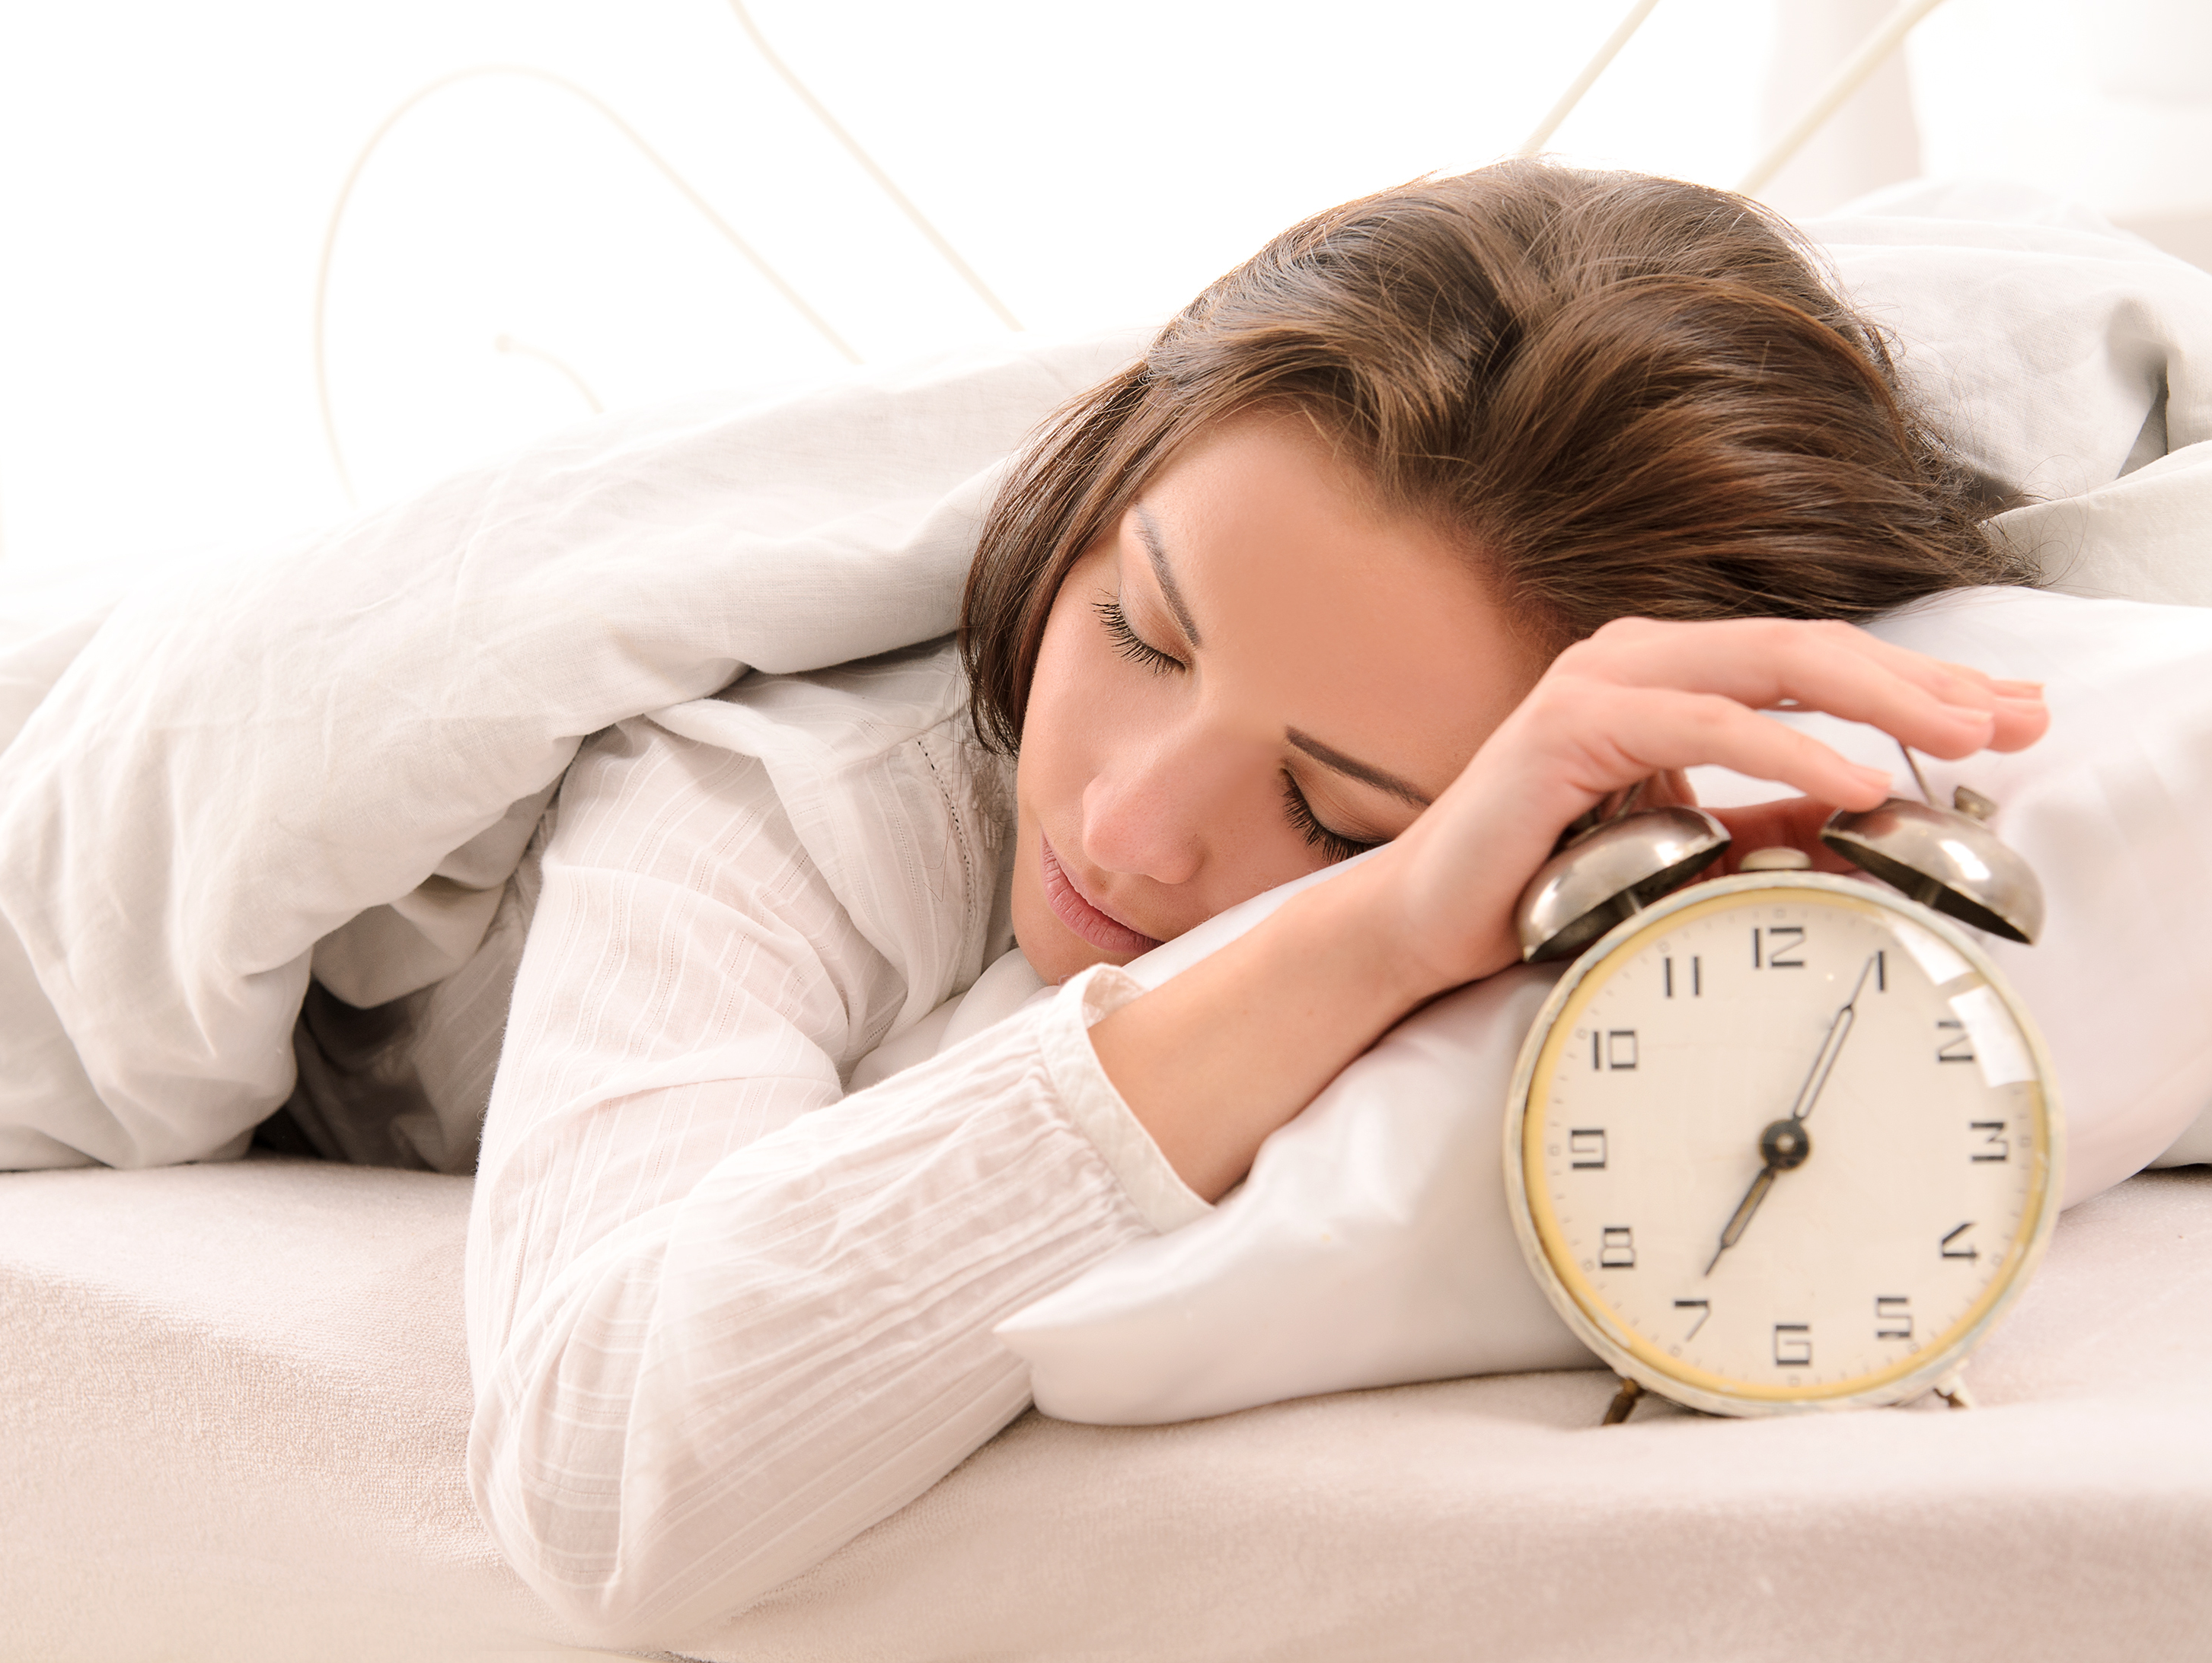
go to bed early and wake early
Advanced Sleep Phase
Notes:
their bedtime. Nonetheless people with advanced sleep phase syndrome do not report that the syndrome affects their daytime work or school activities. Their most common complaint is that their evening activities are cut short by the need to sleep much earlier than what is considered the norm. This can affect family and social relationships. Individuals with Advanced Sleep Phase Syndrome should be cautious about driving in the late afternoon and evening, because they may be too drowsy. They also do not adjust well to evening or night shifts.
The prevalence of advanced sleep phase syndrome in the general population is unknown although it is most prevalent among older adults. Advanced sleep phase syndrome has the same prevalence among men and women. Researchers have also found a strong genetic link: 40%-50% of people suffering from advanced sleep phase syndrome are related to someone who has the syndrome.

Slide 17
MODULE SEVEN E
part four
DELAYED SLEEP PHASE

Slide 18
hard to live a normal schedule
Delayed Sleep Phase
Notes:
Delayed sleep phase syndrome (DSPS) is a disorder in which a person’s sleep is delayed by two hours or more beyond what is considered an acceptable or conventional bedtime. The delayed sleep then causes difficulty in being able to wake up at the desired time.
For example, a person with DSPS may fall asleep after midnight instead of at 10 p.m. and then will have difficulty getting up in the morning for school or work.
People with delayed sleep phase syndrome generally have difficulty:
Falling asleep, unless they go to bed very late (usually some hours after midnight) because their internal clock is sending alerting signals until late into the night
Waking up at a "normal" time in the morning, because their internal clock is not yet producing strong alerting signals
Unless you have other sleep disorders, such a sleep apnea or insomnia, you may actually sleep well with DSPS, in terms of duration and quality of sleep. The problem is that the delay makes it difficult to wake up in time for a typical school or work day.

Slide 19
hard to live a normal schedule
Delayed Sleep Phase
Notes:
People with delayed sleep phase syndrome generally have difficulty:
Falling asleep, unless they go to bed very late (usually some hours after midnight) because their internal clock is sending alerting signals until late into the night
Waking up at a "normal" time in the morning, because their internal clock is not yet producing strong alerting signals
Unless you have other sleep disorders, such a sleep apnea or insomnia, you may actually sleep well with DSPS, in terms of duration and quality of sleep. The problem is that the delay makes it difficult to wake up in time for a typical school or work day.

Slide 20
hard to live a normal schedule
Usually seen in teens to early 20s
Patient usually wants to go to sleep between 1am and 6am
Causes issues when the person with Delayed Phase tried to live a normal schedule
Delayed Sleep Phase
Notes:
Usually seen in teens to early 20s
Patient usually wants to go to sleep between 1am and 6am
Causes issues when the person with Delayed Phase tried to live a normal schedule

Slide 21
MODULE SEVEN E
part five
FREE FLOWING CIRCADIAN RHYTHM

Slide 22
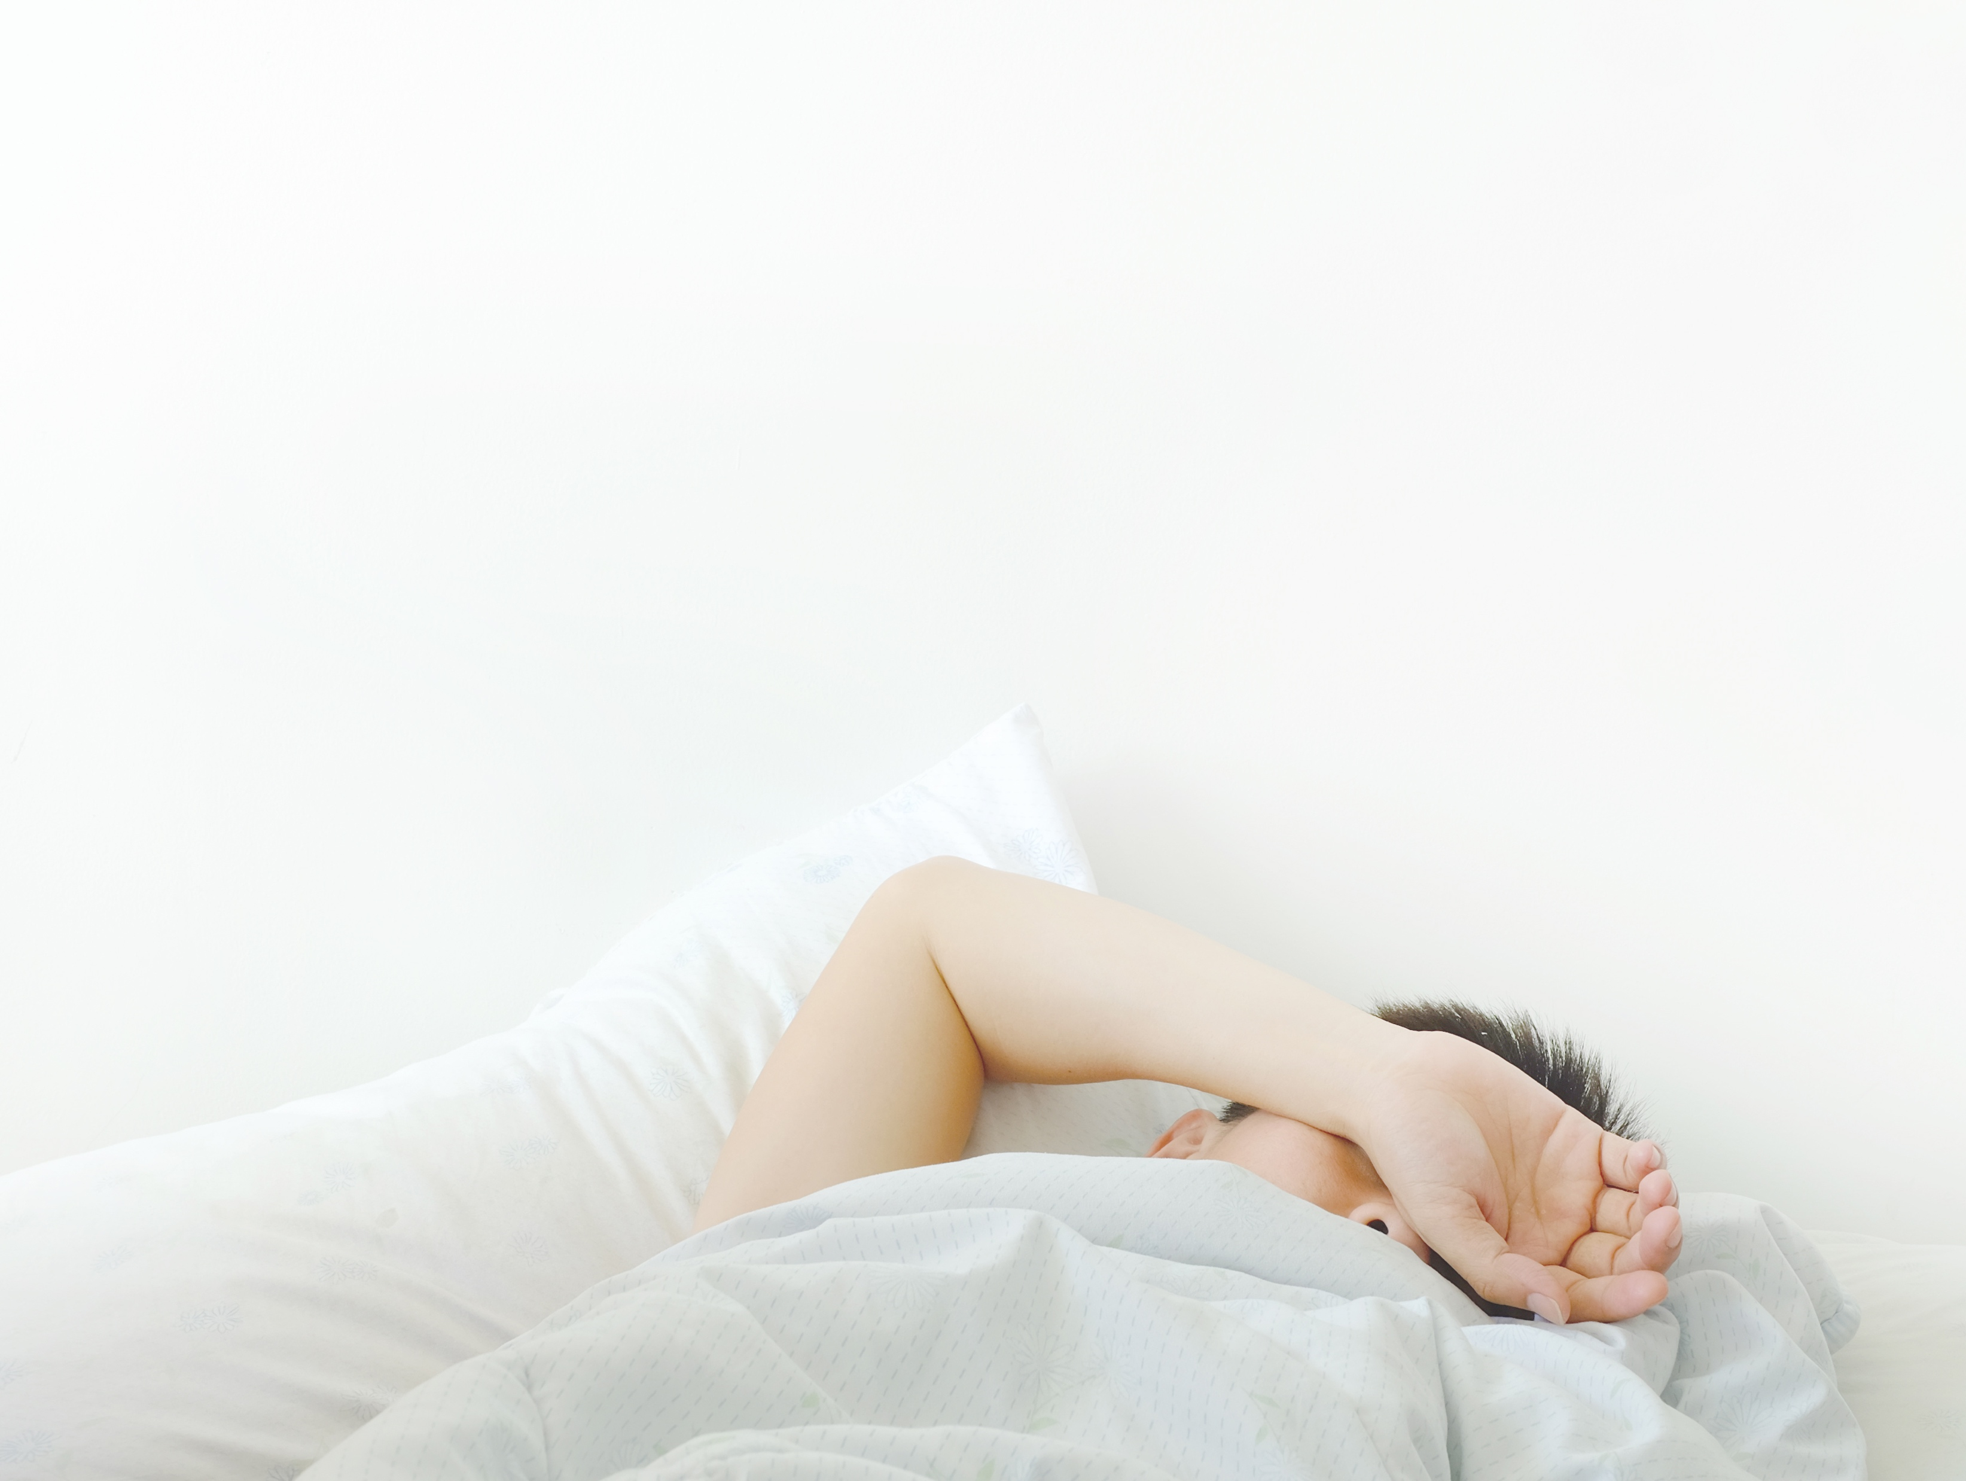
occurs due to secondary issues
This usually occurs due to secondary issues such as blindness
This can be greater than 24 hour cycle since the cycle does not adhere to the circadian and social cues of sleep
Free Flowing Circadian Rhythm
Notes:
This usually occurs due to secondary issues such as blindness
This can be greater than 24 hour cycle since the cycle does not adhere to the circadian and social cues of sleep

Slide 23
MODULE SEVEN E
part six
SHIFT WORK DISORDER

Slide 24
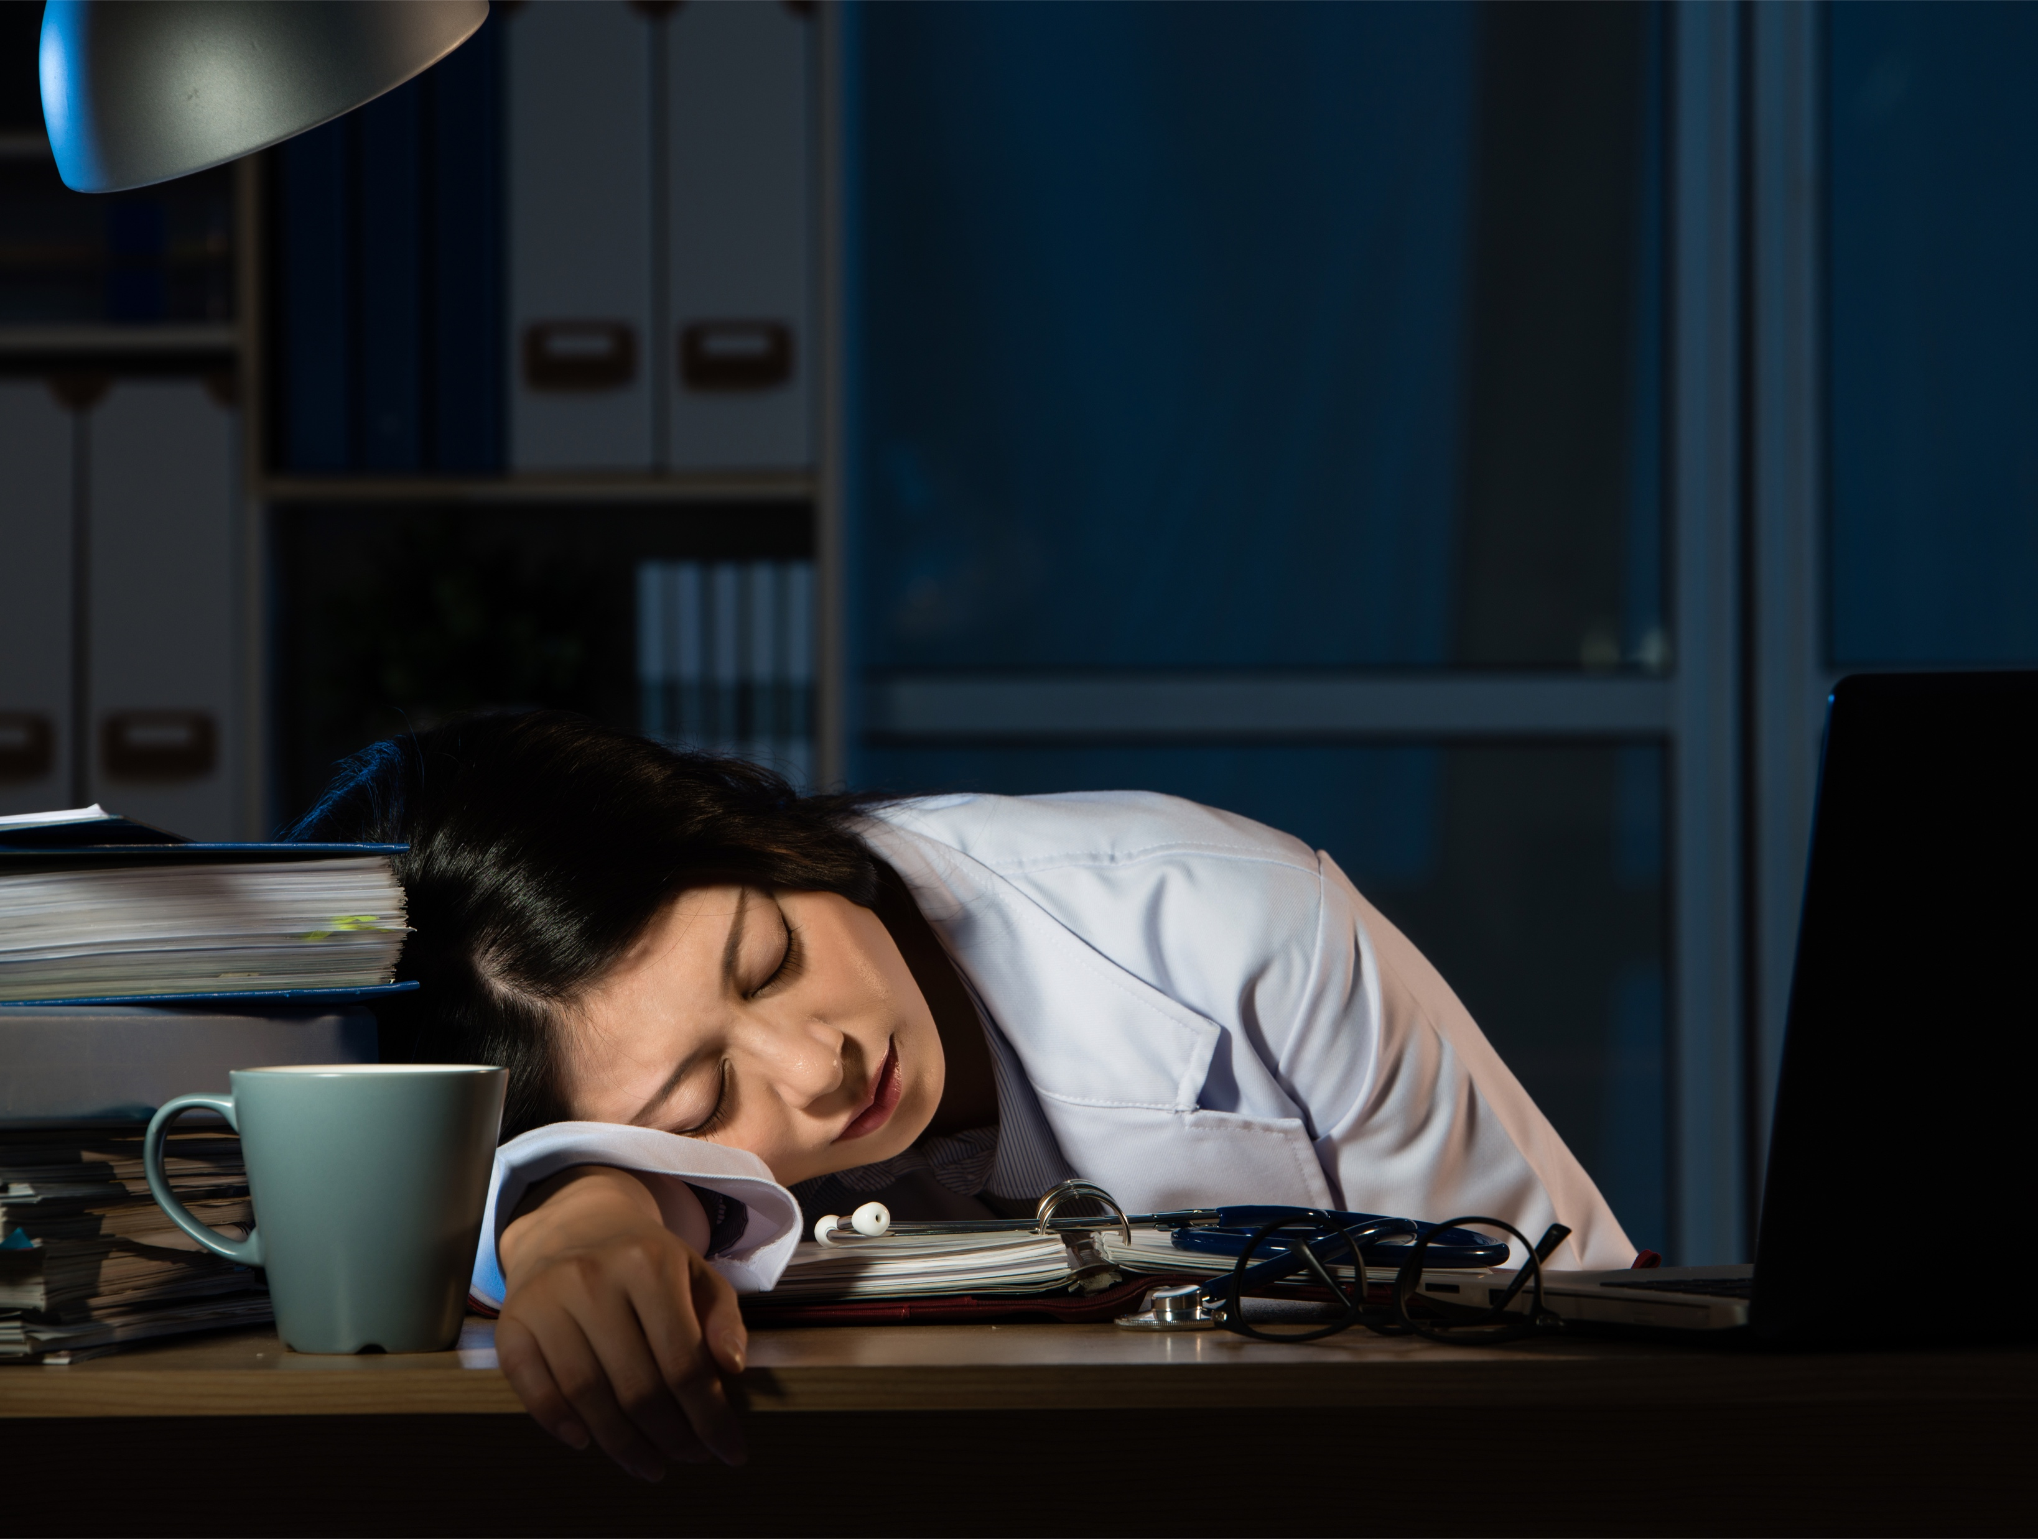
rotating shifts
Shift Work Disorder
Notes:
Shift work sleep disorder is a circadian sleep disorder in which a person experiences a constant or recurrent pattern of sleep interruption due to shift work schedule, resulting in difficulties initiating and maintaining sleep and/or excessive sleepiness when awake. Other symptoms of shift work sleep disorder include difficulty concentrating, headaches, and low energy.
Non-traditional shifts, particularly rotating shifts, force people to place their sleep window at a time that is not congruent with their underlying circadian clock. Rotating shifts also weaken the signals from the internal clock leading to greater difficulties with sleep and sleepiness. As a result, people with shift work sleep disorder may have trouble staying alert at their work shift and feel their sleep is unrefreshing.

Slide 25
rotating shifts
Shift Work Disorder
Notes:
This is when a person works a shift that does not align with their internal circadian rhythm
This can be from either a fixed shift or rotating shifts
The person will experience shorter sleep times and disrupted sleep
There will be a significant reduction in alertness especially during the times where our body is a the lowest part of the rhythm (about 3am)
Many people never adapt to the unusual or rotating shift

Slide 26
MODULE SEVEN E
part seven
JET LAG

Slide 27
misaligns the social cues
Jet Lag
Notes:
This is due to a rapid change in time zones
This misaligns the social cues with the biological cues
Being awake longer has less effect than having to go to sleep earlier
The effect of light is the biggest influencer in adapting to the new time zone

Slide 28
MODULE SEVEN E
part eight
TREATMENT

Slide 29
strong sleep routine
The need for a strong sleep routine
The control of light (a walk outside or use of sunglasses) and the use of light therapy to help to regulate the issue
The strong daytime routine that includes meal times and other daytime cues for wake and sleep
Chronotherapy can be used for someone with delayed sleep phase but they have to be very motivated as it is time consuming
Use of Melatonin can be used under MD recommendations
Treatment
Notes:
The need for a strong sleep routine
The control of light (a walk outside or use of sunglasses) and the use of light therapy to help to regulate the issue
The strong daytime routine that includes meal times and other daytime cues for wake and sleep
Chronotherapy can be used for someone with delayed sleep phase but they have to be very motivated as it is time consuming
Use of Melatonin can be used under MD recommendations

Slide 30
You Are Ready
For The Next Module

