Slide 1
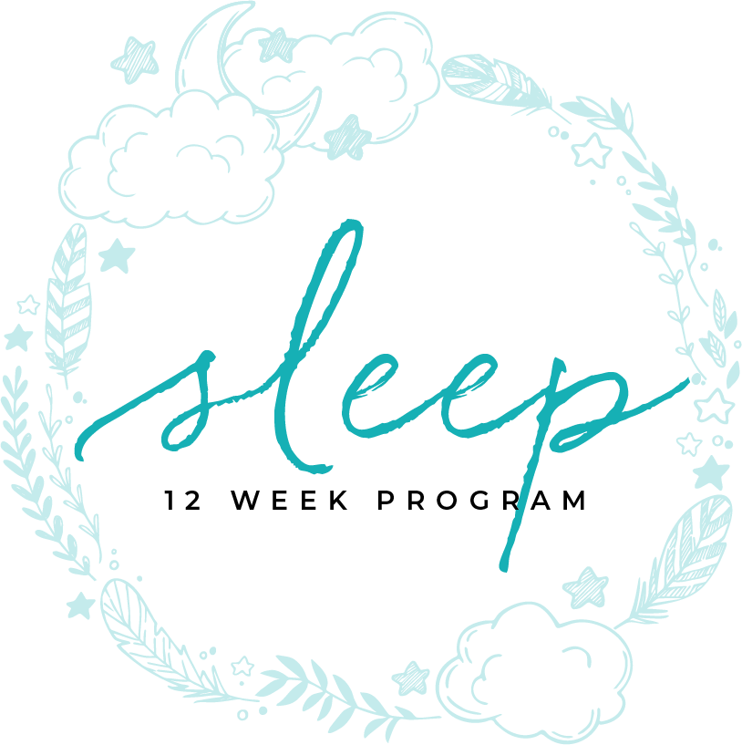
MOVEMENT DISORDERS
MODULE TWELVE

Slide 2
MOVEMENT
DISORDERS

Slide 3
Table of contents
4 | What qualifies as a movement disorder
6 | Types of movement disorders
8 | Restless Leg Syndrome/PLMS
10 | Symptoms
12 | Treatment
14 | Wives Tales
16 | Other leg movements
18 | Rhythmic Movement Disorder
20 | Bruxism

Slide 4
MODULE SEVEN F
WHAT QUALIFIES AS A MOVEMENT DISORDER?
part one

Slide 5
cause sleep disruptions
There are those movements that occur late in the day or when transitioning from wake to sleep. There are movement disorders that disrupt sleep. Both types can cause sleep disruptions.
You may be familiar with the tossing and turning that occurs when you’re unable to fall asleep at night. But for millions of Americans who suffer from sleep movement disorders, it’s the uncontrollable twitching once they climb into bed that prevents them from sleeping in the first place. These common sleep movement disorders can wreak havoc on your nightly slumber. Learn what you can do about it.
What Qualifies As A Movement Disorder
TIME ASLEEP

Slide 6
MODULE SEVEN F
TYPES OF
MOVEMENT DISORDERS
part two

Slide 7
movement disorders
Restless leg syndrome
Periodic limb movement disorder (PLMS)
Rhythmic movement disorder
Alternating leg muscle activity
Hypnogogic foot tremors
Excessive fragmentary myoclonus
Leg cramps
Bruxism
Types Of Movement Disorders
TIME ASLEEP

Slide 8
MODULE SEVEN F
RESTLESS LEG SYNDROME/
PLMS
part three

Slide 9
cause sleep disruptions
What Qualifies As A Movement Disorder
Restless Legs Syndrome
Approximately 10 percent of adults in the U.S. suffer from restless legs syndrome (RLS), a condition in which the person has overwhelming, often unpleasant, urges to move the legs while relaxing. Not surprisingly, this can result in poor sleep quality. While the exact cause of RLS isn’t known, the disorder often runs in families. It affects both men and women and often worsens as people get older. The good news is that RLS can be treated with lifestyle modifications (such as limiting caffeine and alcohol intake, exercising regularly, and adjusting medication intake since some drugs can make RLS worse).
TIME ASLEEP

Slide 10
irresistible urge to move
About 60% of people with Restless leg syndrome (RLS) have PLMS (Periodic Limb Movements of Sleep).
Restless legs syndrome (RLS), also called Willis-Ekbom Disease, causes unpleasant or uncomfortable sensations in the legs and an irresistible urge to move them. Symptoms commonly occur in the late afternoon or evening hours, and are often most severe at night when a person is resting, such as sitting or lying in bed. They also may occur when someone is inactive and sitting for extended periods (for example, when taking a trip by plane or watching a movie). Since symptoms can increase in severity during the night, it could become difficult to fall asleep or return to sleep after waking up. Moving the legs or walking typically relieves the discomfort but the sensations often recur once the movement stops. RLS is classified as a sleep disorder since the symptoms are triggered by resting and attempting to sleep, and as a
Restless Leg Syndrome/ PLMS
TIME ASLEEP

Slide 11
irresistible urge to move
movement disorder, since people are forced to move their legs in order to relieve symptoms. It is, however, best characterized as a neurological sensory disorder with symptoms that are produced from within the brain itself.
RLS is one of several disorders that can cause exhaustion and daytime sleepiness, which can strongly affect mood, concentration, job and school performance, and personal relationships. Many people with RLS report they are often unable to concentrate, have impaired memory, or fail to accomplish daily tasks. Untreated moderate to severe RLS can lead to about a 20 percent decrease in work productivity and can contribute to depression and anxiety. It also can make traveling difficult.
It is estimated that up to 7-10 percent of the U.S. population may have RLS. RLS occurs in both men and women, although women are more likely to have it than men. It may
Restless Leg Syndrome/ PLMS
TIME ASLEEP

Slide 12
irresistible urge to move
begin at any age. Many individuals who are severely affected are middle-aged or older, and the symptoms typically become more frequent and last longer with age.
More than 80 percent of people with RLS also experience periodic limb movement of sleep (PLMS). PLMS is characterized by involuntary leg (and sometimes arm) twitching or jerking movements during sleep that typically occur every 15 to 40 seconds, sometimes throughout the night. Although many individuals with RLS also develop PLMS, most people with PLMS do not experience RLS.
In most cases, the cause of RLS is unknown (called primary RLS). However, RLS has a genetic component and can be found in families where the onset of symptoms is before age 40. Specific gene variants have been associated with RLS. Evidence indicates that low levels of iron in the brain also may be responsible for RLS.
Restless Leg Syndrome/ PLMS
TIME ASLEEP

Slide 13
irresistible urge to move
Considerable evidence also suggests that RLS is related to a dysfunction in one of the sections of the brain that control movement (called the basal ganglia) that use the brain chemical dopamine. Dopamine is needed to produce smooth, purposeful muscle activity and movement. Disruption of these pathways frequently results in involuntary movements. Individuals with Parkinson’s disease, another disorder of the basal ganglia’s dopamine pathways, have increased chance of developing RLS.
Restless Leg Syndrome/ PLMS
TIME ASLEEP
Sleep deprivation and other sleep conditions like sleep apnea also may aggravate or trigger symptoms in some people. Reducing or completely eliminating these factors may relieve symptoms.

Slide 14
irresistible urge to move
Fortunately, most cases of RLS can be treated with non-drug therapies and if necessary, medications. RLS also appears to be related to or accompany the following factors or underlying conditions:
Diabetes
Joint displacement/bone damage
Kidney disease/Dialysis
Medications such as Selective serotonin reuptake inhibitors (SSRIs), such as anti nausea drugs (e.g. prochlorperazine or metoclopramide), antipsychotic drugs (e.g., haloperidol or phenothiazine derivatives), antidepressants that increase serotonin (e.g., fluoxetine or sertraline), and some cold and allergy medications that contain older antihistamines (e.g., diphenhydramine)
Low ferratin levels
Pregnancy
Neuropathy (nerve damage)
Restless Leg Syndrome/ PLMS
TIME ASLEEP

Slide 15
MODULE SEVEN F
SYMPTOMS
part four

Slide 16
worse in early evening
They can be described as creepy crawly, itchy, a need to move or bugs under the skin.
Is worse in early evening to night (5-6pm)
Will get progressively worse but will depend on the age it starts
Can spread to other limb or to other times of day
Symptoms
TIME ASLEEP

Slide 17
MODULE SEVEN F
TREATMENT
part five

Slide 18
medications and other options
Medications
Iron supplements if person has low ferratin level. For individuals with low or low-normal blood tests called ferritin and transferrin saturation, a trial of iron supplements is recommended as the first treatment. Iron supplements are available over-the-counter. A common side effect is upset stomach, which may improve with use of a different type of iron supplement. Because iron is not well-absorbed into the body by the gut, it may cause constipation that can be treated with a stool softeners such as polyethylene glycol. In some people, iron supplementation does not improve a person’s iron levels. Others may require iron given through an IV line in order to boost the iron levels and relieve symptoms.
Treatment
TIME ASLEEP

Slide 19
medications and other options
Medications (continued)
Some doctors use Levadopa, however the side effects can be worse than the condition. The drug increases dopamine effect. They have been shown to reduce symptoms of RLS when they are taken at nighttime. The FDA has approved ropinirole, pramipexole, and rotigotine to treat moderate to severe RLS. These drugs are generally well tolerated but can cause nausea, dizziness, or other short-term side effects. Levodopa plus carbidopa may be effective when used intermittently, but not daily.
Although dopamine-related medications are effective in managing RLS symptoms, long-term use can lead to worsening of the symptoms in many
Treatment
TIME ASLEEP

Slide 20
medications and other options
Medications (continued)
individuals. With chronic use, a person may begin to experience symptoms earlier in the evening or even earlier until the symptoms are present around the clock. Over time, the initial evening or bedtime dose can become less effective, the symptoms at night become more intense, and symptoms could begin to affect the arms or trunk. Fortunately, this apparent progression can be reversed by removing the person from all dopamine-related medications.
Another important adverse effect of dopamine medications that occurs in some people is the development of impulsive or obsessive behaviors such as obsessive gambling or shopping. Should they occur, these behaviors can be improved or reversed by stopping the medication.
Treatment
TIME ASLEEP

Slide 21
medications and other options
Other Options
For some compression socks or air compression boots. This appears to help to short circuit some of the overstimulated nerve cells
Walking and massage sometimes also helps
Certain lifestyle changes and activities may provide some relief if you have mild to moderate symptoms of RLS. These steps include:
avoiding or decreasing the use of alcohol and tobacco
changing or maintaining a regular sleep pattern
a program of moderate exercise
taking a warm bath
using a heating pad or ice pack
Treatment
TIME ASLEEP

Slide 22
medications and other options
There are new medical devices that have been cleared by the U.S. Food & Drug Administration (FDA), including a foot wrap that puts pressure underneath the foot and another that is a pad that delivers vibration to the back of the legs.
Aerobic and leg-stretching exercises of moderate intensity also may provide some relief from mild symptoms.
Treatment
TIME ASLEEP

Slide 23
MODULE SEVEN F
WIVES TALES
part six

Slide 24
it is not in your head
There are old wives tales about just about everything. Sleep has it’s own set of folk cures that don’t work and border on the ridiculous.
Ivory Soap is not a cure
Warm milk is more of a psychological than a physical solution
It is not in your head
Alcohol is not a sleep remedy
Wives Tales
TIME ASLEEP

Slide 25
MODULE SEVEN F
OTHER LEG MOVEMENTS
part seven

Slide 26
cause sleep disruptions
Periodic Limb Movement Disorder
Similar to RLS, periodic limb movement disorder (PLMD) refers to uncontrollable repetitive movements that occur in the lower limbs every 20 to 40 seconds during sleep. These can include brief muscle twitches, jerking movements, and an upward flexing of the feet—episodes that can last from a few minutes to several hours. Because these frequent movements may cause awakenings or mini-arousals during the night, they can contribute to chronic insomnia and daytime fatigue. The underlying cause of PLMD isn’t known but it often accompanies RLS.
What Qualifies As A Movement Disorder
TIME ASLEEP

Slide 27
circulation issues
Alternating leg muscle activity-short bursts of activity that alternates between legs is usually seen at the beginning of the night
Hypnogogic foot tremors (foot tapping)
Excessive fragmentary myoclonus – leg twitches that disrupt sleep (these are shorter than PLMS and usually happen during the transition from wake to sleep).
Leg Cramps or Charley Horse
Look at electrolytes and circulation issues
Other Leg Movements
TIME ASLEEP

Slide 28
MODULE SEVEN F
RHYTHMIC MOVEMENT DISORDER
part eight

Slide 29
usually outgrow it
Rhythmic movement disorders, including body rocking, head rolling, and head banging, are parasomnias that occur largely during sleep-wake transition and are characterized by repetitive, stereotypic movements involving large muscle groups. They are much more common in the first year of life and generally disappear by age 4 years, but in rare cases they persist into adulthood. Although occasionally associated with developmental delay, most occur in normal children and do not result in physical injury to the child. Treatment is generally parental reassurance and, if appropriate, judicious padding of the sleeping surface.
Rhythmic Movement Disorder
TIME ASLEEP

Slide 30
usually outgrow it
Usually seen in toddlers to early adolescence
It is a rhythmic movement that occur when the person starts to fall asleep and is a large movements such as rocking, head or leg banging, or head rolling
Children usually outgrow it
They usually are unaware they are doing it and will not remember doing it when waking.
Rhythmic Movement Disorder
TIME ASLEEP

Slide 31
MODULE SEVEN F
BRUXISM
part nine

Slide 32
cause sleep disruptions
Sleep Bruxism
If you’ve ever woken up with a sore jaw, you may have experienced sleep bruxism, a condition which involves clenching or grinding your teeth during sleep.
An estimated eight percent of adults have sleep bruxism. If it happens occasionally, it may not be harmful but regular sleep bruxism can lead to dental damage, facial pain, and sleep disturbances. The cause isn’t full understood, but some research suggests it is linked with anxiety, the use of certain medications, and sleep apnea.
Reducing stress can help. For severe or ongoing bruxism, your dentist may recommend that you wear an oral appliance such as a bite guard while you sleep.
What Qualifies As A Movement Disorder
TIME ASLEEP

Slide 33
grinding or clenching of teeth
Bruxism is the grinding or clenching of teeth during sleep.
Can be bad enough to cause arousals from sleep or can wake bed partner
Causes jaw or teeth pain, headaches, or TMJ pain
Bruxism
TIME ASLEEP
Treatment:
Relaxation techniques
Oral guard

Slide 34
You Are Ready
For The Next Module

