Slide 1
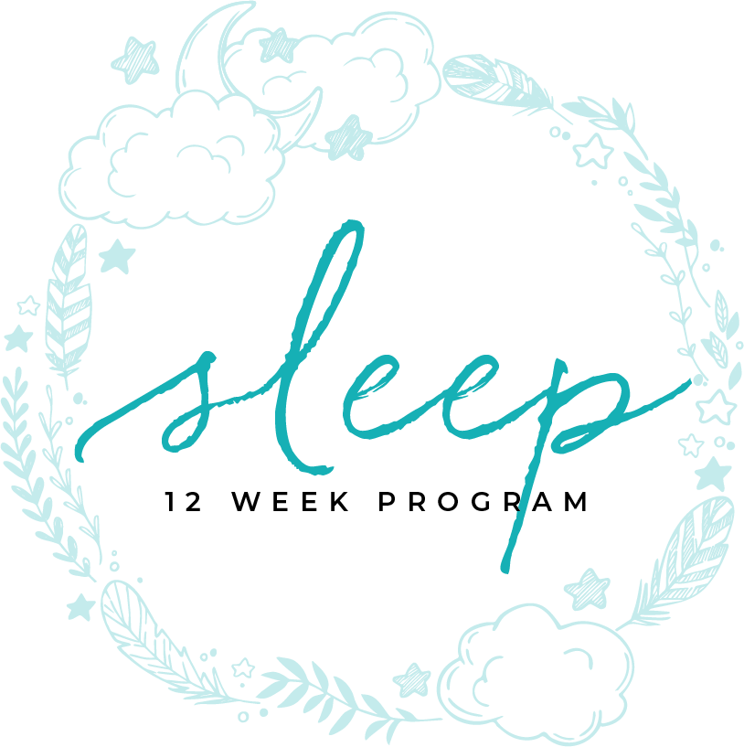
FOOD-GUT-SLEEP
MODULE EIGHT

Slide 2
FOOD, SLEEP, GUT,
CONNECTED

Slide 3
Table of contents
4 | The Connection
6 | Primary Insomnia
8 | Treatment
10 | Sleep Diary
12 | Insomnia Secondary to Sleep Disorder
14 | Insomnia Secondary To Medical Conditions
16 | Final Thought

Slide 4
MODULE EIGHT
THE CONNECTION
part one

Slide 5
More about choices and sleep time
Food, nutrition, and gut health are intertwined to achieve your best night’s sleep and energetic day. The creation of hormones regulate your brain’s wakefulness and sleepiness. This has nothing to do with age, gender, or race. It has to do with the choices we make about both what we eat and how long we sleep.
Although the research is still early and the sample sizes are small, research has shown that sleep duration has a significant effect in quality and quantity of food choices. “Those who sleep less are more likely to consume energy-rich foods, get higher proportions of calories from fats or refined carbohydrates, consume lower proportions of vegetables and fruits, and have more irregular meal patterns and consume snacks more often than those sleeping more. (Peuhkuri, Sihvola, Korpela pp. 2)” Wen Lv, Graham Finlayson, Robin Dando found that the lack of sleep may also alter how taste is effected and will tend to choose foods with stronger flavors, as well as higher salt, sugar, and fat content.
The Connection
TIME ASLEEP

Slide 6
food studies
These choices are then leading to how our body works during the day and how our gut absorbs nutrients and create the hormones associated with wake and sleep.
The Research has been performed to evaluate the effect of foods and beverages in sleep have all been small sample sizes and have had interesting outcomes. Milk for example, showed that normal milk did not show an effect on sleep, however, milk that was fortified with Melatonin or was fermented did show a small improvement in sleep with a decrease in the time it takes to fall asleep and how refreshed the individuals were when they woke up. A study also showed that drinking tart cherry juice twice a day showed a decrease in time it took to fall asleep and another study showed that eating two kiwis before bed helped increase total sleep time. Unfortunately, these studies have all only been performed once and with less than 20 people making them less reliable.
The Connection
TIME ASLEEP

Slide 7
food studies
Several other studies have looked at macronutrients such as fats, carbohydrates and proteins. Although protein did not appear to affect sleep. The studies looked at did show that fat and carbohydrate affects sleep architecture (the stages of sleep such as slow wave sleep and REM sleep) Marie-Pierre St-Onge, Anja Mikic, Cara E Pietrolungo compared studies of macronutrients. Studies showed that high carbohydrate, low fat meals reduce slow wave sleep, where we perform several important functions such as memory consolidation and production of hormones.
This is where gut health jumps in due to the creation of hormones such as insulin and TRP, which is a precursor to serotonin. The belief is that the carbohydrates compete with the hormones entering the brain causing a disrupted sleep. When there are lower carbohydrates at night there is an increase in serotonin and an individual has a shorter sleep latency (time it takes to fall asleep) and less awakenings during the night (St-Ogden, et al).
The Connection
TIME ASLEEP

Slide 8
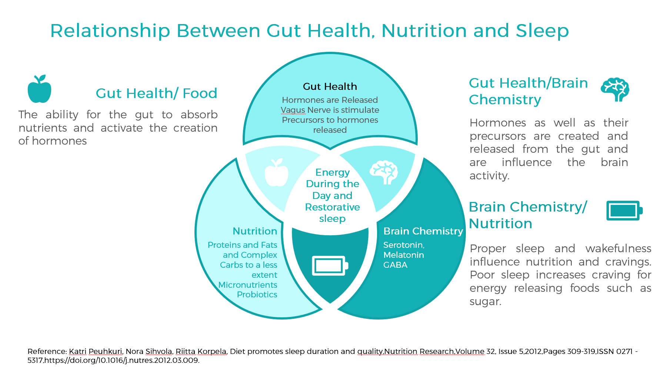

Slide 9
MODULE EIGHT
GUT HEALTH
part one

Slide 10
Healing a bad gut
Remove the triggers. This would include toxins, glutens, sugar, alcohol, dairy.
Learn which foods your body has turned into allergies or intolerance and remove those too. A food allergy test will save time with this.
Rotate your foods, never eat the same food more than every 4 days. (if you take the allergy test, you will know precisely which foods need to be rotated)
Take Probiotics daily. Probiotics will build up good bacteria in the gut.
Gut Health
TIME ASLEEP

Slide 11
Triggers
GMO foods
Antibiotics
Gluten (Ezekiel is a little better – but still gluten)
Sugar (yeast crowds out good bacteria)
Food Allergies (or sensitivities)
Dairy (goats milk, kefir), mainly included because it contains hormones and antibiotics through livestock.
Gut Health
TIME ASLEEP

Slide 12
Healthy Gut Supplements
Probiotics
Prebiotics
Digestive Enzymes
L-glutamine
Gut Health
TIME ASLEEP

Slide 13
Symptoms of poor gut health
Fatigue or fibromyalgia.
Allergies or asthma
Anxiety, depression, or other mood issues
Constipation or diarrhea
Thyroid
Hormonal issues
Weight gain or loss
Candida overgrowth
Autoimmune diseases – arthritis, Hashimoto’s, lupus, celiac, or psoriasis
Gut Health
TIME ASLEEP

Slide 14
MODULE EIGHT
THE FOOD-GUT-SLEEP
CONNECTION
references

Slide 15
Arlet V Nedeltcheva, Jennifer M Kilkus, Jacqueline Imperial, Kristen Kasza, Dale A Schoeller, Plamen D Penev; Sleep curtailment is accompanied by increased intake of calories from snacks, The American Journal of Clinical Nutrition, Volume 89, Issue 1, 1 January 2009, Pages 126–133, https://doi.org/10.3945/ajcn.2008.26574
Greer, Stephanie M., Andrea N. Goldstein, and Matthew P. Walker. "The Impact of Sleep Deprivation on Food Desire in the Human Brain." Nature Communications 4 (2013): 2259. ProQuest. Web. 18 Feb. 2019
Katri Peuhkuri, Nora Sihvola, Riitta Korpela, Diet promotes sleep duration and quality, Nutrition Research,Volume 32, Issue 5,2012,Pages 309-319, ISSN 0271-5317, https://doi.org/10.1016/j.nutres.2012.03.009.
Laurent Brondel, Michael A Romer, Pauline M Nougues, Peio Touyarou, Damien Davenne; Acute partial sleep deprivation increases food intake in healthy men, The American Journal of Clinical Nutrition, Volume 91, Issue 6, 1 June 2010, Pages 1550–1559, https://doi.org/10.3945/ajcn.2009.28523
Lv, Wen, Finlayson, Graham, Dando, Robin. “Sleep, Food Cravings and Taste.” Appetite. Volume 125 Issue 1. June 2018. P 210-216. https://doi.org/10.1016/j.appet.2018.02.013
Marie-Pierre St-Onge, Anja Mikic, Cara E Pietrolungo; Effects of Diet on Sleep Quality, Advances in Nutrition, Volume 7, Issue 5, 1 September 2016, Pages 938–949, https://doi-org.ezproxy.liberty.edu/10.3945/an.116.012336
References
TIME ASLEEP

Slide 16
You Are Ready
For The Next Module

