Slide 1
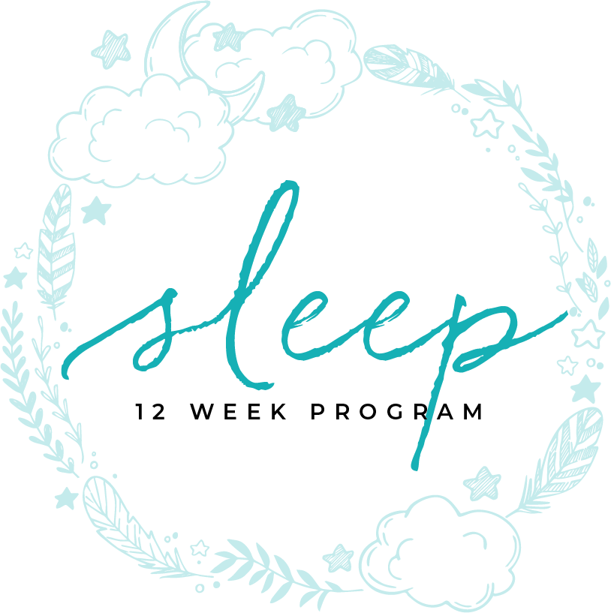
MEDICATIONS
MODULE SEVEN

Slide 2
MEDICATIONS

Slide 3
MODULE NINE
part one
MEDICATIONS THAT AFFECT SLEEP

Slide 4
medications affecting sleep
Alpha Blockers
Beta Blockers
Antidepressants/Antipsychotics
Steroids
Ace Inhibitors
Blood pressure medications
Statins
Stimulants
Hypnotics/Sedatives
Narcotics
Other miscellaneous medications
Over the Counter Medications
Supplements
Medications that Affect Sleep
TIME ASLEEP
Notes:
Alpha Blockers
Beta Blockers
Antidepressants/Antipsychotics
Steroids
Ace Inhibitors
Blood pressure medications
Statins
Stimulants
Hypnotics/Sedatives
Narcotics
Other miscellaneous medications
Over the Counter Medications
Supplements

Slide 5
alpha blockers
Medications that Affect Sleep
Notes:
These are your medications that are used for hypertension and are also used for people who have an enlarged prostate.
This medication decreases REM. This is an issue because we process emotions and memories during this time of sleep.

Slide 6
beta blockers
Medications that Affect Sleep
Notes:
Typically used for blood pressure and arrhythmias
May also be used for migraines, angina, tremors and glaucoma
The side effects include disrupted sleep and nightmares
May be associated with low Melatonin levels.

Slide 7
antidepressants / antipsychotics
MAOIs completely eliminate REM and can decrease total sleep time
Tricyclic antidepressents (Elevil, Doxipin, Comipramin, Anafranil) decrease REM and increase slow wave sleep however depending on the medication it can either be a depressant increasing sleep or activating where it will decrease sleep.
SSRIs (Prozac, Paxil, Trazadone, Effexor, Wellbutrin, Remoran, ect.)
They will decrease REM and when they come off will increase REM
Medications that Affect Sleep
Notes:
MAOIs completely eliminate REM and can decrease total sleep time
Tricyclic antidepressents (Elevil, Doxipin, Comipramin, Anafranil) decrease REM and increase slow wave sleep however depending on the medication it can either be a depressant increasing sleep or activating where it will decrease sleep.
SSRIs (Prozac, Paxil, Trazadone, Effexor, Wellbutrin, Remoran, ect.)
They will decrease REM and when they come off will increase REM

Slide 8
antidepressants / antipsychotics
Antipsychotics
They improve sleep however they can either increase or decrease slow wave sleep depending on dosage
They are sedating so daytime sleepiness is an issue
Mood stabilizers/Anti Epileptics
Lithium can cause sleepiness and total sleep time. It can increase slow wave sleep and decrease REM. It also can cause sleep movements such as sleep talking or sleep walking
Depakote has increase in sleepiness but no change in sleep architecture
Tegretol can cause restlessness and insomnia
Medications that Affect Sleep
Notes:
Antipsychotics
They improve sleep however they can either increase or decrease slow wave sleep depending on dosage
They are sedating so daytime sleepiness is an issue
Mood stabilizers/Anti Epileptics
Lithium can cause sleepiness and total sleep time. It can increase slow wave sleep and decrease REM. It also can cause sleep movements such as sleep talking or sleep walking
Depakote has increase in sleepiness but no change in sleep architecture
Tegretol can cause restlessness and insomnia

Slide 9
steroids
Medications that Affect Sleep
Notes:
These use the adrenal gland to help produce anti-inflammatory response in the body
This can cause Adrenal Fatigue and increase in Cortisol levels which can cause insomnia

Slide 10
ace inhibitors
Used for hypertension, congestive heart failure, and high blood pressure
The side effects of Ace Inhibitors include a dry hacking cough, and increased potassium levels that cause joint pains and leg cramps.
Unfortunately the only solution is to change medications.
Medications that Affect Sleep
Notes:
Used for hypertension, congestive heart failure, and high blood pressure
The side effects of Ace Inhibitors include a dry hacking cough, and increased potassium levels that cause joint pains and leg cramps.
Unfortunately the only solution is to change medications.

Slide 11
arbs / angiotensin II receptor blockers
This is another medication used for heart failure but specifically in patients with Diabetes or kidney disease
This also has issues with increased potassium that causes achy joints and leg cramps
Medications that Affect Sleep

Slide 12
statins
They are used to treat high Cholesterol
They can cause break down of muscle tissue which causes pain and weakness. This can lead to insomnia
Certain fat soluble statins can cross the blood brain barrier and cause nightmares
Medications that Affect Sleep
TIME ASLEEP

Slide 13
Medications that Affect Sleep
stimulants
Notes:
These can include all forms of stimulants including caffeine, nicotine, illegal drugs, and prescribed stimulants such as Providgil, Ritalin, and other medications to treat ADHD
The half life of these drugs can cause significant issues of insomnia, waking after sleep onset, decreased slow wave sleep, and decreased REM.
The effect can be impaired memory, depression daytime fatigue

Slide 14
hypnotics / sedatives
Medications that Affect Sleep
Notes:
They increase total sleep time and stage 2 sleep. It also increases sleep spindles which is a specific type of brain wave but the effects of this change are unknown
It will also increase daytime sleepiness the next day (know as hangover)
They decrease sleep onset, wake after sleep onset
On Barbiturates there is decreased slow wave sleep and REM
On Benzodiazepines there is decreased REM

Slide 15
hypnotics
Medications that Affect Sleep
Notes:
One thing you must consider when weaning off the hypnotics is Rebound.
This can last as long as 1 day to 2 weeks depending on what is taken and how long
It will be a return of symptoms that started the person to take the medications

Slide 16
narcotics
Although they are used acutely there are more and more people who are using them for pain management
It will cause an increase in fatigue and sleepiness
It will cause a decrease in REM which can cause issues with memory
Medications that Affect Sleep
TIME ASLEEP
Notes:
Although they are used acutely there are more and more people who are using them for pain management
It will cause an increase in fatigue and sleepiness
It will cause a decrease in REM which can cause issues with memory

Slide 17
over the counter medications
Medications that Affect Sleep
Notes:
Aspirin can cause decrease in slow wave sleep
Tagamet increases slow wave sleep
Marijuana when used long term will decrease slow wave sleep
Antihistamines will decrease REM sleep and can cause daytime fatigue and insomnia rebound

Slide 18
supplements
Medications that Affect Sleep
Notes:
Most of these (such as valerian, chamomile or GABA) have no scientific support that says they help sleep.
Melatonin as a sleep supplement is a natural occurring substance in the body. It is secreted in the hippocampus to initiate sleep onset.
The problem develops when we take this supplement we stop the body from producing its own Melatonin.
The other issue is dosage . Most research has shown that very small doses of less than 1mg is sufficient however it does need to be able to get into the blood stream so it must be taken properly such as extended release capsules that do not dissolve in the stomach, sublingual, or quick dissolve that are absorbed prior to entering the stomach.

Slide 19
You Are Ready
For The Next Module

