Slide 1
PARTNERS
MODULE EIGHT

Slide 2
PARTNERS WITH
SLEEP CONDITIONS

Slide 3
Table of contents
4 | The Problem
6 | You Can Help

Slide 4
MODULE TEN
part one
THE PROBLEM

Slide 5
The partner’s sleep disrupted
The Problem
Notes:
We’ve seen the problems that arise from all the different sleep conditions. When one of us has a sleep condition, everyone around us has a repercussion of our loved one’s condition and response.
The obvious problem is the disruption in your sleep from a partner’s condition. Whether they’re snoring loudly, getting up 4 times at night to use the bathroom, or just tossing and turning, it’s hard to sleep next to that person uninterrupted.
Poor sleep for a child or partner can create cranky interactions and difficult relationships as well. When your sleep is disrupted, it’s hard to control emotion and understand your feelings. If both partners or parent and child are sleep deprived, patience and empathy is low.
Poor sleep that creates illness may cause loss of interest in sex.

Slide 6
MODULE TEN
part two
YOU CAN HELP

Slide 7
How to help
You Can Help
Notes:
Help your partner to develop good sleep hygiene. If you develop good sleep hygiene, it will support them. Get out and exercise together, stop and read, pray, or meditate before bed, keep a journal with them, avoid alcohol together.
Try to go to bed at the same time each night together.
Your partner’s crabbiness, and lack of appreciation isn’t about you. It’s about their inability to sleep. It makes it even harder for you to sleep when you become attached to their behavior.
Make sure you’re taking care of yourself. Good self-care is important right now.
Encourage your partner to get help. Seeing a doctor and having a health coach can make the difference for your entire household.

Slide 8
How to help
You Can Help
Notes:
Find someone to talk to. If you need, get a therapist until the problem is worked out.
Engage any tools to help YOU sleep better. Wear earplugs, eye mask, use pillows to separate you and muffle the sound (next to you). White sound may help to muffle noise. There are beds that are adjustable, and can be joined together and reduce movement. One side can adapt to a partners physical issues and the other can suit you.
Sleeping in separate bedrooms is a personal decision that can be short term or until the condition subsides. There are ways to keep the connection. Separate “sleep rooms” can be an alternative for some couples. It’s good to designate a room for sex, then sleep in separate rooms.

Slide 9
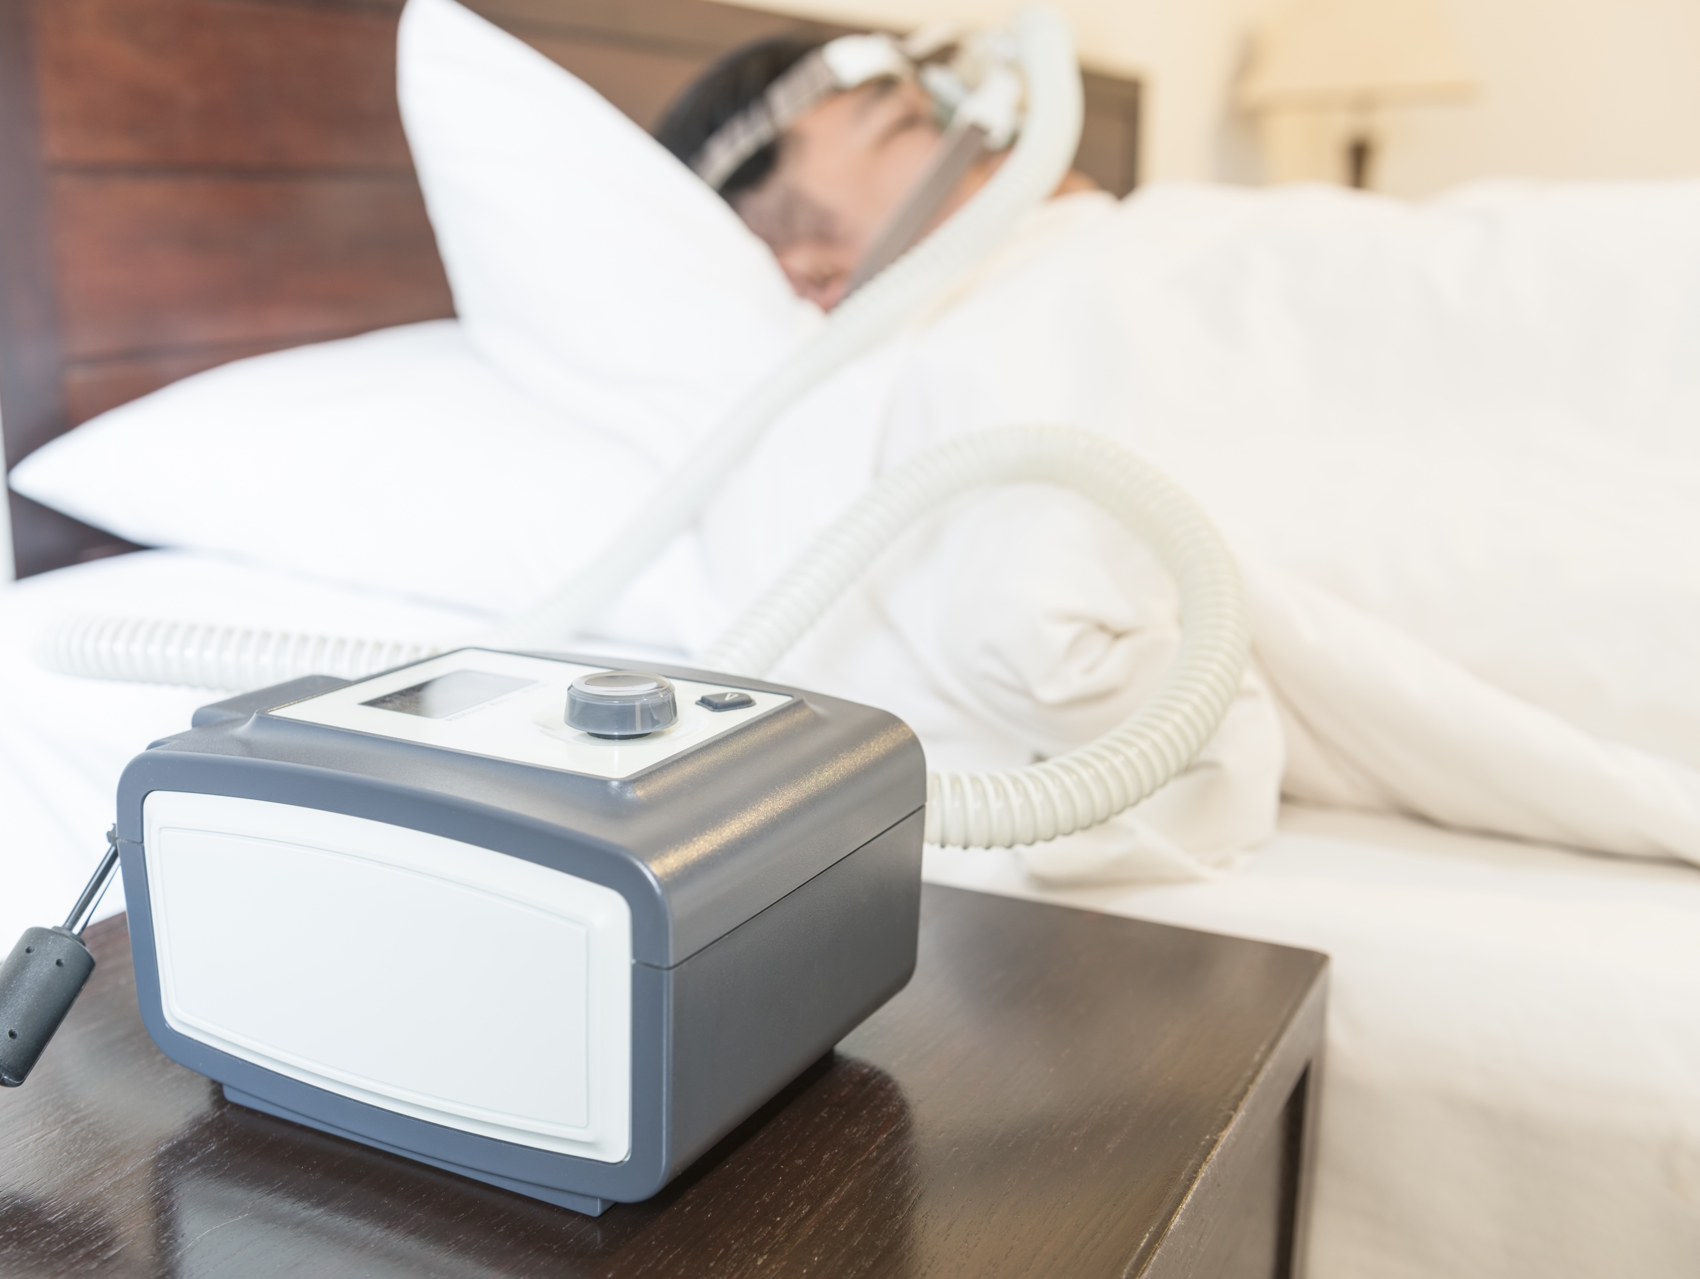
How to help
You Can Help
Notes:
If your partner has a CPAP machine the best thing you can do is encourage its use. If it’s loud there can be several problems.
Is your partner a mouth breather and needs a full face mask?
Is the mask older than 6 months; then you are due for a replacement.
Has your partner’s weight changed? Then have him or her see the MD for adjustment.
Do you hear a hum from the machine. Sometimes the slight vibration can be picked up by the furniture. Put it on a book.
Does your partner repeatedly get sick? Make sure the water is changed daily, the mask is washed daily and everything gets cleaned with soap and water once a week.

Slide 10
You Are Ready
For The Next Module

