Slide 1


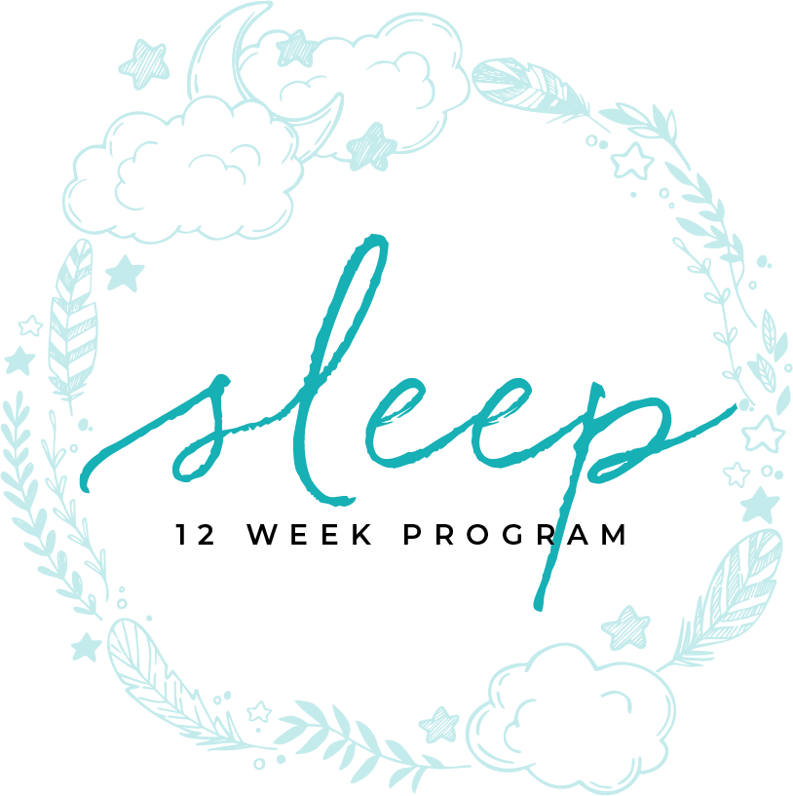
CHILDREN’S SLEEP
MODULE ELEVEN

Slide 2

CHILDREN

Slide 3
Table of contents
4 | Infants
6 | Toddlers
8 | Child
10 | Adolescent / Teen

Slide 4
“A good sleep pattern is essential for a child to succeed at school, reach their full potential and maintain their health and well being”
    Doreen Crawford

Slide 5

MODULE ELEVEN
part one
INFANTS

Slide 6

developed patterns
Infants
Notes:
Babies aren’t born with regular sleep patterns. They develop patterns based on:
the family
light and dark
eating pattern
Babies can start sleeping longer between feedings between 12-14 weeks. By 6 months they should be able to have a more consolidated sleep that allows their parents to get a good night sleep.

Slide 7

Sleep safety
Infants
Notes:
Babies should not have a pillow or a bulky blanker or anything else that can cover their mouth or nose. This includes stuffed toys.
Baby should sleep on their back.
The area the baby lives in, as well as the people around the baby should be smoke free
Co-Sleeping is not recommended but many people do it anyway. If you decide to do this, be sure:
the bed is big enough
there’s no pillow or blanket that can cover the baby’s face
there are no other children in the bed

Slide 8

Routine
Infants
Notes:
Infants develop a sleep routine:
The baby will need to learn to self soothe if YOU hope to sleep through the night
If the baby wakes use a soothing voice, do not turn on the light, and do not pick the baby up
Sickness will affect the sleep routine and you may have to go through several weeks to redevelop the routine.

Slide 9
MODULE ELEVEN
part two
TODDLERS

Slide 10

Routine
Toddlers
Notes:
If you create a strong bedtime routine you will see an improvement in how quickly your child will fall asleep within 2 weeks.
The routine:
Give your child 30 minutes
A bath and personal hygiene routine should be included
Quiet activities help to wind them down
Massage has been shown help with relaxation.
Slow circular motions on stomach, back, scalp, arms and legs for 5-15 minutes.
Lights out need to be no more than 30 minutes after massage

Slide 11
MODULE ELEVEN
part three
CHILD

Slide 12

best practices
Child
Notes:
Sleep is directly related to children’s grades and behavior
Studies have found that parents age, stress level, and education are directly associated with quality of children's sleep
School age children need strong sleep routines
Light plays an important role
Maintaining an appropriate bedtime
Children need better sleep quality. Therefore their environment is very important
Sleep Disorders can look like other issues

Slide 13
MODULE ELEVEN
part four
ADOLESCENT/TEEN

Slide 14

teens need better sleep
Adolescent/Teen
TIME ASLEEP
Notes:
Keep in mind that drowsy driving is responsible for upwards of 100,000 auto accidents. National Sleep Foundation Teens have a hard time with sleep for multiple reasons. It may help to know that teens naturally are predisposed to stay up later. Ideally, school would start later and get out later. This is a case where the patterns of society compete with the well being of teens.
They are plugged in and do not know how to unplug
The are expected to wake early and stay up late to study
Peer Pressure
During puberty sleep disorders can develop
Naps of 20-30 minutes can help.
On weekend you sleep in but no more than 2 hours later than regular wake time.

Slide 15
MODULE ELEVEN
references
CHILDREN’S SLEEP

Slide 16

Massage-based bedtime routine: impact on sleep and mood in infants and mothers. A.Mindellab Christina I.LeecErin S.LeichmanaKatie N.Rotellac. Received 5 May 2017, Revised 22 September 2017, Accepted 24 September 2017, Available online 10 October 2017. https://doi.org/10.1016/j.sleep.2017.09.010
Understanding the physiology of sleep and promoting effective routines with infants in hospital and at home. D.. Crawford. 2017 Nursing Children and Young People (2014+), 29(4), 36. doi:http://dx.doi.org.ezproxy.liberty.edu/10.7748/ncyp.2017.e895
Peltz JS, Rogge RD. The moderating role of parents' dysfunctional sleep-related beliefs among associations between adolescents' pre-bedtime conflict, sleep quality, and their mental health. J Clin Sleep Med. 2019;15(2):265–274.
Sleep Patterns and Sleep Disruptions in School-Age Children, Sadeh, Avi; Raviv, Amiram; Gruber, Reut Developmental Psychology, 05/2000, Volume 36, Issue 3
Sleep efficiency (but not sleep duration) of healthy school-age children is associated with grades in... Gruber, Reut|Somerville, Gail|Enros, Paul|Paquin, Soukaina|Kestler, Myra|Gillies-Poitras, Elizabeth Sleep Medicine, 2014, Volume 15, Issue 12
School-based sleep education program improves sleep and academic performance of school-age children. Gruber, Reut|Somerville, Gail|Bergmame, Lana|Fontil, Laura|Paquin, Soukaina Sleep Medicine, 2016, Volume 21
References

Slide 17
You Are Ready
For The Next Module

