Slide 1
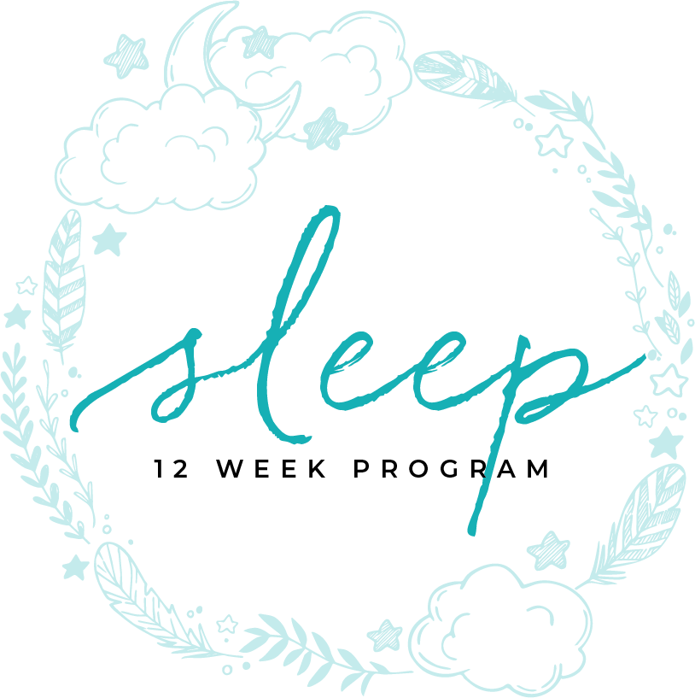
PUTTING IT TO BED
MODULE TWELVE

Slide 2
PUTTING IT TO BED

Slide 3
Table of contents
4 | Importance of Sleep
11 | Best Practices
8 | Further Reading

Slide 4
MODULE TWELVE
BEST PRACTICES
part one

Slide 5
for our health
We all do it. We close our eyes at night and go to sleep and wake up in the morning refreshed and ready to start a new day. Or, at least that’s the way it’s supposed to be.
Importance of Sleep
TIME ASLEEP
In the United States alone, sleep disorders affect up to 70 million people. They cost $16 billion per year in medical expenses and another $50 billion in lost productivity. Many sleep disorders are difficult to diagnose, too, requiring overnight stays in sleep labs and being watched over by video cameras and various sensors. Dr. Kellogg Insight
Not only are sleep labs being used, doctors are studying genetic factors. The problem is, doctors don’t understand which genes are involved in sleep disorders.

Slide 6
for our health
Because it’s too hard to get a cross section of human beings for these tests, they’re using mice. There are ethical concerns both ways.
The future for these scientific studies would be to ideally for the doctor to hand out tripods, position at your home in front of the bed and hit record. Then the researchers watch for the nature of the sleep disorder.
In addition to age, other factors can affect how many hours of sleep you need. For example, Changes in the body during early pregnancy can increase the need for sleep. Menopause can cause night sweats and create undesirable periods of wakefulness in the night.
Children grow while sleeping. They have a tendency to sleep deeply. Adults benefit from human growth hormone during their first period of deep sleep. Deep sleep is the type of sleep that middle aged and older adults could use the most of.
Importance of sleep
TIME ASLEEP

Slide 7
for our health
Experts say sleep deprivation is a widespread problem that drains our health, happiness, and financial resources.
Chronically sleep-deprived people, some 20 percent of Americans, are more prone to costly diseases, accidents, and workplace absenteeism, at a steep cost to our national and global economy. The cost of drowsy driving motor vehicle accidents alone is estimated at $56 billion per year. Shift workers, healthcare workers, long-haul truck drivers, military operators, and others in jobs with demanding hours are at higher risk for sleep deprivation and the problems it causes.
Importance of sleep
TIME ASLEEP

Slide 8
for our health
Over time, chronic sleep deprivation can cause a wide range of health ailments, including:
Increased risk of Type 2 Diabetes
Increased levels of stress hormones
Higher risk of cardiovascular disease
Raised levels of inflammation
Excessive daytime sleepiness
Anxiety
Memory problems
Weight gain
Increased sensitivity to pain
Importance of sleep
TIME ASLEEP

Slide 9
for our health
Sleep deprivation also impairs cognitive functioning, decision-making, and reaction times, which is why sleep deprivation increases the risk of vehicle accidents. Sleep deprivation is also believed to hasten the effects of aging and reduce the skin’s ability to heal.
Because sleep deprivation impacts levels of leptin, a hormone that controls hunger, people who don’t sleep enough may crave more calories and carbohydrates. Some people complain of gastrointestinal upset, like nausea and heartburn or increased or decreased appetite, during periods of sleep deprivation.
Importance of sleep
TIME ASLEEP
https://www.tuck.com/sleep-deprivation/

Slide 10
sleep habits
In the past few weeks you’ve learned that sleep disturbance can be caused by many factors. What’s more troublesome, is that it becomes a vicious cycle creating more issues, less sleep, and even more illnesses. By making simple, and sometimes, not so simple lifestyle changes, your patterns will begin to change, and you may end up seeing improvement in all areas of your life, because of a good night’s sleep.
Establish Habits
TIME ASLEEP

Slide 11
MODULE TWELVE
BEST PRACTICES
part two

Slide 12
sleep hygiene
The best was to address sleep disturbance is to prevent it with healthy sleep habits, sleep experts call this sleep hygiene.
Go to bed at the same time every night and wake up at the same time every morning, even on the weekends. Research shows that you fall asleep easier and stay asleep longer with a routine sleep time.
Relax before you go to bed.
Avoid stress and arguments before bed time.
Exercise daily. One increment of time that is dedicated to vigorous workout helps you sleep better. Light exercise is better than no exercise.
Sleep in cool temperatures.
Establish Habits
TIME ASLEEP

Slide 13
sleep hygiene
Keep the bedroom quiet, use noise blocking techniques. Use earplugs if you need to.
Block the light from entering through windows or doors. Blackout drapery and shades are best, use eye shades if necessary.
Leave work, television and mobile electronics out of the bedroom, especially at night.
Avoid large, heavy meals within three hours of bedtime.
Avoid caffeine within eight hours of bedtime.
Avoid alcohol.
Some medications can make it harder to sleep, which can cause or worsen sleep deprivation. Talk to your doctor about medications that may interfere with sleep, including some antidepressants, stimulants, and decongestants.
Establish Habits
TIME ASLEEP

Slide 14
sleep hygiene
Sleep on a comfortable, supportive bed. If it’s over 10 years old, it’s time to replace it.
Keep your sleep area clean and free from allergens.
Establish Habits
TIME ASLEEP

Slide 15
MODULE TWELVE
SLEEP
further reading

Slide 16
Arlet V Nedeltcheva, Jennifer M Kilkus, Jacqueline Imperial, Kristen Kasza, Dale A Schoeller, Plamen D Penev; Sleep curtailment is accompanied by increased intake of calories from snacks, The American Journal of Clinical Nutrition, Volume 89, Issue 1, 1 January 2009, Pages 126–133, https://doi.org/10.3945/ajcn.2008.26574
Greer, Stephanie M., Andrea N. Goldstein, and Matthew P. Walker. "The Impact of Sleep Deprivation on Food Desire in the Human Brain." Nature Communications 4 (2013): 2259. ProQuest. Web. 18 Feb. 2019
Katri Peuhkuri, Nora Sihvola, Riitta Korpela, Diet promotes sleep duration and quality, Nutrition Research,Volume 32, Issue 5,2012,Pages 309-319, ISSN 0271-5317, https://doi.org/10.1016/j.nutres.2012.03.009.
Laurent Brondel, Michael A Romer, Pauline M Nougues, Peio Touyarou, Damien Davenne; Acute partial sleep deprivation increases food intake in healthy men, The American Journal of Clinical Nutrition, Volume 91, Issue 6, 1 June 2010, Pages 1550–1559, https://doi.org/10.3945/ajcn.2009.28523
Lv, Wen, Finlayson, Graham, Dando, Robin. “Sleep, Food Cravings and Taste.” Appetite. Volume 125 Issue 1. June 2018. P 210-216. https://doi.org/10.1016/j.appet.2018.02.013
Marie-Pierre St-Onge, Anja Mikic, Cara E Pietrolungo; Effects of Diet on Sleep Quality, Advances in Nutrition, Volume 7, Issue 5, 1 September 2016, Pages 938–949, https://doi-org.ezproxy.liberty.edu/10.3945/an.116.012336
Further Reading
TIME ASLEEP

Slide 17
Congratulations!
You’ve completed this sleep program
It’s important to continue to work with your sleep coach to
establish and maintain your habits and sustain your results.

